Slide 1
PORTFOLIO RISK ANALYSIS DASHBOARD
AI-Powered Multi-Stage Risk Intelligence Platform
Team: [Team Name]
Track: [Track Name]
Members: [Team Members]
Hackathon Final Presentation

Slide 2
Problem Statement
The Challenge
Portfolio risk analysis in financial institutions is a manual, time-consuming, and error-prone process. Risk officers spend hours reviewing spreadsheets, checking multiple data sources, and applying subjective judgment to assess portfolio health. This leads to inconsistent ratings, delayed risk identification, and missed early warning signals that could prevent significant losses.
Why It Matters
Manual Reviews
Inconsistent Ratings
Delayed Detection
No Sentiment Layer
Hours of spreadsheet analysis
per portfolio cycle
Subjective judgment leads
to analyst-dependent results
Risk signals missed until
they become critical events
Market perception risks
ignored in traditional analysis

Slide 3
Solution Overview
Our Approach
Key Features
We built an end-to-end automated pipeline that replaces manual portfolio risk review with a 5-stage intelligent system combining rule-based analysis, machine learning, and NLP sentiment analysis.
7 Risk Flags: Volatility, drawdown, volume collapse, severe/extended decline, poor Sharpe, momentum breakdown
RED/YELLOW/GREEN Ratings: Automated color-coded risk classification for instant triage
ML Anomaly Detection: Isolation Forest identifies unusual asset behavior patterns
Risk Prediction: Random Forest predicts future risk rating changes with confidence scores
Sentiment Analysis: NLP on simulated financial news for RED-flagged assets with theme extraction
Interactive Dashboard: 4-tab Streamlit interface with charts, drilldowns, and expandable asset rows
Cloud Persistence: PostgreSQL storage enables loading and comparing past pipeline runs
What Makes It Unique
Fully automated: No code changes needed to run analysis on any portfolio
Configurable thresholds: 11 risk parameters adjustable via UI sliders for different market conditions
Multi-layer analysis: Rule-based flags + ML anomaly detection + NLP sentiment in a single pipeline
Persistent storage: Results saved to cloud database for historical comparison and audit trail
One-click reports: PDF and CSV outputs generated automatically for compliance
Industry Impact: Reduces manual review from hours to seconds with consistent, bias-free analysis

Slide 4
Industry Impact, Collaboration & Production Viability
Path to Production
Scalability
Collaboration Potential
→ Replace simulated data feeds with live Bloomberg/Reuters APIs
→ Integrate with existing portfolio management systems (PMS)
→ Add user authentication and role-based access control
→ Deploy on cloud infrastructure with CI/CD pipeline
→ Currently handles 10-100 assets per run; horizontally scalable
→ PostgreSQL backend supports concurrent users and large datasets
→ Modular pipeline — each stage can be scaled independently
→ ML models retrain on growing historical data for better accuracy
→ Data providers: Bloomberg, Reuters for live market feeds
→ Risk teams: Customize thresholds per desk/strategy
→ Compliance: Automated audit-ready PDF reports
→ Quant teams: Extend ML models with proprietary features
Challenges & Limitations
Simulated data: Currently uses generated data; production requires live data integration and validation
Model accuracy: ML models need real historical data for meaningful predictions; current accuracy is on synthetic data
Sentiment scope: NLP analysis limited to simulated news; real-world requires API access to news aggregators
Regulatory compliance: Production deployment needs SOC2/ISO compliance review for financial data handling

Slide 5
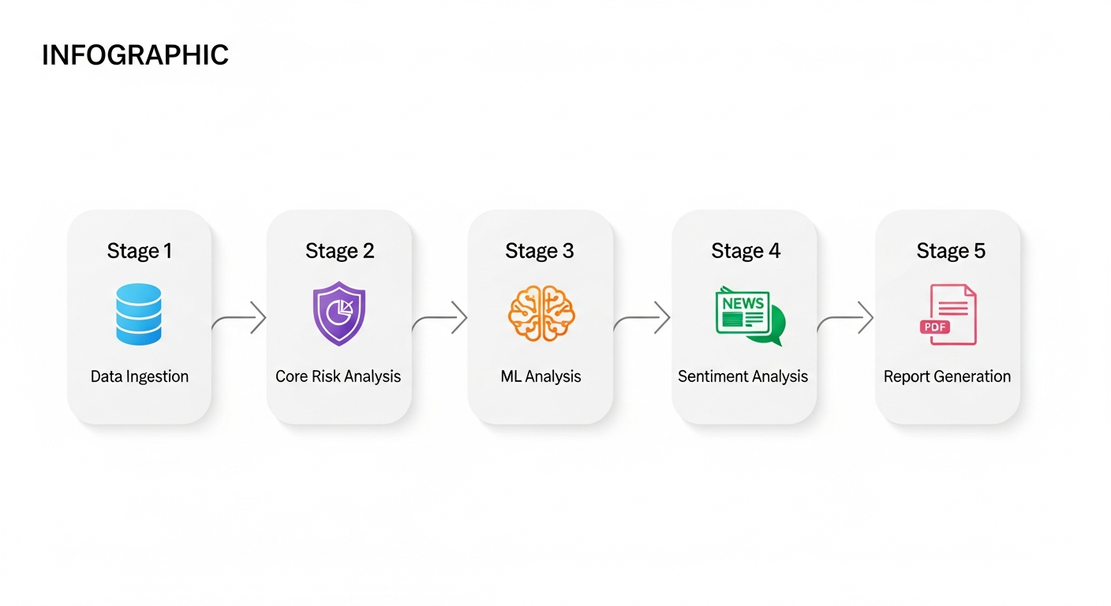
Technical Implementation
Tech Stack
Architecture Diagram
Frontend: Streamlit with Plotly interactive charts
Backend: Python 3.11 with modular pipeline architecture
ML: scikit-learn (Isolation Forest, Random Forest)
NLP: TextBlob for sentiment analysis on financial news
Database: PostgreSQL (Replit managed) for persistent storage
Reports: ReportLab (PDF) + pandas (CSV) generation
Data: NumPy/pandas for time-series analysis
Visualization: Plotly + Matplotlib for charts
Data Usage
Model Performance
252 days of simulated daily price & volume data per asset
9 engineered features for ML (volatility, drawdown, Sharpe, etc.)
15-30 simulated news articles per RED-flagged asset
Feature scaling via StandardScaler for model input
Responsible AI: Full transparency into risk logic and thresholds
Isolation Forest: ~15% contamination rate, 4-tier severity scoring
Random Forest: Balanced class weights, 100 estimators
Train/test split: 70/30 with stratification when possible
Feature importance ranking identifies top risk drivers
Validation checks ensure score consistency and range correctness

Slide 6
Demo: Product Walkthrough
Interactive Dashboard — 4-Tab Layout
Tab 1: Overview
Tab 2: Risk & Sentiment
Tab 3: Asset Deep Dive
Tab 4: Appendix
KPI strip: Total Assets, Market Cap, Risk counts, Avg Volatility
Sector allocation donut chart and risk distribution pie
Volatility vs Drawdown scatter plot color-coded by risk
ML Analysis summary with anomaly toggle and feature importance
Recommendations expander with prioritized actions
Expandable flagged asset rows with inline deep dive
4-column layout: Asset Info, Risk Metrics, Performance, Risk Flags
Sentiment scores, trends, and news article tables per asset
Searchable asset selector with risk rating indicator
Full asset profile with all metrics and ML predictions
Historical price chart with ML anomaly analysis
Sentiment details for RED-flagged assets
Methodology documentation for all 5 pipeline stages
Performance metrics table (returns, Sharpe ratios)
Risk flags detail table across all assets
Risk thresholds reference with current values
Key Functionalities
User Experience
Sidebar controls: Portfolio size slider + 11 configurable risk thresholds
Cloud persistence: Auto-save runs to PostgreSQL, load/delete from sidebar
One-click export: PDF reports and CSV data files generated per run
No code required: Business users configure everything via UI controls
Color-coded everything: RED/YELLOW/GREEN badges, charts, and indicators
Progressive disclosure: Overview first, drill down into details on demand

Slide 7
Portfolio Risk Analysis Dashboard
Turning hours of manual analysis into seconds of automated intelligence
✓ 5-stage automated pipeline: Ingest → Analyze → ML → Sentiment → Report
✓ 7 configurable risk flags with transparent RED/YELLOW/GREEN classification
✓ ML anomaly detection catches risks that manual review may miss
✓ NLP sentiment layer adds market perception to quantitative analysis
✓ Cloud-persistent results enable historical comparison and audit readiness
✓ Production-ready architecture with clear path to live data integration
Thank You — Questions?
Live demo available

