Slide 1









    The Control Panel
    Main dashboard for user interaction.
    - Run analysis
    - Show results
    - Download reports
    The Data Collector
    Fetches stock data (simulated).
    - Prices, volumes, company info
    - Financial metrics
    Rule-Based Risk Calculator
    Calculates risk using formulas.
    - Volatility, Drawdown, Sharpe Ratio, RSI, Beta
    - Risk Rating: RED/YELLOW/GREEN
YELLOW/GREEN
RED
    The Report Writer
    Generates PDF report.
    - Tables, charts, summary
    The News Reader
    Analyzes news sentiment for RED-flagged stocks.
    - TextBlob NLP
    - Sentiment score & trend
    - Confidence level
    The AI Detective
    Uses ML models to detect anomalies & predict risk.
    - Isolation Forest
    - Random Forest Classifier
    - Output: Score, Rating, Confidence
TextBlob NLP – Analyze text to give sentiment score
Anomaly detection – Identifies strange behaving stock
Risk Prediction – Predicts future Risk Rating

Slide 2
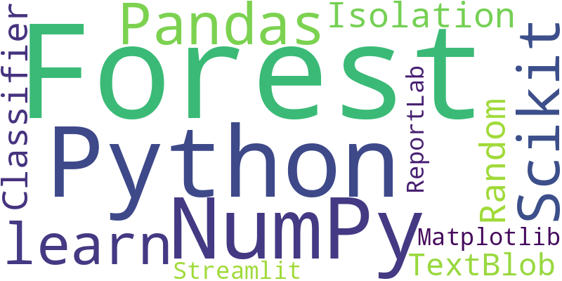
Here is your word cloud representing the tech stack:

Slide 3


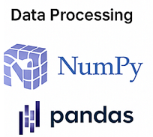

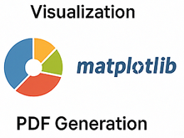

Risk Analysis System

Slide 4
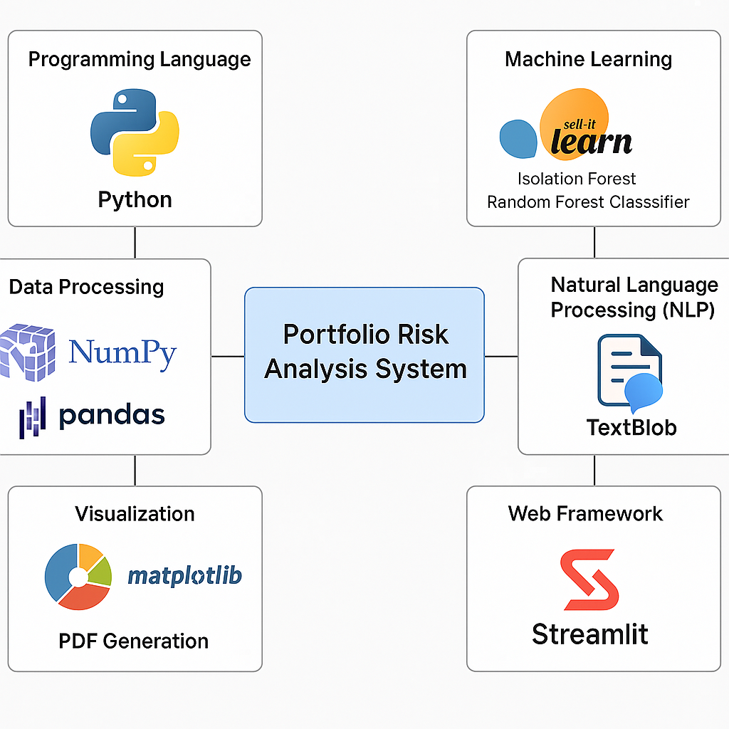

Slide 5
