Slide 1
Portfolio Risk
Analysis Dashboard
Automated Multi-Stage Risk Intelligence Platform
Business & Technical Overview

Slide 2
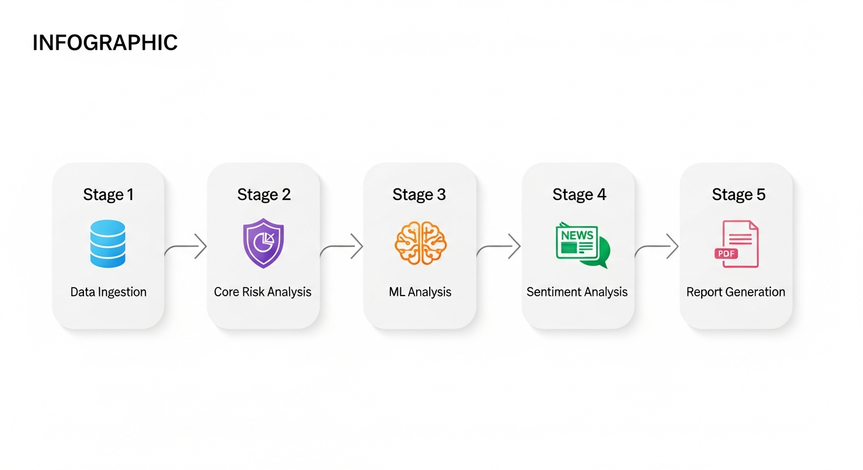
Executive Summary
An end-to-end automated platform that ingests portfolio data, performs quantitative risk analysis, applies machine learning for anomaly detection, analyzes market sentiment, and generates actionable reports — all from a single interactive dashboard.
Key Value: Reduces manual portfolio risk review from hours to seconds. Provides consistent, repeatable risk assessments with full transparency into methodology and thresholds.

Slide 3
Key Features at a Glance
Interactive Dashboard
Configurable Thresholds
Expandable Flagged Assets
4-tab layout with real-time charts, metrics, and drill-down capabilities
Adjust all risk parameters via sidebar sliders — no code needed
Click any flagged asset row to see full deep dive, sentiment & articles
ML-Powered Detection
Sentiment Intelligence
Export & Compliance
Isolation Forest anomalies + Random Forest predictions with confidence
NLP analysis on financial news with trend detection and theme extraction
One-click PDF reports and CSV data exports for audit trails

Slide 4
Business Value Proposition
For Portfolio Managers & Risk Officers
Measurable Impact
⚡ Instant portfolio-wide risk scoring across all assets
🚦 Color-coded ratings (RED / YELLOW / GREEN) for quick triage
⚙️ Configurable thresholds — adjust sensitivity without code
🔍 Expandable flagged asset rows with inline deep-dive details
📰 Sentiment analysis surfaces market perception risks early
📄 One-click PDF & CSV reports for compliance and audit
90%+
100%
10-100
Reduction in
manual review time
Consistent, rule-based
bias-free analysis
Assets analyzed
per pipeline run
🧠 ML anomaly detection catches risks human review may miss
🔎 Full audit trail with methodology transparency
📊 Interactive charts — no more static spreadsheets
⏰ Seconds to run, not hours of manual work

Slide 5
Dashboard — Four-Tab Layout
KPI metrics strip (total assets, market cap, risk counts, avg volatility)
Sector allocation donut chart
Risk distribution pie chart
Volatility vs Drawdown scatter plot
ML analysis summary with anomaly toggle
Tab 1: Overview
Collapsible recommendations section
Expandable flagged asset rows — click any row to see:
• Asset info, risk metrics, performance, risk flags
• Sentiment scores and news articles
Sentiment overview with aggregate metrics
Tab 2: Risk & Sentiment
Dropdown to select any asset in the portfolio
Four-column layout: Info, Metrics, Performance, Flags
Collapsible sentiment analysis section
Historical price chart with ML anomaly overlay
Tab 3: Asset Deep Dive
Methodology documentation
Collapsible performance metrics table
Collapsible risk flags detail matrix
Collapsible risk thresholds reference
Tab 4: Appendix

Slide 6
Risk Analysis Framework
7 Risk Flags
Rating Logic
High Volatility
> 40% annualized
RED
Any critical flag triggered
(Extreme Drawdown, Volume Collapse, Severe Decline)
Extreme Drawdown
< -20% max drawdown
Volume Collapse
< -50% volume decline
YELLOW
2+ warning flags triggered, OR
Momentum Breakdown + 1 warning flag
Severe Decline
< -15% in 1 month
Extended Decline
< -25% in 3 months
Poor Risk/Return
Sharpe ratio < -0.5
GREEN
No critical flags and fewer than
2 warning flags
Momentum Breakdown
Both 1M & 3M < -10%
All thresholds are fully configurable via the sidebar — no code changes needed.

Slide 7
ML & Sentiment Analysis
Machine Learning Pipeline
Sentiment Analysis
Anomaly Detection — Isolation Forest algorithm identifies outlier assets based on risk metrics
Risk Prediction — Random Forest classifier predicts future risk rating changes
Feature Importance — ranks which factors drive risk predictions most
Model accuracy and confidence scores reported per asset
Stratified training with automatic handling of class imbalance
Triggered only for RED-flagged assets — focused analysis where it matters
Simulated financial news from 8 sources (Reuters, Bloomberg, FT, WSJ, etc.)
NLP-based sentiment scoring per article with relevance weighting
Trend detection: IMPROVING / STABLE / DETERIORATING
Key theme extraction: earnings, regulatory, management, operations, etc.
Full article listing available per asset in expandable deep-dive rows

Slide 8
Technical Architecture
Technology Stack
Project Structure
Frontend: Streamlit with custom CSS theming
Data Processing: Pandas, NumPy
ML Models: scikit-learn (Isolation Forest, Random Forest)
NLP: TextBlob for sentiment analysis
Visualization: Plotly (interactive charts)
Reports: ReportLab (PDF generation)
Runtime: Python 3.11+
app.py — Main dashboard application (tabbed layout)
pipeline/data_ingestion.py — Stage 1: Market data ingestion
pipeline/core_analysis.py — Stage 2: Risk analysis engine
pipeline/ml_analysis.py — Stage 3: ML models
pipeline/sentiment_analysis.py — Stage 4: NLP sentiment
pipeline/report_generator.py — Stage 5: PDF/CSV generation
utils/mock_data.py — Simulated Bloomberg data generator
Modular pipeline design — each stage is independently testable and replaceable. Swap simulated data for real Bloomberg/Reuters feeds with minimal code changes.

Slide 9
Configurable Risk Thresholds
All risk thresholds are adjustable directly from the dashboard sidebar — no code changes required. This enables risk officers to tune sensitivity for different market conditions or portfolio strategies.
Threshold
Default
Description
Volatility RED / YELLOW
40% / 25%
Annualized volatility trigger levels
Max Drawdown RED / YELLOW
-20% / -10%
Maximum drawdown thresholds
Volume Decline RED / YELLOW
-50% / -30%
Trading volume decline limits
Severe Decline (1M)
-15%
One-month price drop threshold
Extended Decline (3M)
-25%
Three-month price drop threshold
Poor Sharpe Ratio
-0.5
Risk-adjusted return floor
Momentum Breakdown
-10%
Combined short & medium-term decline
Correlation Threshold
80%
High inter-asset correlation flag

Slide 10
Ready to Transform
Portfolio Risk Management?
From data ingestion to actionable insights — automated, transparent, and configurable.
Portfolio Risk Analysis Dashboard • Powered by Python, Streamlit & ML

