Slide 1
Python programming

Slide 2
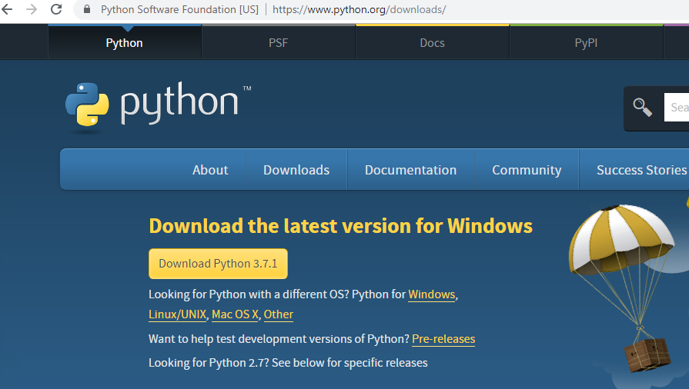
Python installation
https://www.python.org/downloads/
Download the latest version

Slide 3
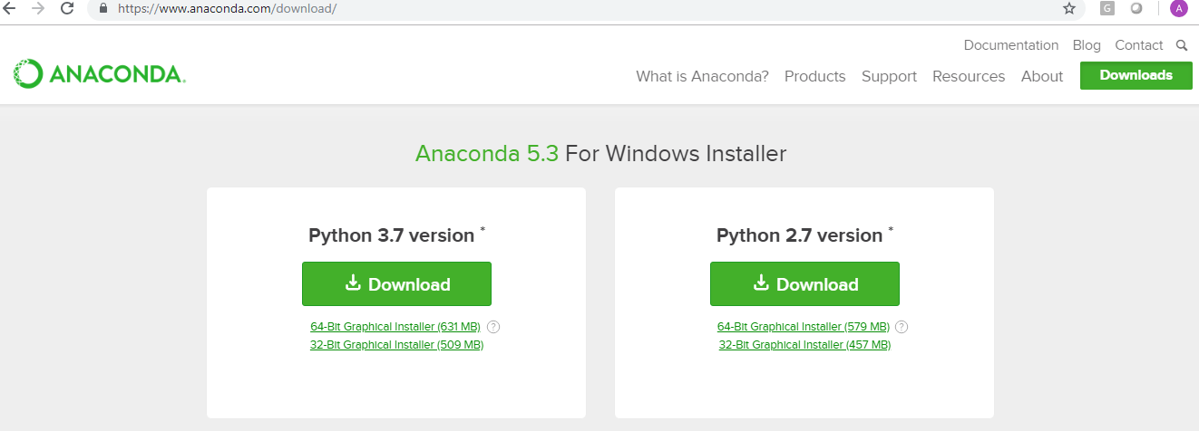
Anaconda installation
https://www.continuum.io

Slide 4
Key Points
Important Note
Download both Python and Anaconda in Same location
conda update –all
If you want the last version of each package run

Slide 5
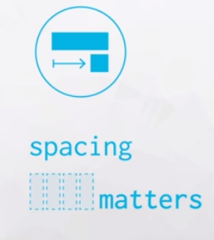
Basic things to keep in mind
Case Sensitive
Example : Aa
Errors
Spacing

Slide 6
Data Types and Operators
Data Types:
Integers, Floats, Booleans, Strings, Lists, Tuples, Sets, Dictionaries
Operators:
Arithmetic, Assignment, Comparison, Logical, Membership, Identity
Others
Built-In Functions, Compound Data Structures, Type Conversion
Whitespace and Style Guidelines

Slide 7
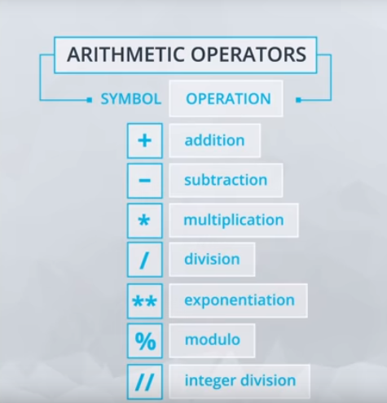
Arithmetic operators

Slide 8
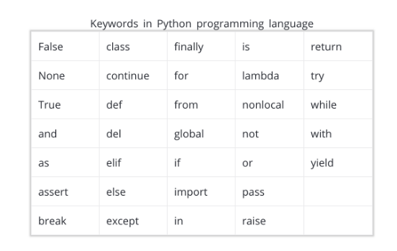
Key words in python

Slide 9
Data types:Integer and float
Int 8,69,1000
Float 8.50,9.2,
Number with and without decimal are different in Python.
Example : Rank and marks
Limit each line of code to 80 characters, though 99 is okay for certain use cases
Give importance to white space
Example : (7*3 – 1)

Slide 10
operators
Boolean Operator
True Or False
Comparison Operators
< - Less than
> - Greater Than
<= - Less than or equal to
>= - Greater than or equal to
== - Equal to
!= - Not equal to

Slide 11
Tableau
https://www.tableau.com/about/blog/2017/1/building-advanced-analytics-applications-tabpy-64916
https://www.tableau.com/pricing/teams-orgs#online
Tableau Creator ( 10 .3 version)

