Slide 1
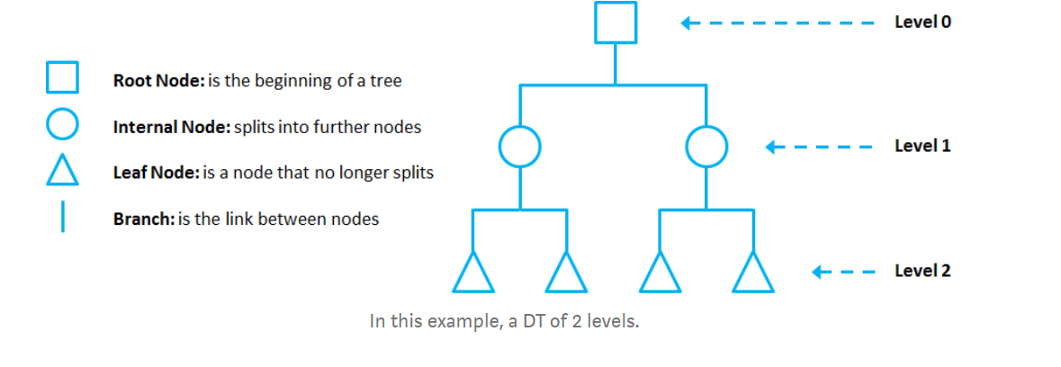
DECISION TREE

Slide 2
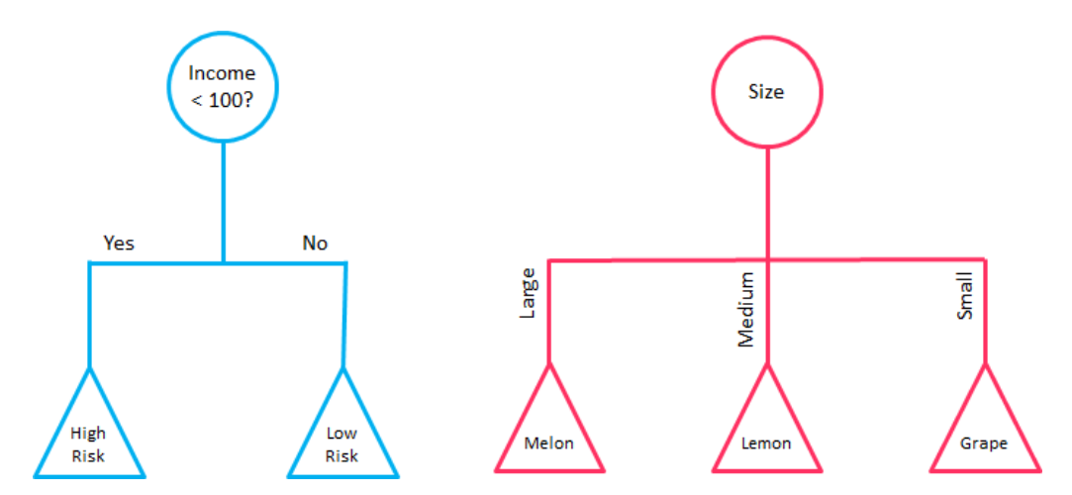
DECISION TREE – BINARY and MULTI

Slide 3
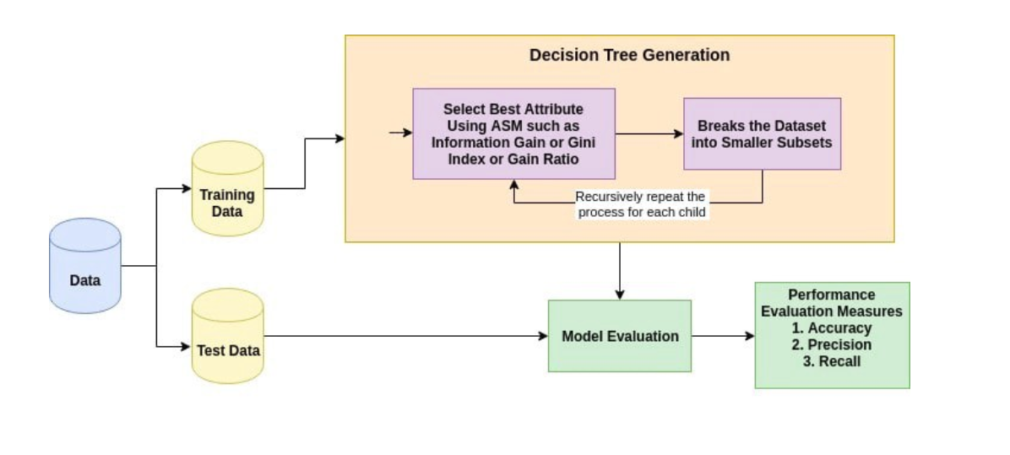
DECISION TREE

Slide 4
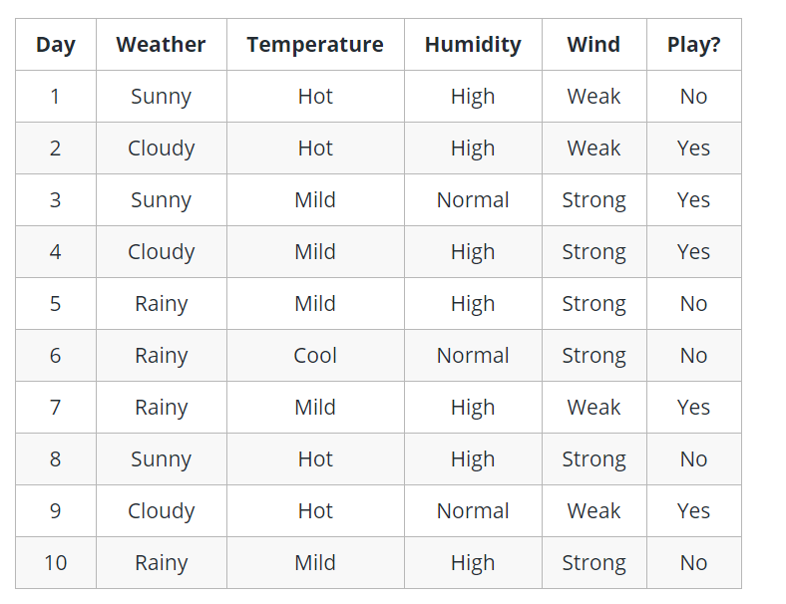
DECISION TREE

Slide 5
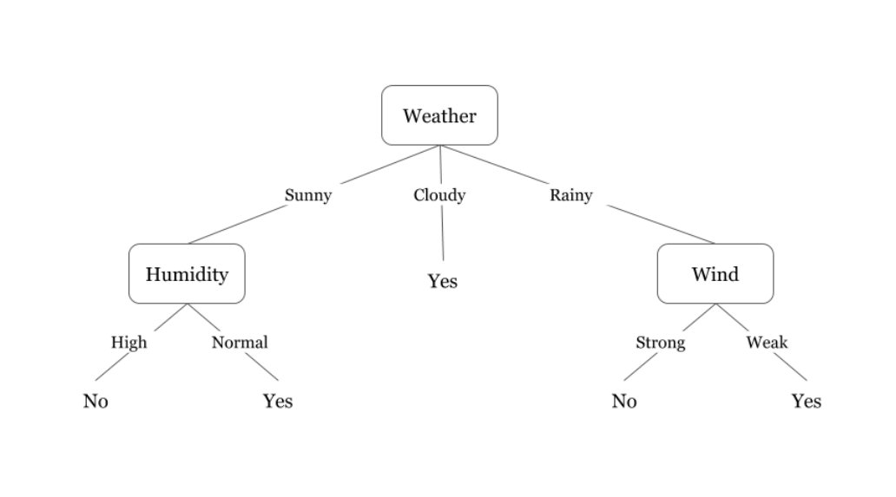
DECISION TREE

Slide 6
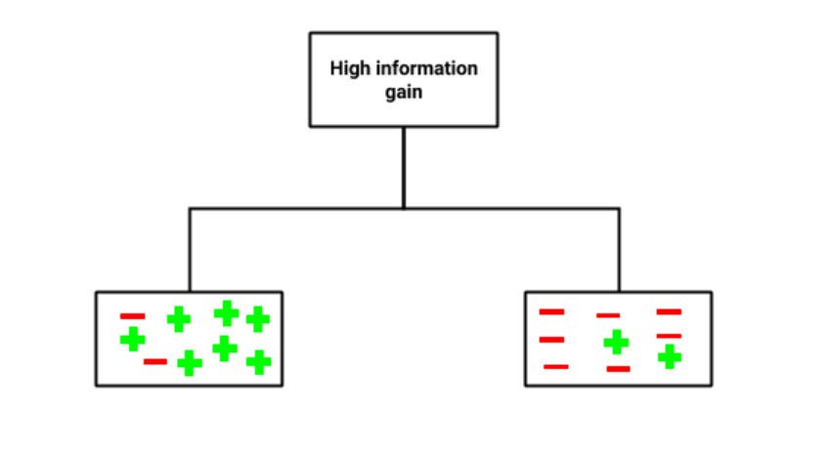
DECISION TREE-HIGH INFORMATION GAIN

Slide 7
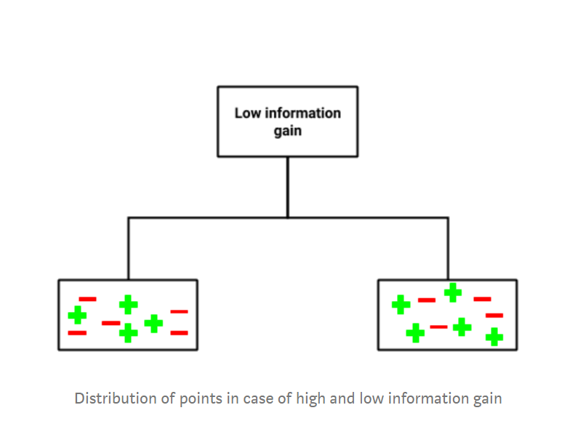
DECISION TREE-LOW INFORMATION GAIN

Slide 8
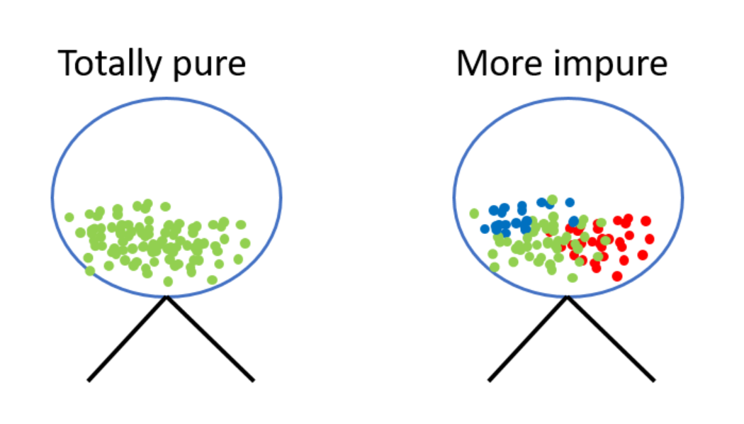
DECISION TREE-ENTROPHY

Slide 9
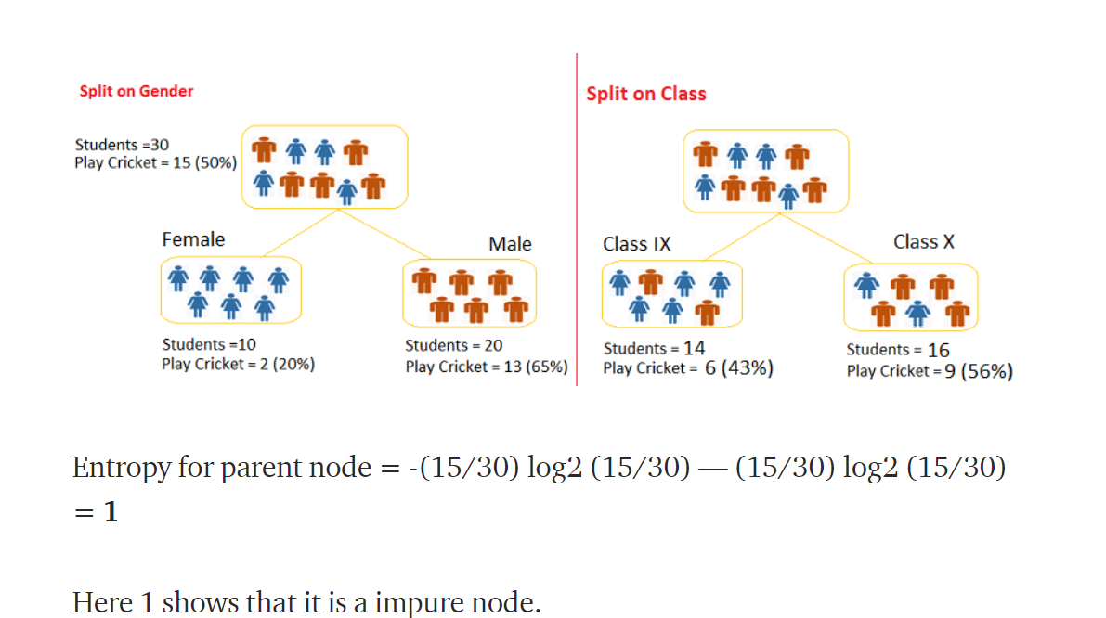
DECISION TREE-GINI SPLIT

Slide 10
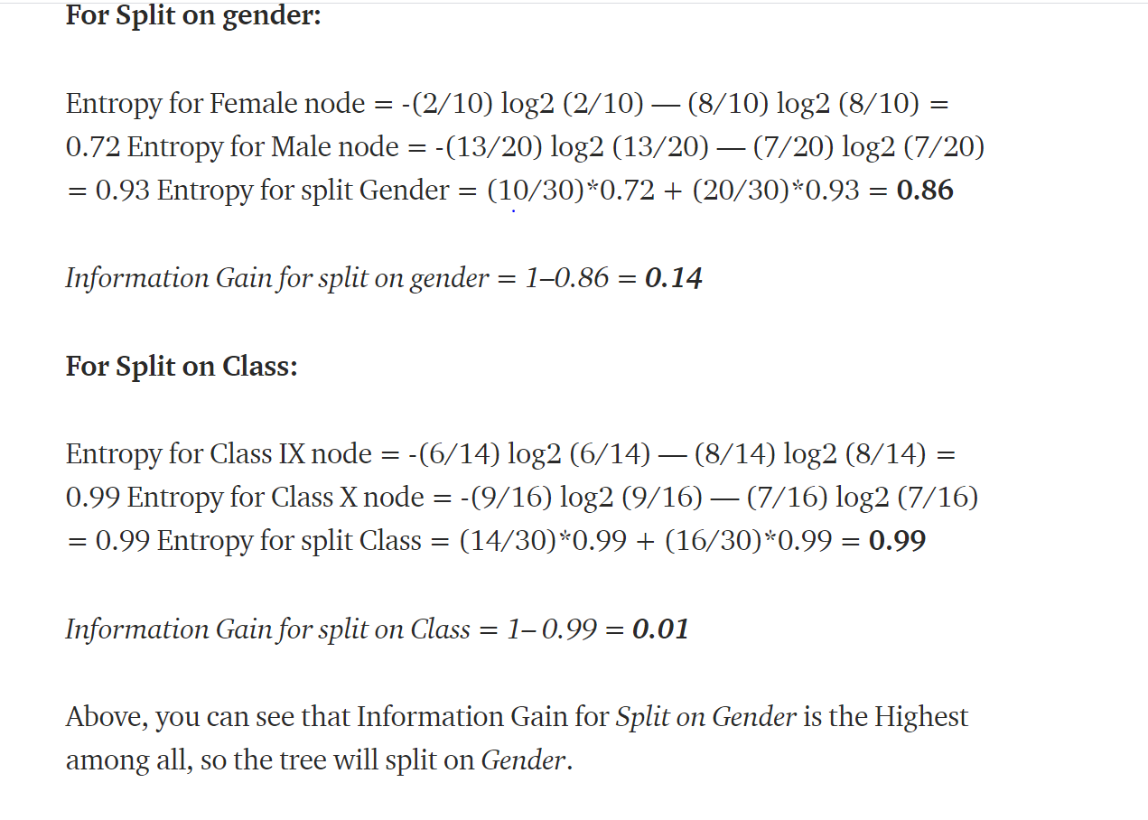
DECISION TREE-GINI SPLIT

Slide 11
THANK YOU

