Slide 1
MapReduce and Spark
By
Aravinthan Jayabal

Slide 2
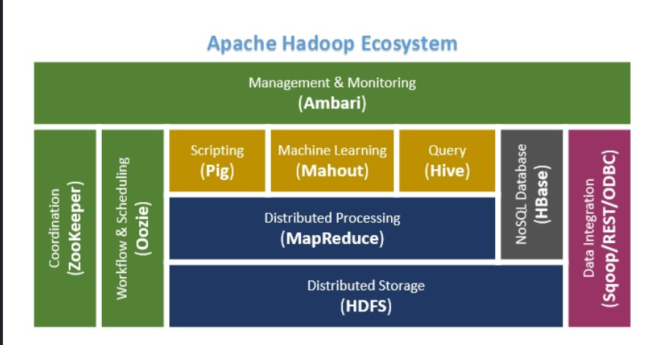
HADOOP ARCHITECTURE

Slide 3

Spark

Slide 4
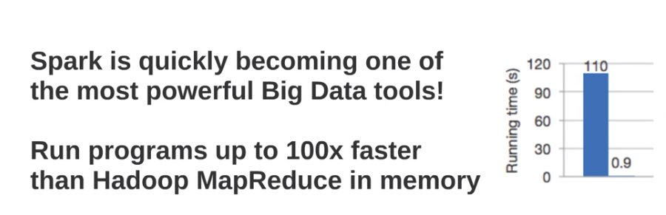
Spark VS Mapreduce

Slide 5
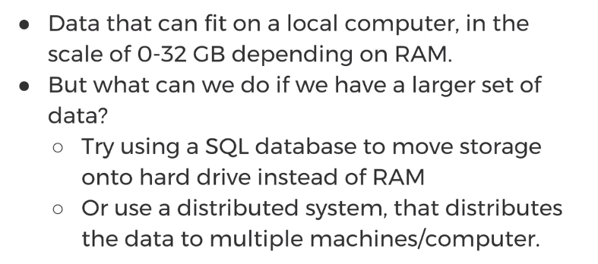
BIG DATA

Slide 6
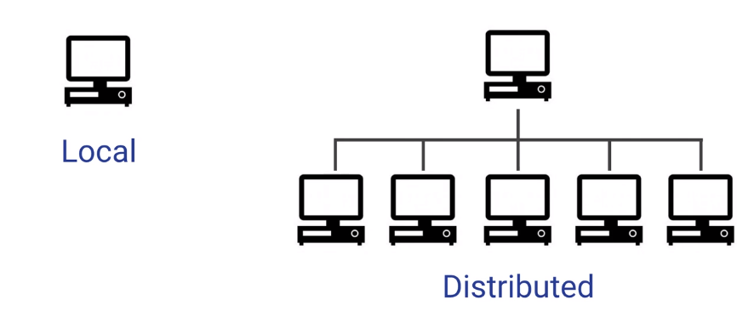
Local VS Distributed System

Slide 7
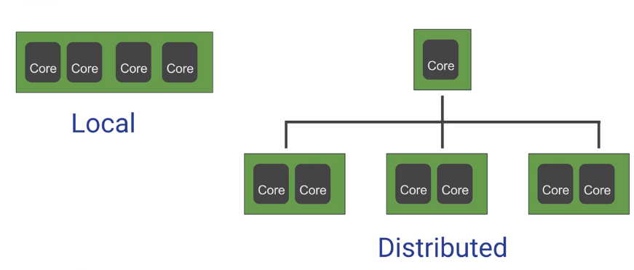
Local VS Distributed

Slide 8
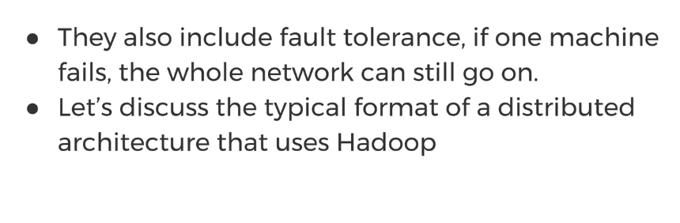
Advantage of DS

Slide 9
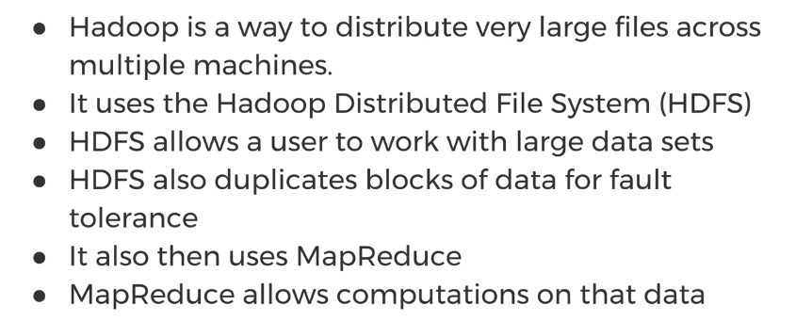
Hadoop

Slide 10
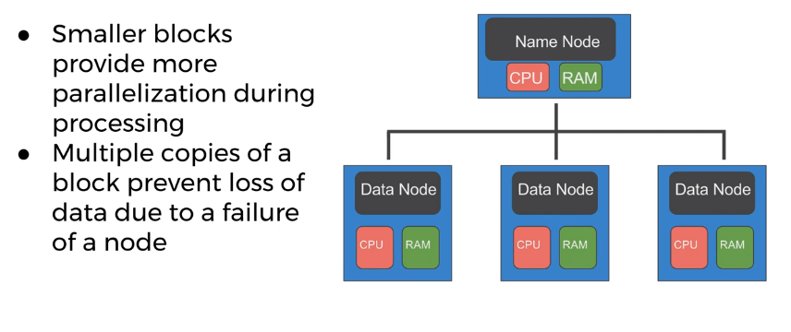
Distributed Storage

Slide 11
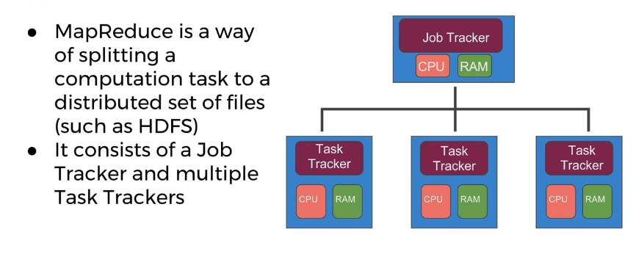
Map Reduce

Slide 12
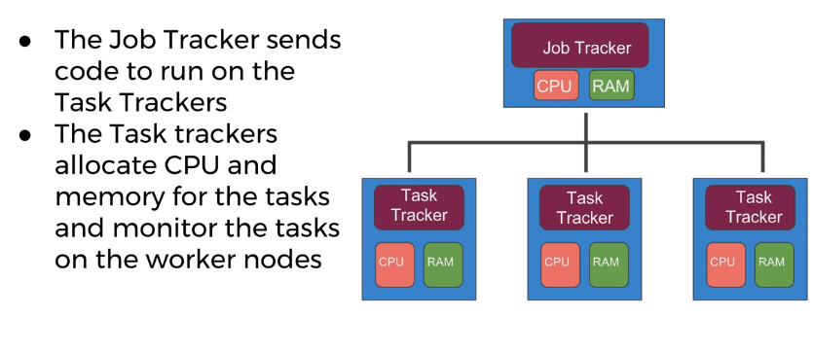
MapReduce

Slide 13
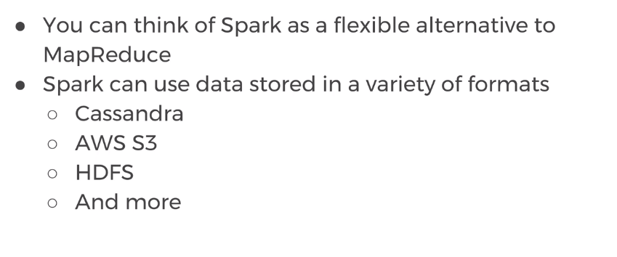
Spark

Slide 14
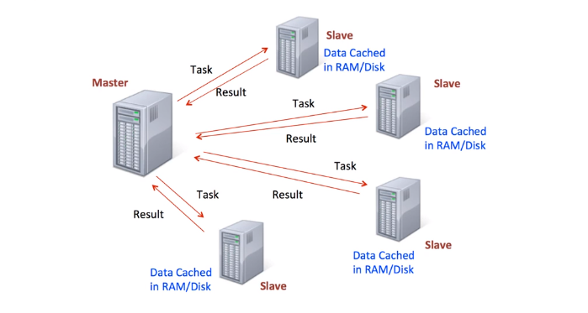
Spark – Data Frame Sytax

Slide 15
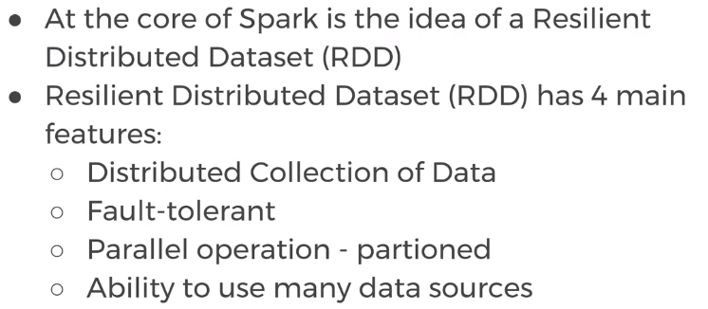
Spark - RDD

Slide 16
Spark Link
http://spark.apache.org
http://spark.apache.org/docs/latest/sql-programming-guide.html
http://spark.apache.org/docs/latest/ml-guide.html

Slide 17
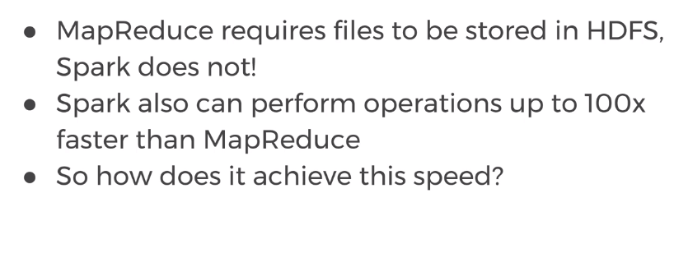
Spark VS Mapreduce

Slide 18
Data Bricks
https://databricks.com/try-databricks
https://community.cloud.databricks.com/login.html
Import pysark
df = sqlContext.sql("SELECT * FROM dataset_facebook_csv ")

