Slide 1
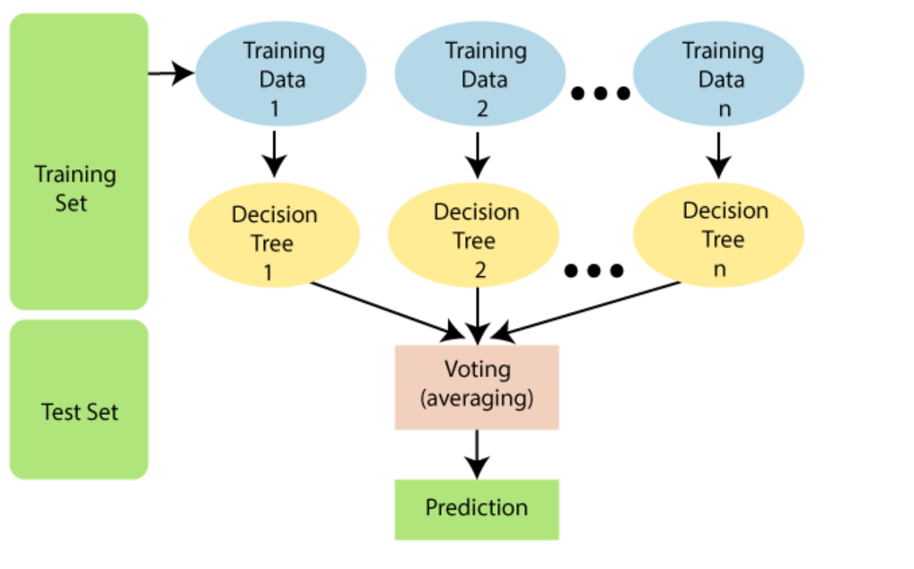
RANDOM FOREST

Slide 2
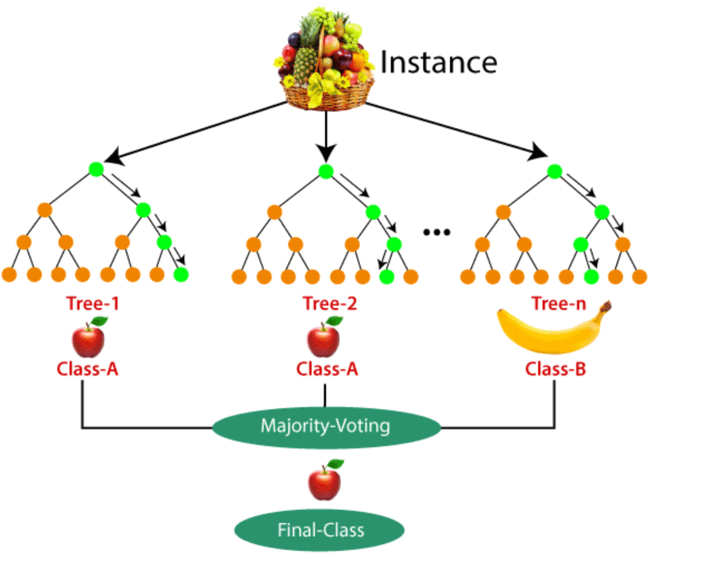
RANDOM FOREST

Slide 3
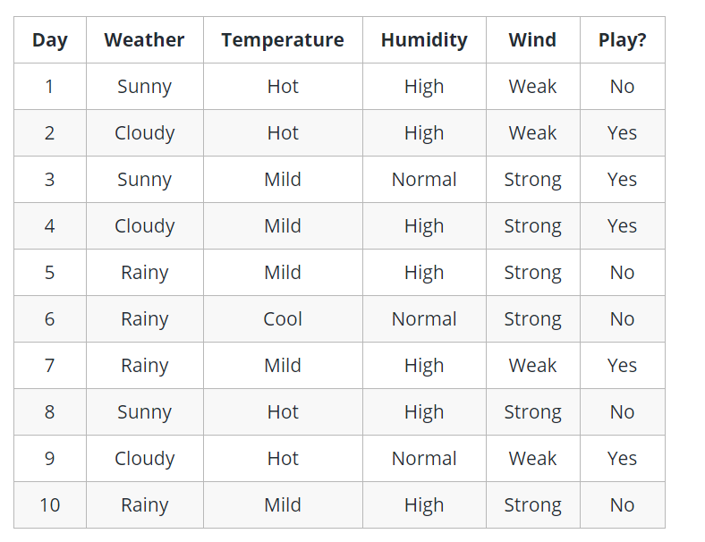
DECISION TREE

Slide 4
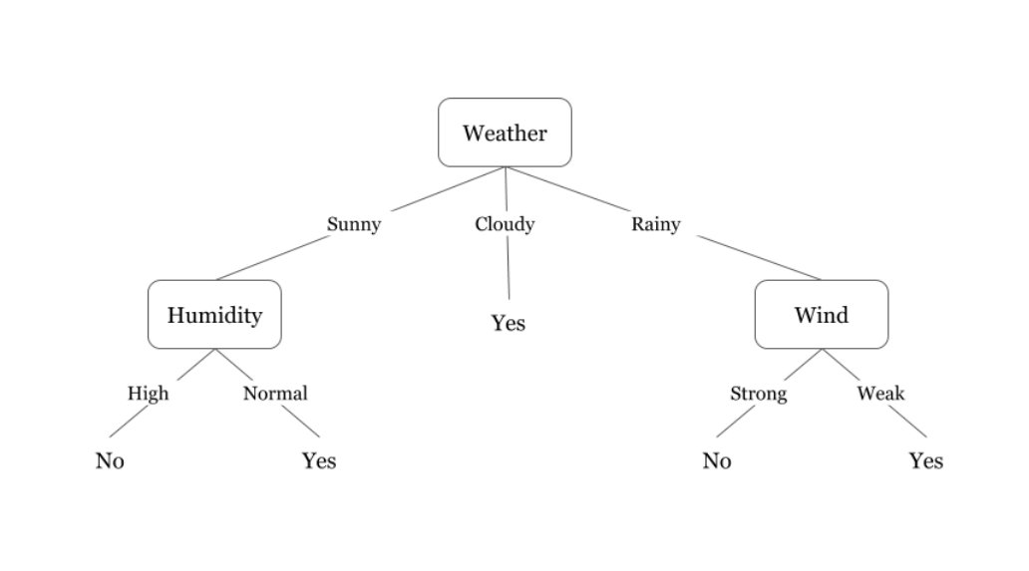
DECISION TREE

Slide 5
THANK YOU

