Slide 1
IMBALANCED DATA

Slide 2
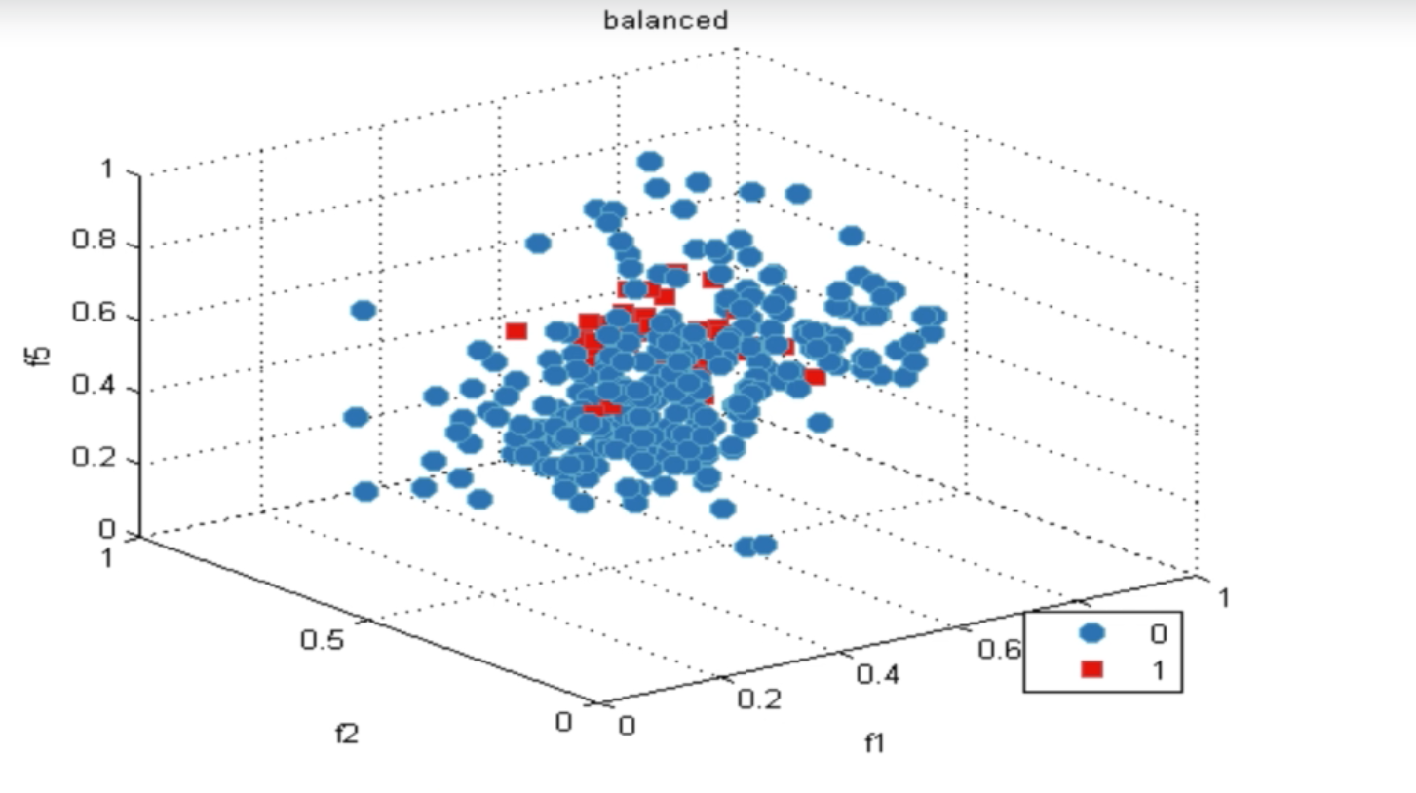
REAL WORLD APPLICATION

Slide 3
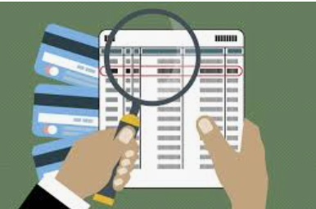
REAL WORLD APPLICATION
CREDICARD TRANSACTION
NORMAL VS SUSPISUOS

Slide 4
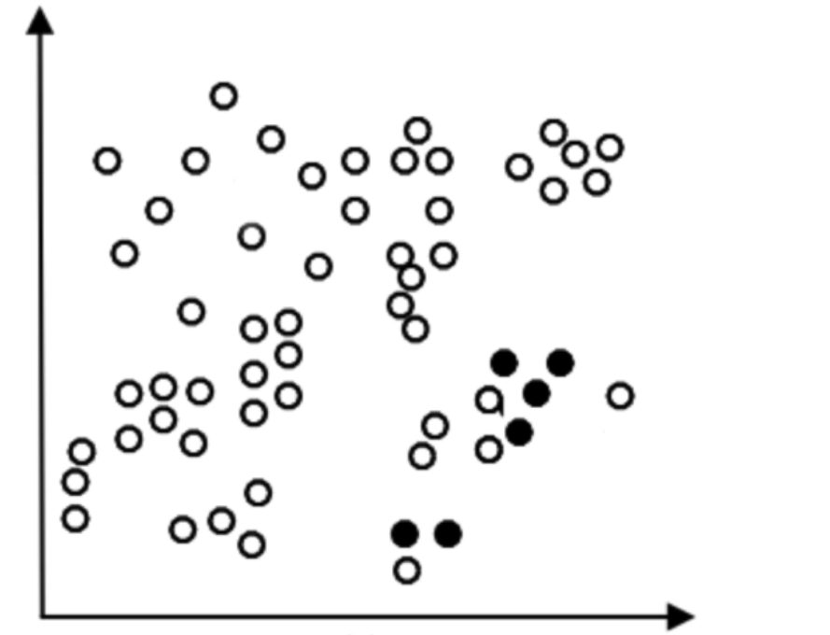
CLASSIFICATION ERROR

Slide 5
DEGREE OF BIAS
100 : 1
0 1
1000 : 1
10000 : 1
Classifier will favour majority class

Slide 6
DEGREE OF BIAS
Maximum ML IS UNDER ASSUMPTION OF BALANCE CLASS DISTIBUTION
50 : 50
1 0

Slide 7
UNBALANCED CHARACTERISTICS
DEGREE OF BIAS
100 : 1
DATASETSIZE
SMALL DATASET
MORE FEATURES

Slide 8
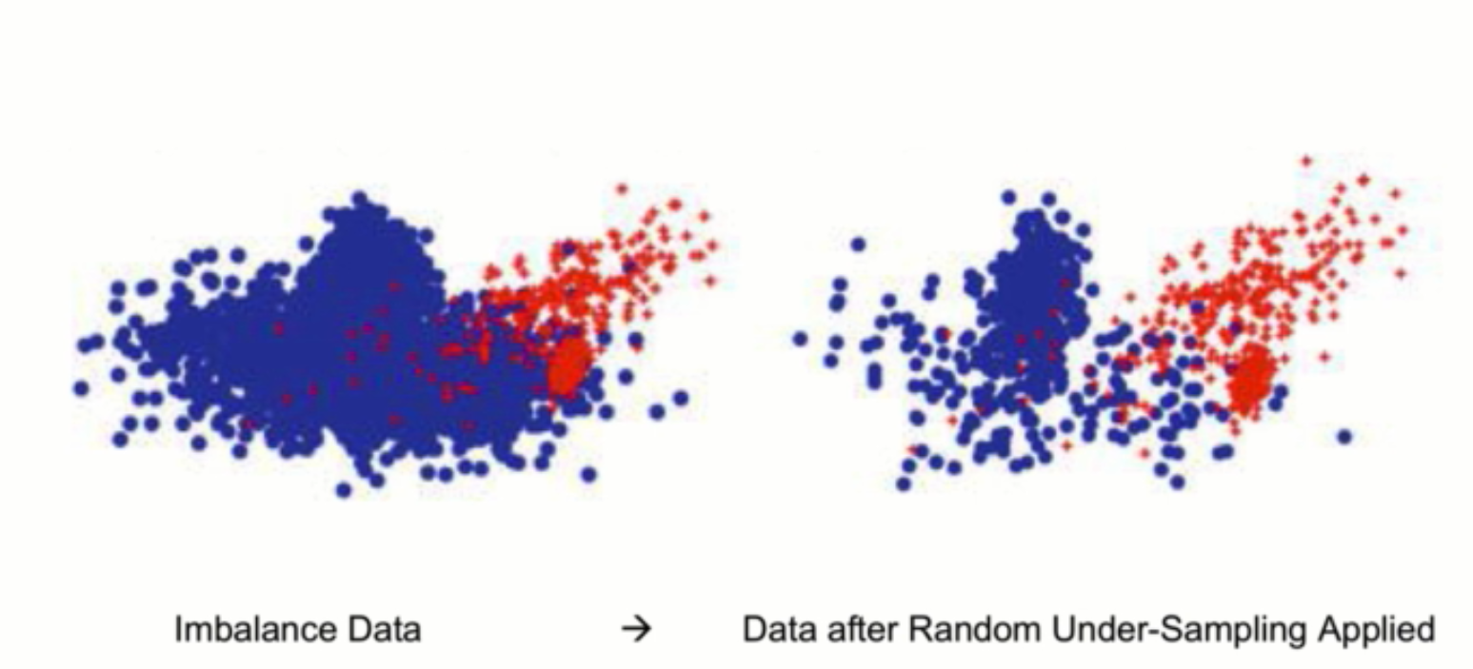
RANDOM UNDERSAMPLING

Slide 9
SMOTE
Synthetic Minority Oversampling Technique
Creating new minority class
Interpolating between several minority class

Slide 10
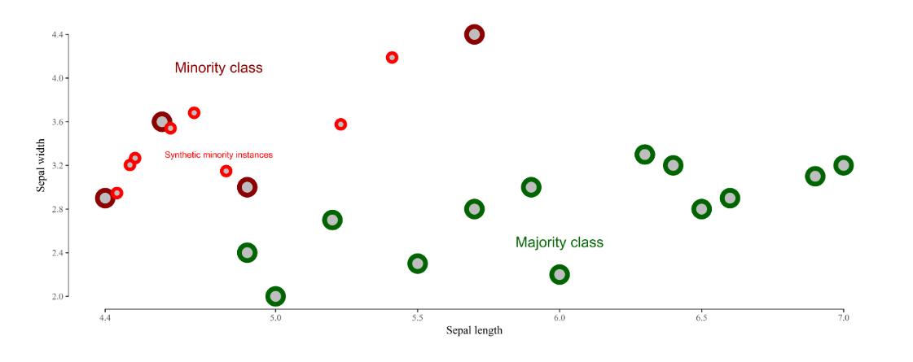
SMOTE

Slide 11
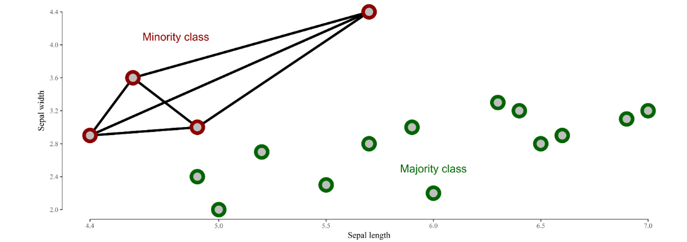
SMOTE

Slide 12
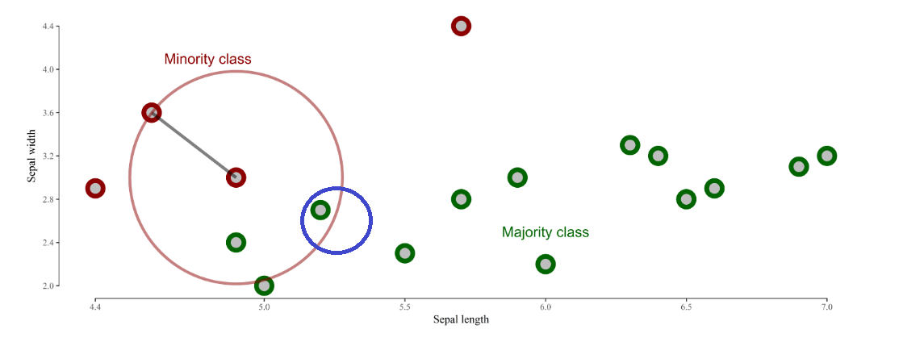
SMOTE K =1

Slide 13
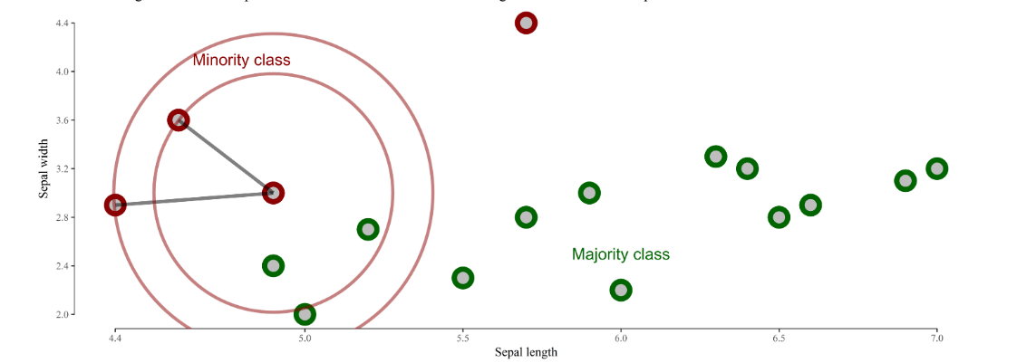
SMOTE K =2 , New point is randomly selected

Slide 14
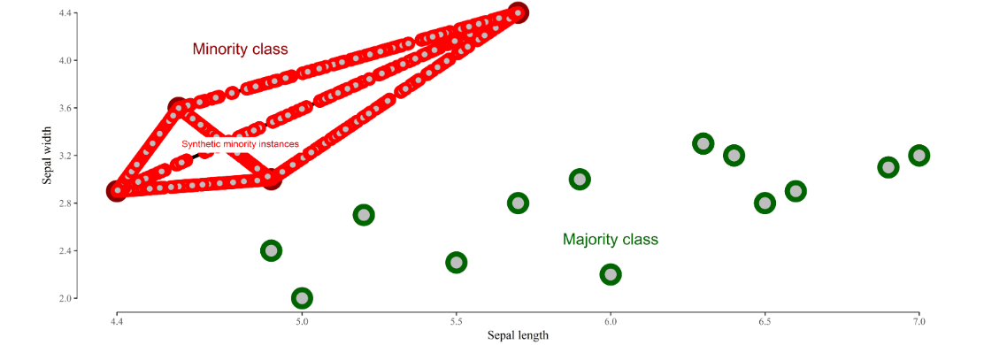
SMOTE K =5 , 30 percent of data point is geenrated

Slide 15
SMOT
https://rikunert.com/SMOTE_explained

