Slide 1
SVM

Slide 2
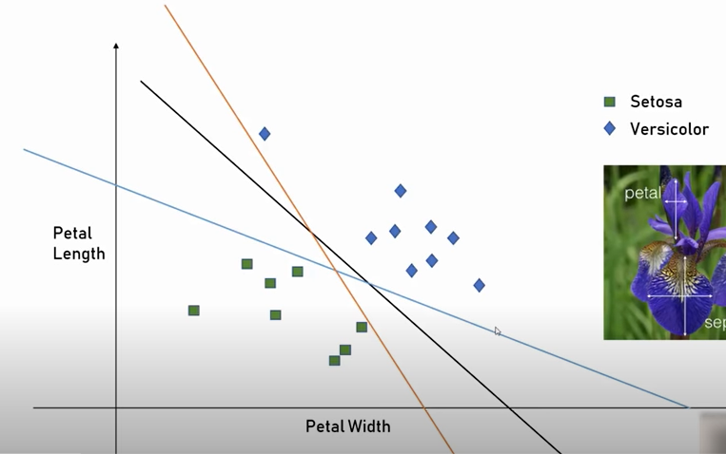
SVM

Slide 3
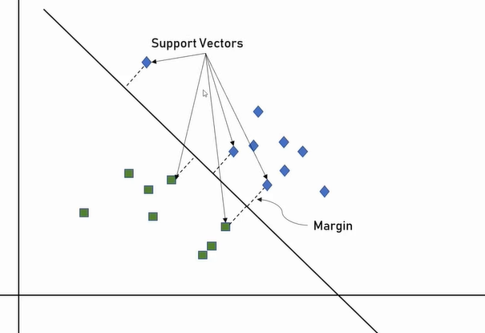
SVM

Slide 4
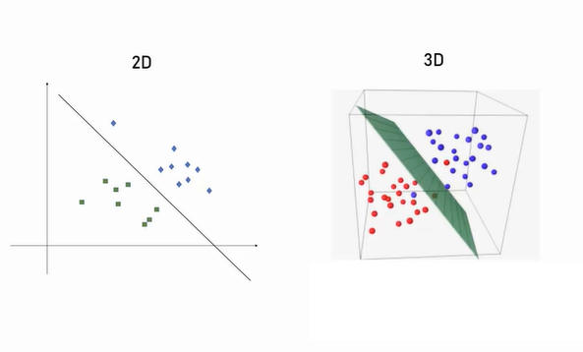
SVM

Slide 5
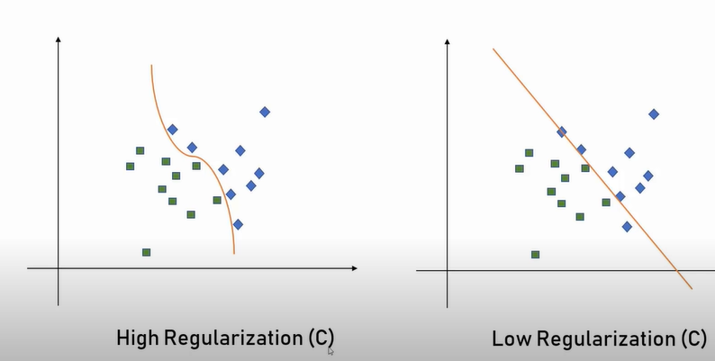
SVM-Regularization

Slide 6
SVM-Regularization

