Slide 1
DEEP LEARNING

Slide 2
ML VS DEEPLEARNING
Machine learning
It is a subset of artificial intelligence associated with creating algorithms that can change themselves without human intervention to get the desired result –by feeding themselves through structured data.
Deep learning
Itis a subset of machine learning where algorithms are created and function similarly to machine learning, but there are many levels of these algorithms, each providing a different interpretation of the data it conveys. This network of algorithms is called artificial neural networks. In simple words, it resembles the neural connections that exist in the human brain.

Slide 3
ML VS DEEPLEARNING
Both of these subsets of AI are somehow connected to data, which makes it possible to represent a certain form of “intelligence.” However, you should be aware that deep learning requires much more data than a traditional machine learning algorithm.

Slide 4
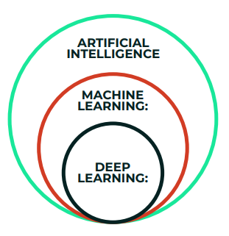
AI VS ML VS DL

Slide 5
AI VS ML VS DL
Machine learning Process:
(1) select the model to train
(2) manually perform feature extraction.
Deep Learning Process:
Select the architecture of the network
features are automatically extracted by feeding in the training data (such as images) along with the target class (label)

Slide 6
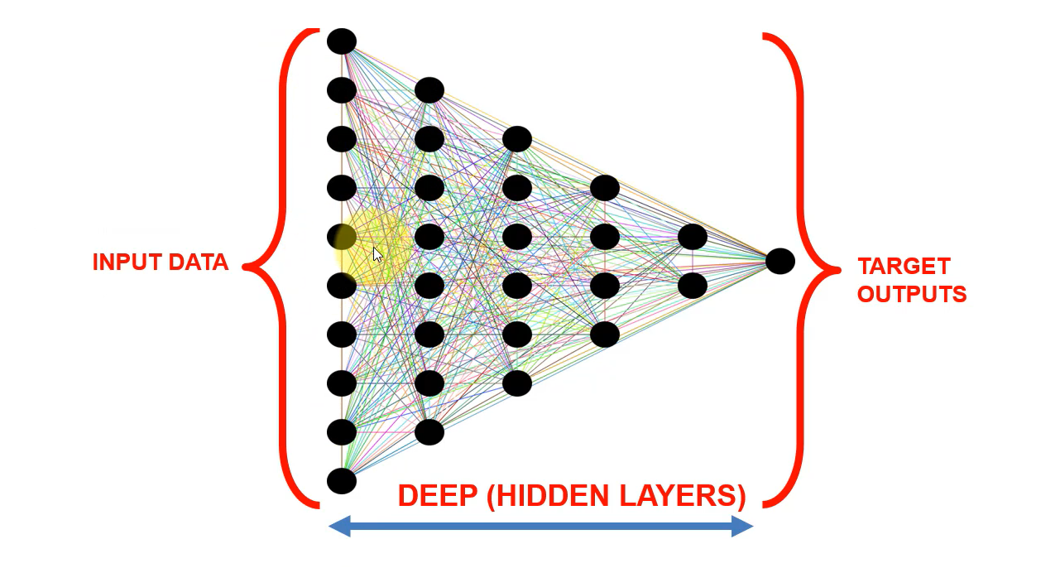
ANN

Slide 7
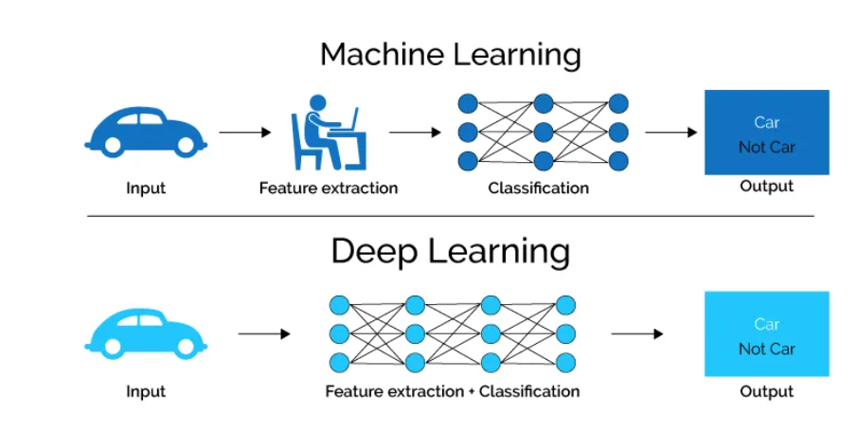
ML VS DL - ANN

Slide 8
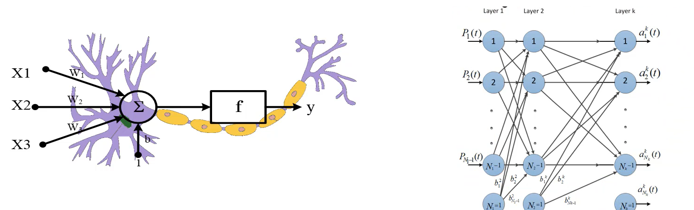
ANN

Slide 9

SINGLE NEURON – DOUBLE NEURON

Slide 10
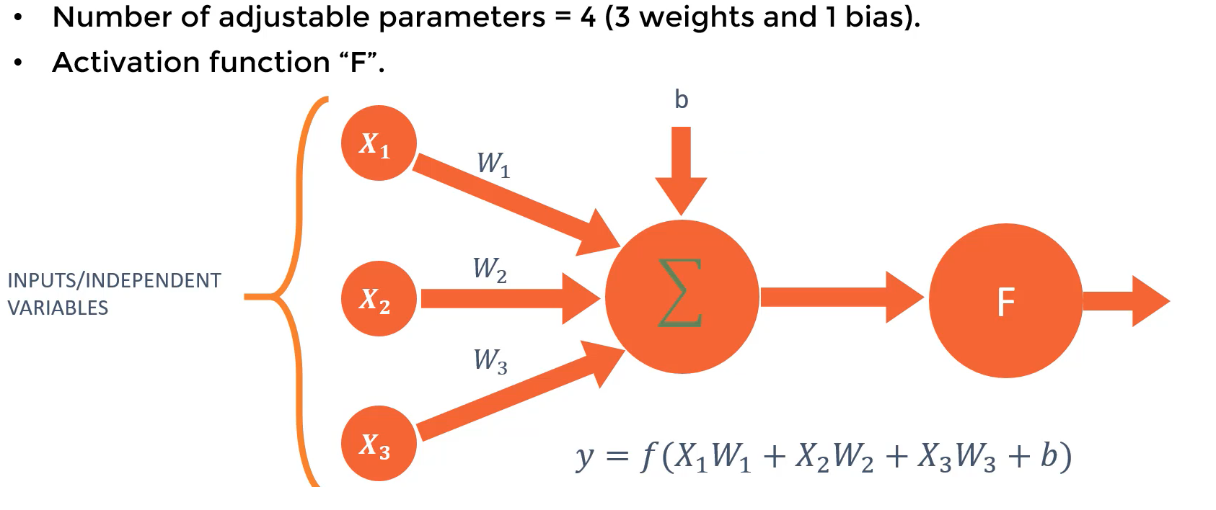
Single Neuron

Slide 11
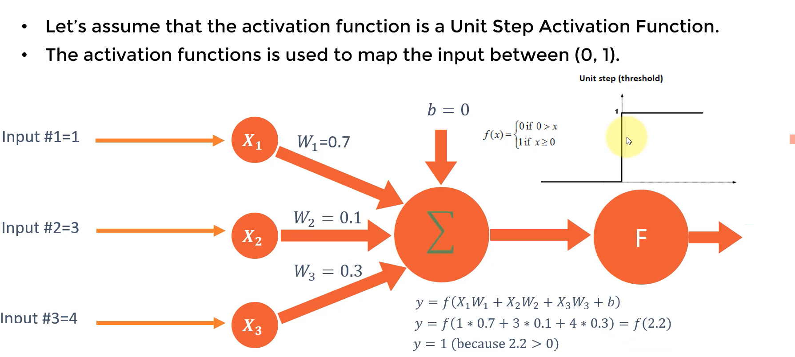
Single Neuron

Slide 12

MULTI NEURON NEURON

Slide 13
ANN
Play Ground : TensorFLow
https://playground.tensorflow.org/

Slide 14
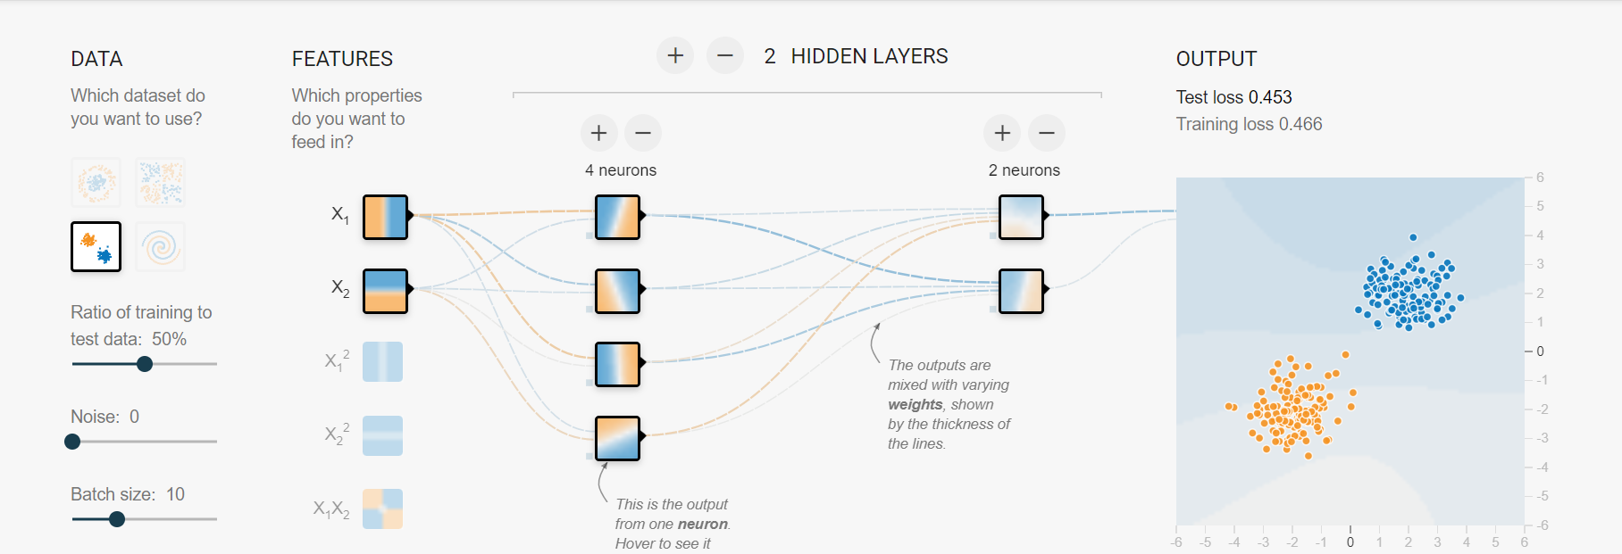
ANN

Slide 15
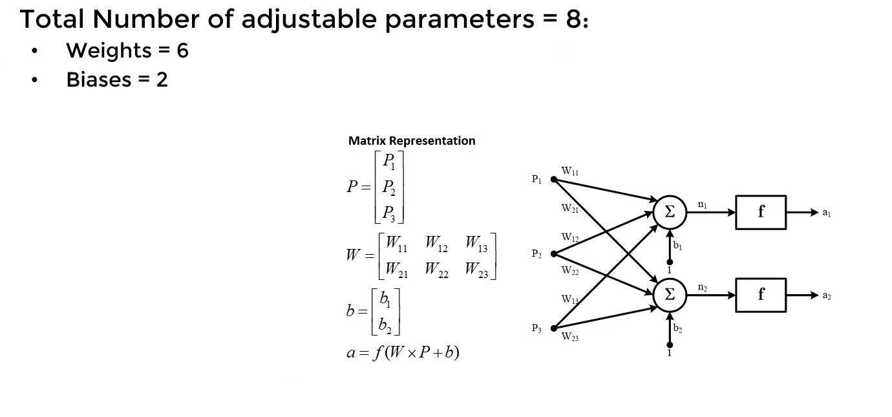
TWO NEURON

Slide 16
ANN
Regference : https://www.sciencedirect.com/science/article/abs/pii/016974399380052J

Slide 17
TWO NEURON

Slide 18
ANN

