Slide 1
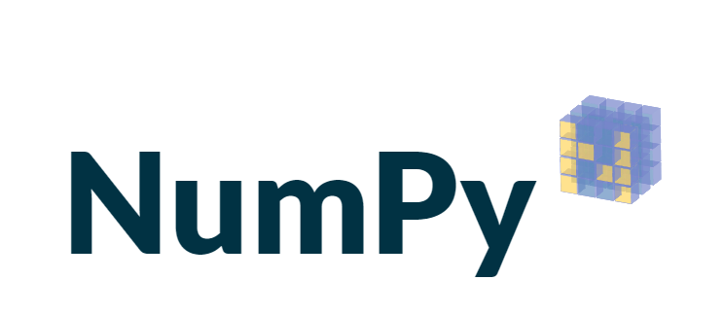

Slide 2
NUMPY LIBRARY
Using NumPy, a Data Scientist can perform the following operations −
Mathematical and logical operations on arrays.
Shape the data.
Operations related to linear algebra. NumPy has in-built functions for linear algebra and random number generation

Slide 3
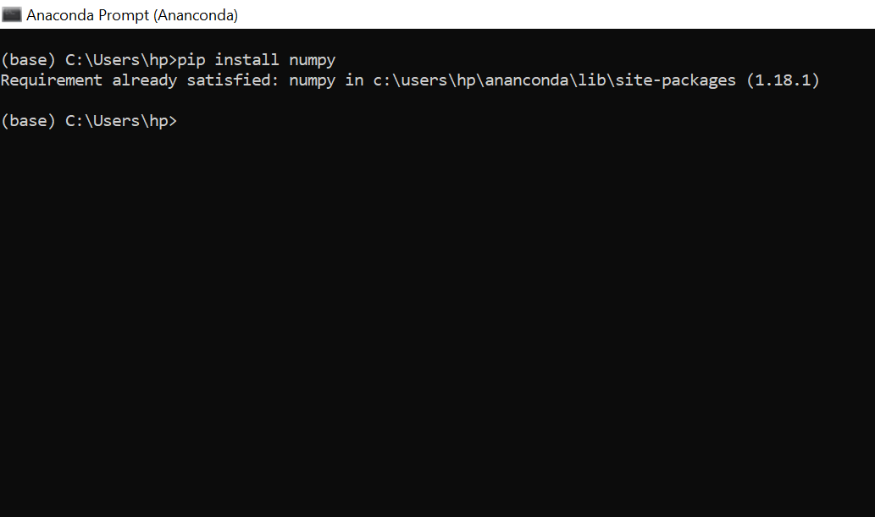
INSTALL NUMPY LIBRARY
Pip install numpy

Slide 4
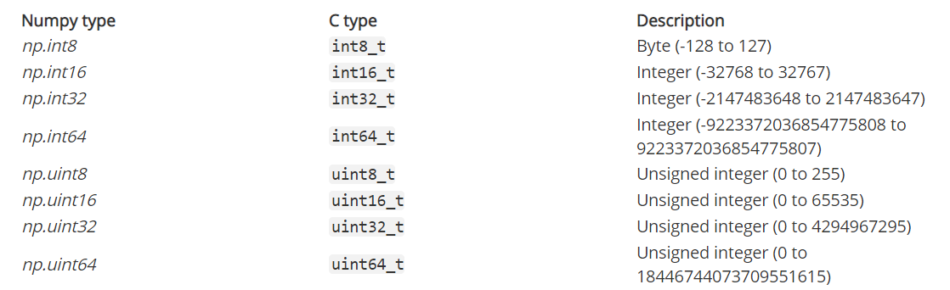
NUMPY LIBRARY

Slide 5
NUMPY LIBRARY
List
List to Array
Array to list
Size
Dimension
1 dimension , 2 dimension , 3 dimension

Slide 6
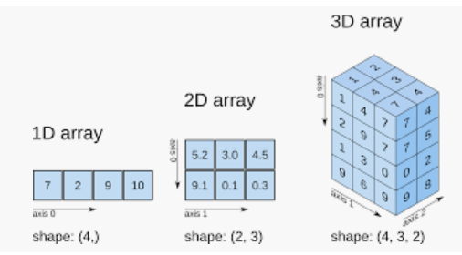
NUMPY Reshaping – 1 D,2D,3D
Reshaping is very important

Slide 7
THANK YOU

