Slide 1
GROUPY BY

Slide 2
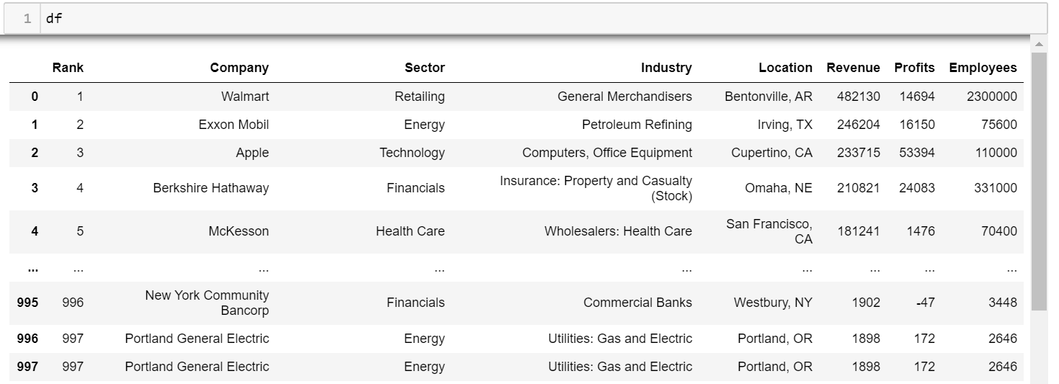
GROUP BY DATAFRAME

Slide 3
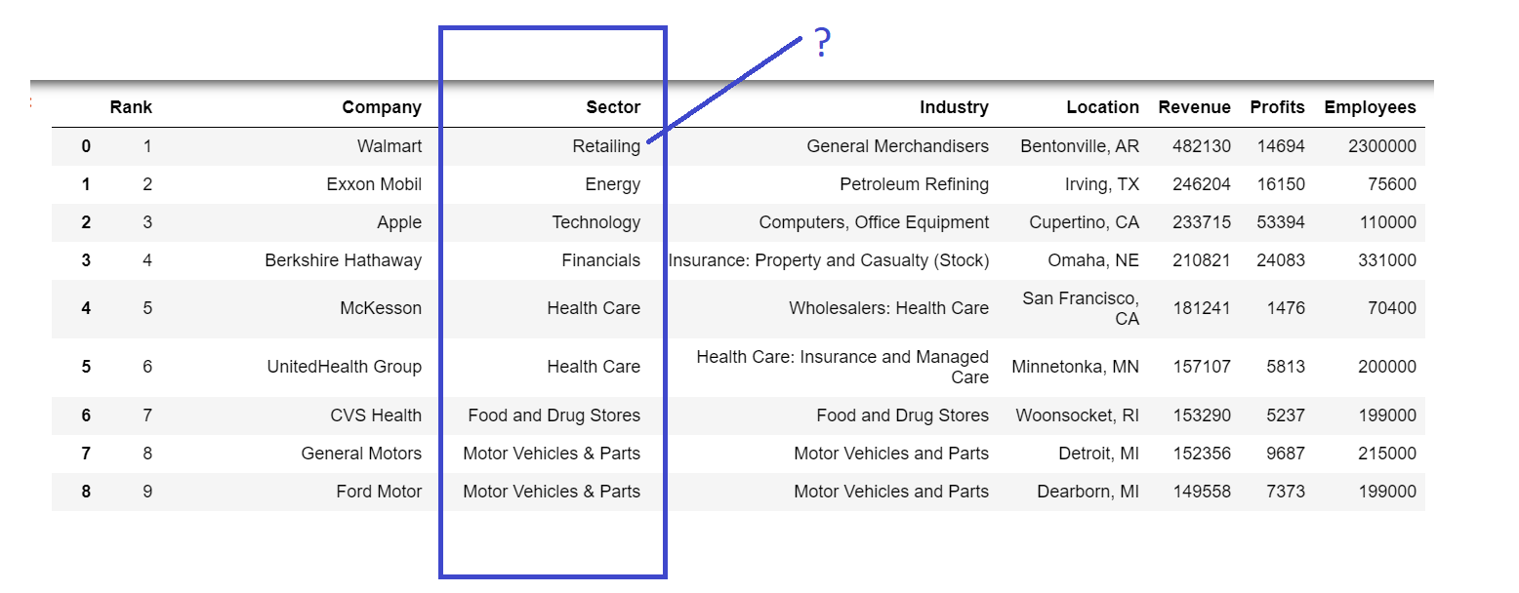
GROUP BY DATAFRAME

Slide 4
DIFFERENCE BETWEEN PANDAS AND GROUPBY DATAFRAME
Difference between Pandas AND Group
Pandas returns result for entire data frame
Group by returns values based on particular group

Slide 5
DIFFERENCE BETWEEN PANDAS AND GROUPBY DATAFRAME
Difference between Pandas AND Group
Pandas returns result for entire data frame
Group by returns values based on particular group

Slide 6
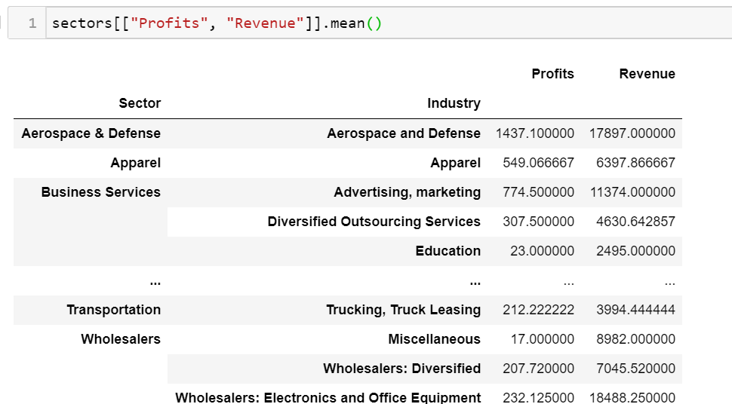
GROUPBY

