Slide 1
DATA VISUALIZATION –PYTHON LIBRARIES

Slide 2
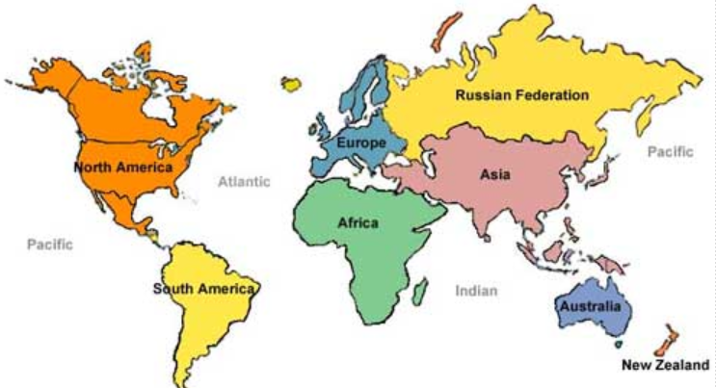
My Team

Slide 3
Data Analytics
Data Visualizing
Data Loading/
Cleaning
Interpret
And
Commnc.
Machine Learning

Slide 4
Data Loading - Pandas
Csv
Sql
Web
Year | Sales | Profit | Reven.
2010 | 75000 | 1000 | 85000
2011 | 85000 | 2000 | 95000

Slide 5
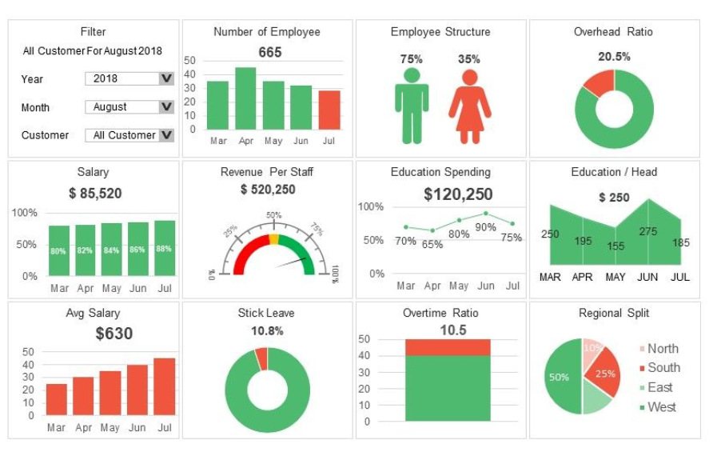
Data Visualization – HR Dash Board

Slide 6
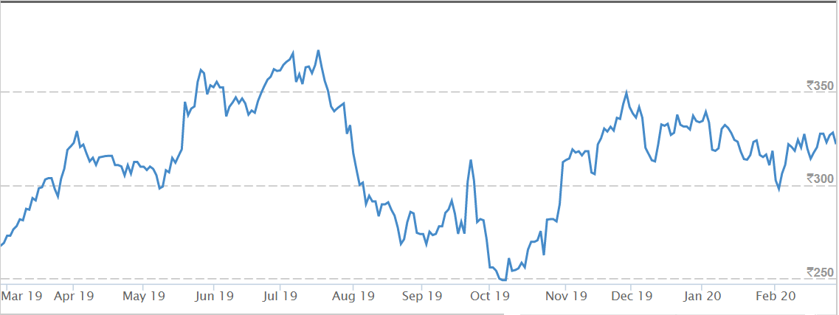
Data Visualization – One Year SBI Trend

Slide 7
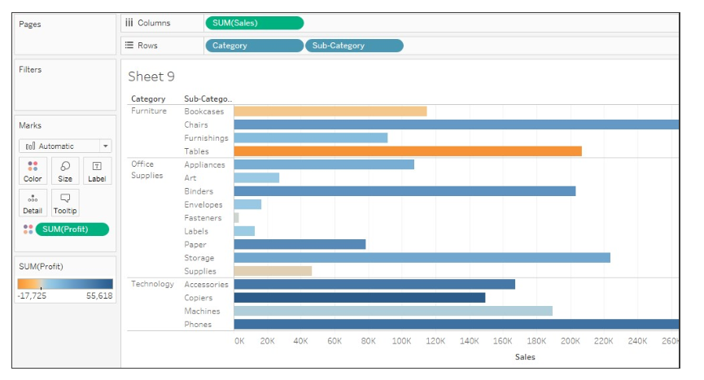
Data Visualization – Sales Chart

Slide 8
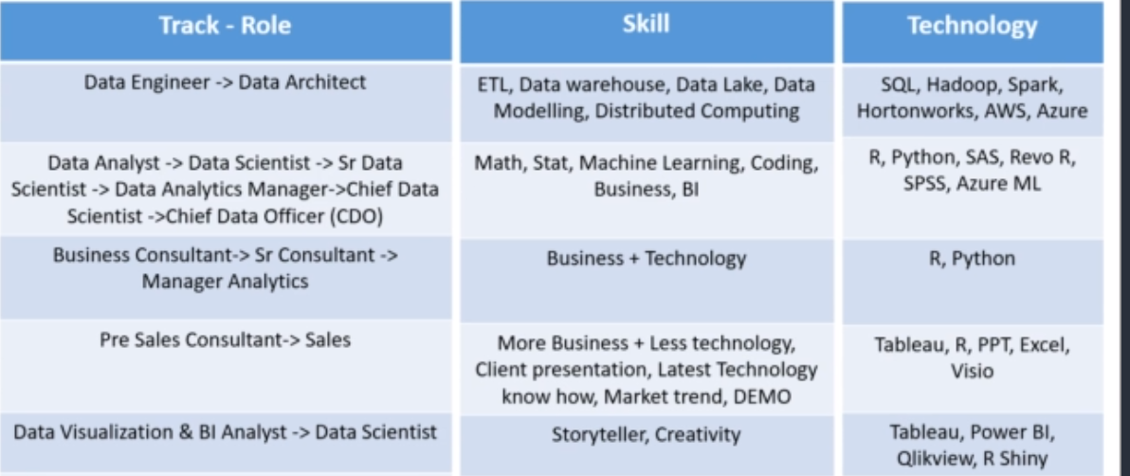
Language Tools and Roles

Slide 9

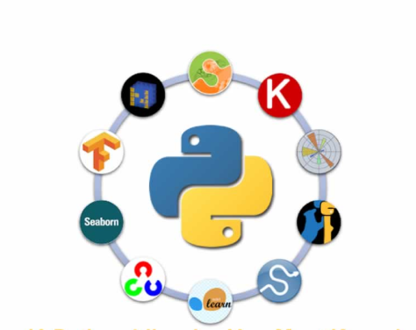


Data Visualization Language and Tools
Python

Slide 10
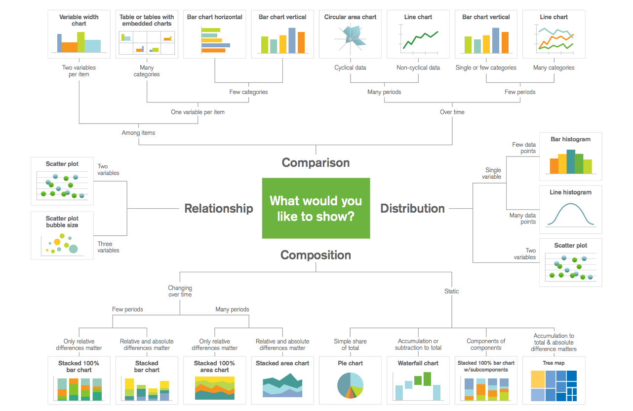
Data Visualization

Slide 11

Library

Slide 12
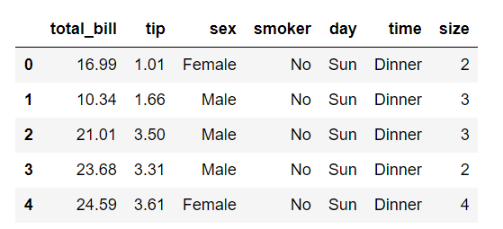
DataBase with Objects

Slide 13
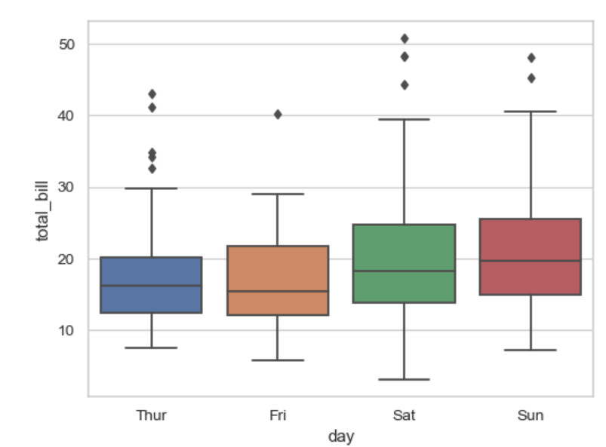
Library - Seaborne
Seaborne
Seaborne Library
Boxplot
Violin Plot
Bargraph
Day
Box Plot
Tot.

Slide 14
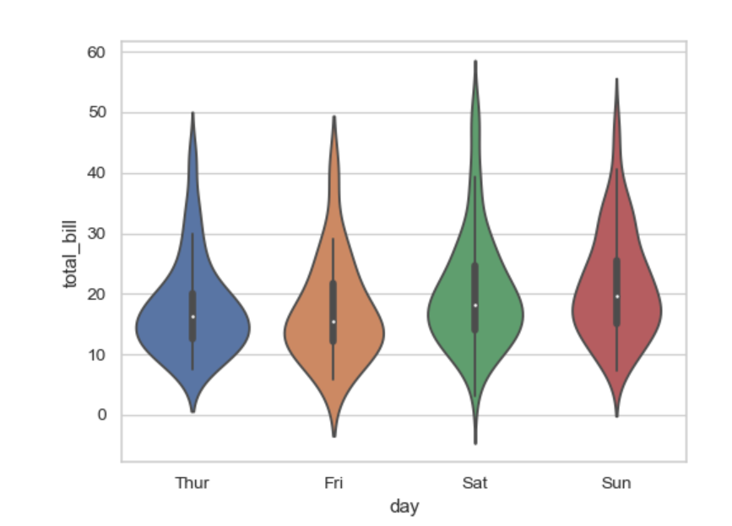
Seaborne Library – Violin
Seaborne
Seaborne Library
Boxplot
Violin Plot
Bargraph
Day
Voilin
Tot.

Slide 15
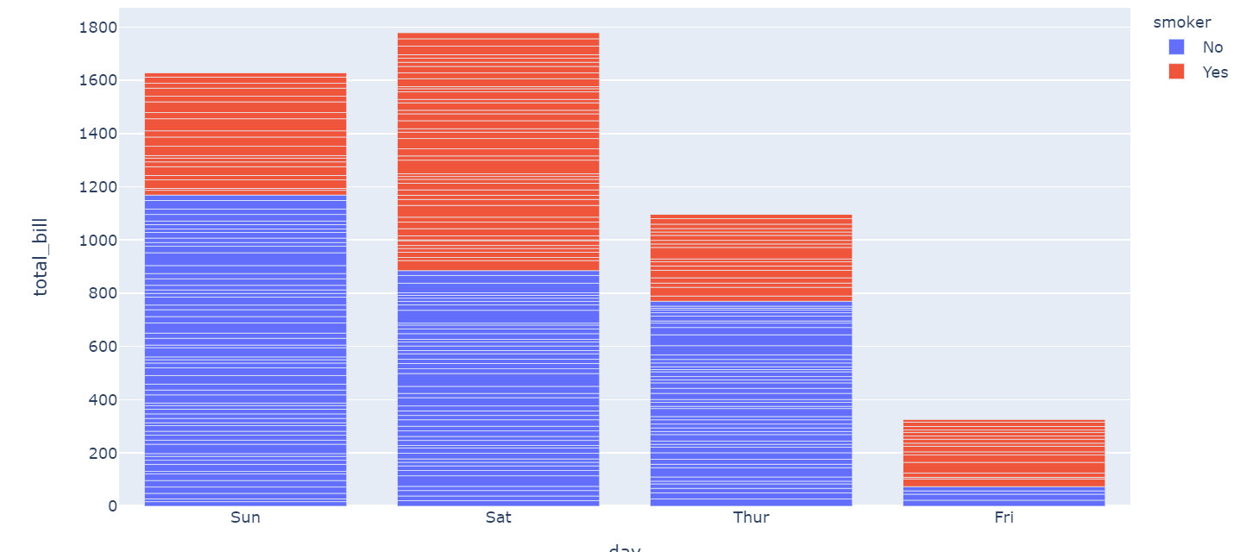
Plotly Library – Violin
Plotlt
Plotly Library
Boxplot
Violin Plot
Bargraph
PieCHart
Day
bar
Tot.

Slide 16

Kaizens Theory

Slide 17


