Slide 1
Statistics

Slide 2
Statistics is a branch of mathematics dealing with data collection, organization, analysis, interpretation and presentation.[

Slide 3
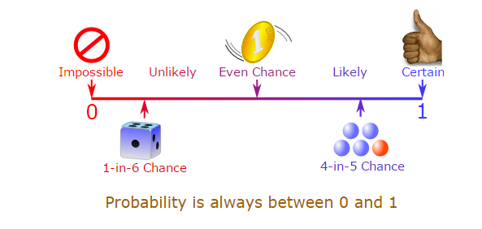
Probability

Slide 4
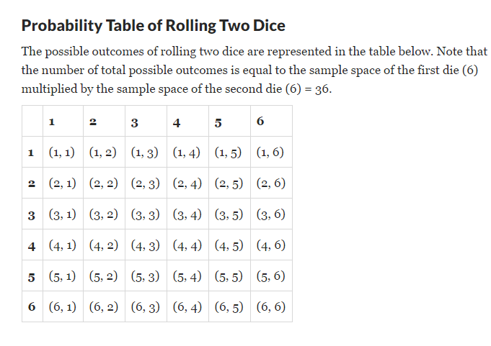
Two Dice Problem

Slide 5
Probability
A probability is always greater than or equal to 0 and less than or equal to 1,

Slide 6
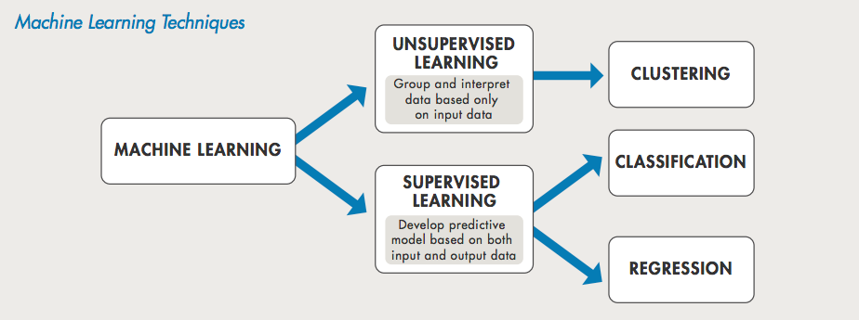
ML Algorithm

Slide 7
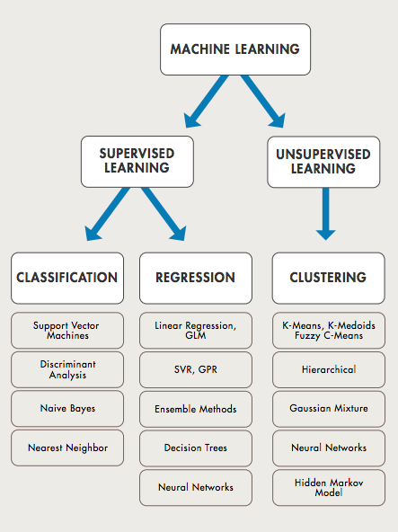

Slide 8
Supervised Learning
Basically supervised learning is a learning in which we teach or train the machine using data which is well labeled that means some data is already tagged with correct answer.
If shape of object is rounded and depression at top having color Red then it will be labelled as –Apple.
If shape of object is long curving cylinder having color Green-Yellow then it will be labelled as –Banana.

Slide 9

Supervised Learning

Slide 10
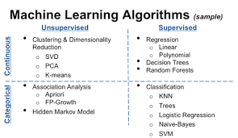
Supervised and Unsupervised

Slide 11
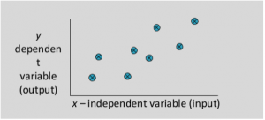
Linear Regression

Slide 12
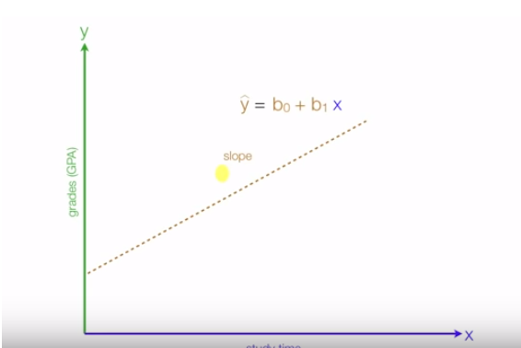
Slope is posive

Slide 13
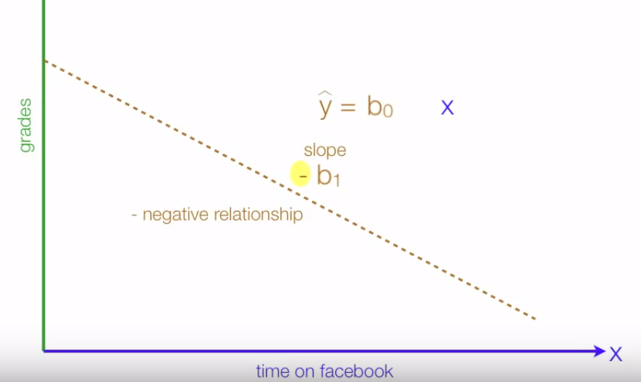
Negative relationship

Slide 14
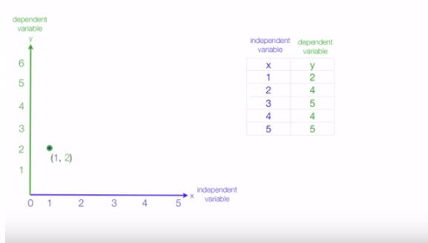
Line near Regression

Slide 15
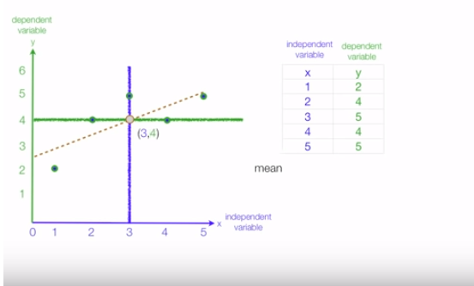
Mean of x and y meeting

Slide 16
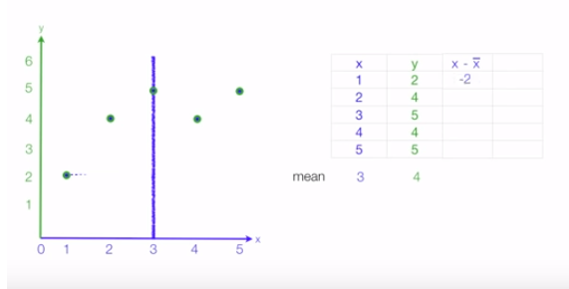
Observation from x mean

Slide 17
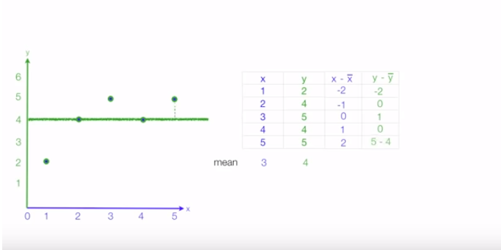
Observation from y mean

Slide 18
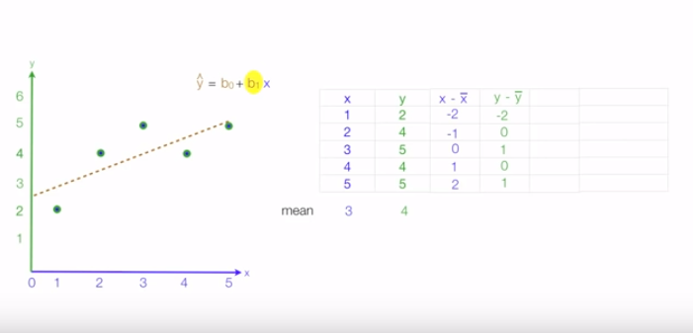
Finding Slope

Slide 19
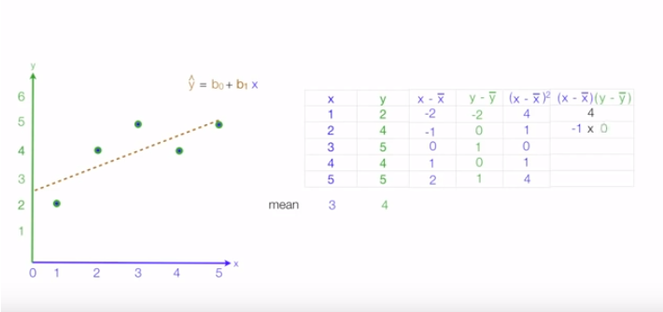
Calculatinf x-xbar and few values

Slide 20
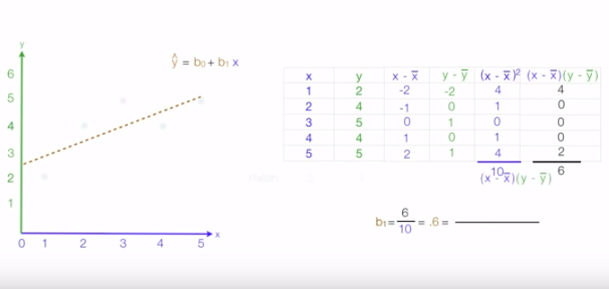
Calculating b1

Slide 21
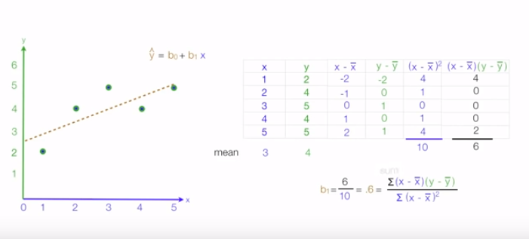
Calculating b1

Slide 22
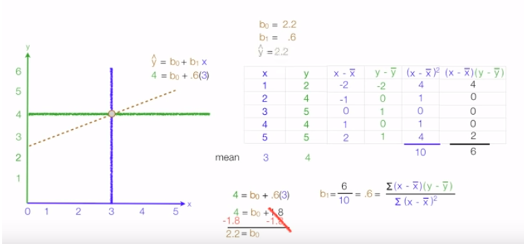
Calculating b0

Slide 23
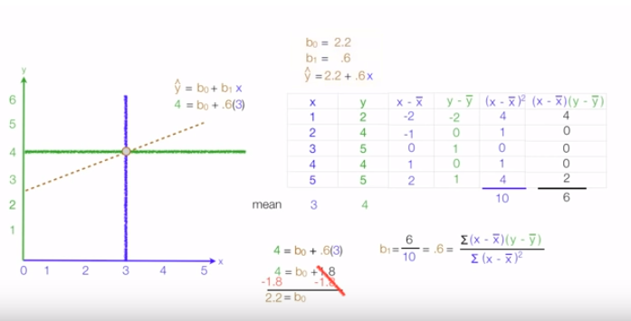
Calculating y

Slide 24
