Slide 1

Automata Formal Languages and Logic
PLY library in Python
Presented By:
Divya N

Slide 2

Compiler design is a fascinating and essential field of computer science that focuses on the creation of software tools called compilers.
A compiler is a program that translates human-readable source code written in a high-level programming language into machine code or another lower-level representation that can be executed by a computer.

Slide 3
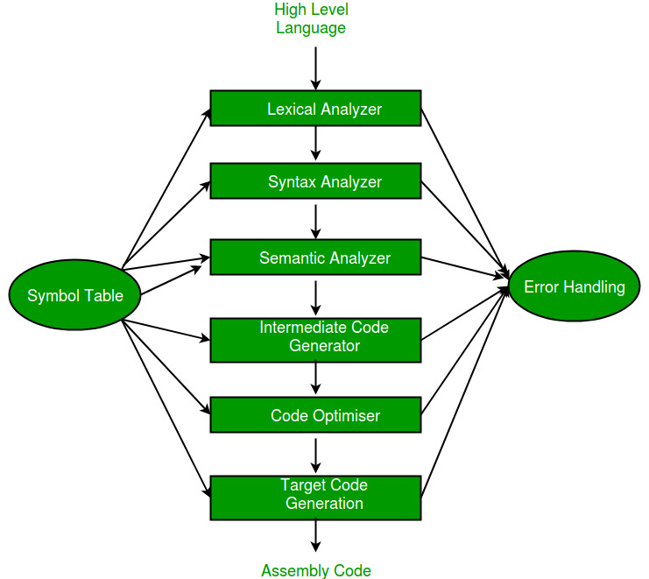

Slide 4
Lexer
Parser

Slide 5
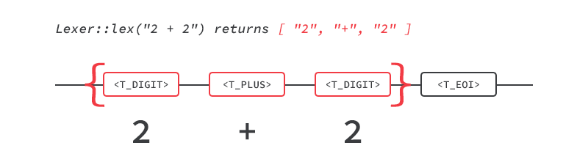
Lexer
Lexer performs lexical tokenization which is the conversion of a text into (semantically or syntactically) meaningful lexical tokens belonging to categories defined by a "lexer" program. In case of a natural language, those categories include nouns, verbs, adjectives, punctuations etc. In case of a programming language, the categories include identifiers, operators, grouping symbols and data types.
More specifically, the input is broken into pairs of token types and values.

Slide 6
Parser
Parsing is the process of analyzing a string of symbols, either in natural language, computer languages or data structures, conforming to the rules of a formal grammar.
It takes a series of tokens as input and generates a parse tree for the same.
Parsers are used when there is a need to represent input data from source code abstractly as a data structure so that it can be checked for the correct syntax.

Slide 7
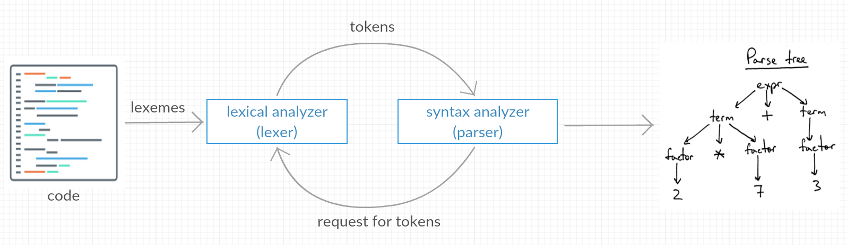

Slide 8
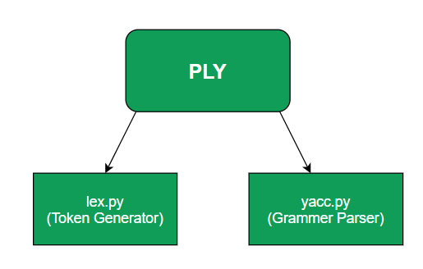
PLY is a python implementation of the two tools – lex and yacc in form of separate modules in a package.
These modules are named lex.py and yacc.py and work similar to the original UNIX tools lex and yacc.

Slide 9
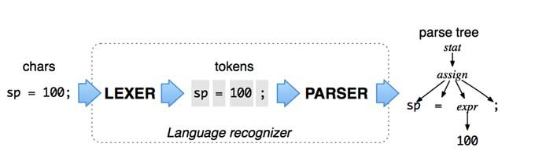

Slide 10
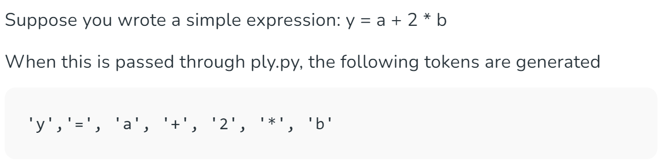
To import this module in your python code use import ply.lex as lex
This module provides an external interface too in the form of token() which returns the valid tokens from the input.

Slide 11
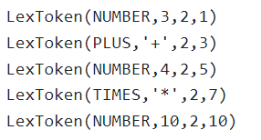

The output from lexer would look like this:
Input:
Lexer Output Tokens:
tok.type
tok.val
tok.lineno
tok.lexpos

Slide 12
Another module of this package is yacc.py where yacc stands for Yet Another Compiler Compiler.
To import yacc into your python code use, import ply.yacc as yacc
It uses LALR(1) parsing : LALR Parser (Look-Ahead, Left-to-right, Rightmost Derivation parser) is lookahead LR parser. It is the most powerful parser which can handle large classes of grammar.

Slide 13
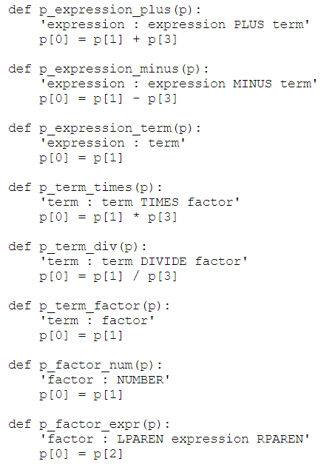
Write the grammar in the form of a CFG and use it to define rules in the yacc file.
expression → expression PLUS term
expression → expression MINUS term
expression → term
term → term TIMES factor
term → term DIVIDE factor
term → factor
factor → NUMBER
factor → LPAREN expression RPAREN

Slide 14
The PLY parser uses the defined lexer to tokenize the input expression into a sequence of tokens based on the token definitions and regular expressions.
The parser then applies the defined parsing rules and operator precedence to build a parse tree that represents the structure of the expression.
During this process, it uses the token values (e.g., numeric values for tokens) to perform the actual computation according to the grammar rules.
System level processing
After successful parsing, returns the result of the parsed expression otherwise the parser raises a syntax error

Slide 15
Steps to write a program using PLY
Install PLY
Import lex and yacc modules
Define the tokens that the lexer should recognize and perform any associated actions. Use regular expressions to define the token patterns.
Create the lexer using lex.lex(). This lexer will tokenize the input text.
Define the operator precedence and parsing rules using yacc. This includes specifying how expressions should be parsed and what actions should be taken when parsing specific rules.
Create the parser using . This parser will parse expressions according to the defined rules. Use result = parser.parse(expr) for final output.

Slide 16
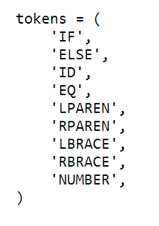
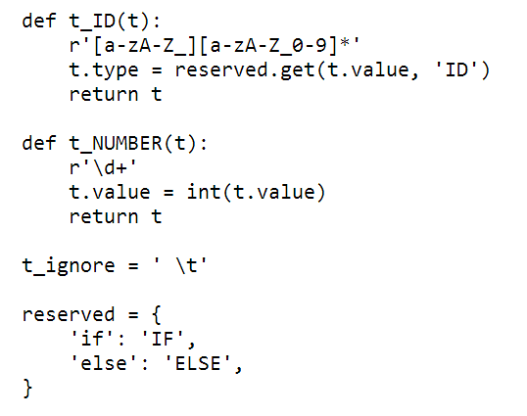
Sample code - if else construct in Python

Slide 17
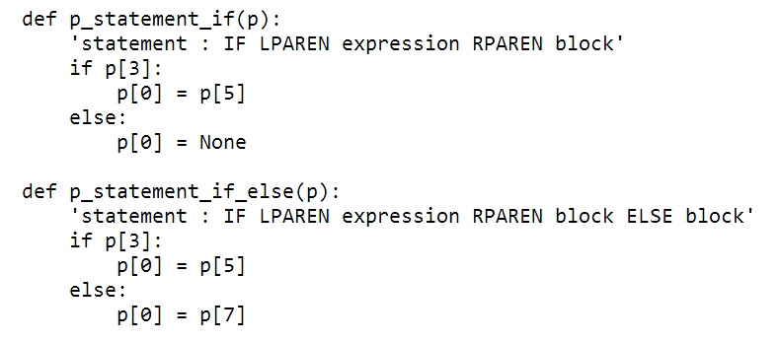


Slide 18
Thank You! For any queries : divya9103n@gmail.com

