Slide 1
HEALTHCARE DASHBOARD ANALYSIS REPORT
SUMMARY OF KEY RESULTS FROM THE POWER BI ANALYSIS FOR MANAGEMENT REVIEW.

Slide 2
EXECUTIVE SUMMARY
The Overall YTD Patient increased by 12.23% compared to PYTD Patient
YTD Patient is 2M
YTD Inpatient is 68K
YOY Inpatient increased by 5.60%
YTD Outpatient is 2M
YOY Outpatient increased by 11.95%
YTD Day Case is 175K
YOY Day Case Increased by 18.30%

Slide 3
PATIENT PERFORMANCE INSIGHT
THE YTD PATIENT BY AGE_PROFILE
The Age 0-15 influenced a total of 26.5K with 12.54%
Age 16-64 influenced a total of 132k with 62.3%
Age 65+ influenced a total of 53K with 25.1%
THE YTD PATIENT BY CASE_TYPE
Outpatient has the highest YTD Patient by Case_type with 88.21%
Day Case YTD Patient with 8.36%
Inpatient YTD Patient with 3.43%

Slide 4
PATIENT PERFORMANCE INSIGHT
YTD PATIENT BY ADULT_CHILD
The Adult influenced a total of 1.85M to the YTD Patient
The Child influenced a total of 272k to the YTD Patient

Slide 5
RECOMMENDATIONS
The YOY Patient growth is about 12.23%, indicating a steady increase in healthcare demand. The management should plan for future demand by expanding facilities, hiring more Doctors and Nurses and investing in medical equipment to handle the growing number of patients.
Patients Age 65+ show significant growth (14%) YOY, indicating an aging population requiring more medical attention. The management should develop specialized Adult care program like Regular health monitoring, elder friendly facilities.
Day Case show the highest growth rate of 18.30% YOY, meaning more patients are using short term treatment option. Management should expand the Day case unit and invest in equipment for minor procedures.

Slide 6
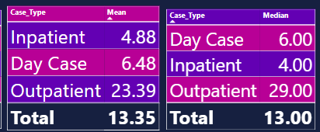
TABLE CHART OF THE MEAN AND MEDIAN

Slide 7
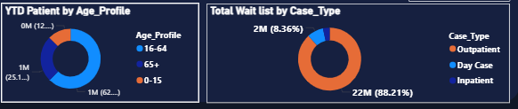
YTD PATIENT BY AGE_PROFILE & CASE_TYPE

