Slide 1
Concurrent C#
Synchronous vs. Asynchronous programming, Tasks, C# 4.5 features async and await

Slide 2
Table of Contents (1)
Current Synchronous Programming Problems
CPU-demanding tasks
Resource access
The "Free Lunch" Is Over
Clock Speed Limitations
Asynchronous Programming
Benefits
Difficulties

Slide 3
Table of Contents (2)
Parallel Processing and Concurrency in .NET
Threading
Tasks
Data Parallelism
Using the Tasks.Parallel Class and PLINQ
Task Parallelism
Task Overview
Creating and Running Tasks
Exceptions in Tasks
Using async and await with Tasks

Slide 4
Synchronous Programming

Slide 5
Synchronous Programming
Executing program components sequentially
i.e. "Sequential programming"
Actions happen one after another
Uses a single thread of a single process
Components wait for previous components to finish
Program resources are accessible at all points

Slide 6

Synchronous Programming Problems
If one component blocks, entire program blocks
UI may become unresponsive
No utilization of multi-core systems
CPU demanding tasks delay execution of all other tasks
Accessing resources blocks entire program
Especially problematic with web resources

Slide 7
Synchronous Programming Problems
Resource access problems
Resources may be large
While loading, UI blocks
Program stops responding
Resources may be web-based
Slow connections mean slow loading
Server may hang
While accessing, sync programs stop all other operations

Slide 8
Resource Access Problems
Live Demo

Slide 9
Synchronous Programming Problems
CPU-demanding tasks problems
CPU-demanding problems will freeze the program
Program stops responding
Some CPU-demanding tasks are many smaller, independent tasks
Sync programming must sequentially go through them

Slide 10
CPU-demanding Tasks Problems
Live Demo

Slide 11
The "Free Lunch" Is Over
Recent limitations in clock speed, transistors and moore's Law

Slide 12
"Free Lunch"
"Tomorrow's processors will have even more throughput"
"Today's applications are increasingly throttled by factors other than CPU throughput and memory speed"
In short, computational power is expected to grow
Code is expected to run better on new hardware
So, you can write code however you like (sequentially) and better hardware will run it better?

Slide 13


Slide 14
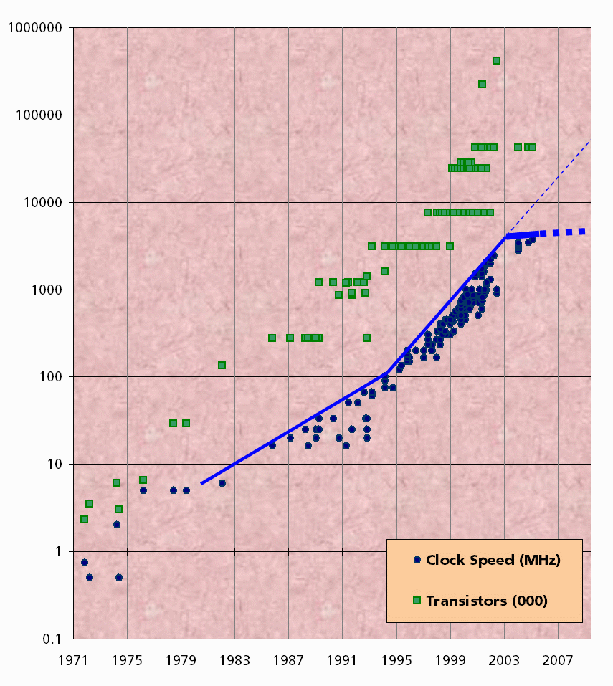
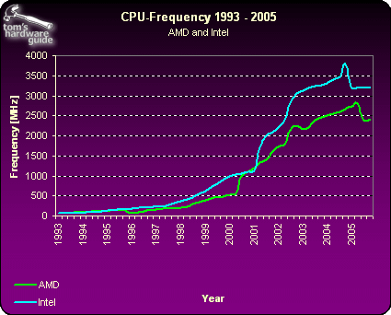
In case you haven't noticed…
Sources:
Tom's Hardware: The Mother of All CPU Charts 2005/2006
Herb Sutter: A Fundamental Turn Toward Concurrency in Software

Slide 15
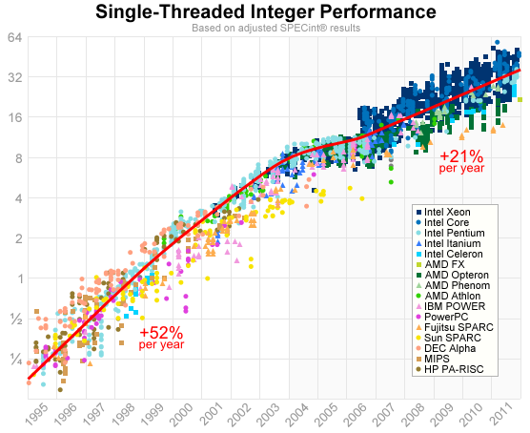
A more recent graph
SPEC metric
Y-axis is logarithmic
Compared to a reference machine
Source: A Look Back at Single-Threaded CPU Performance

Slide 16
Clock Speed Increase Rate Has Been Going Down
26x mainstream performance increase for 1996 – 2004
4.6x mainstream performance increase since 2004
We're slowing down
Even lower if you take out Intel CPUs
Reasons:
Higher clock speeds require much more power
Higher clock speeds produce much more heat

Slide 17
So new hardware is not improving software?
No, hardware is improving in new areas, software needs to adapt
Main areas of improvement in the past:
Clock speed
Execution optimization
Cache
Main improvement areas in new hardware
Hyperthreading
Multicore architecture
Cache

Slide 18
Asynchronous Programming
UTILizing new improvements in hardware

Slide 19
Asynchronous Programming
Program components can execute in parallel
Some actions run alongside other actions
Each action happens in a separate thread
Independent components don't wait for each other
Program resources shared between threads
If one thread uses a resources, others shouldn't use it

Slide 20
Asynchronous Programming Benefits
Benefits of Async Programming
If component blocks, other components still run
Until they need a resource from blocked component
UI runs separately
Always responsive
Utilization of multi-core systems
Each core executes one or several threads
CPU demanding tasks on "background" threads
Resource access runs on "background" threads

Slide 21
Asynchronous Programming Difficulties
Hard to imagine which code parts run at specific time
Hard to notify a "component" has executed
So far, callbacks were the way
Have to protect resources
One thread uses a resources
Other threads must wait for the resource
Hard to synchronize resource access
Deadlocks can occur

Slide 22
Parallel Processing and Concurrency in .NET
Broad View on the Concurrency APIs

Slide 23
Parallel Processing and Concurrency in .NET
The .NET framework has introduced several concurrency approaches over the years
Managed Threading
Asynchronous Programming Model (APM)
Event-based Asynchronous Pattern (EAP)
Task-based Asynchronous Pattern (TAP)

Slide 24
Parallel Processing an Concurrency in .NET
Managed Threading provides low-level thread operations
Some features still in use, but the approach is generally too low-level
APM and EAP are high-level APIs, but are now legacy
The recommended approach is TAP
TAP also integrates with new .NET language features

Slide 25
Task-based Asynchronous Programming
Asynchronous operations are represented through Tasks
A task is "work" that will be done in the future
The API manages treads
the programmer doesn't need to worry about Thread Pools and Thread management
The framework decides how to place Tasks on threads

Slide 26
Tasks
A Task has
Code to execute (passed in as a delegate)
A Result, when it finishes
A Status indicating its execution status
Exception property, containing an AggregateException
The Tasks library is called TPL (Task Parallel Library)
The Tasks namespace provides some built-in concurrent operations in Tasks.Parallel

Slide 27
Data Parallelism
Using the built-in concurrency from the TPL

Slide 28
Data Parallelism
Data Parallelism in the TPL refers to parallelization of loops
The Tasks.Parallel class supports several variations of
Asynchronous For loops
Asynchronous ForEach loops
Tasks.Parallel also provides the Invoke method
which executes a collection of Action<T> optimized for multi-core systems
i.e. compiler decides whether actions will be parallel

Slide 29
Simple Parallel For loop
static void MultiplyMatricesParallel(double[,] matA, double[,] matB, double[,] result)
{
int matACols = matA.GetLength(1);
int matBCols = matB.GetLength(1);
int matARows = matA.GetLength(0);
Parallel.For(0, matARows, i =>
{
for (int j = 0; j < matBCols; j++)
{
double temp = 0;
for (int k = 0; k < matACols; k++)
{
temp += matA[i, k] * matB[k, j];
}
result[i, j] = temp;
}
});
}

Slide 30
Simple Parallel ForEach loop
Parallel.ForEach(filesInDirectory, currentFile =>
{
string filename = System.IO.Path.GetFileName(currentFile);
// Warning: The Console will slow down our loop
Console.WriteLine("Processing {0} on thread {1}", filename,
Thread.CurrentThread.ManagedThreadId);
System.Drawing.Bitmap bitmap = new System.Drawing.Bitmap(currentFile);
bitmap.RotateFlip(System.Drawing.RotateFlipType.Rotate180FlipNone);
bitmap.Save(System.IO.Path.Combine(targetDirectoryPath, filename));
});

Slide 31
Local Variables for a Loop
Parallel.For<long>(0, nums.Length, () => 0, (j, loop, subtotal) =>
{
subtotal += nums[j];
return subtotal;`
},
(x) => Interlocked.Add(ref total, x)
);
<long> means the type of the local variable "subtotal'
Returning inside the lambda sets the third parameter for the next lambda (i.e. "subtotal")

Slide 32
Exception handling for Parallel Loops
Store exceptions from inside the lambda => aggregate exception
var exceptions = new ConcurrentQueue<Exception>();
Parallel.ForEach(data, dataItem =>
{
try
{
if (dataItem < 3)
throw new ArgumentException(String.Format("Element values must be > 3", dataItem));
else
Console.Write(dataItem + " ");
}
catch (Exception e) { exceptions.Enqueue(e); }
});
if (exceptions.Count > 0) throw new AggregateException(exceptions);

Slide 33
PLINQ
Parallel LINQ operations can be done, thanks to asynchronous looping
Parallel LINQ is an extension to LINQ to Objects
Not the same as LINQ to SQL
All you need to do is call AsParallel() on the collection
The compiler does the rest
There are some specifics in some operations, but that is beyond the scope of this lecture
int[] nums = new int[] { 1, 2, 3, 4, 5 };
var evenNumsParallel = from num in nums.AsParallel()
where num % 2 == 0
select num;

Slide 34
Task Parallelism
The .NET 4.0 Approach to Parallel Operations

Slide 35
Task Parallelism
As we mentioned, Tasks are high-level representation of work on Threads
A task does not always have its own thread (that is for the runtime to decide)
There are several fundamental Task operations
Creating and Running
Continuing a task (i.e. attaching a chain of operations)
Handling Exceptions
Progress Reporting (optional)

Slide 36
Creating and Running Tasks
Several methods to create a task
Task constructor
Task.Run factory method
Tasks.TaskFactory factory class
Various methods for task creation
Using Task constructor
Task is created, callback is defined
Task is not executed – user has to call Run() method
Useful for detailed construction of the Task

Slide 37
Creating and Running Tasks (2)
Using Task.Run() static factory method
Receives a delegate to execute
Returns a new Task
The Task begins execution
Has some customization parameters, but not much
TaskFactory approach
Allows a lot of Task customization
Scheduling, Grouping tasks, etc.

Slide 38
In most cases, Task.Run() will be enough
public static Task<List<int>> CalcPrimesAsync(int toNumber)
{
return Task.Run(
() => CalcPrimes(toNumber)
);
}

Slide 39
Creating Tasks with Task.Run()
Live Demo

Slide 40
Task Continuation and Returning Values
One way to get a value from a Task is to check the Result property
Warning: this is a blocking operation
Another way to transfer values is to use ContinueWith to call a method with the result
This does not guarantee ContinueWith will execute in the same context!

Slide 41
Async Programming with C#
Problems with callbacks
Code becomes hard to track
Exceptions are not propagated properly
Thread context is not saved
i.e. a callback defined in one thread is not guaranteed to work on same thread

Slide 42
Async Programming with C#
Thread context problem example:
UI thread attaches a callback to a calculation method
Callback should prints results in a ListView
Calculation method completes -> callback is run
But not on UI thread
The callback has no access to the UI thread's resources and we get a "wrong thread" exception

Slide 43
Tasks with async & await
The C# 5 approach to asynchronous programming

Slide 44
Tasks with async & await
Tasks + async & await = modern approach
Tasks can be "awaited"
Methods can be marked as asynchronous
async and await keywords
Make sense when used together
Enable "inline" multithreaded code
Remove callbacks from code ("flatten")
Code looks like normal sync code
Compiler generates appropriate callbacks

Slide 45
Tasks with async & await
async keyword – used on a method signature
Marks a method, which can be asynchronous
Doesn't make it asynchronous – you do, through an "await"
Wraps any returned result in a Task
i.e. method return value is Task (or void)
Means "this could wait for a resource or operation"
If it starts waiting, return to the calling method
When the wait is over, go back to called method

Slide 46
Tasks with async & await
await keyword
Used in a method which has async keyword
Saves the context in a state machine
Marks waiting for a resource
Resource should be a Task<T>
Returns T result from Task<T>, when it completes
Means await the completion of a task
While awaiting -> let the rest of the program run
Awaiting over -> continue executing the next statements in the method

Slide 47
Tasks with async & await
Live Demo

Slide 48
Questions?

