Slide 1
Agentic RAG over SEC 10-K filings
Venkatesh Giri
An agent that plans, asks when it needs to, and cites what it used
Python · LangGraph · FAISS + BM25 · DuckDB · Llama 3.3 70B
sec-filling-chat.streamlit.app

Slide 2
The problem
A STANDARD PIPELINE RUNS THE SAME STEPS EVERY TIME
WHAT THE BRIEF ASKED FOR
question
→
retrieve
→
generate
→
answer
■ Plans its own approach per question
■ Asks when the request is under-specified
■ Grounds every answer in the filings
■ Shows its work — the plan and the citations
■ Ask "what were the main revenue drivers?" and it answers from whichever filings the search happened to return.
■ If the wording misses the filing's language, there is no second try.
The hard part is not retrieval. It is knowing when to ask instead of when to answer.

Slide 3
Two subsystems
OFFLINE · RUNS ONCE
SEC EDGAR
→
parse Items
→
chunk
→
embed
→
FAISS · DuckDB · BM25
ONLINE · RUNS PER QUESTION
user
→
LangGraph agent loop
→
the three indices
■ Corpus: 5 companies × FY2024–2025. 10 filings, 1,292 chunks, 7 Item sections. Small enough to know exactly what is in it.
■ Why LangGraph: the loop needs cycles and saved state. Its interrupt and checkpointer are what let a question pause a run and pick it up later. Doing that by hand means writing state persistence by hand.
The built index is committed, so the whole thing runs with uv sync and one command — no ingestion, and no API key until you ask a question.

Slide 4
INGESTION
From filing to searchable chunk
fetch 10-K · edgartools
THREE DECISIONS THAT MATTERED
↓
■ Split on Items. A 10-K's Items — 1A Risk Factors, 7 MD&A — are already topic units, so a chunk rarely straddles two subjects.
■ Count tokens, not characters. 480 sits under the embedding model's 512 window, so nothing is quietly cut off at encode time. Character counting would fail without any error.
■ One `chunk_id` across all three stores, written in a single pass, so the vector, the row and the keyword entry always mean the same chunk.
split on Item boundaries
↓
chunk · 480 tokens / 64 overlap
↓
embed · bge-small-en-v1.5

Slide 5
RETRIEVAL
Filter, search, then judge
DuckDB filter
→
dense · top 20
→
sparse · top 20
→
union · 28 typical
→
cross-encoder
→
top 4 per sub-question
■ The filing is fixed first. The dense search is restricted to the matching chunks before it runs; the keyword arm scores and then filters. Either way nothing from the wrong company or year survives.
■ Dense finds meaning — "supplier risk" reaches "supplier concentration". Sparse finds exact strings — tickers, Item 1A, defined terms.
■ Both scores are then set aside. They only choose who becomes a candidate; the cross-encoder re-scores everything and is the only ranker.
Two arms of 20 could give 40, but across eight questions the union came to 28 — the arms agree on about 7, and BM25 returns only chunks that actually match a term (for "CEO's favourite colour" it returned none, and dense carried the search alone). Of the four passages finally kept, 3 in 4 were found by both arms. Mean reranker confidence in them is 41%, and it tracks what the agent does next: 85–92% on questions it answers straight away, near zero on the two it refines or refuses.

Slide 6
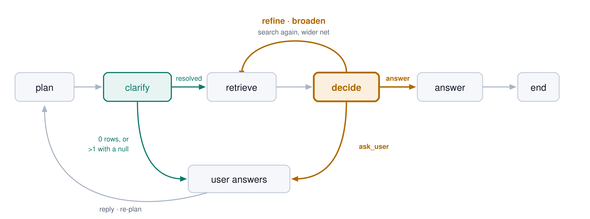
THE LOOP
Five nodes — and the four things decide can do
Two nodes make a choice — clarify with a catalog lookup, decide with the model; the other three are fixed steps. Both routers only translate a decision the node already made. A clear question visits 5 nodes; one that needs a clarification and a retry visits 9.

Slide 7
PLANNING & ASKING
The planner leaves a gap; the gate reads it
PLAN
GATE — ONE DUCKDB QUERY
■ Up to 4 sub-questions, each with its own text, company, fiscal_year.
■ One per target, so "compare Apple and Tesla" cannot collapse into a single blurred search.
■ Names are normalised to tickers — appl, apple inc → AAPL.
■ A missing company or year stays null on purpose. That null is the signal.
0 rows | Asks, listing the filings that do exist
>1 row | and a filter is null → asks which filing
1 row | Searches, says nothing
■ No model call — about 10 ms, and the same plan always gets the same decision.
■ At most one clarification per question; after that it searches with what it has.
Two sub-questions that each resolve to one filing is not ambiguity — it is a plan. Ambiguity here means under-specified, and it is a lookup rather than a judgement.

Slide 8
SELF-CORRECTION
Decide what to do next
THE MODEL PICKS ONE ACTION
THE CODE KEEPS IT HONEST
■ answer — the facts are there, or clearly absent
■ refine — right filing, wrong wording → reword
■ broaden — wrong company or year → fix the filter
■ ask_user — the person could still narrow it
■ The retry budget is checked before the model is called. Once it is spent, the next step is answer and the model has no say.
■ Nothing came back → broaden without asking. There is nothing to grade, and the filter is the only thing that could have excluded everything.
■ k grows 4 → 8 → 12 per sub-question on each attempt.
■ If the model returns something that does not parse, the node falls back to answering rather than failing.
Four fixed actions, validated by Pydantic, rather than open-ended tool use. It cannot do anything I did not plan for — but every path it can take is one I can list.

Slide 9
MEMORY
Five turns, and a button to forget
A TURN IS NOT A TRANSCRIPT
MEASURED ON THE PLANNER
"What were the main revenue drivers?" (AAPL/2024)
FOLLOW-UP | RESOLVES TO
"what about Microsoft?" | MSFT / 2024
"and 2025?" | AAPL / 2025
"NVIDIA legal, 2025" | NVDA / 2025
■ About 20 tokens, not 2,000. The planner only needs the company and year, not the prose.
■ Passed in by the UI, never accumulated by the graph, so each question is still reproducible on its own.
■ The third ignores history — a question that names its own company must not inherit the last one's.
The trade-off: after an Apple question, a vague follow-up gets answered instead of clarified — reasonable behaviour, but the gate stops firing. That is why Clear memory is a button. Clearing also drops a run that was paused on a question.

Slide 10
DEMO
Let me show you
"What were the main revenue drivers?"
No company, no year → the gate asks → I answer "Apple 2024" → one continuous trace
Worth watching in the reasoning panel: the plan it wrote, the gate's decision, any retry and the reason for it, and the chunk ids behind each claim.
"Compare Apple and Tesla risk factors in 2024"
Two sub-questions, two filtered searches, one grounded comparison

Slide 11
EVALUATION
Measured, not asserted
20/20
ROUTING CASES
0 / 10
NEEDLESSLY CLARIFIED
8/8
CITATIONS VALID
45/48
CLAIMS SUPPORTED
■ Routing. 20 labelled questions. Because the gate is a lookup, one run covers what the planner extracted and whether it asked at the right time — no labelled chunks, no judge, seconds to run.
■ Ten of the twenty are there to catch over-asking. An agent that asks a question every time would pass a simpler check and fail this one.
■ Grounding. Checking the cited chunk ids against what retrieval returned is free. Only faithfulness needs a judge.
■ It found a real problem. One Tesla answer scored 60% — it used key-personnel risk that was not in the passages, while every citation it gave was valid. A citation check alone would have passed it.
The harness runs the real nodes, so it cannot drift from the code. I also fed it deliberately wrong expectations by hand — inverted gate, wrong ticker, wrong sub-question count — and confirmed each one fails.

Slide 12
LATENCY
Where the two seconds go
STAGE | MEDIAN
plan · model | 284 ms
clarify gate · SQL | 10 ms
retrieve · local | 370 ms
decide · model | 293 ms
answer · model | 1,073 ms
end to end | ≈ 2.1 s
■ Each retry adds roughly 660 ms — one more search and one more decision.
■ The parts I control are about 380 ms and steady. The model calls move with provider load: the same answer call ranged 0.8 s to 13 s when the account was being throttled.
■ The reranker is the local bottleneck and runs on CPU, which is what would cap any parallel fan-out.
■ Model load is about 12 s once per process, cached by Streamlit — not per question.
Median of three single-filing questions on this laptop. A two-company comparison runs the search twice, so it lands higher — I would quote around 2 s typical and size any promise around the provider, since that is where the variance is.

Slide 13
Trade-offs
DECISION | WHY | WHAT IT COSTS
Gate is a catalog lookup | Free, fast, same answer every time | Catches a missing company or year, not vague wording
Four fixed actions | Every path can be listed and tested | Cannot handle a situation I did not plan for
Budgets in code, not the prompt | The loop cannot run away | Sometimes answers a little early
FAISS flat index | 1,292 chunks — exact search, 1.9 MB, nothing to tune | Brute force, and held in memory; needs HNSW at scale
One 70B model | The 8B echoed the schema back and repeated itself | No cheaper tier for the small calls
Memory capped at five turns | Enough for a chain of follow-ups; longer and old turns pull the planner off topic | Nothing survives a page refresh
No internet lookup | Every answer traces to a filing I control | Nothing after the filing date; no defined way to fetch or trust a live source
Assumes one 10-K per company per year, and that the Item split from edgartools is correct.

Slide 14
What I would build next
MAKE IT HOLD AT SCALE
MAKE IT KNOW MORE, AND KNOW IT BETTER
■ Swap the index. FAISS flat scans everything and lives in RAM. HNSW or IVF for the vectors, and a real inverted index for the keyword arm — BM25 currently scores all 1,292 chunks on every query.
■ Move the state out of process. PostgresSaver instead of MemorySaver, so a paused question survives a restart and works across replicas.
■ Cache. Plans and answers for repeated questions, and the embedding of a query I have already seen. Most of the cost is the model, not the search.
■ Reach outside the corpus. Fetch newer filings on demand, and let the agent search the web when the filings genuinely cannot answer — with the same rule as now: cite the source or say you could not find it.
■ Widen the eval. Recall against labelled chunks, and many more routing cases so the 20/20 is a trend rather than a single run.
■ A model per job. A small fast model for pulling out the ticker and year, the large one only where the decision is expensive.
■ Accumulate passages across retries — one field, and the single change most likely to improve answers today.
Thank you — happy to go deeper on any of it.

