Slide 1
Agentic RAG for SEC Filings
Venkatesh Giri

Slide 2
The Core Vulnerability of Standard RAG:
Standard vector DBs cannot reliably execute hard constraints (e.g., 'only 2023 filings').
Result: Vector drift. The model silently mixes temporal context across different years or corporate entities.
Our Architectural Solution:
Decouple strict metadata filtering from the semantic search engine.
Replace open-ended ReAct LLM loops with a deterministic state machine.
Enforce fail-fast SQL checks before executing expensive embedding calls.

Slide 3
Decoupled Storage & Hybrid Retrieval
DuckDB (In-Process SQL) -> The Catalog
Handles exact metadata filters and target validation in <5ms.
FAISS (Dense) + BM25 (Sparse) -> The Search
Dense catches semantic intent; Sparse catches exact tickers and section codes.
Why we reject RRF (Reciprocal Rank Fusion):
RRF relies on arbitrary rank math. Instead, we union candidate IDs to guarantee we never drop a perfect keyword match.
Cross-Encoder (Reranker) -> The Filter
Evaluates the hybrid union set jointly (query + passage) for highest precision before sending context to the LLM.
Reranks the hybrid union for better answer quality.
Compares the retrieved docs directly with the query.

Slide 4
Orchestration & Pydantic State Management
Why LangGraph over standard Chaining?
Financial workflows require full state visibility and explicit loop control. Routing is a validated enum, never free-form LLM output.
Strict State Typing with Pydantic:
The graph's state object is strongly typed via Pydantic.
Guarantees schema validation across node transitions, ensuring predictable data mutation.
Stateless Re-planning (no checkpointer):
A clarification re-enters the graph as a fresh run carrying the original question. Costs one extra small-model call, and removes thread state as a failure mode.

Slide 5
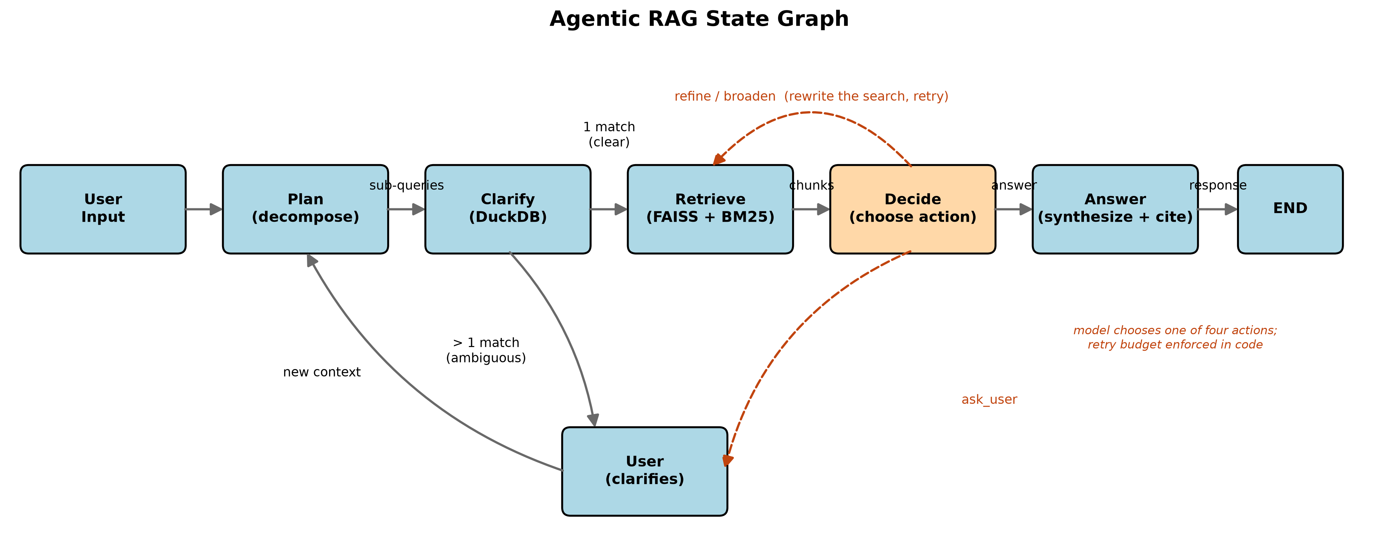
Agent Node Strategy & Execution Flow
Small LLM First Strategy:
The Planner uses a fast, low-parameter model purely for structured entity extraction (Company, Year).
Reserve Large Models:
Only the final Answer node uses an expensive reasoning model, minimizing token cost and latency.
Single-Responsibility Nodes:
Each node executes one explicit task. The Decide node picks the next action from a closed enum; the retry budget stays in Python.

Slide 6
Deterministic Guardrails: The Clarify Gate
Why SQL First? (Zero Hallucination Routing)
By executing SQL against DuckDB first, we filter the allowed candidate set before touching vectors.
Mathematically eliminates the LLM hallucinating data from the wrong company.
The 0, 1, >1 Rule:
0 Matches -> Halt execution. Target not in corpus.
1 Match -> Exact target resolved. Proceed silently.
> 1 Match -> Interrupt. Force user to clarify based on exact database options.

Slide 7
Stateless Design: Eliminating Attention Drift
The Danger of Long-Term Memory in RAG:
Passing full chat history back into the LLM inevitably causes 'attention drift'.
The LLM begins confusing constraints from 10 messages ago with the current query, destroying accuracy.
Solution: One turn based Chatbot.
Every single query is treated as a fresh, strict database lookup.
The User can have one turn to clarify the ambiguity, the agent will ask the question to clarify.
The 100th question in a session is mathematically guaranteed to be as precise and grounded as the 1st.

Slide 8
Explainability.
Reasoning:
The agent always has the reasoning so the user can understand the rationale behind the generated answer.
Citation:
Every single answer is backed by citations directly from the source.
Improves explainability of the answers.

Slide 9
Latency & Execution Controls
Target Latency SLA (~1.6s End-to-End):
Plan (Small LLM): ~200ms
Clarify Gate (DuckDB): <5ms (Fail-fast validation)
Hybrid Union + Cross-Encoder: ~150ms
Answer Synthesis: ~1.2s (Streaming)
Strict Retry Caps:
O(1) loop depth limit (max_iterations = 2). Graph explicitly prevents infinite execution.
Token Budget Management:
Cross-Encoder strictly caps LLM input context to <2,000 tokens.
Dynamic Search Depth: k expands on retries to prevent placebo loops.

Slide 10
Model Risk Management (MRM)
100% Traceability
The Pydantic state object records every SQL match, candidate score, and node transition.
Audit-Ready Logs
Execution traces can be piped directly to internal telemetry platforms for MRM compliance.
Deterministic Citations
Every generated claim is hard-bound to a specific chunk_id and SEC canonical source URL.

Slide 11
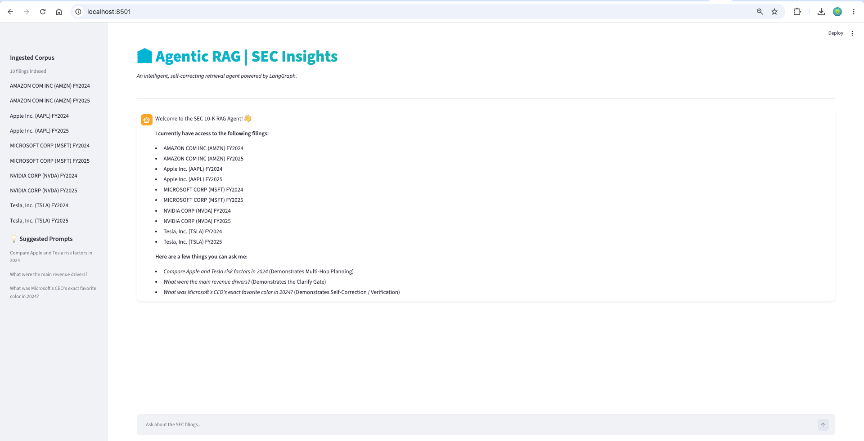
User Interface (UI)

Slide 12
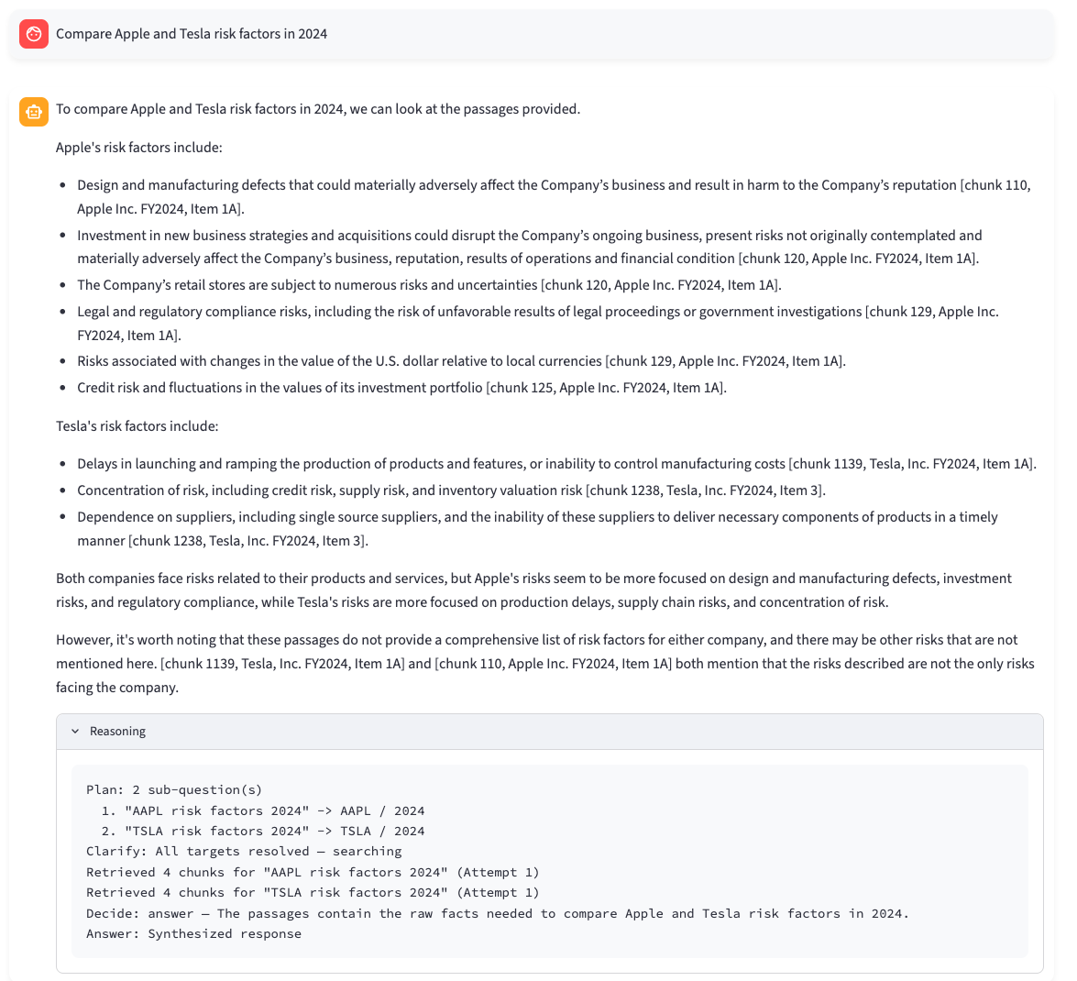
Examples of the Agents : 1. Multi planning with planner node

Slide 13
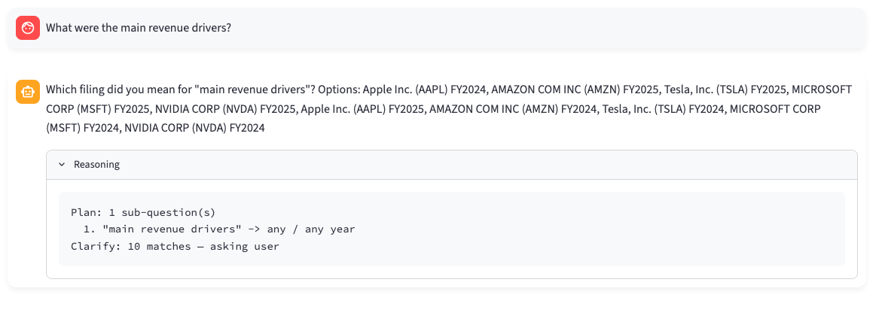
2. Clarify: Resolving Ambiguity with Clarify Node

Slide 14
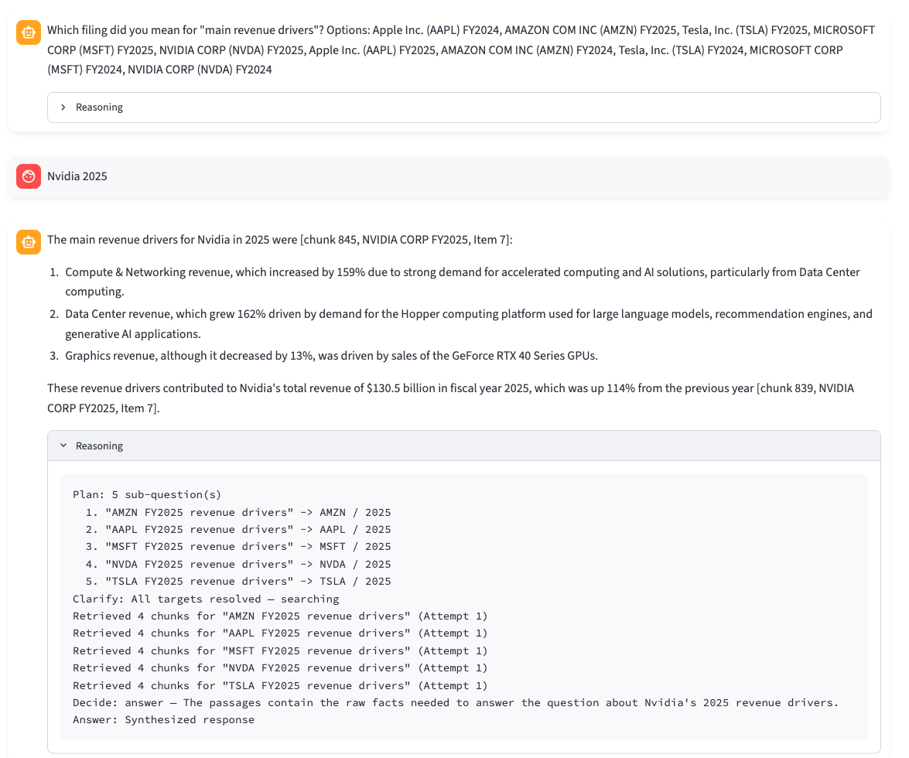
Clarify: Multi-turn

Slide 15
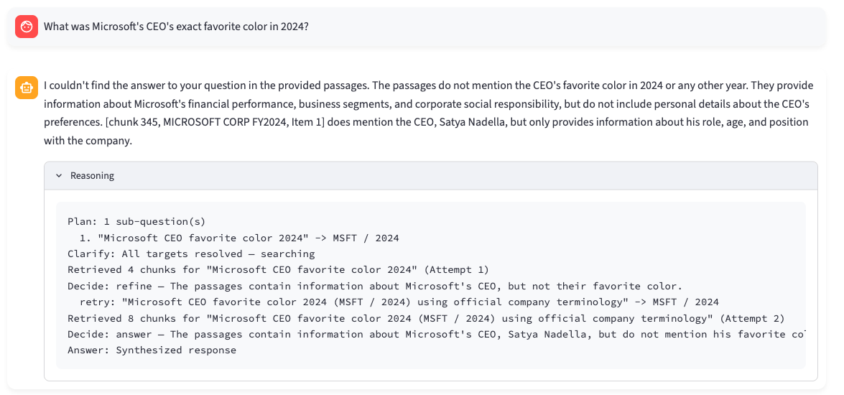
3. Dynamic Action Selection with Decide Node

