Slide 1
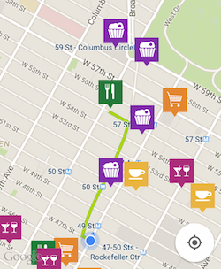




Slide 2

Master
KEY

Slide 3

vendy
PAIRING DEVICES
PAYMENT CONFIRMED!
select item on machine
collect item from machine
Select your items by pressing the buttons on the vending machine.
email receipt
$19.87

