Slide 1

Smartwatch Data Collection, Cleaning & Exploratory Data Analysis

Slide 2
Introduction
Smartwatches have changed the way we live and stay connected.
They combine style, fitness, and technology in one smart device.
With features like heart rate monitor, step counter, notifications, and voice control, they make daily life easier and healthier.
Popular brands like Boat, Noise, Fire-Boltt, and Apple offer a wide range of options for every user.
Today, smartwatches are not just gadgets — they are a lifestyle companion and a symbol of modern innovation.

Slide 3
Business Problem
Smartwatch data from e-commerce sites is unstructured and inconsistent, making it hard to compare products.
Prices, offers, and sizes are often missing or written in different formats, leading to confusion.
Businesses and customers lack insights into key factors like price trends and deal effectiveness.
There is a need to analyze smartwatch data to understand:
    Pricing trends and discount strategies
    Popular brands, sizes, and deal types
    The relationship between MRP, price, and offers

Slide 4
Objective
Perform data cleaning and Exploratory Data Analysis (EDA) to extract meaningful insights for business decisions.

Slide 5
Web Scraping Details
Website Used: Flipkart
Tools: Python, BeautifulSoup, Requests, Pandas
Process:
- Scraped smartwatch details like brand, model, MRP, price, offer, size, deal type, and display size.
- Cleaned and saved data as a CSV file for analysis.
Total Data: 400+ rows, 8+ features

Slide 6
Exploratory Data Analysis (EDA)
1.) Data Cleaning Steps
Removed commas and converted price and MRP to float
Standardized size names (free size, medium, large, etc.)
Converted mm → inch for display size
Categorized deals (Super Deal, Bank Offer, etc.)
Filled missing values with mean
Removed duplicates and corrected headers

Slide 7
2.) Data Manipulation Steps
Transformations Made:
Created a new feature discount_amount = MRP - price.
Added discount_category (Low, Medium, High, Very High) to group offers.
Classified products into price_category (Budget, Affordable, Mid-range, Premium, Luxury).
Converted display sizes from mm → inches for consistency.
Filtered and focused on top 10 popular brands for analysis.
Outcome:
Enhanced dataset with meaningful derived features to reveal deeper insights.

Slide 8
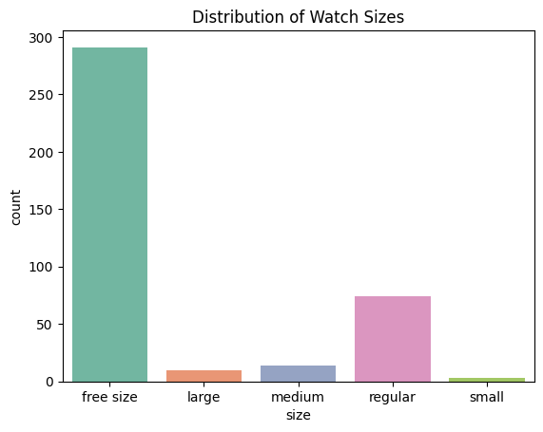
3.) Univariate Analysis
Free Size is the most common among all smartwatches, showing that most brands prefer a universal design that fits all wrist types.
Regular Size follows next, indicating moderate demand for standard-sized models.
Large, Medium, and Small sizes are less frequent, suggesting limited customization based on wrist size.
The dominance of Free Size reflects a clear market preference for flexibility and convenience, reducing the need for size-specific variants.

Slide 9
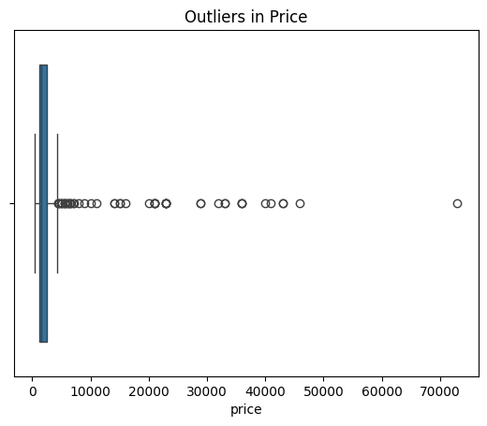
Most smartwatch prices fall within a moderate range (e.g., ₹1,000 – ₹10,000).
A few extreme values (outliers) represent premium models priced much higher.
The presence of many outliers shows that the market has both budget-friendly and luxury options.
The spread of prices suggests high price variation across brands and models.

Slide 10
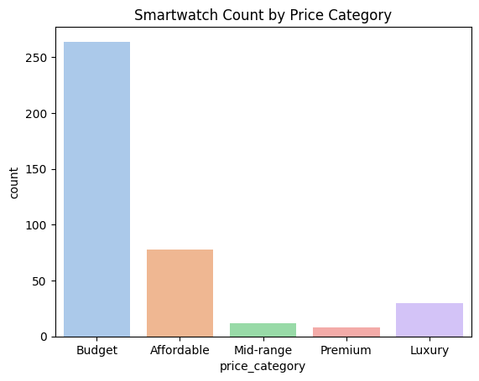
The budget category has the highest number of smartwatches, showing that most products are affordable.
The mid-range category has a decent number of options, catering to balanced buyers.
The premium category has the fewest products, indicating limited availability or niche targeting.
The smartwatch market is dominated by budget-friendly models, suggesting strong demand among cost-conscious consumers.
Brands like boAt, Noise, and Fire-Boltt focus mainly on these affordable categories, while premium brands like Apple and Samsung occupy the higher-end segment.
This reflects a mass-market strategy for Indian brands and a value-based strategy for global ones.

Slide 11
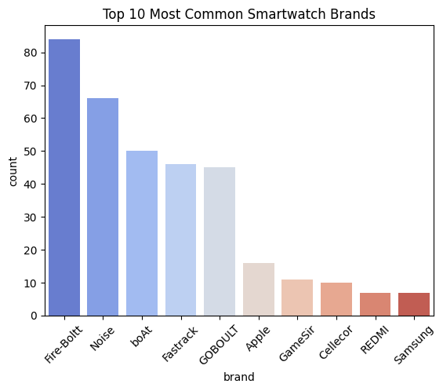
The top smartwatch brands based on listings are Fire-Boltt, Noise and boAt, indicating these brands dominate the online market.
These brands offer a wide variety of models across price ranges, targeting budget-conscious customers and maximizing visibility.
Premium brands such as Apple, Samsung, and Huawei appear less frequently but cater to the high-end segment with advanced features and higher prices.

Slide 12
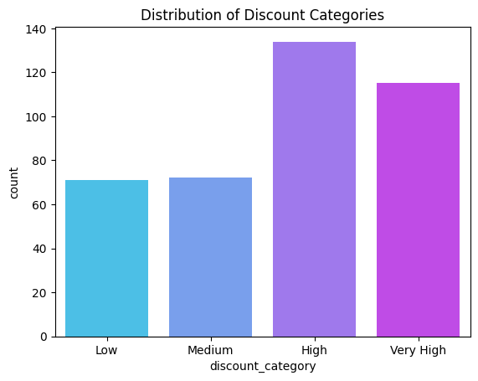
The “High Discount” category dominates the dataset, showing that most smartwatch listings rely on heavy discounts to attract customers.
The “Very High Discount” category ranks next, meaning several brands use extreme markdowns to boost visibility and sales.
Medium and Low Discount categories are comparatively smaller, indicating fewer premium or fixed-price products.
The smartwatch market operates in a discount-driven environment, where competitive pricing plays a major role in sales performance.
Most sellers target budget-conscious consumers, and large discounts are used as a key marketing strategy to increase conversions and outperform competitors.

Slide 13
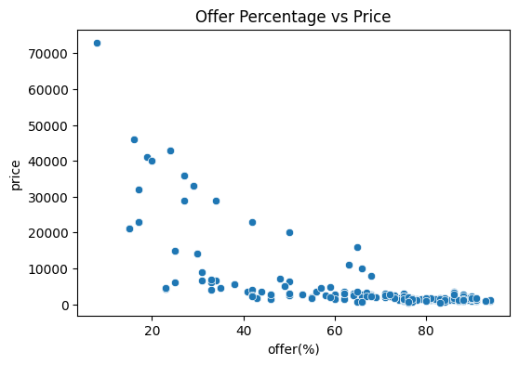
4.) Bi-Variate Analysis
The scatter plot shows a negative correlation between offer percentage and price.
Higher discounts are usually applied to low- to mid-range smartwatches, while premium models have smaller or no discounts.
A few outlier points suggest some high-end watches with heavy promotional offers — likely limited-time deals.
E-commerce platforms use high discounts mainly to boost sales of affordable smartwatch models, appealing to price-sensitive customers.
Premium brands (like Apple and Samsung) rely more on brand value than discounts, indicating a segmented pricing strategy in the smartwatch market.

Slide 14
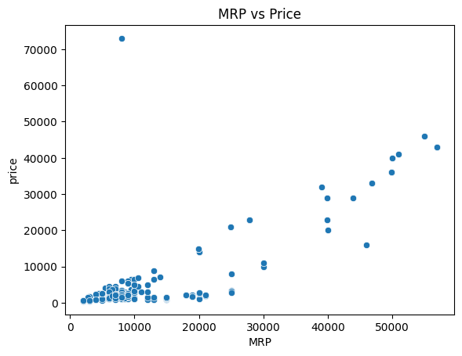
The scatterplot between MRP and Price shows a clear positive correlation — as the MRP increases, the selling price also rises proportionally. However, the gap between MRP and actual price widens for higher-priced watches, suggesting heavier discounts on premium products. This indicates that brands often use significant markdowns to make high-end models more attractive to buyers while maintaining perceived premium value.

Slide 15
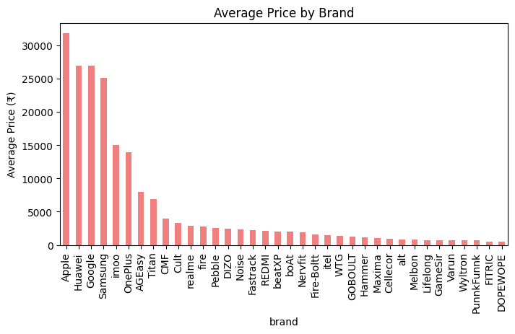
Apple and Samsung lead in average price, reflecting premium quality.
Noise, boAt, and Fire-Boltt dominate affordable smartwatch sales.
The price gap shows clear separation between luxury and budget brands.
Indian brands attract buyers through aggressive discounts and low pricing.
Premium brands rely on brand reputation rather than heavy discounts.

Slide 16
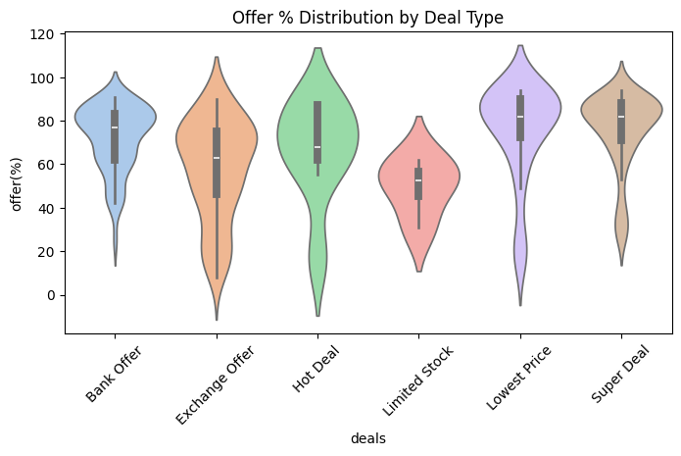
Super Deal and Bank Offer are the most aggressive discount strategies, attracting customers with large reductions.
Exchange and Hot Deals are moderate, aimed at promotions rather than full discount.
Limited Stock / Lowest Price / Other focus on urgency or market competitiveness rather than high discount.
Overall, the plot visually confirms that the smartwatch market relies heavily on discount-based promotions, especially for popular deals.

Slide 17
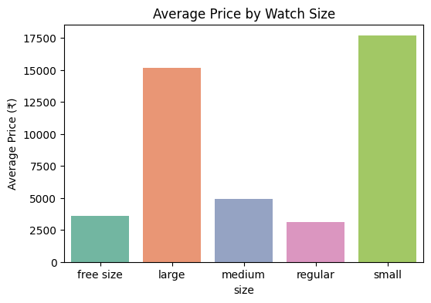
Regular watches have the lowest average price.
Free Size watches are slightly higher than Regular.
Medium watches come next in average price.
Large watches have higher average prices than Medium.
Small watches have the highest average price among all sizes.
Overall, price generally increases from Regular → Free → Medium → Large → Small, reflecting pricing strategy based on size and demand.

Slide 18
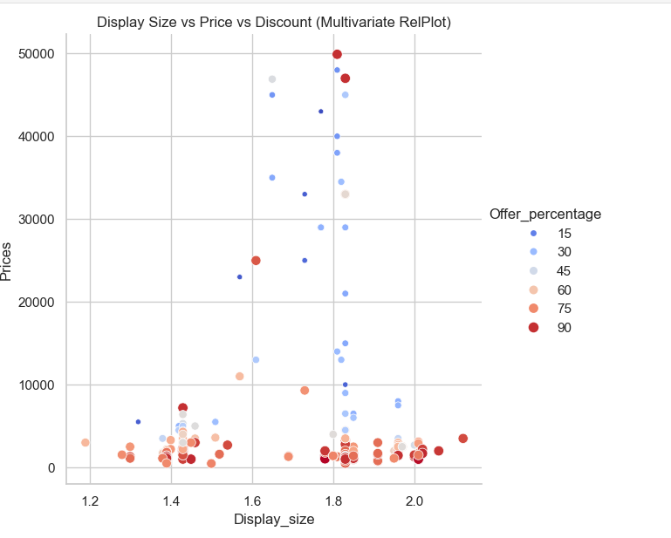
Multi-Variate Analysis
Price does not show a strong relationship with display size.
High offer percentages are mostly given on lower-priced watches.
Premium smartwatches have smaller or no discounts.
Display size has minimal impact on pricing or offer percentage.

Slide 19
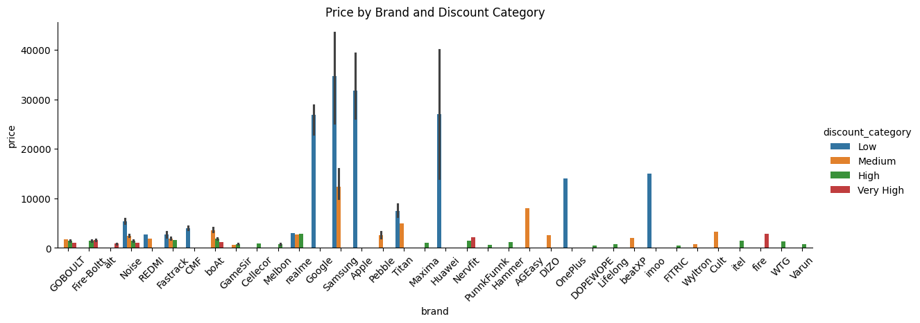
High-priced brands: Apple, Samsung, and Google have higher prices, mostly in the "Low" discount category.
Discount pattern: Most brands have prices concentrated in the "Low" discount category.-
Price range: Prices vary widely, with some brands like Apple and Samsung reaching up to ₹40,000.-
Brand pricing strategy: Premium brands like Apple and Samsung have higher prices with less discount, while others offer more discounts across categories.

Slide 20
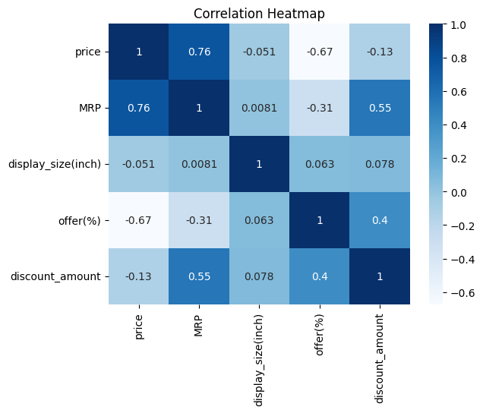
Price increases when MRP increases.
More discount % → lower selling price.
Higher MRP → bigger discount amount.
Offer % and discount amount move together.
Display size doesn’t affect price or offers.
Pricing mainly depends on MRP and discounts.

Slide 21
Key Business Questions
Which brands lead the smartwatch market?
How do discounts and deals affect prices?
Which price category sells the most?
What is the link between MRP, price, and offer %?
Which watch size is most preferred?
How do brands use discounts to attract buyers?
What factors drive smartwatch pricing trends?

Slide 22
Conclusion
Market dominated by Noise, Fire-Boltt, and boAt.
Most products fall in High/Very High discount range.
Super Deal and Bank Offer give top promotions.
Free Size watches are most common and preferred.
Premium brands keep high prices, fewer discounts.
MRP and Price show strong positive correlation.
The market is discount-driven and price-sensitive.

Slide 23
Experience
Learned full data analysis workflow (scraping → cleaning → EDA).
Used Python, Pandas, BeautifulSoup, Seaborn for insights.
Improved data cleaning and visualization skills.
Understood real-world pricing and discount patterns.
Gained confidence in presenting analytical results.

Slide 24
Challenges
Faced missing, duplicate, and inconsistent data.
Cleaned price formats and deal names.
Standardized size and display values.
Managed complex data transformations.
Designed clear visuals to show insights effectively.

Slide 25

THANK YOU

