Slide 1
Distributional Semantic Models Part 2
M. Antònia Martí and Venelin Kovatchev
Contact: vkovatchev@ub.edu

Slide 2
Outline
DSM vectors: The best setup
Compositionality
Limits and challenges
Polysemy
Compositionality
Non-compositionality
From similarity to dissimilarity
Universal vs task oriented representations

Slide 3
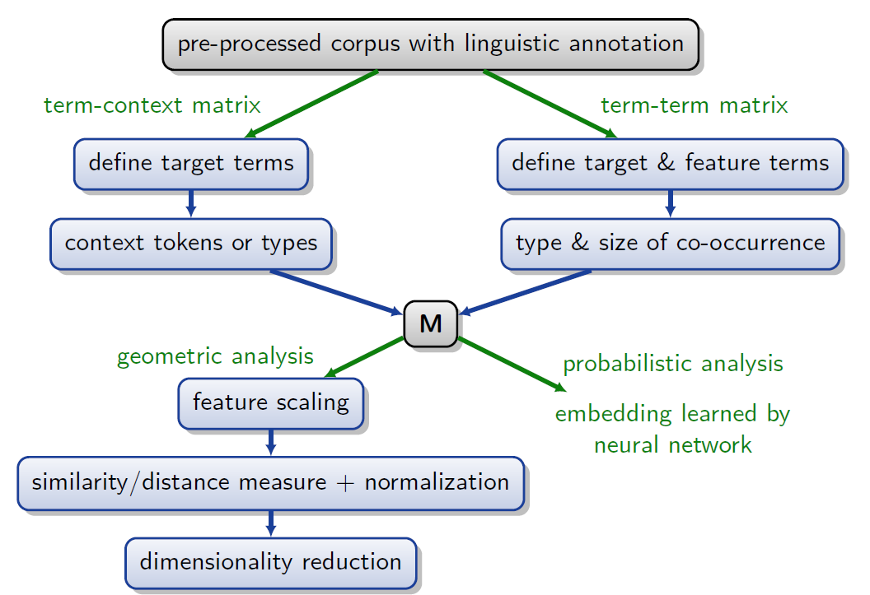
Building a distributional Semantic Model

Slide 4
Parameter selection for Co-occ DSM The “best” co-occurrence DSM
No model works perfectly for every situation
Lapesa and Evert (2014)
Tasks: toefl multiple-choice; Correlation to similarity ratings; noun clustering
Parameters: Corpus; window; feature selection (top dimensions); feature scoring; transformation; dimensionality reduction; skipped dimensions
537,600 different setups
The best setup for each task is different
it is possible to obtain a setup that performs relatively well on all of the tasks
Window 4; 50,00 orig dimensions; sumple-ll; log transform; 500 svd; skip 50

Slide 5
Word embeddings. Models, setups. “the Best” embeddings
Once again – there is no perfect, multi-purpose embeddings
Task-specific (or non-English) embeddings
General purpose word embeddings
google news word2vec
Wikipedia and gigaword glove vectors
More data – better embeddings
Parameter selection (Especially window size) is crucial for the task at hand

Slide 6
Compositionality From words to phrases and sentences
“The meaning of a complex expression is determined by the meanings of its constituent expressions and the rules used to combine them”
Can we obtain a numeric (vector) representation of a phrase or a sentence?
How to obtain a phrase or a sentence representation from the representations of the words they contain?
How to scale above phrases and sentences and represent paragraphs and documents?
Bag of vectors (the non-compositional approach).

Slide 7
Mathematical compositionality
The first approaches to compositionality in DSM use simple mathematical operations
Vector addition
Phrase/sentence centroid
Pointwise multiplication
Both addition and multiplication can be weighted with weights either pre-set or learned from corpora
still often used as a rough estimation (or a baseline) of phrase or sentence meaning

Slide 8
Linguistically conditioned compositionality
Combine the vector representations with some sort of text structure
Syntactic structure
Semantic structure
Baroni and Zamparelli: “Nouns are vectors, Adjectives are matrices”
Learn the matrices by comparing the vector of a noun and the vectors of phrases
Richard Socher: represent each word as a vector and a matrix
Expand the Noun/Adjective paradigm and assign matrix to every word

Slide 9
Deep learning Approaches
Encode the whole sentence in a ML algorithm
Maite’s classes
Depends on the architecture and the task at hand
Learn representations for every task (backpropagating)
Non-transparent compositional rules
Data dependent
Very efficient for certain tasks

Slide 10
Limits and challenges in front of DSM
Polysemy
Determine the number of senses a word has in the corpus
Obtain a separate vector for each sense
Identify the correct sense being used
metaphors
Compositionality
Non-compositionality
idioms
Non-compositional sequences (“Fish tank”, “thrash can”, “Eye doctor”)

Slide 11
From similarity to dissimilarity
What kind of similarity is being caught by DSM
A single geometrical measure (cosine, Euclidean)
A complex, task-specific learned measure
What kind of similarity exists in the language (ex):
Similarity vs relatedness: (car, bus) vs (car, road)
Similarity vs dissimilarity: (love, like) vs (love, hate)
Entailment (directional): (dog, animal) vs (human, boy)
All semantic relations are mapped onto the same geometrical similarity measures

Slide 12
Distinguishing similarity
Modify the DSM
Parameter selection
Filtering
Learn specific embeddings, focused on certain (linguistic) similarity
Use different (complex, trained) for every different relation
Training data (With labels)

Slide 13
Universal vs task oriented
More often than not, DSM models are built to solve a specific task
They are not reusable in their entirety (some parts can be re-used)
Computationally heavy
Cognitively implausible
Universal models exist, but they perform worse than task specific ones
Your model is as good as your data
Raw source corpus
Tagged task data

Slide 14
The future of dSM?
The best performing (Computational) semantic framework up to date
The most popular state-of-the-art approach
Still far from perfect both in theoretical and in practical terms
A Promising framework
Under constant development
But…
we should keep our minds open for other ideas as well

