Slide 1
NLP in practice Defining the task Designing real applications
M. Antònia Martí and Venelin Kovatchev
Contact: vkovatchev@ub.edu

Slide 2
Outline
Solving problems using NLP
The available toolbox
Three approaches to solving problems using NLP
Autor profiling
Community question answering
DISCOVER

Slide 3
Solving problems using NLP
Use a combination of NLP tools and heuristics to solve a (practical) problem
Reduce “universal NLP” functionalities to the task at hand
Define the problem to solve
From a business/user-case perspective
Formally
Obtain data relevant to the task
Build and evaluate a system

Slide 4
The available toolbox Working with raw corpora
How to obtain and read a corpus
How to clean a corpus (encoding, tags, unnecessary data) – regex
How to tokenize a corpus
How to obtain raw corpus stats: tokens, types, frequencies, n-grams, simple co-occurrence
Raw co-occurrence matrices
Word embeddings over raw corpus

Slide 5
The available toolbox Processed corpora
Understand and use structured corpora:
Sentence segmented, pos tagged, chunked, syntactically parsed
Apply standard linguistic processing
POS tagging, Chunking, Syntax parsing
Re-organize corpus in processed matrices
Filter elements
Work with DSM representations

Slide 6
Three approaches to solving problems using NLP
The meta topic: Bridging NLP and machine learning
Handcrafted features
Define and extract a (custom) feature vector from text
Feed the vector to a (simple) ML algorithm
Vector representations + external features
Represent the text as a vector in the input layer of a neural network
Enrich with skip-arks that include pairwise features
Manually engineered system
Use linguistic knowledge to manually engineer a more complex multi-step system

Slide 7
Autor profiling
The task: distinguish between classes of authors
Gender, age, native language, personality type
Of interest for Forensic, security, marketing
Formally: classify a given text into a number of different classes
PAN 2013 competition (Rangel et al, 2013)
English and Spanish
Two factors: Gender and Age (13-17, 23-27, 33-47)
Labeled data from blogs
Text and two labels – gender and age group

Slide 8
Overview of the task results
All of the approaches used supervised machine learning methods
Most frequently used: Decision trees, SVM, logistic regression
Most of the approaches used hand-crafted heuristic features
Frequency of specific elements: punctuation, capital letters, emoticons,
Content features: dictionaries, named entities, sentiment words, emotion words
Corpus processing
Cleaning of tags
POS tagging

Slide 9
Best performing system on English
Meina et al, 2013: #1 on English, #12 on Spanish
Preprocessing
Cleaning (tags unreadable data) and tokenizing using Regex
Sentence segmentation
311 features for English, 476 FEATURES FOR SPANISH
Various ML algorithms
The best performing one: random forest

Slide 10
Meina et al, 2013 Feature engineering
Structural features:
number of paragraphs, sentences, words, special chars; Usage of hyperlinks, images;
Part of speech features:
(relative) Frequency of the different parts of speech
Sequences of part of speech:
vector of features based on the probabilities of every POS n-gram in every class
Text difficulty and readability
pre-existing systems based on number of sentences, words, syllables and difficult words

Slide 11
Meina et al, 2013 Feature Engineering (part 2)
Dictionary based features:
emotion words, connective words, persuasive words
Number of error and language mistakes
Topic features:
Pre-existing systems based on LSA (co-occurrence) techniques
Natural language N-Gram model
Estimate the top n-grams for each group;
Merge the results and compute MI to measure how informative every n-gram is

Slide 12
Pipeline of the approach
Obtain the corpus (given in the competition)
Clean and process the corpus (tokenization, sentence segmentation, pos tagging)
Formalize the text as a set of features
Count based; frequency based;
External resources: dictionaries; complete systems;
Feed the feature vector in a classifier, train and evaluate

Slide 13
Community question-answering
The task:
in a community forum, determine which answers are relevant to the initial question
Formally:
given a question and a number of answers, rank the answers with respect to their relevance to the question
SemEval (2016) competition

Slide 14
Guzman, Marques, Nakov (2016)
Re-use an architecture used for machine translation evaluation
compare every 2 answers with the question, using a neural network
Second evaluation using a classification method based on question and an answer
Rank the answers based on their pairwise comparison
Use two different kinds of features
Different Embeddings
Pairwise MTE measures

Slide 15
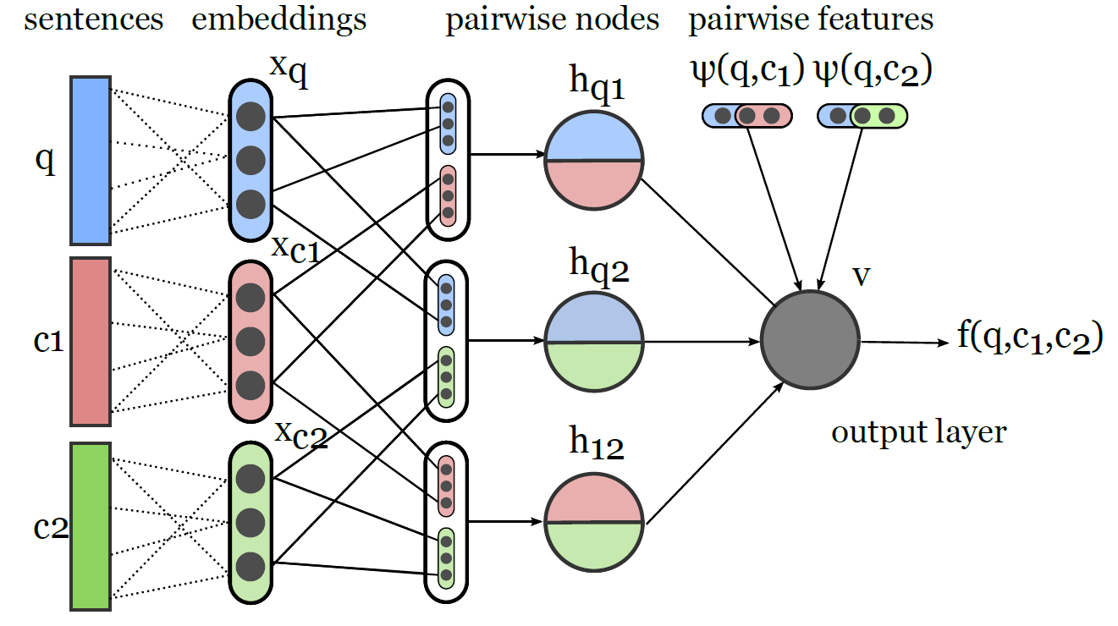
Architecture of the network

Slide 16
Feature selection
The question and each answer are mapped to vectors
300 dimensional pre-trained word2vec embeddings (average of all words in the sent)
25 dimensional vector from socher (Stanford parser)
The skip arcs include pairwise similarity feature vectors
MTE evaluation scores: BLEU, NIST, TER, METEOr
Task specific features
Manually trained embeddings (on the same corpus)
Heuristic features: number of tokens, sentences; type/token ratio; number of nouns, adjectives, adverbs, pronouns; number of positive/negative smileys; number of urls, etc…

Slide 17
System pipeline
Obtain the corpus (given in the competition)
Clean and Process the corpus (tokenization, pos tagging, syntactic parsing)
Formalize the text as set of features
Vector representations
Hand-crafted features
Obtain pairwise features for pairs of relevant texts
Pre-built MTE measures
Train and evaluate the system

Slide 18
Pattern recognition and generalization
direct evidence based approaches in NLP
Describe and analyze observed data
identify relevant patterns, which contain valuable (useful) information
Predict the probability of (re)occurrence of patterns
Generalization and unseen evens in NLP
Obtain information that is not directly observed
Update the probabilities based on generalization over the observed data
Predict non-observed patterns
Set unknown probability to 0 or to a specific equal mass
Try to generalize from observed data

Slide 19
Discover: Hypothesis and methodology
Methodology for automatic identification of lexico-syntactic constructions
Pattern-construction hypothesis: “those contexts that are relevant to the definition of a cluster of semantically related words tend to be (part of) lexico-syntactic constructions”
Example
“travel with a car”, “travel with a bus”, “travel with a truck”
Cluster [“car”, “bus”, “truck”]
“travel with a” -> part of a construction (can be combined with the cluster [“car”, “bus”, “truck”]
“refuel a car”, “refuel a bus” -> “refuel a” – part of a construction
“refuel a” + [“car”, “bus”, “truck”] -> generate from the cluster unseen construction “refuel a truck”

Slide 20
Discover pipeline
Corpus processing
Text cleaning (tags, unreadable words)
POS tagging
syntactic parsing
DSM matrix (word-context; context = syntactic relation + word)
Clustering
Linking of clusters
Pattern generation

Slide 21
Conclusions and overview of the course
During the course you have been familiarized with
Basic linguistic notions and problems
Standard data formats and structures in computational linguistics
Standard linguistic processing of the data
Problems, ambiguities and limitations on language processing
Some basic and some end-to-end applications of NLP
Basics of Using language with machine learning
Questions, comments, recommendations ☺

