Slide 1
Python for Linguists
Python basics: Data types, Variables
Venelin Kovatchev
Language and computation center
University of Barcelona

Slide 2

Getting to know Python
Created in 1991
Available for Windows, Mac, Linux...
The current version of Python is Python 3
You can still find programs and libraries created with Python 2, but Python 2 is no longer supported

Slide 3
Installing Python
Python should be pre-installed on all computers in the auditory
If you want to install python, I recommend using Anaconda
For the purpose of this course, we will need the following packages:
matplotlib, collections, csv, nltk, pandas
numpy, scipy, scikit-learn, genism, spacy
nltk.data

Slide 4
Running Python
There are various ways to run python
If you have a program, you can run it with: python3 myprogram.py
You can start python as an interpreter and run commands: python3
Jupyter Notebook: an application that allows you to create “notebooks”, a special file consisting of cells, which are containers of code.
You can run each container separately and get its results.
User-friendly and good for experiments, exploratory analysis, teaching.
Popular for researchers.
We’ll mainly use notebooks for the course

Slide 5
Algorithms and Data Part I: Data

Slide 6
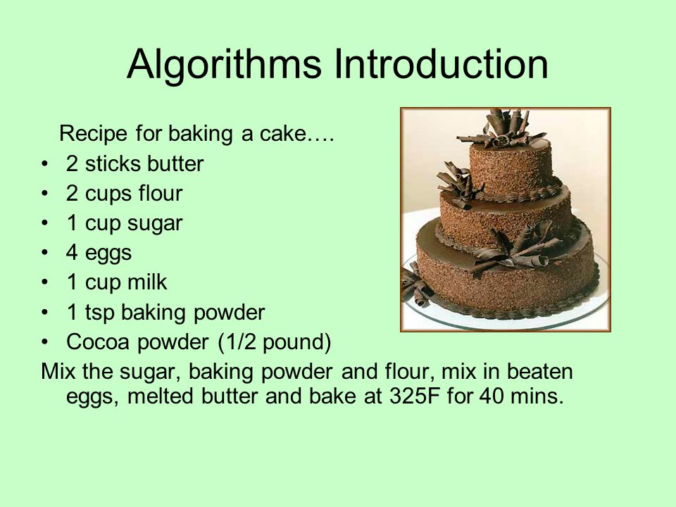
Computing = Data + Algorithms
DATA (output)
DATA (input)
ALGORITHM

Slide 7
Data and Data Types
The data are the ``ingredients’’ of our cake program
There are different ``types’’ of data in python
Each data type has specific characteristics and operations
Often the data types correspond to real world ``types’’ which makes it easier to understand and process

Slide 8
Numeric Data Types
Numeric data types are essential for any programming
In python we distinguish between two numeric data types:
Integer: 1, 2, 3, 4, … 100, … 1337, …
Float: 3.1415, 66.667, 91.5, …
The two types are very similar in their properties
Why make the distinction between the two? It’s related to the way computers store and process numbers

Slide 9
Operating with Numeric Data
The operations for numeric data are what you would expect in a math class:
Addition / Sum ( + ) : 2 + 3 = 5
Subtraction ( – ) : 3 – 2 = 1
Multiplication ( * ) : 2 * 3 = 3 * 2 = 6
(True) Division ( / ) : 5 / 2 = 2.5
(Integer) Division ( // ) : 5 // 2 = 2
Power ( ** ) : 5 ** 2 = 25

Slide 10
Boolean Data Type
Boolean Data Type includes only 2 values: TRUE and FALSE
Other data types can have infinite values (e.g.: infinite numbers)
Why do we need the Boolean type?
Historical reasons: computers operate in a binary manner; philosophy works with truth
Evaluating truth conditions (e.g.: ``is your soon-to-be-friend at home when you call?’’)
Efficiency of computation and code-writing
There are programming languages that work without explicit Boolean types

Slide 11
Operating with Boolean Types
If you have taken courses in formal logic you probably know some operations:
Logical AND
Logical OR
Logical NOT
There are many other more complex operators that we will see later in the course

Slide 12
Text Types (String)
One of the most important types for this course: the ``string’’ type
In linguistics, we can distinguish between characters, words, phrases, sentences
In Python, we work with ``strings’’
A string is a sequence of characters enclosed by quotes:
“s” – a single character string; ‘string’ – a word string; “a string” – a phrase string;
‘This is a string in single quotes!’ – a sentence string;
“And this is another string. It is enclosed by double quotes.” – multiple sentences string;

Slide 13
Operations with string types
The two basic operations with strings are concatenation and slicing:
Concatenation combines two strings into one:
“a ” and “string” can be combined into “a string”
Note the empty space at the end of the first string. “A” and “string” would give “Astring”
Slicing is an operation that returns a part of a string:
Using slicing you can take “a string” and extract any sequence of characters, for example: “a”, “ “, “str”, or “string”

Slide 14
List type
Another data type that is very popular for language processing is the ``list’’ type
A list is a collection of OTHER data types, surrounded by brackets [] and separated by a comma:
A list of integers: [1, 2, 3, 4, 5]
A list of strings: [“some”, “words”, “in”, “a”, “list”]
A list of integers AND strings: [6, “words”, “and”, 2, “numbers”, “in”, “a”, “list”]
The typical operations for lists are concatenation and slicing (like strings)

Slide 15
Algorithms and Data Part II: Algorithms

Slide 16
Computing = Data + Algorithms
DATA (output)
DATA (input)
ALGORITHM

Slide 17
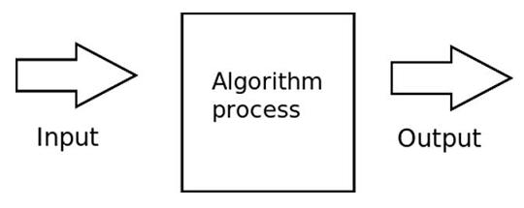
Algorithms: Transforming the data
At a very simplified level, algorithm receives some data (input), process it in a specific way and returns different data (output)
In the cooking example, the ``cooking’’ algorithm receives raw products as input and returns a cake as output

Slide 18
Intermediate steps in algorithms
The ``transformation’’ from input to output can include intermediate steps
“Mix the sugar, baking powder and flour”
“Mix in beaten eggs”
“Melt the butter”
“Mix in melted butter”
“Bake at 325F for 40 mins”
Intermediate steps have intermediate ``inputs’’ and ``outputs’’ which can be different from the global ones. We use variables to keep track of those.

Slide 19
Defining and using Variables

Slide 20
What are Variables
“Variables are used to store information to be referenced and manipulated in a computer program.”
“Variables provide a way of labeling data with a descriptive name, so our programs can be understood more clearly by the reader and ourselves.”
“It is helpful to think of variables as containers that hold information. Their sole purpose is to label and store data in memory. This data can then be used throughout your program.”

Slide 21
A Cake analogy for variables
A ``variable’’ is the cookware where you mix all your products
At the beginning of the programming (cooking) it’s empty
After step 1, it contains `` the sugar, baking powder and flour’’
After step 2: ``sugar, baking powder, flour, and beaten eggs’’
After step 4: ``sugar, baking powder, flour, beaten eggs, and butter’’
At the end of the programming (cooking) it contains a cake

Slide 22
Defining a variable in Python
Defining a variable in Python has a very simple syntax: variable = value
Defining a string: sentence = “This is a string.”
Defining a Boolean: beer = True
Defining an integer: sentence_length = 17
Values can be defined as an expression. That is, as the ``output’’ of an action:
pi_number = 3.0 + 0.1 + 0.04

Slide 23
Assigning names to variables
Variable names must follow specific conventions, otherwise we get errors:
UPPERCASE (A-Z) and lowercase (a-z) letters are allowed
Numbers (0-9) are allowed, except as the first character of the variable name
Special characters are NOT allowed, with the exception of underscore (_)
Some words are reserved for python specific commands
The good practice is to use names that make sense. For example if you are counting something, you can name your variable ``count’’.

Slide 24
Using variables and data types
In the first practice for the course, we will go through some examples on variables and data types and we will use some of the basic operations
We will make use of a few pre-defined functions in python:
print() – prints a specific value or the value of a variable
len() – counts the number of characters in a string or the number of elements in a list
We will learn more about functions in the next class

Slide 25
Thank you! Questions?

