Slide 1
Python for Linguists Reading and Writing Files CSV and XML
Venelin Kovatchev
Language and computation center
University of Barcelona

Slide 2
What we know so far
Reading data from files (with open… as f: )
Processing files line by line using lists and strings
Writing data to files line by line

Slide 3
Working with More Complex files
Working with text files is often better than working with variables
Sometimes we need to work with more complex types of files
Starting with this class we will learn how to use different “tools” in Python

Slide 4
Reading and writing text files
with open(‘macbeth.txt’, ‘r’, encoding=’utf-8’) as f:
with open(‘copy.txt’, ‘w’, encoding=’utf-8’) as g:
for line in f:
print(line, file=g)
With this, we can:
Read text files no matter what they contain.
Write to text files in whatever format we wish.

Slide 5
CSV: Comma Separated Value
Excel-like, columns separated by a special character (comma, semicolon…)
id;movie name;year;pages
1;Harry Potter and the Sorcerer’s Stone;1997;223
2;Harry Potter and the Chamber of Secrets;1998;286
3;Harry Potter and the Prisoner of Azkaban;1999;317

Slide 6
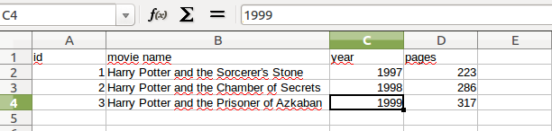
CSV (2)
Excel-like, columns separated by a special character (comma, semicolon…)

Slide 7
What data Structure to use for CSV?
String: “1;Harry Potter and the Sorcerer’s Stone;1997;223”
List: [1, ”Harry Potter and the Sorcerer’s Stone”, 1997, 223]
Dictionary: {“id”:1,
“title”: “Harry Potter and the Sorcerer’s Stone”,
“year”: 1997,
“pages”: 223}

Slide 8
The CSV Module
To read csv files, we use the csv module
Modules are external resources (functions, data types) that are not available in the “basic” python. We use them to add functionalities to the program
Modules are introduced using the “import” special word
We import the csv module with the following line:
import csv

Slide 9
Reading csv files
import csv
with open(‘movie_plots.csv’, ‘r’) as f:
reader = csv.reader(f)
for row in reader:
print(row[1])
It is very similar to what we already know, but instead of a string it reads a list
Must handle column names, because they will appear as 1st row

Slide 10
Reading CSV files (2)
import csv
with open(‘movie_plots.csv’, ‘r’) as f:
reader = csv.DictReader(f)
for row in reader:
print(row[‘Title’])
If we use DictReader instead of reader, we get a dictionary instead of a list
1st row = column names (by default)

Slide 11
Writing to CSV Files
import csv
with open(‘potter.csv’, ‘w’) as f:
writer = csv.writer(f)
writer.writerow(mylist)
writerow(List) writes 1 row, using as column values the elements in the List

Slide 12
Writing to CSV files
import csv
with open(‘potter.csv’, ‘w’) as f:
writer = csv.DictWriter(f)
writer.writerow(mydict)
Now writerow(Dict) takes a dictionary, and fills column values based on column names on keys

Slide 13
Processing CSV. More Options.
Default delimiter: comma.
You can specify others (on reading or writing): csv.reader(f, delimiter=’;’)
Many possibilities and options. If needed, take a look at:
https://docs.python.org/3/library/csv.html
In practical setup we can consider also library Pandas, with functions read_csv() and to_csv()

Slide 14
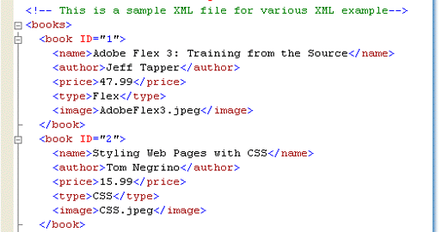
XML <tag>Extensible Markup Language</tag>

Slide 15
XML Format
Start tag
End tag
Attribute
Content

Slide 16
XML as a tree
books
book (id=”1”)
book (id=”2”)
...
name
author
price
Adobe Flex 3: ...
47.99
Jeff Tapper

Slide 17
Working with XML
The basic library for processing XML in python is called ElementTree
You can import it using the following command:
import xml.etree.ElementTree as ET
You can read a file using he following command
tree = ET.parse(‘potter.xml’)
For more information on XML parsing, check the doc page:
https://docs.python.org/3/library/xml.etree.elementtree.html

Slide 18
Processing files in Python
Text files in Python:
Open/Close: with open… as f
Read: for line in f
Write: print(), f.write()
File readers for CSV and XML:
When your problem is standard, someone solved it already. “Import” a tool.
Many other tools:
JSON https://docs.python.org/3/library/json.html
Excel https://pypi.org/project/xlrd/

Slide 19
Thanks! Questions?

