Slide 1
Python for Linguists Python basics: Decision Structures, Loops, Functions
Venelin Kovatchev
Language and computation center
University of Barcelona

Slide 2
What we know so far: Computation
Computation = Data + Algorithms
Data: “ingredients of the cake”, “the cake itself”
Algorithm: a process – preparing a cake from ingredients
The algorithm has input and output
The algorithm has intermediate steps
We keep track of the changes in the data using variables

Slide 3
What we know so far: Data types
There are different data types, each type has different operations
Numeric types: Integers (1,2,3); Floating (1.5, 3.14, 6.667)
Boolean type: True, False
String type: “a”, “a string”, “a much longer string. Also includes #$%^”
List type: [“contains”, “other”, “types”, “as elements”, 3, True]

Slide 4
What we know so far: Working with data
We learned basic operations for different types
The type of data determines the type of operations we can use with it
Numeric types can be modified using algebraic operations
Strings and lists can be concatenated or sliced

Slide 5
From simple operations to real programs
Knowing data types and their operations is important for programming
There is more to programming than just data types and basic operations
In this class we will learn about some of the most important and frequently used tools for programming: control structures, loops, and functions

Slide 6
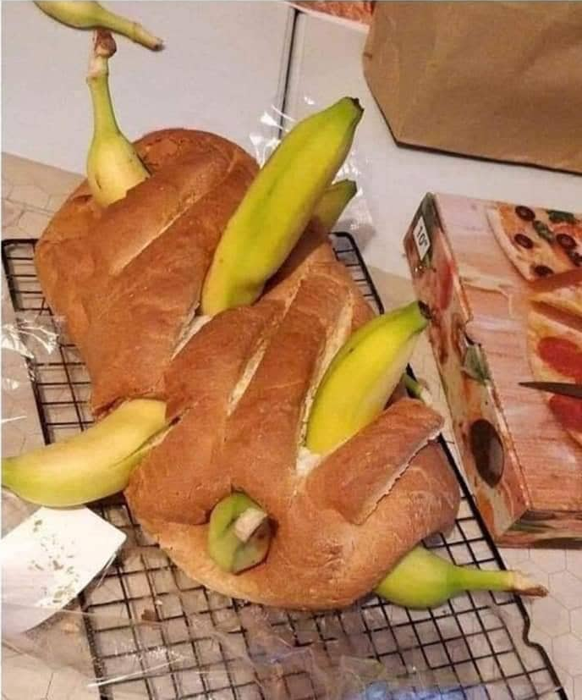
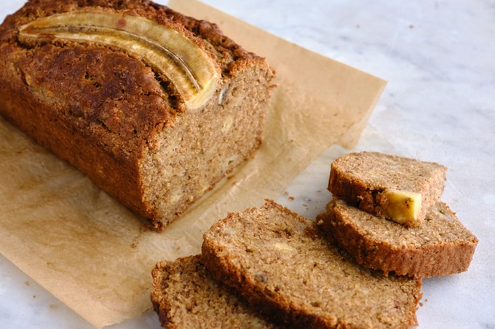
From simple Operations to Real Programs

Slide 7
Decision Structures Conditions

Slide 8
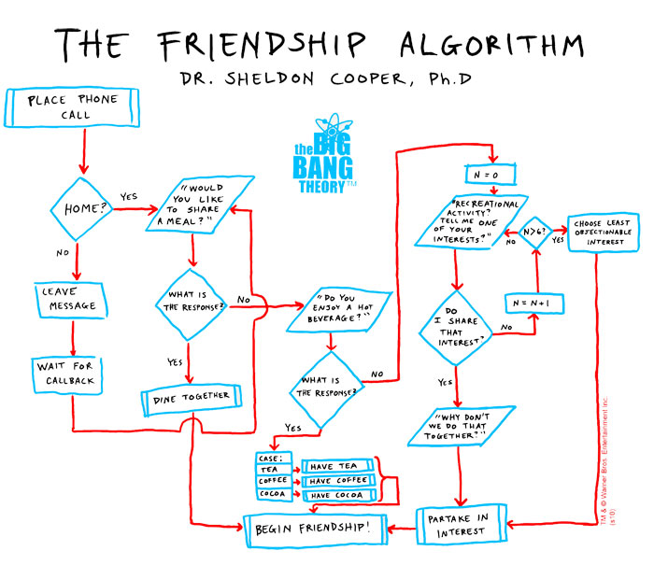

Slide 9
Decision structures
In the friendship algorithm, there are many situations where the progress of the algorithm depends on the ``value’’ of a certain condition:
“Is your soon-to-be friend at home?” – “yes”/”no”
“Does your soon-to-be friend want to have a diner?” – “yes”/”no”
This is a point in the algorithm, where the program needs to make a decision. Naturally, in Python, these points are called ``decision structures’’.

Slide 10
Decision structures: Condition, Value, Action
Each decision structure has a condition:
“Is your soon-to-be friend at home?”
The condition of a decision structure has a Boolean value (True/False)
“Yes, they are at home” -> True; “No, they are not at home” -> False
Depending on the value of the condition, the decision structure makes a ``decision’’ and performs an action:
IF True THEN “invite them to a diner”

Slide 11
Decision Structures in Python
The decision structures in python have a very intuitive syntax:
if CONDITION:
ACTION
else:
ANOTHER ACTION

Slide 12
Decision Structures in Python (2)
Decision structures in python are introduced with the special word “if”
The special word “if” is followed by a condition
The condition is something that we need to “check” before we decide what to do. For example, a condition can be “is your soon-to-be friend home?”
The result of “checking” the condition must be either True or False
After the condition, we end the line with two points “:”. The two points let Python know that the condition is over.

Slide 13
Decision Structures in Python (3)
When the condition after the if is True, python will execute the code on the following lines. Note that in the line “ACTION” has different alignment.
The ACTION code will ONLY be executed when condition is TRUE
The special word “else” is optional. It indicates a second type of action, which has to be executed when the condition is False
If the decision structure has no “else” and the condition is false, the program will do nothing

Slide 14
Nesting of Decision Structures
Decision structures in Python can be nested. That is, you can have decision structure within another decision structure
For example:
If age < 25:
if gender = “female”:
print(“young woman”)
else:
print(“young man”)

Slide 15
What can be inside a Condition
So far we know that the “result” of a condition must be True or False
But what CAN these conditions be?
Boolean: if True: (or) if False: <-This will work, but doesn’t make much sense
Equal to ( == ): if 5 == 4: (or) if age == 25:
Not equal to (!=): if 5 != 4: (or) if age != 25:
Greater than ( > ): if 5 > 4: (or) if age > 25:
Greater or equal : if 5 >= 4: (or) if age >= 25:
Less than ( < ): if 5 < 4: (or) if age < 25:
Less or equal than: if 5 <= 4: (or) if age <= 25:

Slide 16
What can be inside a condition
The numeric examples are only the most simple “conditions”
Conditions can be applied to other data types such as string or list
Conditions can also be functions or methods that return a Boolean value (we will learn about functions and methods later in the class)

Slide 17
Loops The while loop

Slide 18
Loops
Sometimes in the program, we need to perform the same action several times
For example, in the friendship algorithm, you keep asking your friend-to-be about his hobbies. You stop when you find a hobby that you share or you stop when you already know 6 of his hobbies.
There are two ways to write this algorithm: you can write the same code 6 times (ask, check if shared, ask again…) OR you can use a loop
There are several different kinds of loops in Python, we will start with WHILE

Slide 19
The While loop
The while loop in python is similar to the Decision Structure in the fact that it uses conditions. The structure of the while loop is as follows:
instruction_1
while CONDITION:
instruction_2
Instruction_3
Once again, the two points indicate the “end” of the condition
In general, instructions inside the loop modify the truth value of the boolean expression, so the program can continue.

Slide 20
The while loop (2)
The workings of the while loop is very similar to the decision structure
The main difference between the two is that decision structure executes the instructions (or actions) only once. The while loops keeps executing it, as long as the condition remains true.
Typically, each iteration of the loop modifies something related with the condition.
For example, in the friendship algorithm, every time we ask our friend-to-be about a hobby, we increase the number of times we asked by 1. At 6 our condition changes.

Slide 21
Functions and Methods

Slide 22
Functions
Variables let us put a “name” on the data and reuse that data easily
Functions let us put a “name” on an algorithm and reuse that algorithm
The function is a piece of code, written somewhere, that we can execute by calling its name
We already know two functions: the print() function and the len() function

Slide 23
Functions: Usage and Parameters
To execute a function, you need to use the “name” of the function and provide the corresponding “parameters”
print(“Hello World!”)
The function named “print” displays some text on your screen
The “parameter” of the function is “Hello World” – that is, we tell the function WHAT do we want to print. Changing the parameter changes the text, however the underlying process of “printing” is exactly the same for every text

Slide 24
Built-in Functions and Custom Functions
There are many functions in python that are “built-in”. This means that the function is part of python and you can use it right away.
The print() and len() functions are examples of built-in functions
You can also create “custom” functions – specific functions that you create for a particular program. You have to choose the name, define the parameters and write the code that you want to be part of the function

Slide 25
Functions. Return Values.
There are two different kind of functions
Functions that simply execute some code
Functions that execute some code and return a value (output)
print(“Hello World”) simply displays the text on the screen. It doesn’t tell you anything about “Hello World”
len(“Hello World”) reads the string “Hello World”, counts the number of characters and returns that number (11). You can store that number in a variable (e.g.: str_len = len(“Hello World”) ) or you can print it

Slide 26
Functions. Arguments and Return Values.
Think of functions as algorithms:
input → algorithm → output
arguments → function code → return values
Functions may have 0 or more arguments: printRandomPhrase()
And 0 or more return values: first, last = getFirstAndLastLetter(word)

Slide 27
Methods
Methods are functions that are specific for a particular data “object”
Defining classes, objects and object oriented programming is outside of the scope of this class, so for now methods are functions for a specific data type
Examples of string specific methods:
text_var = “Some text HERE”
text_var.lower() <- returns “some text here”
text_var.endswith(“E”) <- returns True

Slide 28
Methods (2)
Methods “belong” to a certain variable. They do “something” with the content of that variable. For example .lower() transforms every character to its lowercase variant
Methods are accessed by the dot (.) operator after the variable name
Similar to functions, methods can have 0 or more parameters
Similar to functions, methods may return 0 or more values

Slide 29
Functions and methods
Modules and imports
Built-in functions are just available in your Python code.
Built-in types (int, string, bool, …those you know so far) have their methods available too.
Any other function lives out of the Python core, and must be called before you use it in your code. Example: the math package.
import math
math.sqrt(36) <- returns 6
The dot operator again.
When you access function or data inside something (object, module) you always need the dot.

Slide 30
Defining your own function
Observe the code of the following function. Do you know what it does?
def personal_q(age, gender):
if age <25:
if gender == “female”:
print(“Young woman!”)
else:
print(“Young man!”)
else:
print (“Wise person!”)

Slide 31
Defining your own function (2)
def starts a function definition
function name is right after def
all function parameters are in parenthesis. Each parameter is a variable.
two dots mark the end of the definition of name and parameters
inside the function the code is the same like outside. Note the text alignment!
return indicates the return value, if any (there was none in our function)
nothing is executed after return, the function ends

Slide 32
Programing Basics
The first two classes cover the basics of programming
Make sure you understand well everything we discussed as it will be used throughout the whole class
If anything is unclear or you feel uncomfortable with it, don’t hesitate to ask me
The practical session should make you familiar with everything we discussed so far

Slide 33
Thanks! Questions?

