Slide 1
Introduction to Python for Linguists
Venelin Kovatchev
Language and computation center
University of Barcelona

Slide 2
General Info
Aula: 4.4
Duration: 30 hours
Schedule: Mon and Wed, 15:00-17:00, from 10.02 until 30.03
Instructor: Venelin Kovatchev ( vkovatchev [at] ub.edu )
PhD student at the Language and Computation Group (CLiC)
All materials are available at https://github.com/venelink/python_course

Slide 3
Target Audience
This is a course in introduction to programming in Python
It is designated for linguists (or people with humanitarian profile), therefore I will give linguistic examples. However it is suitable for non-linguists as well
I expect no previous knowledge of programming
I will try to explain all mathematical and programming concepts as I introduce them

Slide 4
Course Objectives
This course will familiarize you with:
basic programming concepts
the logic and structure of a program
transitioning from linguistic problems to programming problems
In the practical section of the course you will work with:
control structures, loops, functions, text files
external Python ``libraries’’ designed for language processing (NLTK, Spacy)
corpora of language (English and Spanish)

Slide 5
Acknowledgements and Bibliography
I have used some slides from Javier Beltran’s course from 2019
I may use some examples from ``Introducción a la programación para humanistas’’ by Leticia Martín-Fuertes Moreno
For people who are interested in knowing more about python programming and NLP I recommend reading ``The NLTK book’’ and ``Python Programming: An Introduction to Computer Science’’

Slide 6
Introduction to Algorithmic Thinking

Slide 7
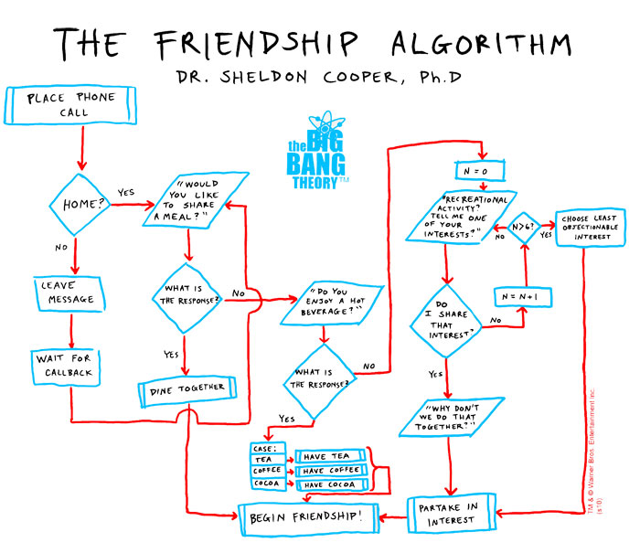

Slide 8
Computing = Data + algorithms
Algorithm: ``a process or set of rules to be followed in calculations or other problem-solving operations, especially by a computer.’’
Making friends, Tagging a corpus, Sound processing…
Data: ``facts and statistics collected together for reference or analysis.’’
The friends’ hobbies, Corpora, Collections of sound files…

Slide 9
Why do we need computing?
Computing is practical
The amount of available data is growing fast, humans cannot process it all by hand
With proper instructions, computers can perform some tasks much faster than humans
Computing is scientific
Automation can help researchers both in preparing experiments and analyzing results
The AI dream
We’re still very far from it

Slide 10
``Talking’’ to computers: Programming Languages

Slide 11
Layers of Abstraction: From 0 and 1 to human language
A computer only ``understands’’ electrical impulses
Electrical impulses can be ``translated’’ into 0s and 1s
A human understands natural languages, but also artificial languages, mathematics, etc
How to make the humans and the computers understand each other?
Teach the humans ``speak’’ 0s and 1s
``Teach’’ the computers a language that is more ``human-like’’

Slide 12

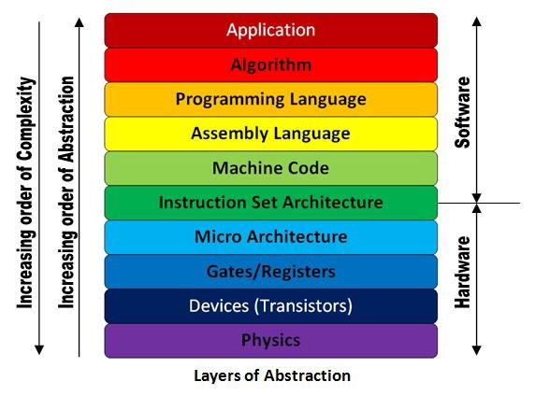
Layers of Abstraction
Higher levels of abstraction are more ``human like’’
Lower levels of abstraction are more ``computer like’’
In this course we will be working at the highest levels (you don’t have to speak 0-1)

Slide 13
Programming languages
Programming languages are a compromise between 0s and 1s and the human natural language
For the programmer, a programming language is a language:
It has a predefined structure and rules (syntax)
It can be learned through practice
For the computer, a programming language is also a program:
It includes all instructions necessary to ``translate’’ the commands to 0s and 1s

Slide 14
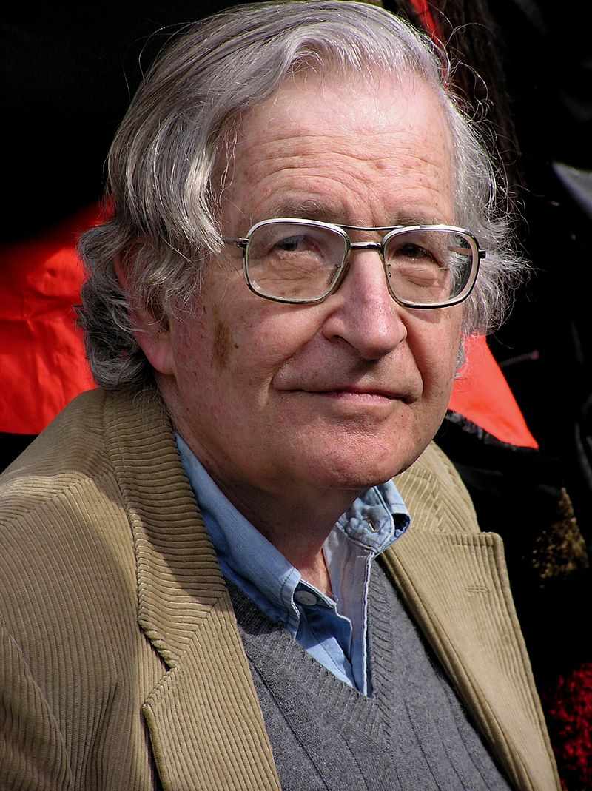
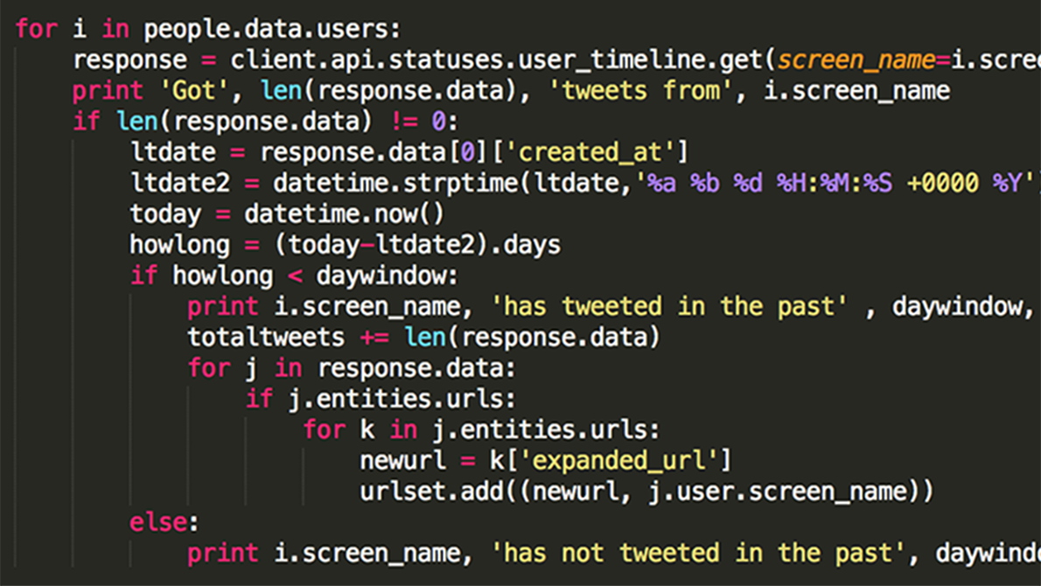
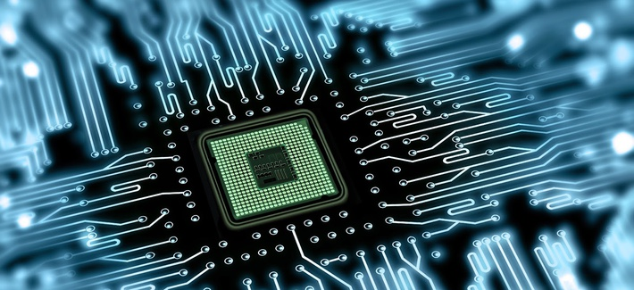
Programming Languages
Your task
Any task
You guys
The programming language
0101101100011010010001011101111101100...

Slide 15

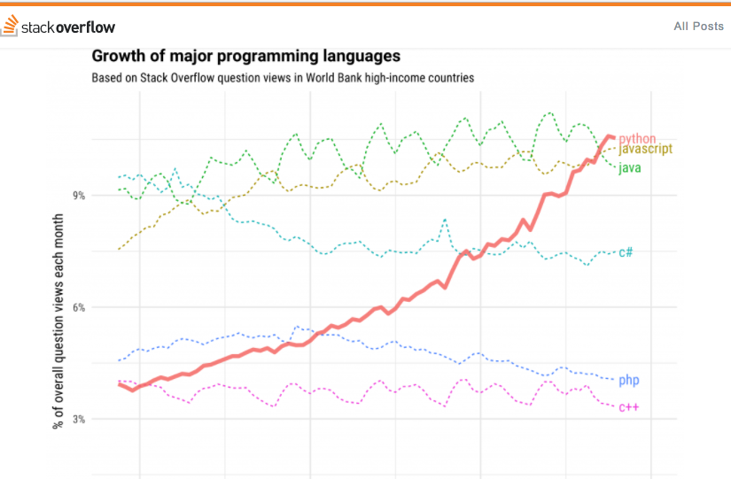
The Python programming language
The language for this course
Easy to learn
Tries to resemble human language
General purpose + scientific computing
Extremely popular
Many existing libraries and programs

Slide 16
Thank you Questions?

