Slide 1
Python for Linguists Syntactic Parsing
Venelin Kovatchev
Language and computation center
University of Barcelona

Slide 2
What we know so far
Core programming:
Data types and variables
Functions and Methods
Decision structures
Loops
Basic corpus preprocessing:
Cleaning
Tokenization and sentence segmentation
Corpus statistics and n-grams
Part of Speech tagging. “Supervised” Machine learning.

Slide 3
Syntax
Syntax is the order and structure of the elements in a language statement.
How words combine to express meaning.
Syntax applies to computer languages as well as to natural languages.
e.g.: in Python – how you define a function, which parameter corresponds to which value
Usually, we think of syntax as "word order” but is not just that, it has hierarchy

Slide 4
Syntax (2)
Important questions within syntax:
Constituency: How words group together?
Grammatical relations: What kind of relationships do these groups have with the verb?
Dependencies: What kind of relationships do the individual words have between them?

Slide 5
Constituency
Groups of words may behave as a single unit or phrase, called Constituent (phrase)
John often comes late to class.
My friend and I both have a dog named Spot.
Many parts of the Asian coastline were destroyed by a tsunami in 2004.
The old hotel at the end of the street is going to be knocked down to make way for a new supermarket.
Sitting in a tree at the bottom of the garden was a huge black bird with long blue tail feathers.

Slide 6
Constituent Analysis
The first step of a syntactic analysis
Identifies all constituents in a clause
The automatic constituent analysis is sometimes called “shallow parsing”
For many practical applications, a constituent analysis contains enough information and we don’t need to perform full syntactic parsing

Slide 7
Grammatical Relations
Grammatical relations are functional relationships between the constituents in a clause.
Standard examples of grammatical relations from traditional grammar are subject, direct object, and indirect object.
In NLP, grammatical relations are typically represented using a Context Free Grammar (CFG)

Slide 8
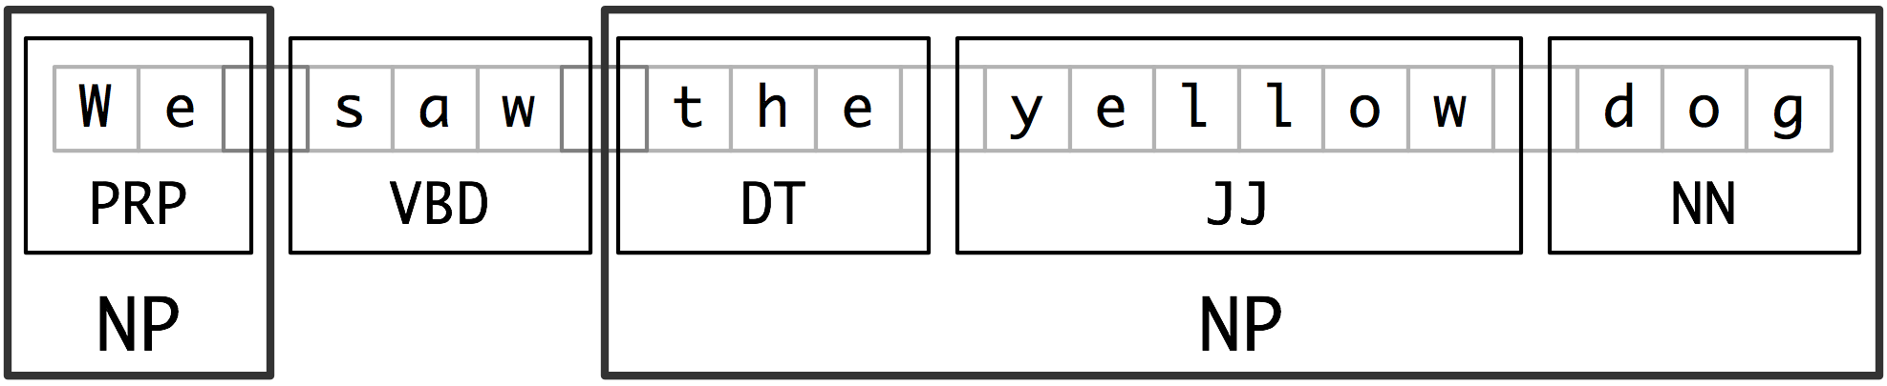
I-O-B Chunking
A simple shallow parsing approach: Inside, Outside, Beginning
By marking “inside”, “outside”, “beginning”, the I-O-B chunker identifies the beginning and the end of each constituent
The I-O-B chunker typically only looks at POS tags, not at the actual words

Slide 9
Context Free Grammars
A mathematical system for modeling constituency structure of English and other languages
Typically has a human interpretable visualization in terms of hierarchical trees
1st time used for language analysis and description by N. Chomsky (1956)

Slide 10
Context Free Grammar. Rules
NP -> Det Nominal the flight
NP -> ProperNoun John
Nominal -> Noun| Noun Nominal |Pronoun flight, John, car, I, we, …
(Note that Nominal is recursive – it contains “Nominal” as possible expansion)

Slide 11
Context Free Grammar. Lexicon
Det -> a
Det -> the
Noun -> flight
Noun -> car
Pronoun -> I, we, you, they, …

Slide 12
Context Free Grammar. Rules (2)
In each CF rule
Terminal : correspond to words in the language (Lexicon)
Det -> a
Det -> the
Noun -> flight
Nonterminal: Elements of the metalanguage (generalizations)
NP -> Det Nominal
Nominal -> Noun| Noun Nominal

Slide 13
Context Free Grammar. Rules (3)
In each CF rule:
The symbol on the left: always a single non-terminal
The symbol on the right: an ordered list of one or more terminals, or non terminals or both.
In the lexicon, the nonterminal associated to each word is typically its PoS
Det -> a

Slide 14
Context Free Grammar Rules (2)
A CFG has four parameters:
A set of non-terminal symbols, N (or variables: NP, V, PP, …)
A set of terminal symbols, K (disjoint from N: a, the, John, cat, …)
A set of production rules P, of the form A -> a, where A is a non terminal and a is a string of symbols from the infinite set of strings (K U N)*
An axiomatic initial symbol S
A language is defined via de concept of derivation

Slide 15

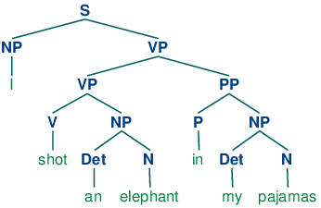
Context Free Grammar Rules and Trees
A sentence represented with a context free grammar can be visualized as a hierarchical tree

Slide 16
CFG. Generation and Parsing
A context free grammar can be seen as a device for generating sentences:
Given a set of rules and a lexicon – generate a possible sentence
A context free grammar can also be seen as a device for assigning a structure to a specific sentence:
Can this sentence be derived using a predefined grammar?
What kind of constituents does the sentence have?
What are the grammatical relations within the sentence

Slide 17
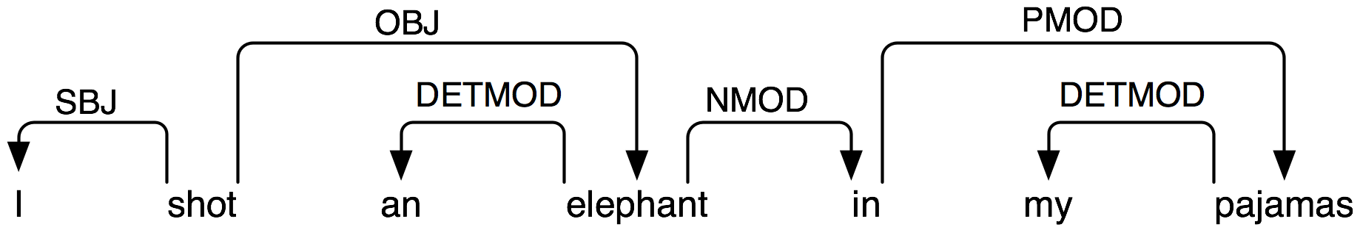
Dependencies
Dependencies are similar to grammatical categories, however the dependencies connect words rather than constituents (phrases)

Slide 18
Syntactic parser
A device (or a program) that given a text and a grammar can:
Say whether the text can be generated using the grammar
Assign a structure to the text according to the grammar
Top down parser: searches for a parse tree by trying to build from the root node S down to the “leaves” (words)
Bottom up parser: starts with the words of the input and tries to build trees from the words up, until it successfully builds a tree rooted in the start symbol S

Slide 19
Top-down versus Bottom-up
Top down:
Never wastes time exploring trees that cannot result in an S
Never explores subtrees that cannot find a place in some S-rooted tree
It spends a lot effort with S-rooted trees that don’t match the sentence
Bottom-up
Generates trees that not lead to an S and are abandoned.

Slide 20
Parsing ambiguity
One of the most frequent problems in parsing: often one text can be parsed in different ways
How to pick the correct parse?
Common kinds of syntactic ambiguity are:
PP attachment
Coordination ambiguity
Non-phrase bracketing ambiguity

Slide 21
Thanks! Questions?

