Slide 1
CNV
Machine learning / Deep learning

Slide 2
GDC
The data was provided by the GDC portal and it covers kidney and lung tumours.
GDC “identified genomic regions that are repeated and inferred the copy number of these repeats” and in particular Circular Binary Segmentation (CBS) analysis was performed.
“CBS translates noisy intensity measurements into chromosomal regions of equal copy number” furthermore it “performs well in identifying changes and estimating their location especially when detecting narrow regions of change”.
“The GDC further transforms these copy number values into segment mean values which are equal to log2(copy-number/2)”
https://docs.gdc.cancer.gov/Data/Bioinformatics_Pipelines/CNV_Pipeline/
https://academic.oup.com/biostatistics/article/5/4/557/275197 “Circular binary segmentation for the analysis of array-based DNA copy number data” ADAM B. OLSHEN, E. S. VENKATRAMAN, ROBERT LUCITO, MICHAEL WIGLER
Type of region | Copy number value
Diploid | =0
Amplification | >0
Deletion | <0

Slide 3
Original Dataset
GDC Aliquot | Chromosome | Start | End | Num_probes | Segment_mean
9ecc … c2d5f9 | 1 | S1 | E1 | 84010 | 0.0122
9ecc … c2d5f9 | 1 | S2 | E2 | 3 | -2.0614
9ecc … c2d5f9 | 1 | S3 | E3 | 45689 | 0.0128
… | … | … | … | … | …
Chromosome 1
S2
E2
PZ 1
S1
E1
S3
E3
PZ 2
PZ 3
PZ 4

Slide 4
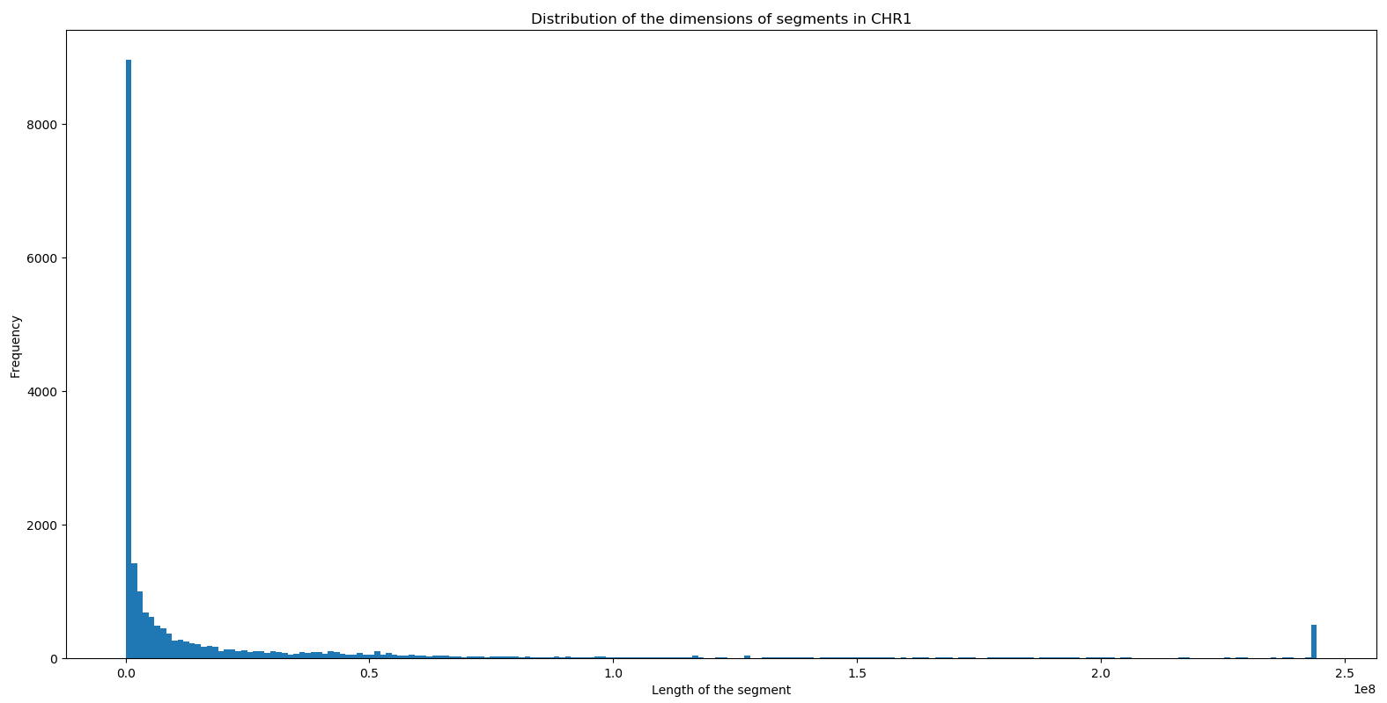
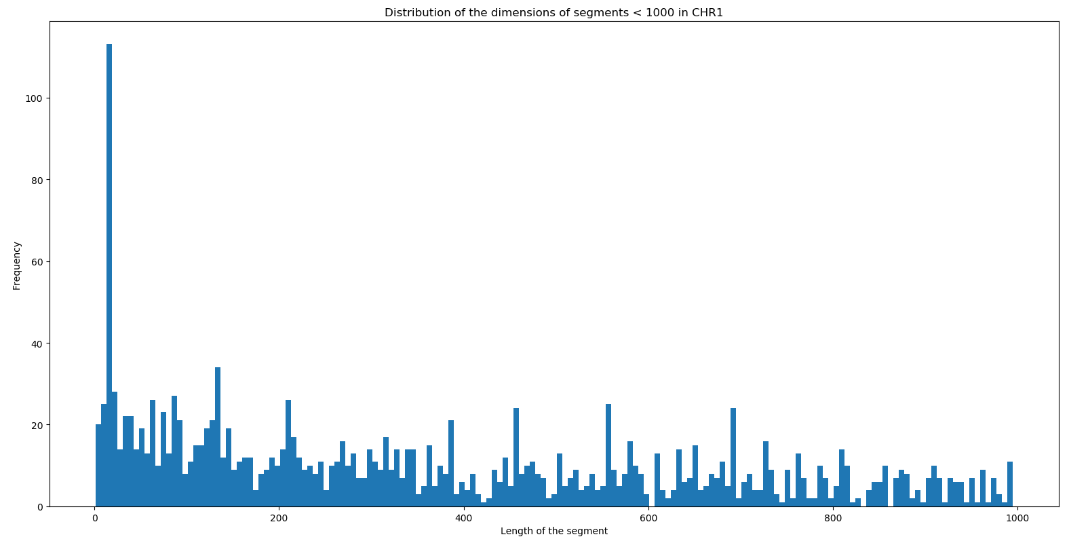
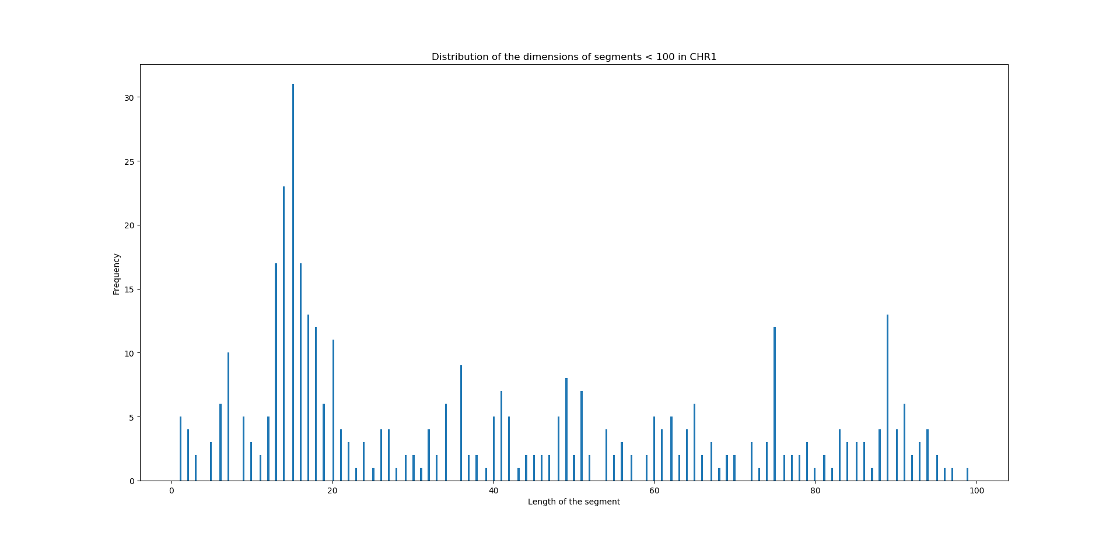
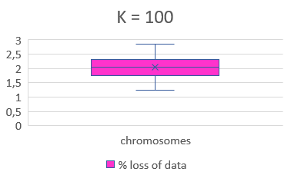
First approach
The first attempt was segmenting the chromosome with step «k». «k» was chosen after the evaluation of the histogram of the distribution of the segment lengths for all of the given patients.
The vast majority of the segments were characterized by a length smaller than 2 * 10^6.
K=1000
K=100
Going further in the analysis it was found that a non negligeable number of segments were of smaller dimensions.
To avoid the loss of too much data a step of 100 bases was considered acceptable.
There was a loss of 1-3% of data, depending on the chromosome.

Slide 5
First approach: results
The chromosome was then divided in n segments of lenght k. The new segments were characterized by the value that was predominant (i.e. covered more of the 60% of its length) in the original dataset
Original chr1
PZ 1
PZ 2
PZ 3
Segmented chr1
PZ 1
PZ 2
PZ 3
Issues:
Some information could be lost at the borders of the segments
Values related to small regions would be discarded in any case
 | f1 | f2 | f3 | f4 | f5 | f6
Pz1
Pz2
Pz3
Actually the highest (and possibly the most relevant) CNV values were found in the smallest regions.

Slide 6
Second approach
A variable step was then used to overcome the issues: a new segment was generated from each breakpoint as shown in the figure.
PZ 1
PZ 2
PZ 3
 | f1 | f2 | f3 | f4 | f5 | f6 | f7 | f8 | f9 | f10 | f11 | f12 | f13
Pz1
Pz2
Pz3
Issues:
The number of segments increased considerably
New segments were created even when the CNV value was not indicated (blank regions hence diploid)
The number of redundant data increased
Advantages
The entirety of the information was extracted and retained, the small segments (like the red one) were reported in the final matrix
No alteration of data
No assumptions
In the end a 2.000x400.000 matrix was obtained

Slide 7
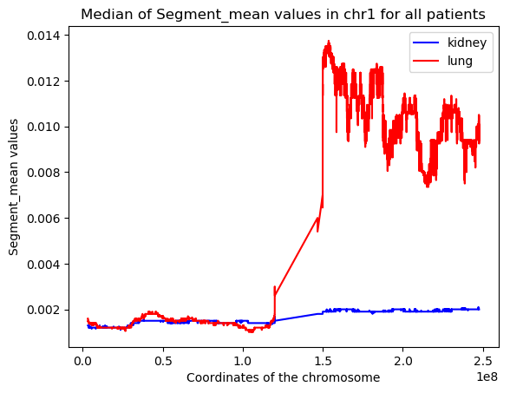
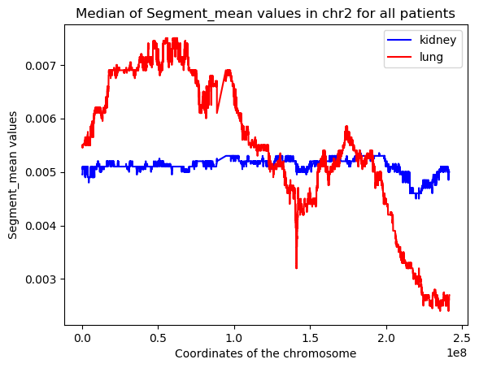
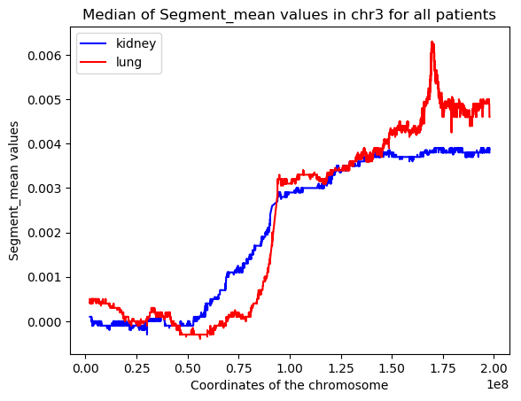
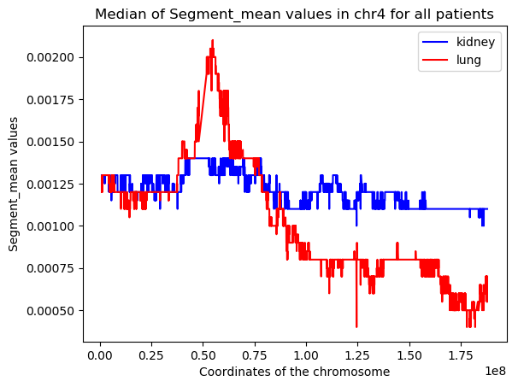
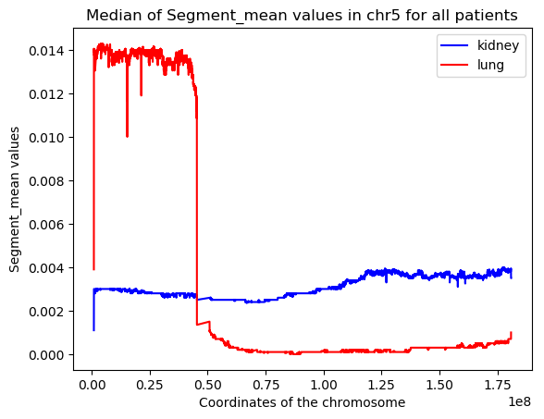
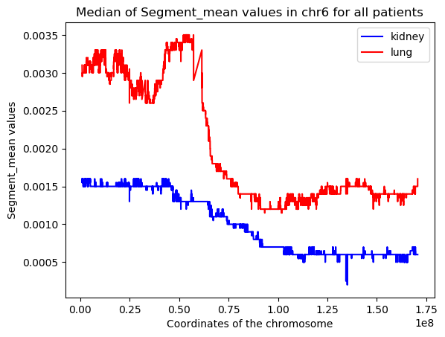
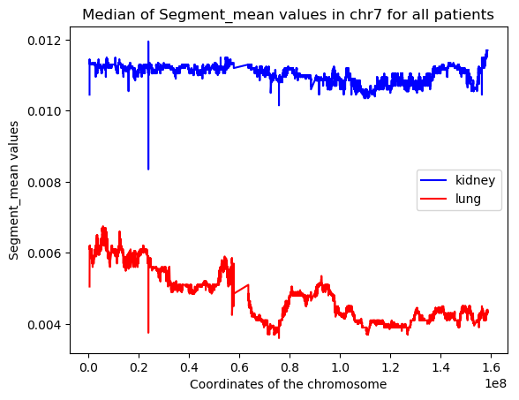
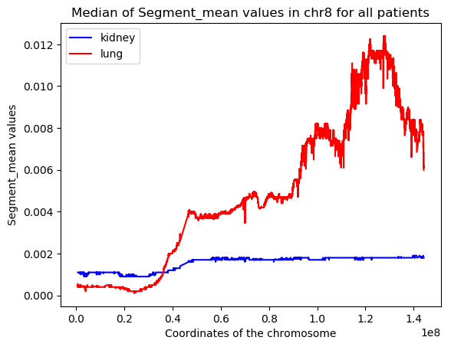
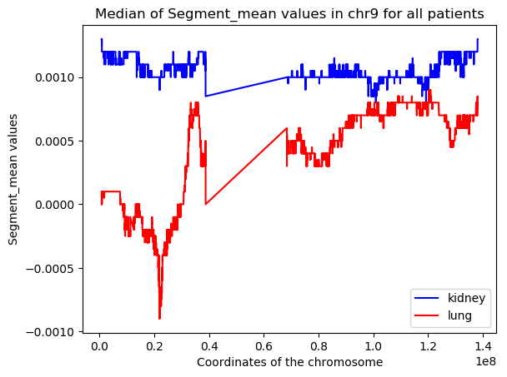
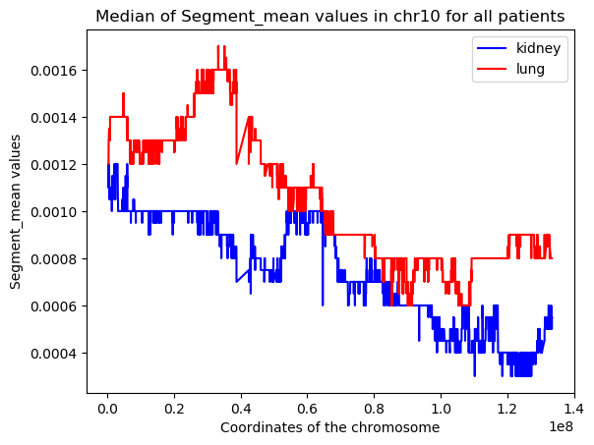
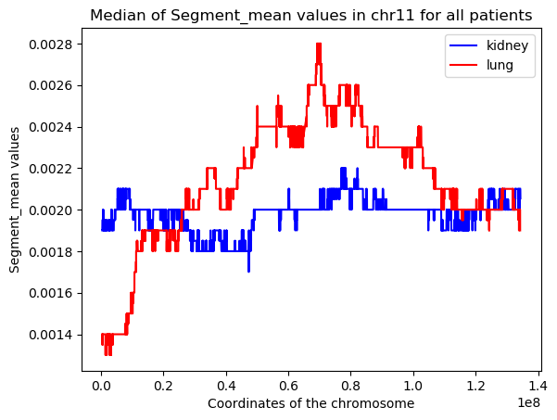
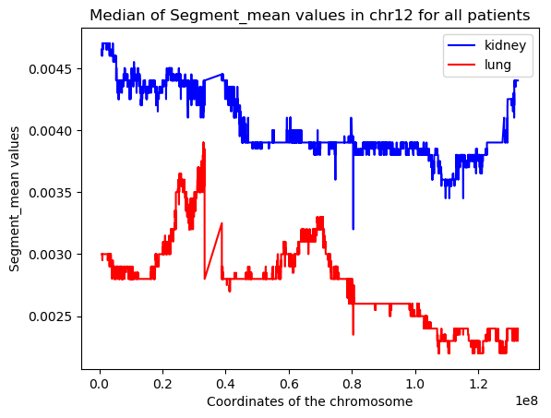
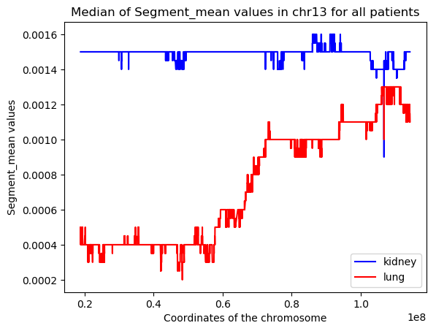
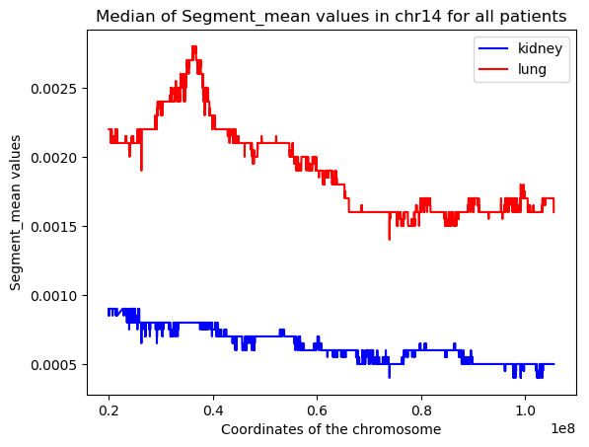
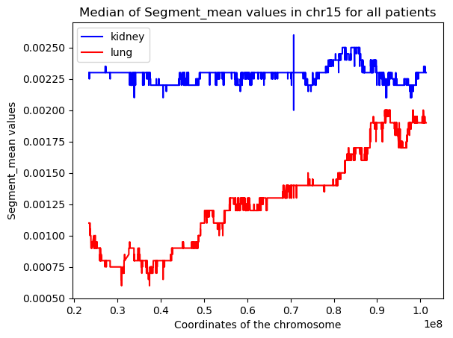
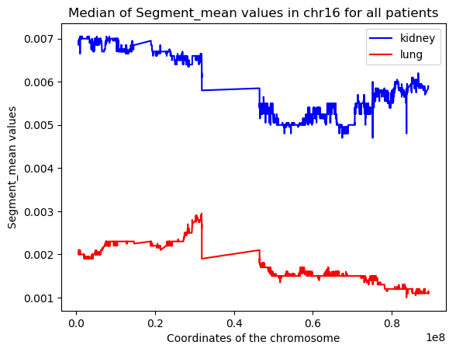
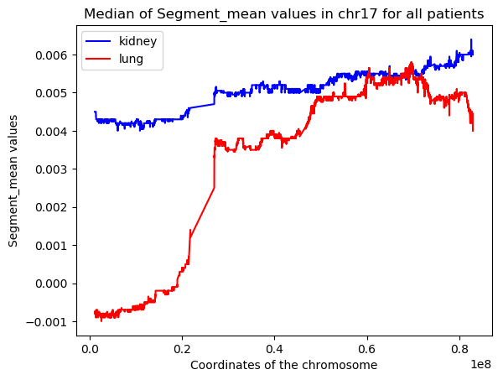
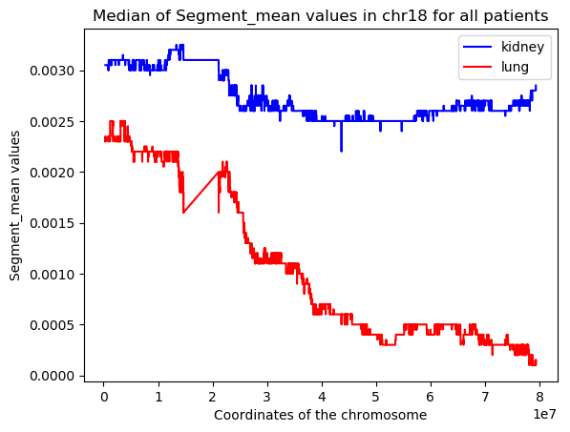
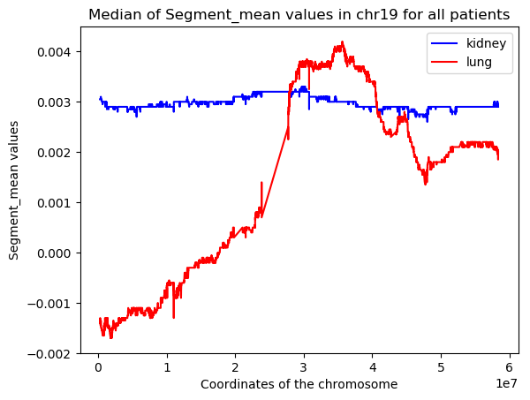
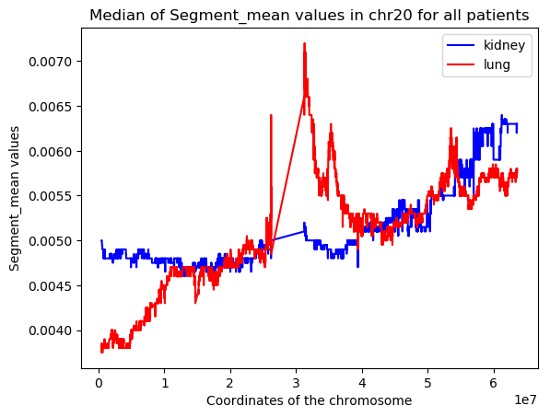
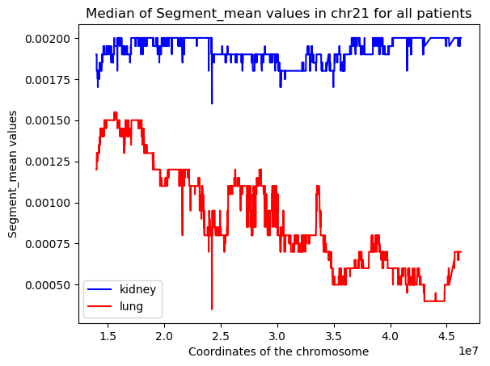
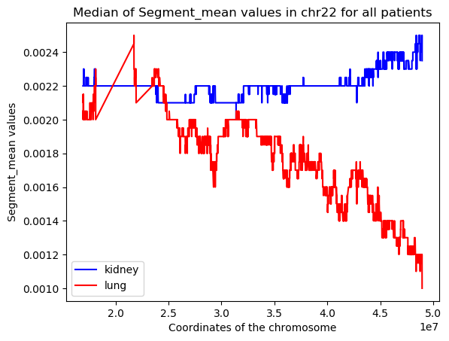
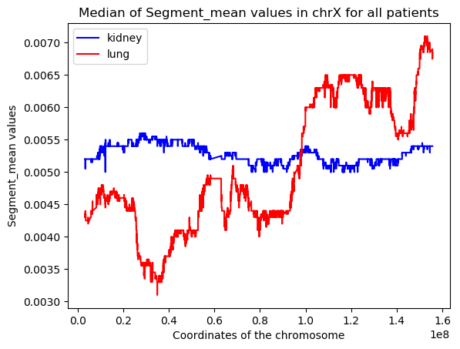
The CNV data in the chromosomes: kidney vs lung

Slide 8
The CNV data in the chromosomes: kidney vs lung
A more in depth look at the median of the segment mean value highlighted that the difference between kidney and lung data was bigger in certain chromosomes.
Chromosome 1, 5, 7, 8, 16, 17 had substantially big regions where the difference between the sm value of the kidney and the sm value of the lung was bigger that 0.005. It is reasonable to assume that these chromosomes could be more relevant in the classification process. It can be also assumed that the values corresponding to chromosome 4, 10 and 11 are so similar that the classification tool could be unable to discern between kidney and lung.

Slide 9
CNV and protein coding genes

Slide 10
CNV and tumor suppressor regions

Slide 11
Feature selection
In order to reduce the computational time and hopefully improve the performances of the machine learning tools, feature selection was implemented.
Variance
This method removes features with variation below a certain cutoff.
The idea is when a feature doesn’t vary much within itself, it generally has very little predictive power. Variance Threshold doesn’t consider the relationship of features with the target variable.
Variance threshold | % of feat retained | (10 folds) Mean of accuracy +- standard deviation
 |  | KNN | DT | SVM | SGDC | NN 12 – 8 | NN 24 – 12
0.1 | 0.21%
0.09 | 0.32%
0.08 |  | 0.66 +- 0.04 | 0.75 +- 0.03 | 0.63 +- 0.03 | 0.67 +- 0.3 | 0.85
0.07 | 1.28% | 0.65 +- 0.05 | 0.75 +- 0.03 | 0.63 +- 0.05 | 0.69 +- 0.02 | 0.89 | 0.71 +- 0.04
0.06 | 2.5% | 0.69 +- 0.01 | 0.75 +- 0.03 |  | 0.72 +- 0.03 | 0.98
0.05 | 5% | 0.69 +- 0.05 | 0.77 +- 0.03 |  |  | 0.99
0.04 | 10.83% | OOM | OOM | OOM |  | OOM
0.03 | 31.31% | OOM | OOM | OOM |  | OOM
0.02 | 67.63% | OOM | OOM | OOM |  | OOM
0.01 | 97.43% | OOM | OOM | OOM |  | OOM
!Svm ha una confmat sbilanciata verso una classe

Slide 12
Cascade feature selection: variance + random forest / variance + correlation

Slide 13
2 hidden layers NN
Several 2-layer neural networks models were built with different combinations of number of nodes and epochs to test which model would solve the classification in the most efficient way. Accuracy was used as performance measure.

