Slide 1
CNV data as a biomarker for cancer types
Machine learning

Slide 2
GDC
The data was provided by the GDC portal and it covers kidney and lung tumours.
GDC “identified genomic regions that are repeated and inferred the copy number of these repeats” and in particular Circular Binary Segmentation (CBS) analysis was performed.
“CBS translates noisy intensity measurements into chromosomal regions of equal copy number” furthermore it “performs well in identifying changes and estimating their location especially when detecting narrow regions of change”.
“The GDC further transforms these copy number values into segment mean values which are equal to log2(copy-number/2)”
Type of region | Copy number value
Diploid | =0
Amplification | >0
Deletion | <0
https://docs.gdc.cancer.gov/Data/Bioinformatics_Pipelines/CNV_Pipeline/
https://academic.oup.com/biostatistics/article/5/4/557/275197 “Circular binary segmentation for the analysis of array-based DNA copy number data” ADAM B. OLSHEN, E. S. VENKATRAMAN, ROBERT LUCITO, MICHAEL WIGLER

Slide 3
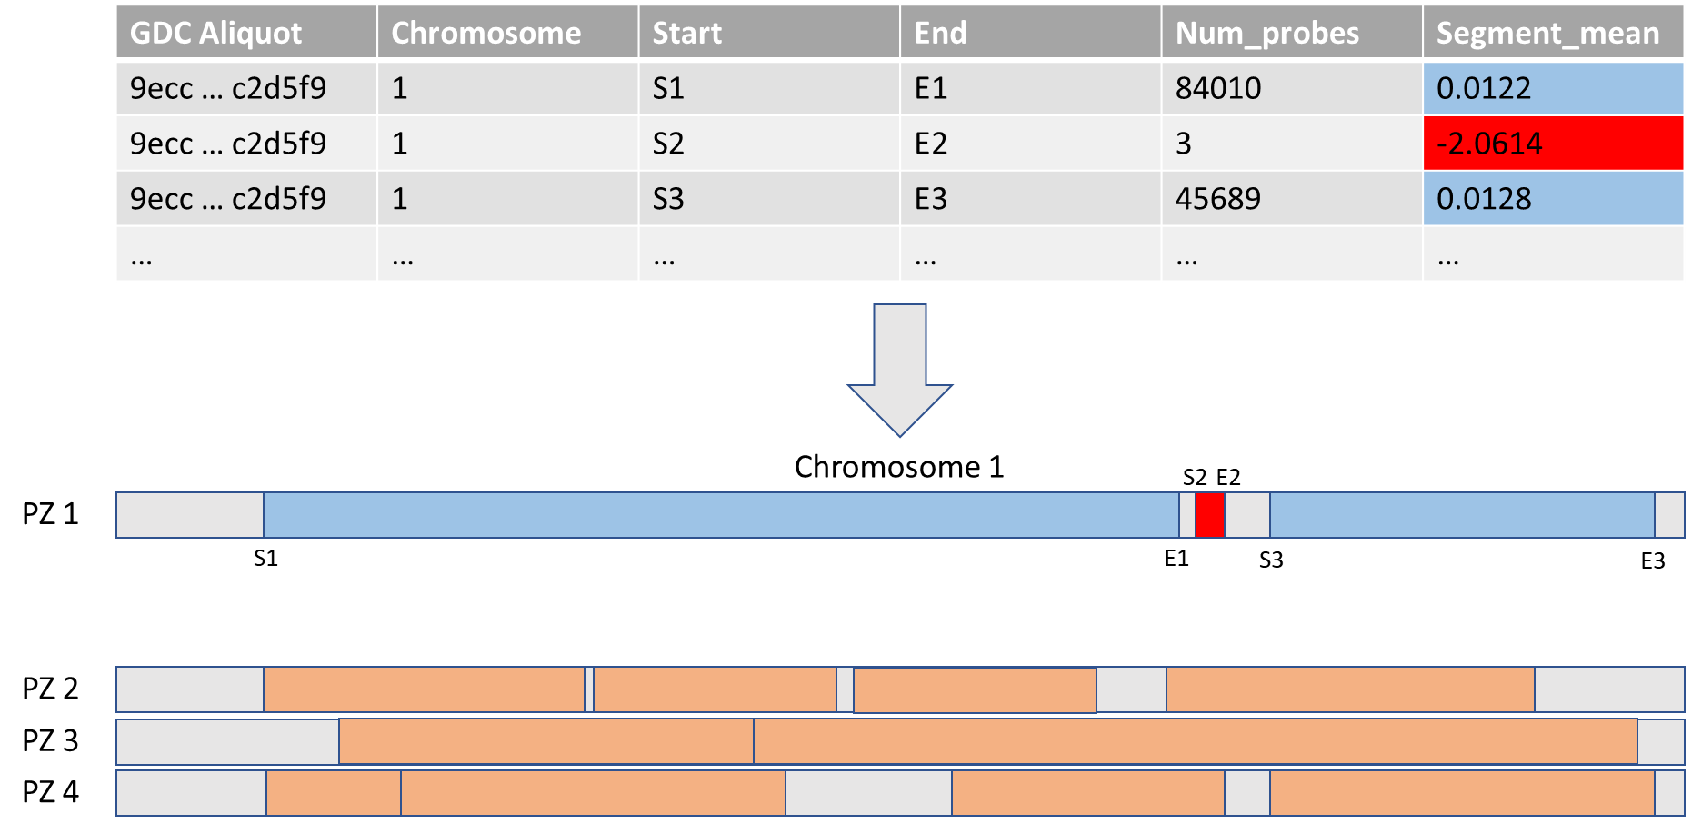
Original Dataset

Slide 4
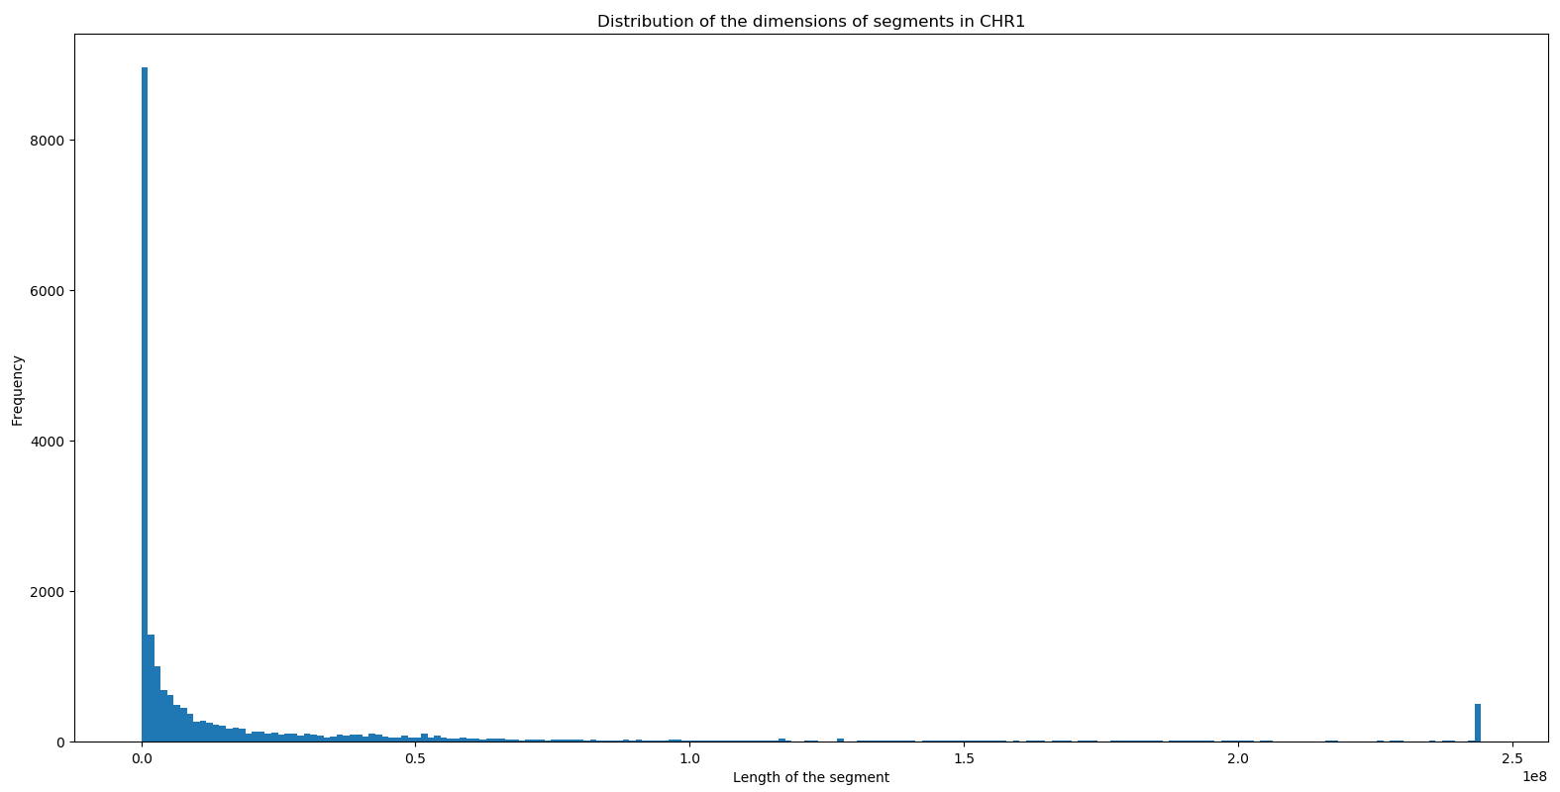
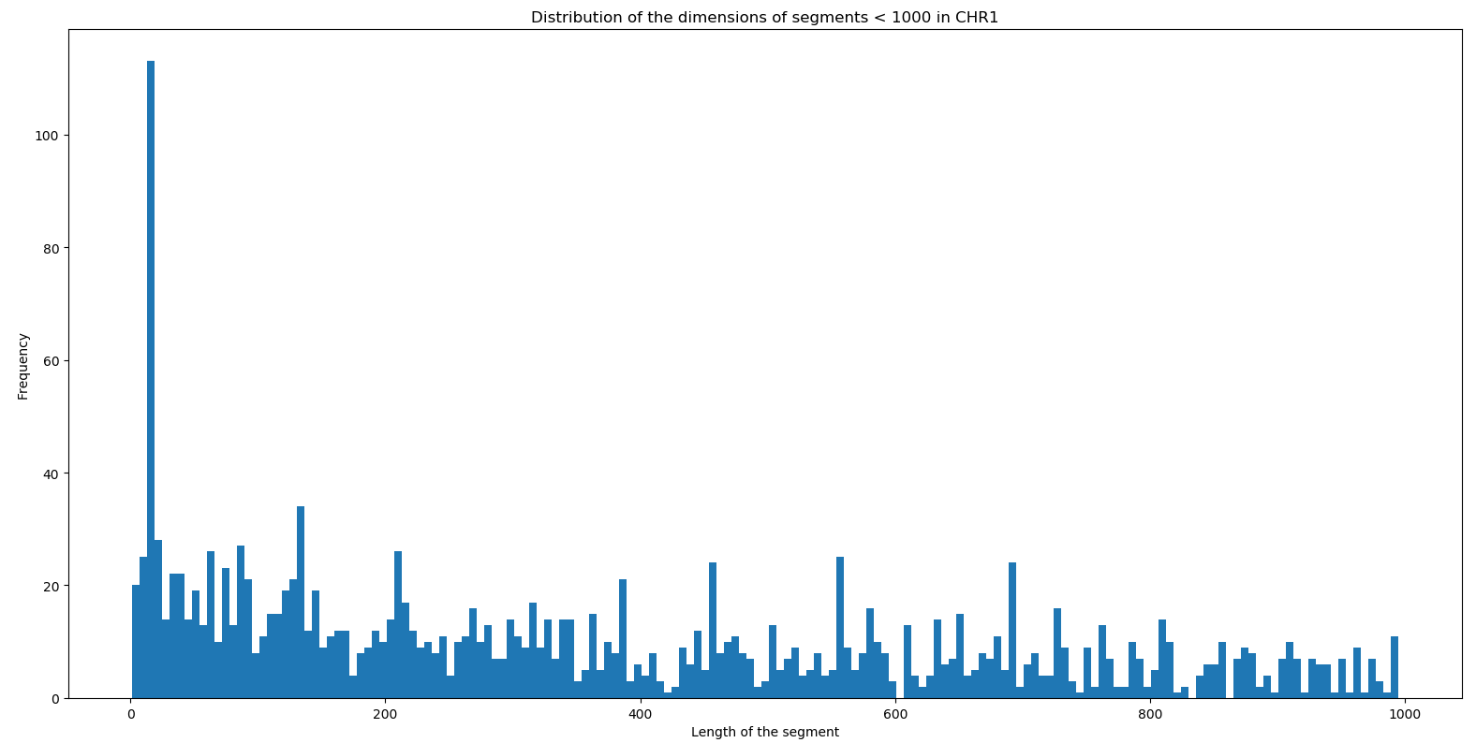
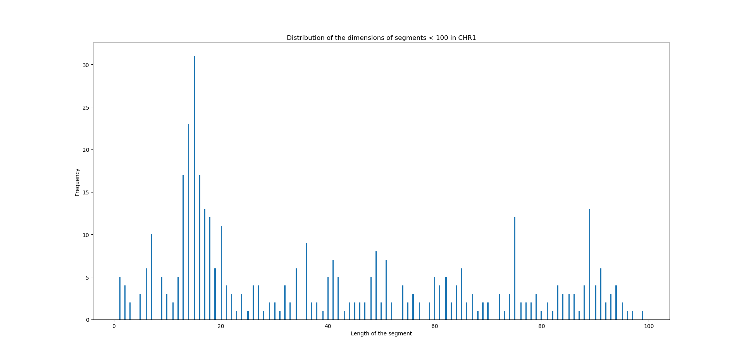
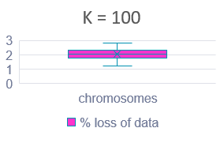
First approach
The first attempt was segmenting the chromosome with step «k». «k» was chosen after the evaluation of the histogram of the distribution of the segment lengths for all of the given patients.
The vast majority of the segments were characterized by a length smaller than 2 * 10^6.
K=1000
K=100
Going further in the analysis it was found that a non negligeable number of segments were of smaller dimensions.
To avoid the loss of too much data a step of 100 bases was considered acceptable.
There was a loss of 1-3% of data, depending on the chromosome.

Slide 5
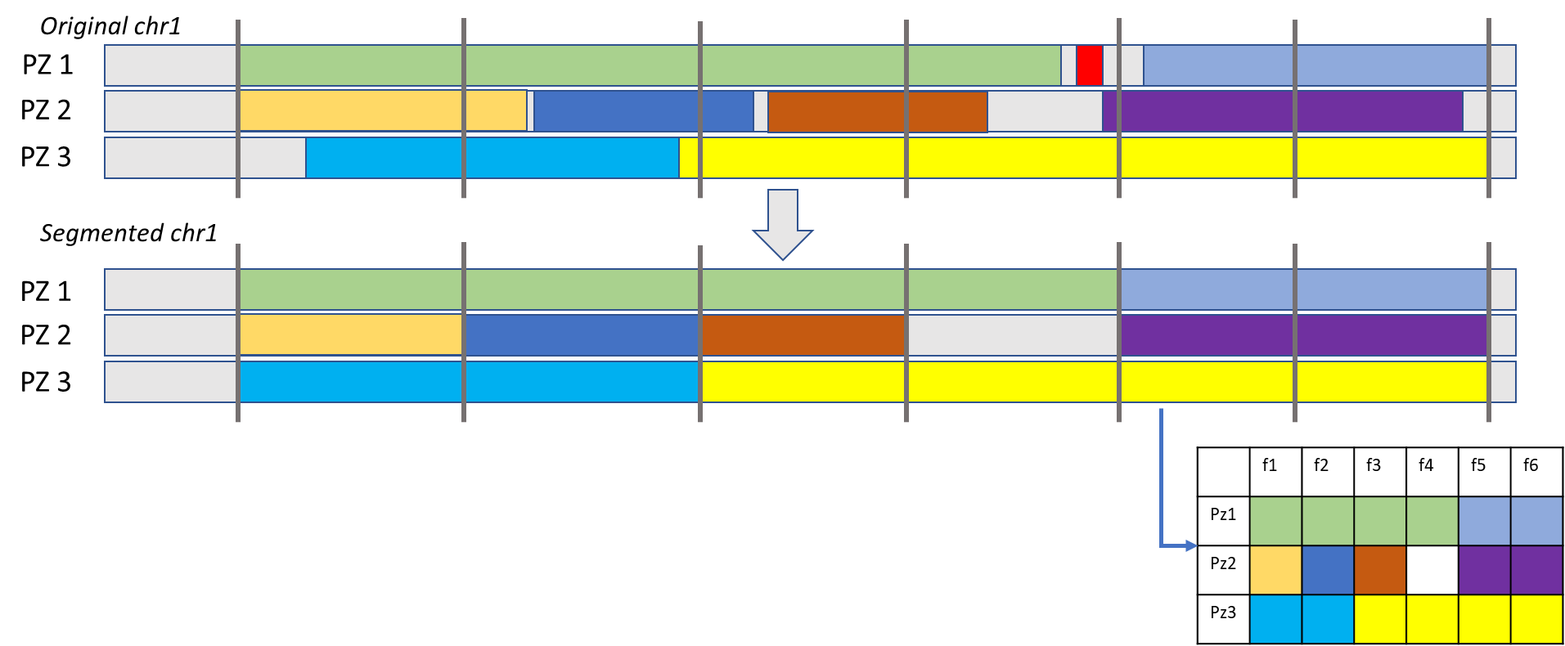
First approach: results
The chromosome was then divided in n segments of lenght k. The new segments were characterized by the value that was predominant (i.e. covered more of the 60% of its length) in the original dataset
Issues:
Some information could be lost at the borders of the segments
Values related to small regions would be discarded in any case
Actually the highest (and possibly the most relevant) CNV values were found in the smallest regions.

Slide 6
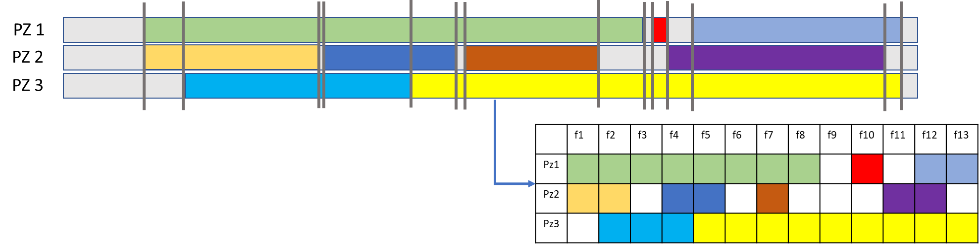
Second approach
A variable step was then used to overcome the issues: a new segment was generated from each breakpoint as shown in the figure.
Issues:
The number of segments increased considerably
New segments were created even when the CNV value was not indicated (blank regions hence diploid)
The number of redundant data increased
Advantages
The entirety of the information was extracted and retained, the small segments (like the red one) were reported in the final matrix
No alteration of data
No assumptions
In the end a 2.000x400.000 matrix was obtained

Slide 7
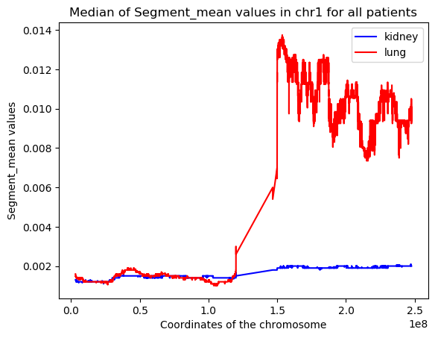
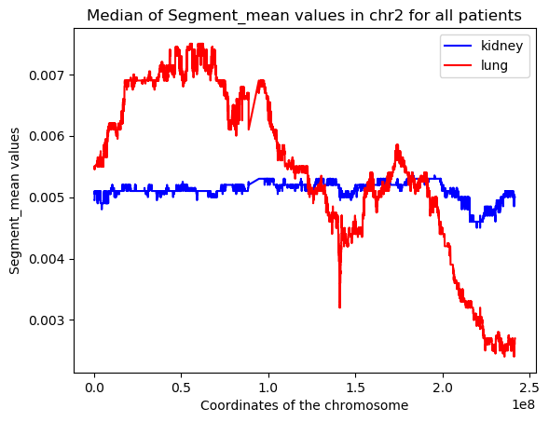
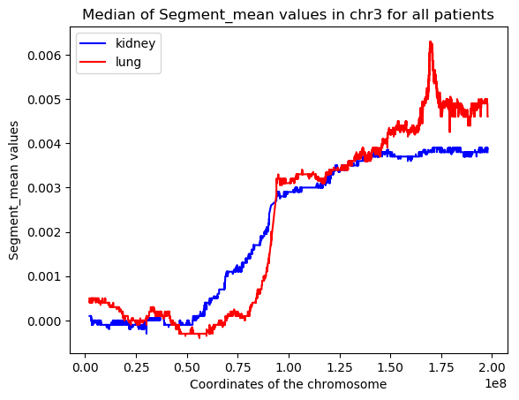
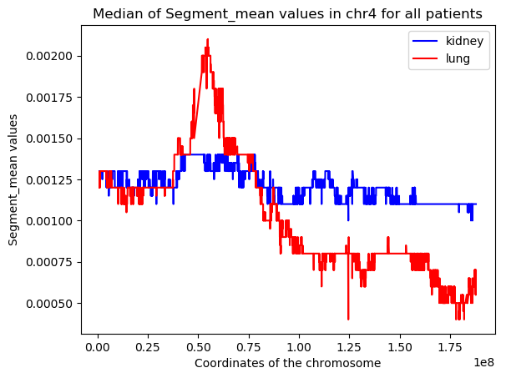
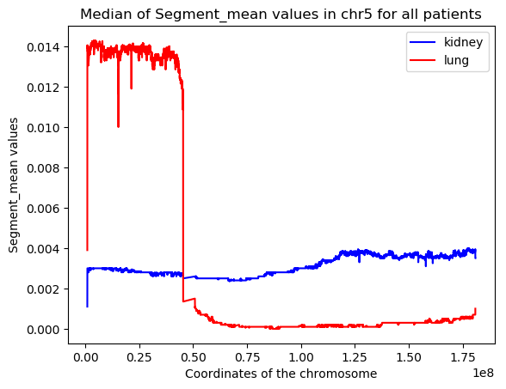
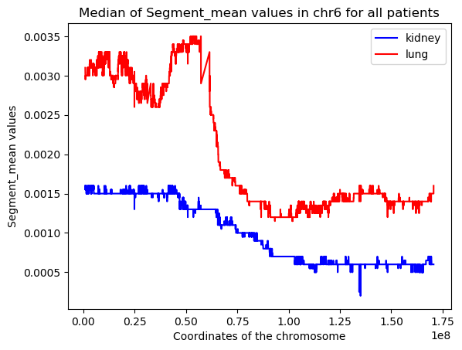
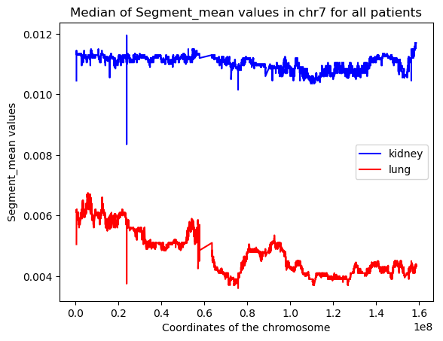
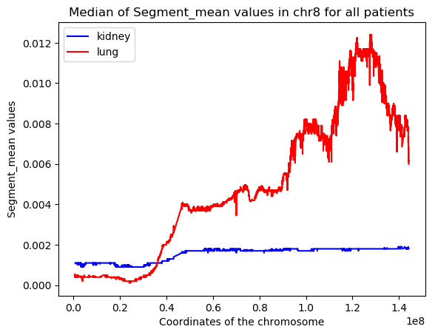
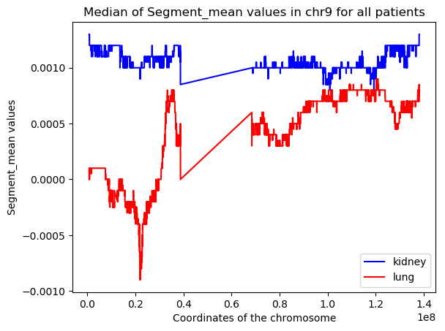
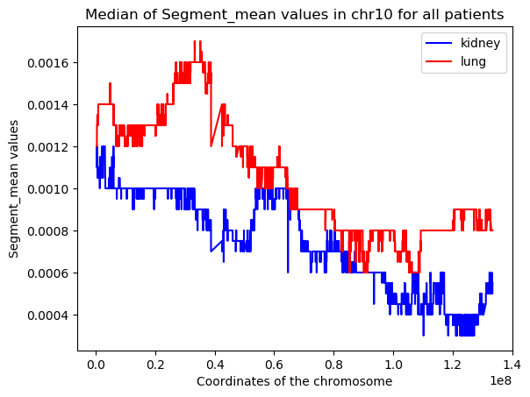
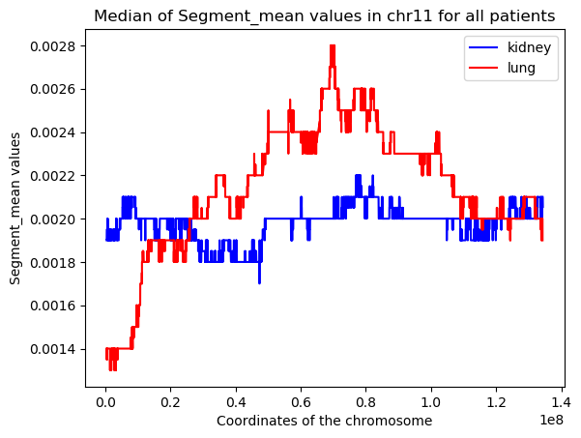
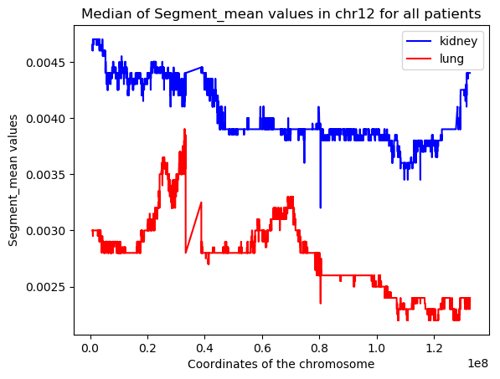
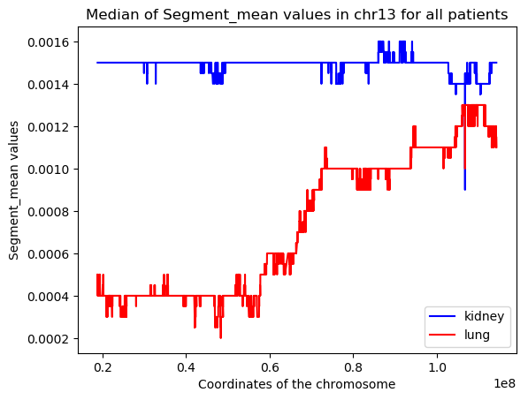
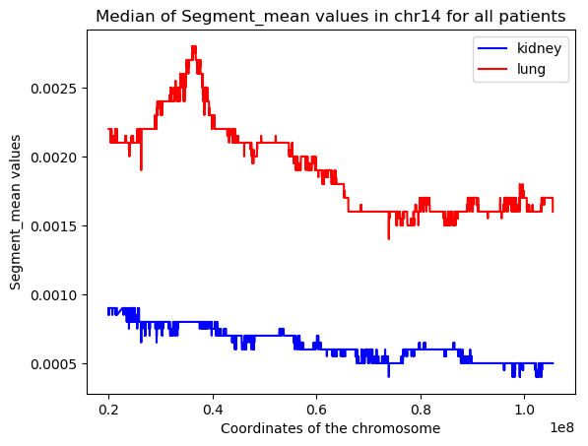
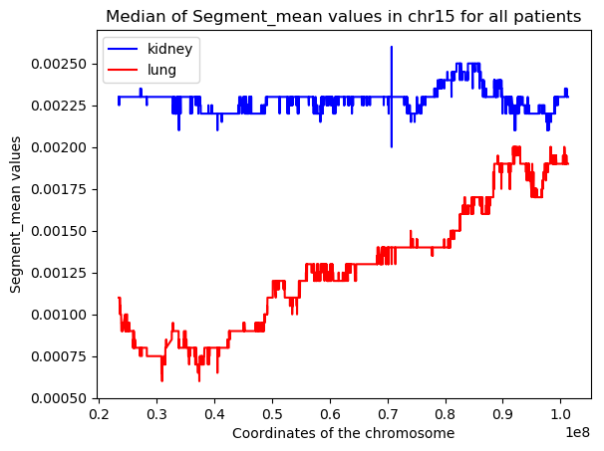
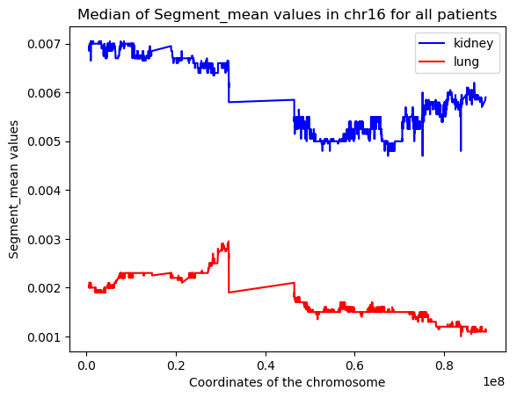
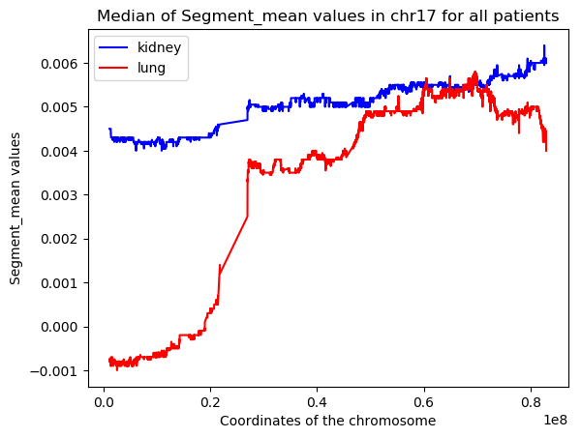
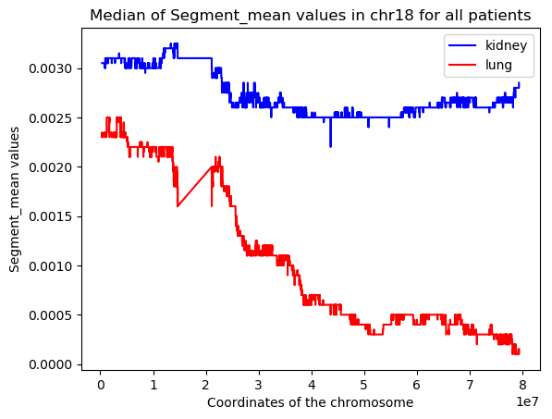
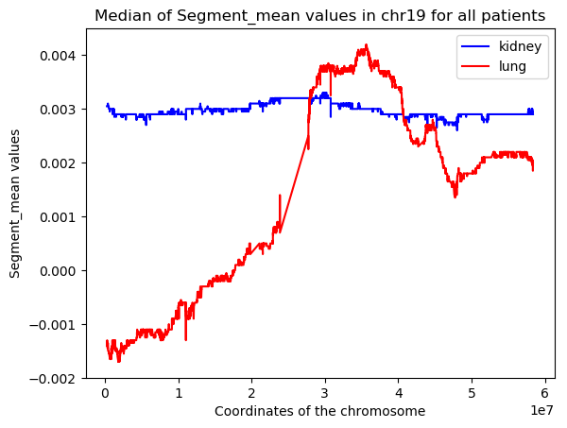
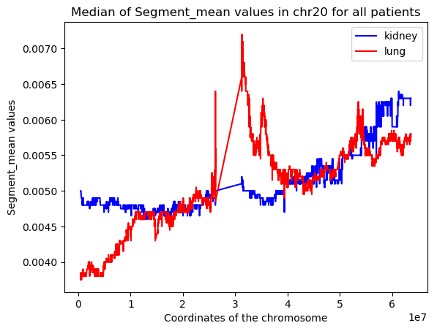
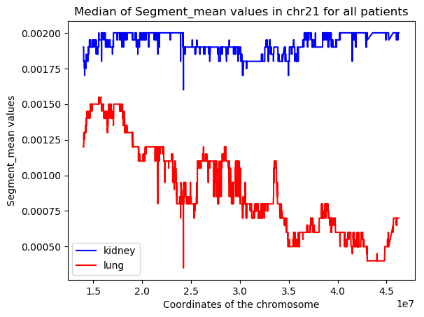
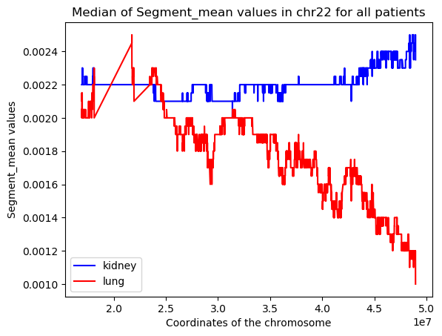
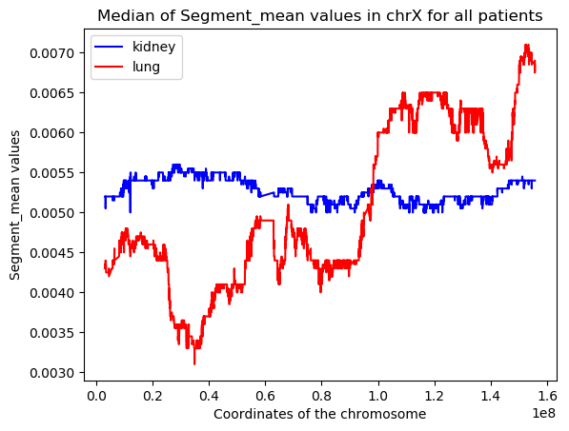
The CNV data in the chromosomes: kidney vs lung

Slide 8
The CNV data in the chromosomes: kidney vs lung
Some regions of the chromosomes show a remarkable difference in the segment mean value when the data coming from the kidney is compared to the one from the lung.
The extent of the region of the chromosome characterized by a great difference between kideny and lung data was calculated for each chromosome and returned as a percentage of its total length.
Notes:
For chromosome 1, 5, 7, 8, 16, 17 the regions with difference between the sm value of the kidney and the sm value of the lung bigger than 0.005 occupied a large portion of the chromosome itself. It is reasonable to assume that these chromosomes could be more relevant in the classification process with respect to the others. It can be also assumed that the values corresponding to chromosome 4, 10 and 11 are so similar that the classification tool could be unable to discern between kidney and lung.

Slide 9
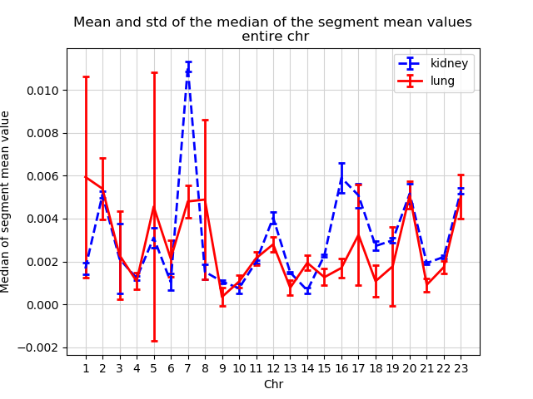
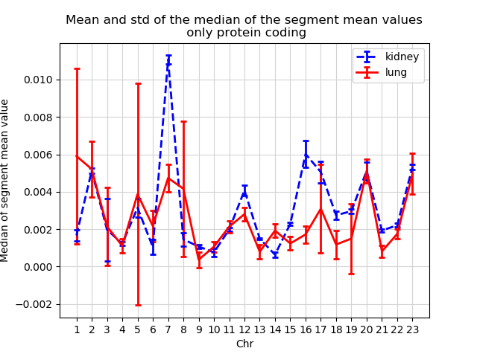
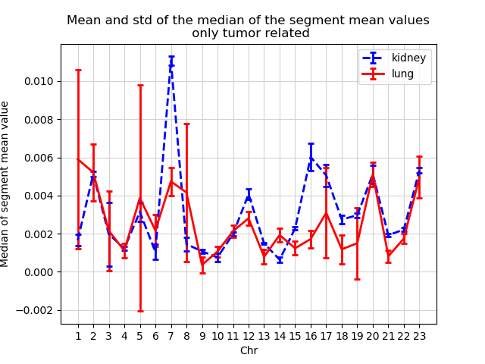
Distribution of the CNV
For some of the chromosomes the separation of values is evident and this behavior is confirmed also when looking at the protein coding regions and the tumor related regions.

Slide 10
Feature selection
406333 is the number of features obtained in the first step. In order to use the machine learning tools these features must be greatly reduced. The reduction followed 3 different approaches:
# of features
Var thresh | Var | Var & rand forest | Var & short segments
0.1 | 762 | 135 | 69
0.09 | 1225 | 183 | 111
0.08 | 1973 | 232 | 161
0.07 | 4564 | 207 | 389
Variance
This method removes features with variation below a certain cutoff.
The idea is when a feature doesn’t vary much within itself, it generally has very little predictive power. Variance Threshold doesn’t consider the relationship of features with the target variable.
Variance + Random forest
Random forest was used as a filter to obtain the best features for the classification task.
Variance + short segments
As previously said some segments appear to be really small but at the same time containing the greatest segment mean values so only these features were retained

Slide 11
Distribution of the features
From this qualitative analysis we can assume that the feature set obtained with variance 0.07 & random forest is likely to classify better than the one obtained with the same variance & short segments.

Slide 12
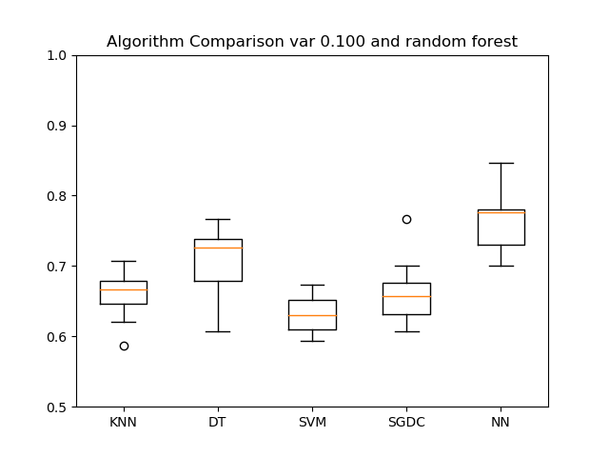
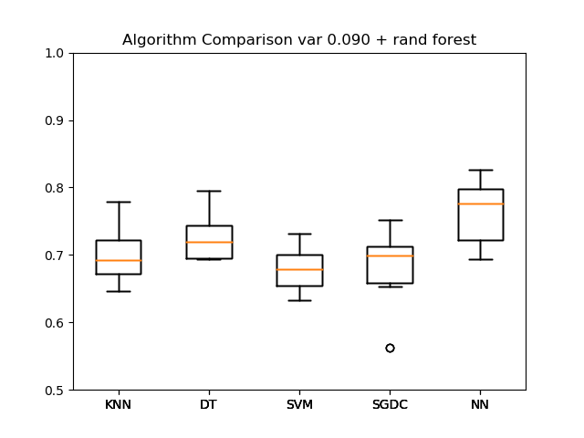
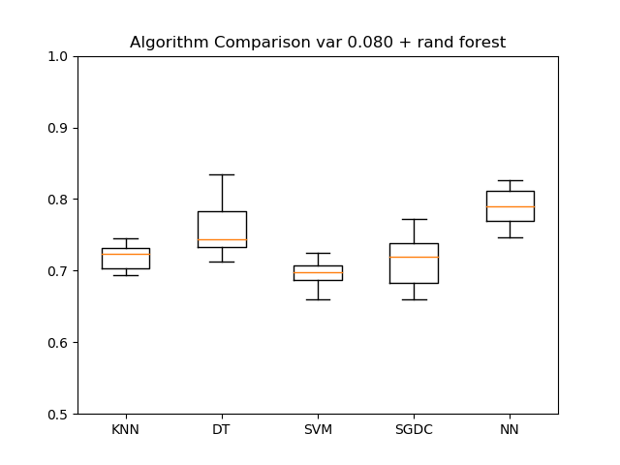
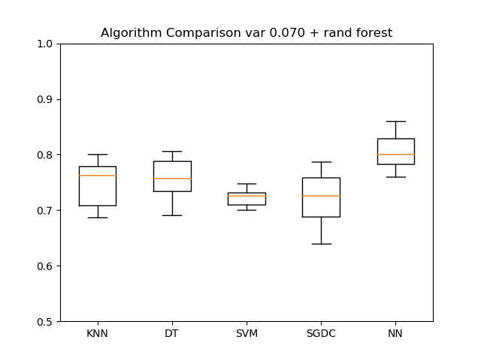
Results: variance + random forest
Cross Validation over 10 folds.
Mean +- std of the accuracy of the training set:
Max accuracy: 0.8 for the neural network and variance threshold = 0.070 (# of features 207)

Slide 13
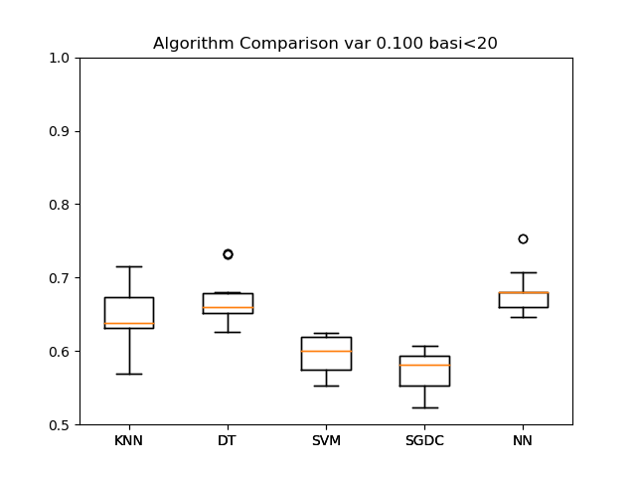
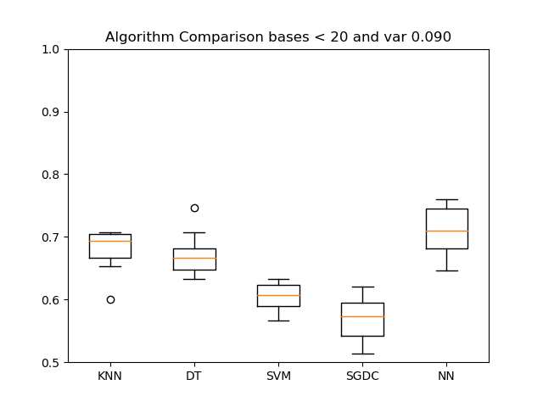
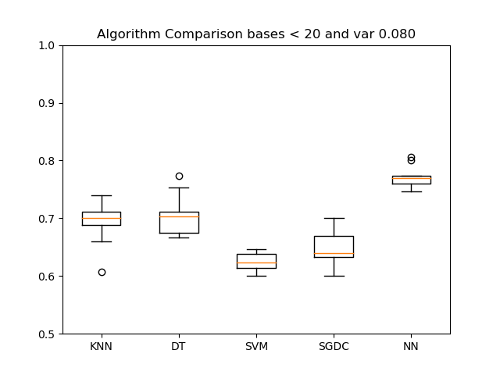
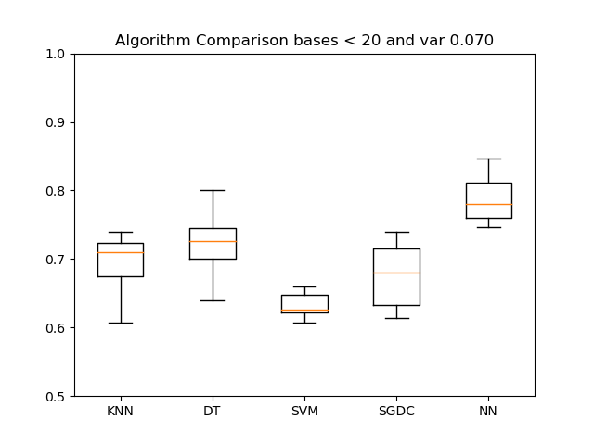
Results: variance + short segments
Cross Validation over 10 folds.
Mean +- std of the accuracy of the training set:
Max accuracy: 0.78 for the neural network and variance threshold = 0.070 (# of features 389)

Slide 14
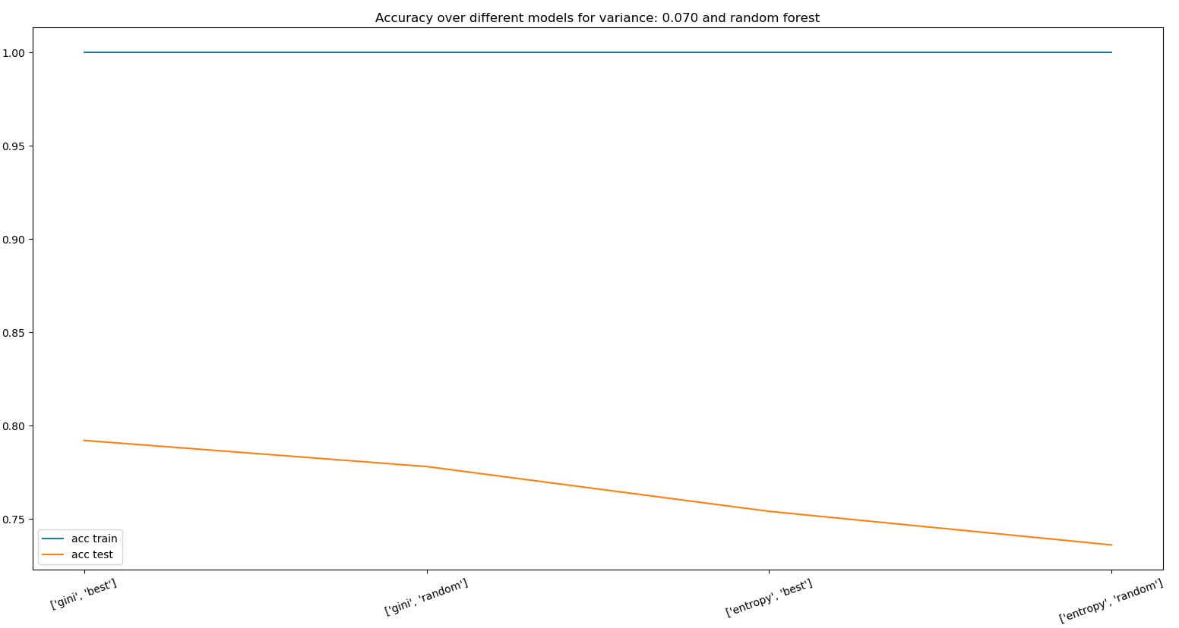
Decision Tree
Best confusion matrix train
 | True | False
Positive | 752 | 0
Negative | 0 | 748
The feature set was the one with variance = 0.07 and random forest.
kidney
lung
Best confusion matrix test
 | True | False
Positive | 201 | 47
Negative | 57 | 195
Max accuracy test: 1-0.79 with «gini» for the information gain and «best» splitter

Slide 15
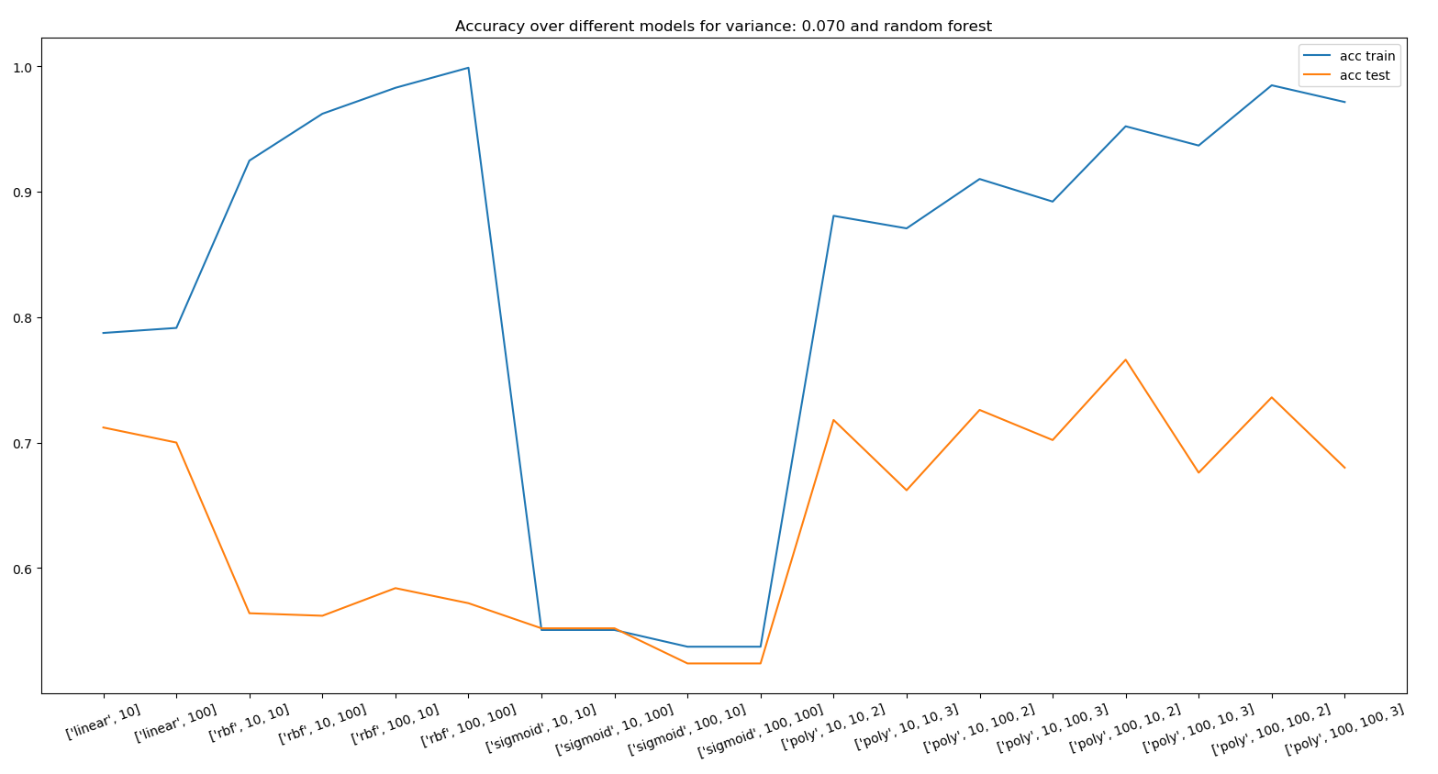
SVM
Best confusion matrix train
 | True | False
Positive | 681 | 71
Negative | 1 | 747
The feature set was the one with variance = 0.07 and random forest.
The possible C and gamma were 10, 50, 100.
Best confusion matrix test
 | True | False
Positive | 172 | 76
Negative | 41 | 211
Max accuracy: 0.95-0.76 for kernel «poly», gamma «100», C «10», degree «2»

Slide 16
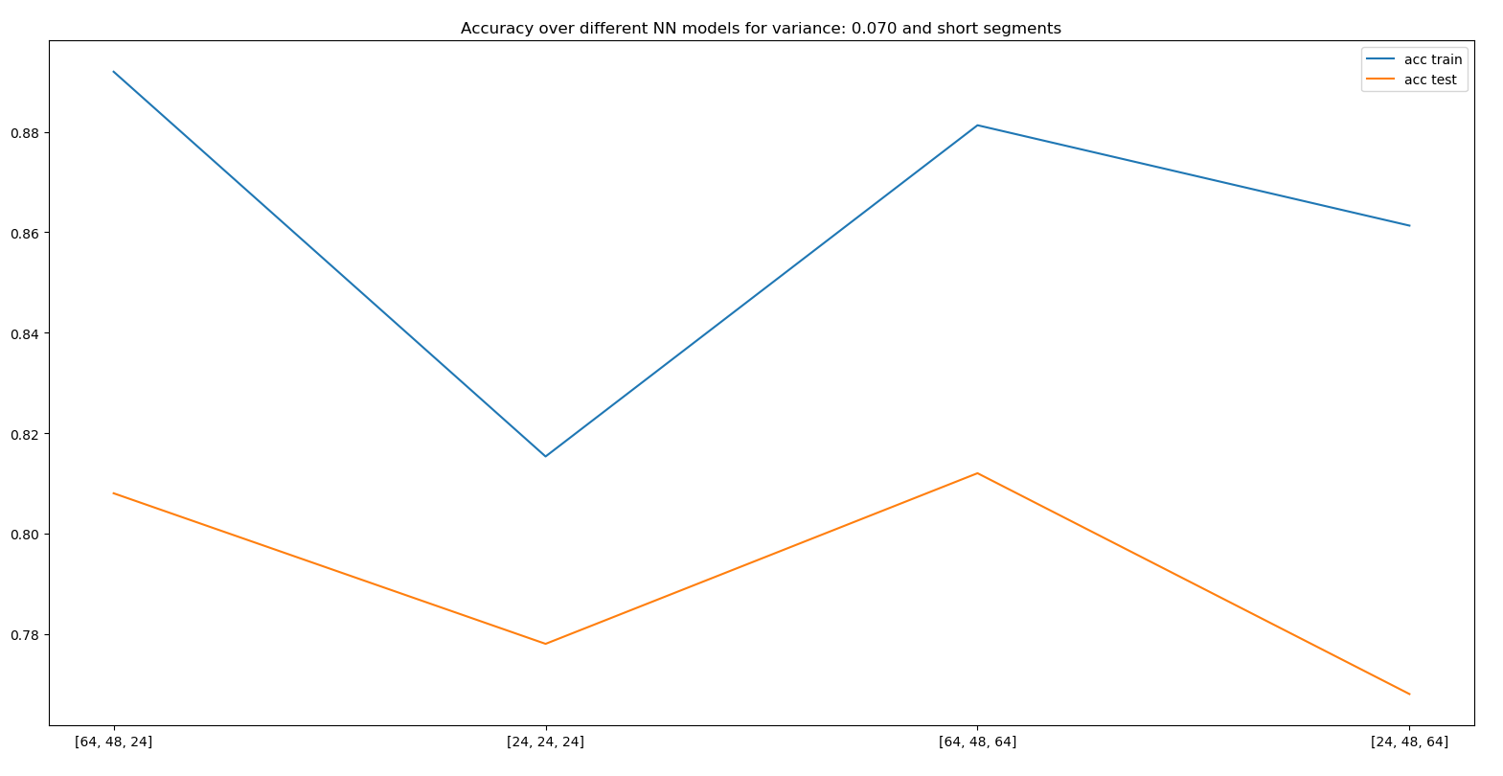
Multilayer perceptron
Best confusion matrix train
 | True | False
Positive | 645 | 107
Negative | 55 | 693
The feature set chosen was variance = 0.07 and random forest.
Parameters: 3-layers, learning rate = 0.001
Best confusion matrix test
 | True | False
Positive | 195 | 53
Negative | 43 | 209
Max accuracy: 0.89-0.81 for the configuration 64-48-24
Notes:
several 3-layer neural networks models were built, with different combinations of number of nodes, to test which model would solve the classification in the most efficient way. Accuracy was used as performance measure.

Slide 17
Conclusions
Machine learning is an effective tool for this kind of problem but it does not work perfectly
Different feature selection methods could improve the performances

Slide 18
THANKS!

