Slide 1
CNV data as a biomarker for cancer types
Machine learning / Deep learning

Slide 2
GDC
The data was provided by the GDC portal and it covers kidney and lung tumours.
GDC “identified genomic regions that are repeated and inferred the copy number of these repeats” and in particular Circular Binary Segmentation (CBS) analysis was performed.
“CBS translates noisy intensity measurements into chromosomal regions of equal copy number” furthermore it “performs well in identifying changes and estimating their location especially when detecting narrow regions of change”.
“The GDC further transforms these copy number values into segment mean values which are equal to log2(copy-number/2)”
Type of region | Copy number value
Diploid | =0
Amplification | >0
Deletion | <0
https://docs.gdc.cancer.gov/Data/Bioinformatics_Pipelines/CNV_Pipeline/
https://academic.oup.com/biostatistics/article/5/4/557/275197 “Circular binary segmentation for the analysis of array-based DNA copy number data” ADAM B. OLSHEN, E. S. VENKATRAMAN, ROBERT LUCITO, MICHAEL WIGLER

Slide 3
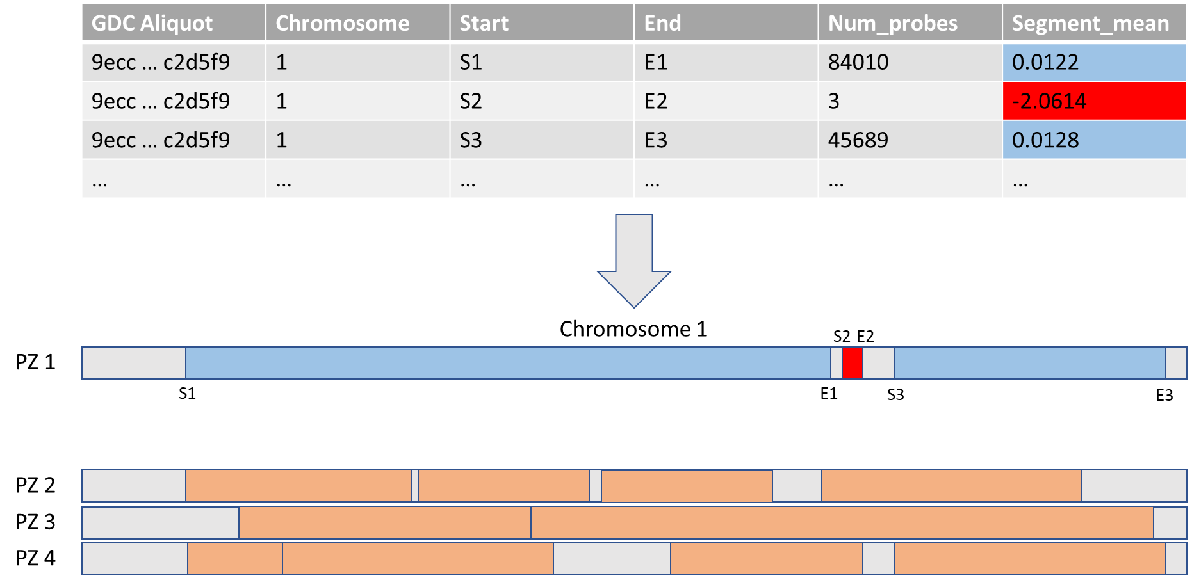
Original Dataset

Slide 4
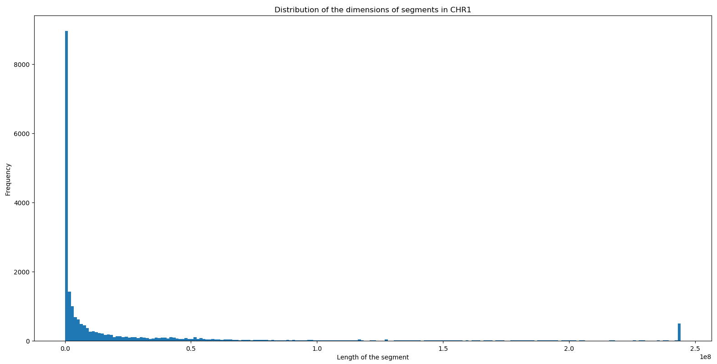
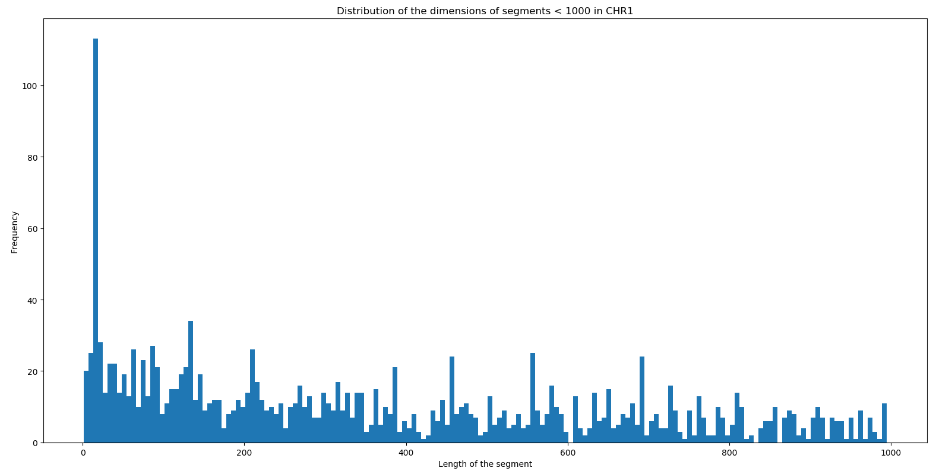
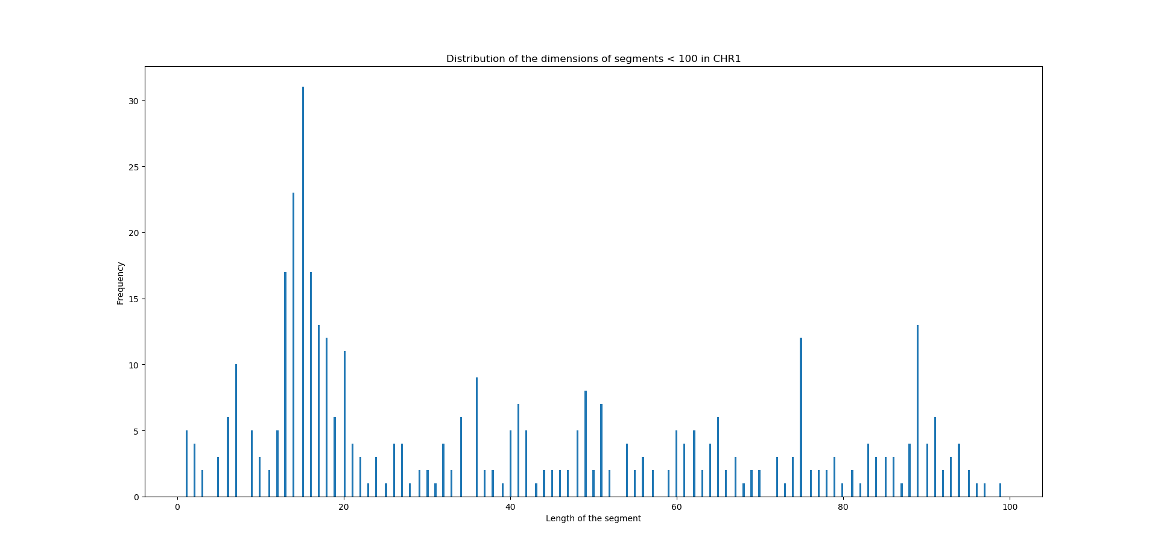
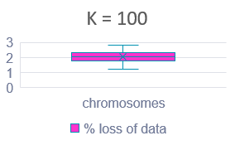
First approach
The first attempt was segmenting the chromosome with step «k». «k» was chosen after the evaluation of the histogram of the distribution of the segment lengths for all of the given patients.
The vast majority of the segments were characterized by a length smaller than 2 * 10^6.
K=1000
K=100
Going further in the analysis it was found that a non negligeable number of segments were of smaller dimensions.
To avoid the loss of too much data a step of 100 bases was considered acceptable.
There was a loss of 1-3% of data, depending on the chromosome.

Slide 5
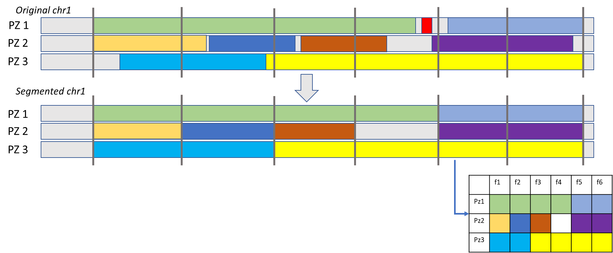
First approach: results
The chromosome was then divided in n segments of lenght k. The new segments were characterized by the value that was predominant (i.e. covered more of the 60% of its length) in the original dataset
Issues:
Some information could be lost at the borders of the segments
Values related to small regions would be discarded in any case
Actually the highest (and possibly the most relevant) CNV values were found in the smallest regions.

Slide 6
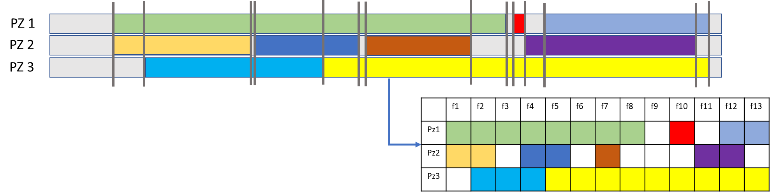
Second approach
A variable step was then used to overcome the issues: a new segment was generated from each breakpoint as shown in the figure.
Issues:
The number of segments increased considerably
New segments were created even when the CNV value was not indicated (blank regions hence diploid)
The number of redundant data increased
Advantages
The entirety of the information was extracted and retained, the small segments (like the red one) were reported in the final matrix
No alteration of data
No assumptions
In the end a 2.000x400.000 matrix was obtained

Slide 7
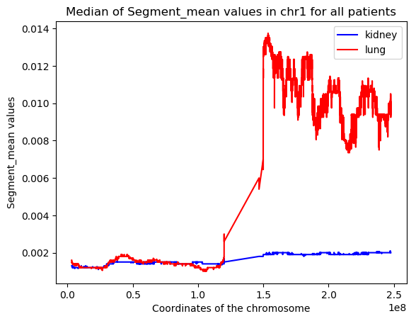
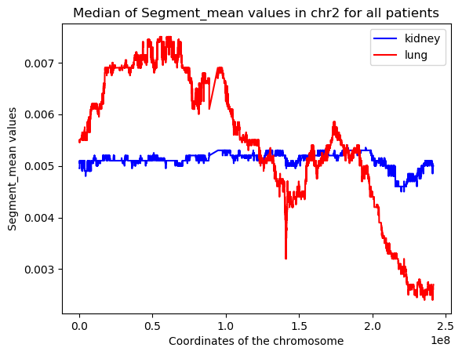
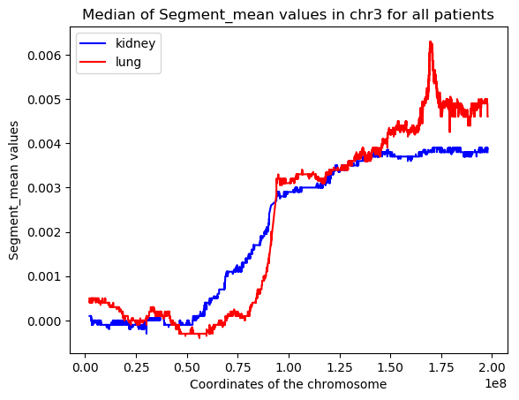
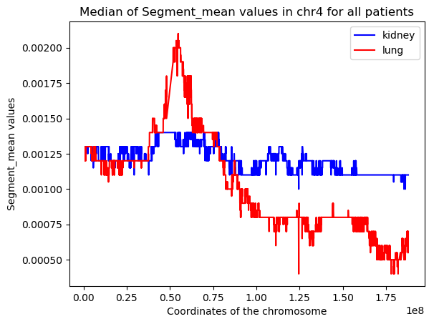
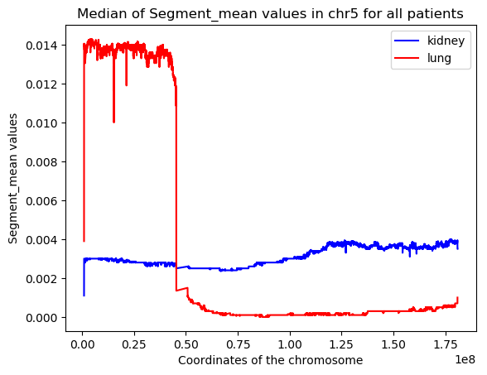
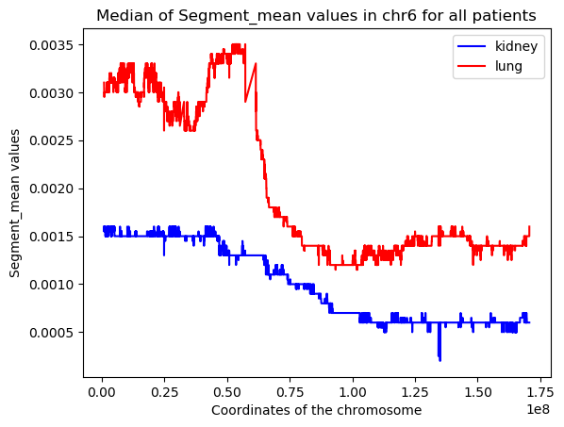
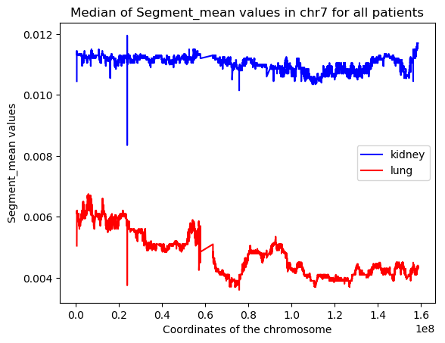
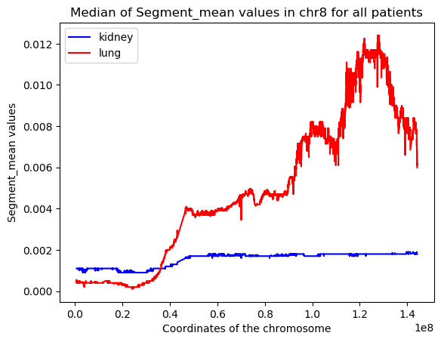
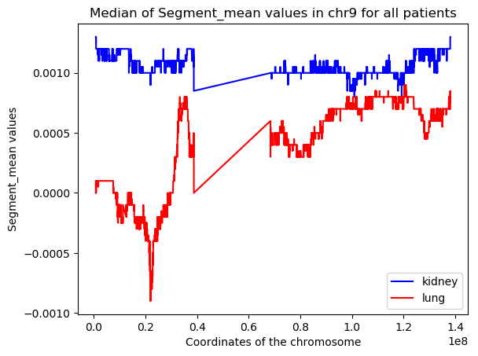
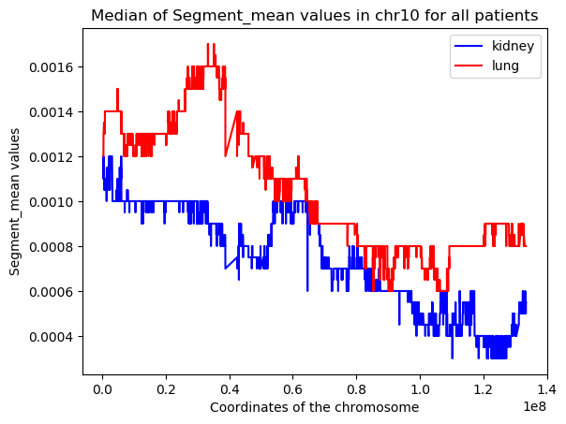
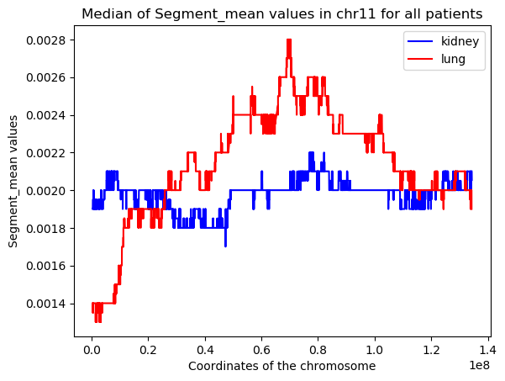
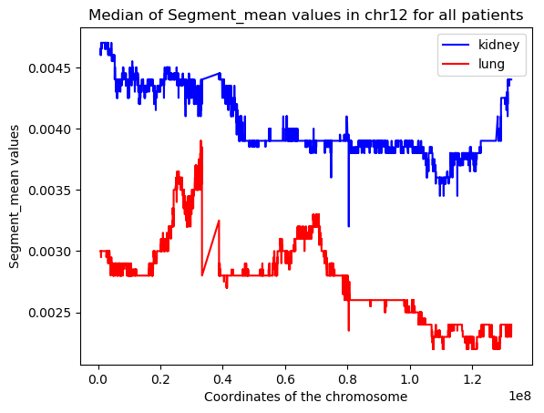
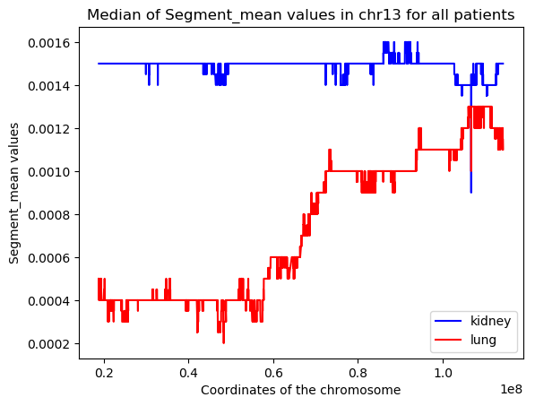
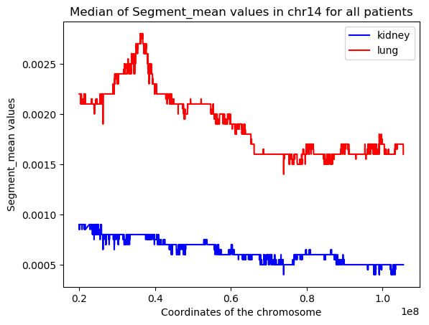
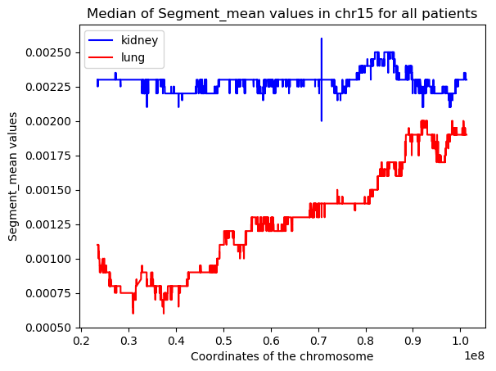
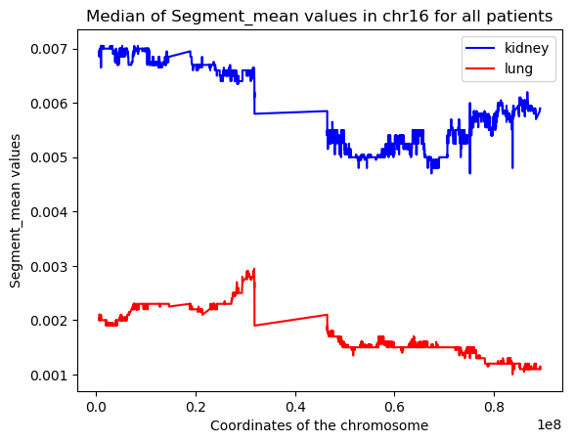
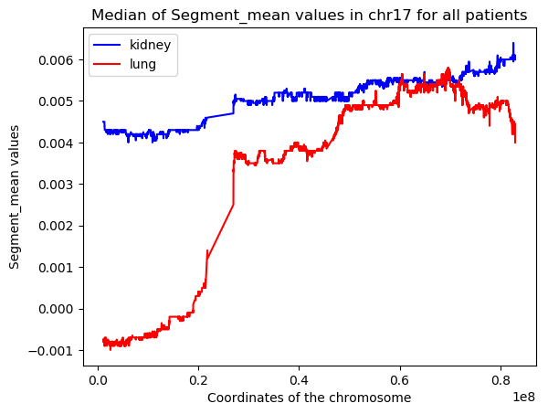
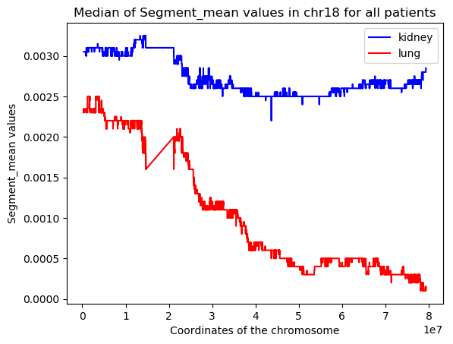
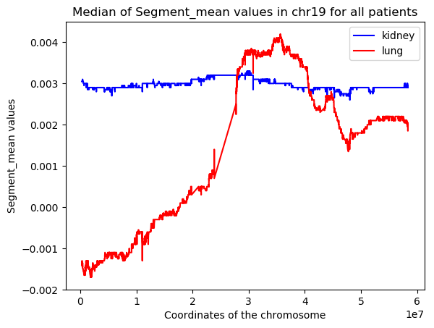
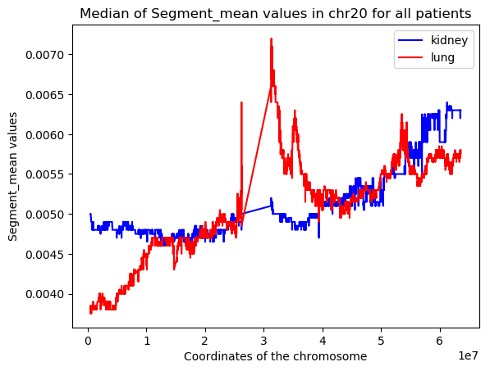
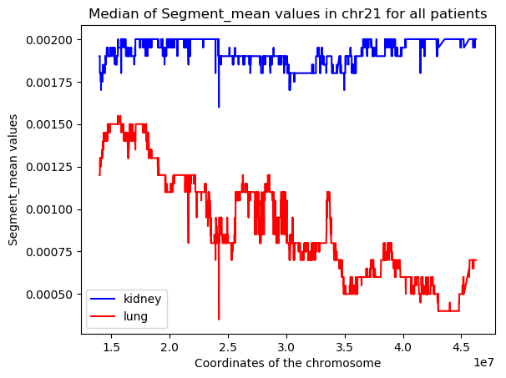
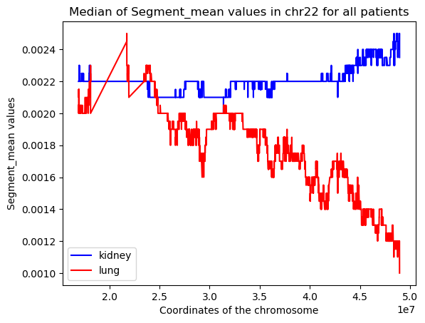
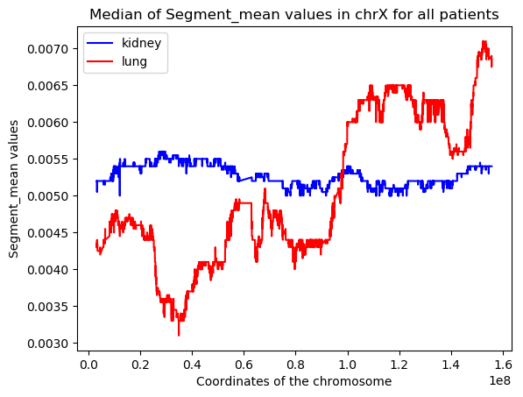
The CNV data in the chromosomes: kidney vs lung

Slide 8
The CNV data in the chromosomes: kidney vs lung
Some regions of the chromosomes show a remarkable difference in the segment mean value when the data coming from the kidney is compared to the one from the lung.
The extent of the region of the chromosome characterized by a great difference between kideny and lung data was calculated for each chromosome and returned as a percentage of its total length.
Notes:
For chromosome 1, 5, 7, 8, 16, 17 the regions with difference between the sm value of the kidney and the sm value of the lung bigger than 0.005 occupied a large portion of the chromosome itself. It is reasonable to assume that these chromosomes could be more relevant in the classification process with respect to the others. It can be also assumed that the values corresponding to chromosome 4, 10 and 11 are so similar that the classification tool could be unable to discern between kidney and lung.

Slide 9
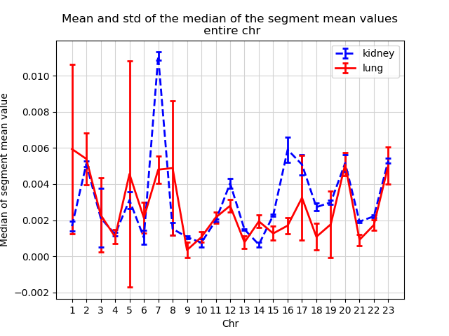
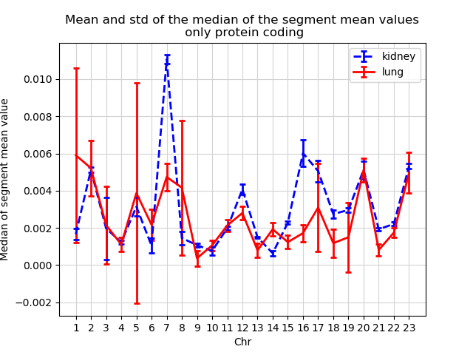
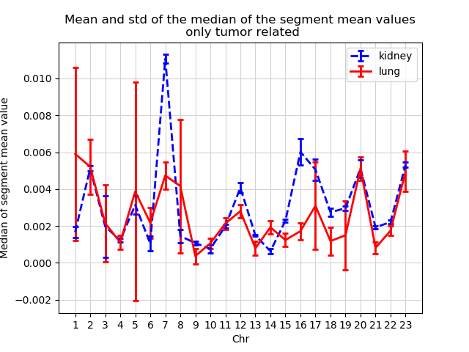
Distribution of the CNV
For some of the chromosomes the separation of values is evident and this behavior is confirmed also when looking at the protein coding regions and the tumor related regions.

Slide 10
Feature selection
406333 is the number of features obtained in the first step. In order to use the machine learning tools these features must be greatly reduced. The reduction followed 3 different approaches:
# of features
Var thresh | Var | Var & rand forest | Var & short segments
0.12
0.11
0.1 | 762 | 135 | 69
0.09 | 1225 | 183 | 111
0.08 | 1973 | 232 | 161
0.07 | 4564 | 207 | 389
Variance
This method removes features with variation below a certain cutoff.
The idea is when a feature doesn’t vary much within itself, it generally has very little predictive power. Variance Threshold doesn’t consider the relationship of features with the target variable.
Variance + random forest
A cascade of variance and random forest was used as feature selection method to reduce even more the number of features.
Variance + short segments
As previously said some segments appear to be really small but at the same time containing the greatest segment mean values so only these features were retained

Slide 11
Distribution of the features in the best feature selection dataset

Slide 12
Results: variance
Cross Validation over 10 folds, accuracy on the training set:
Mean +- std of the accuracy of the training set:
Max accuracy: 0. for the neural network and variance threshold = 0. (# of features -)

Slide 13
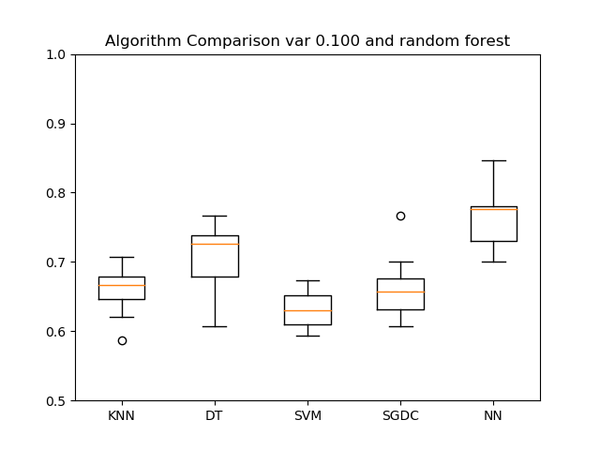
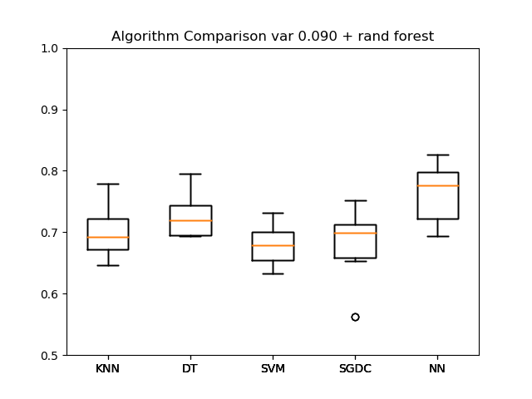
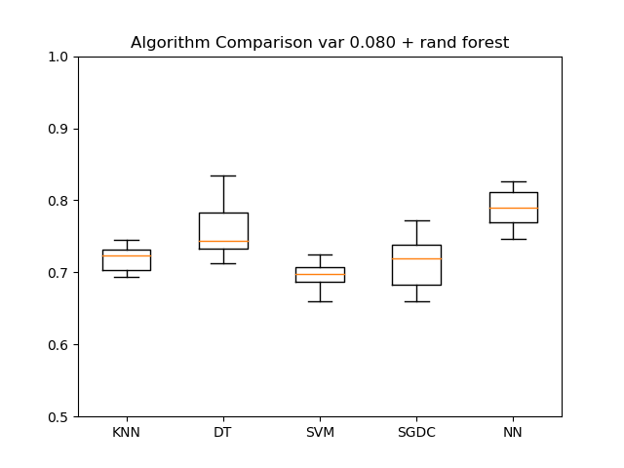
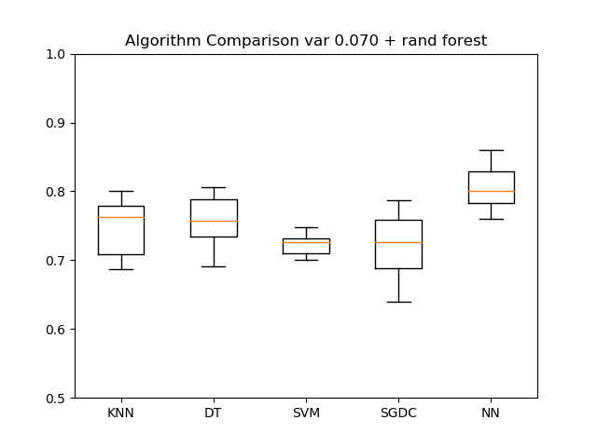
Results: variance + random forest
Cross Validation over 10 folds.
Mean +- std of the accuracy of the training set
Max accuracy: 0.76 for the neural network and variance threshold = 0.100 (# of features -)

Slide 14
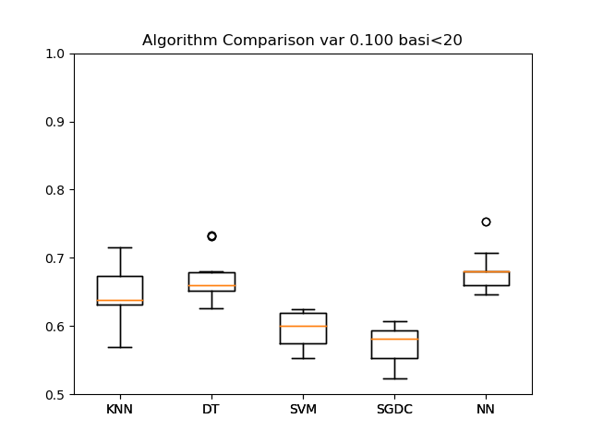
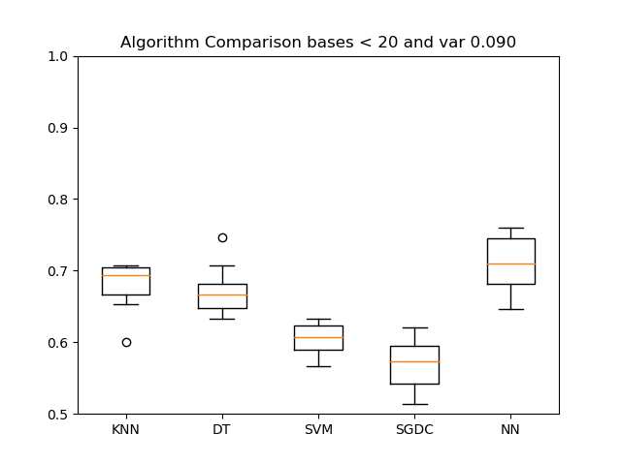
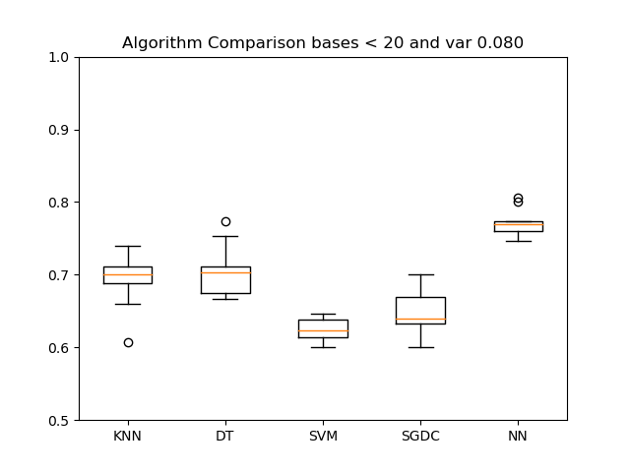
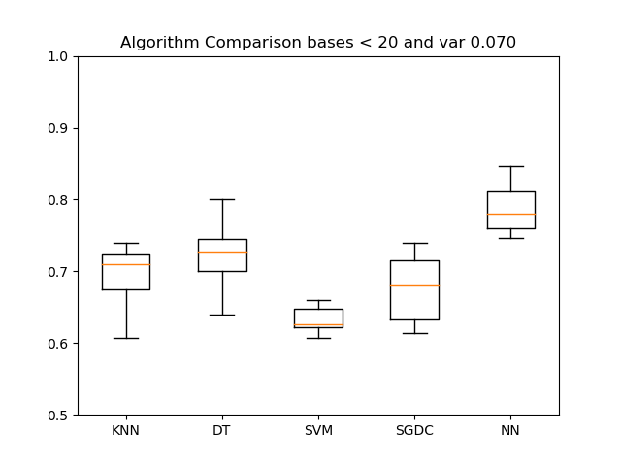
Results: variance + short segments
Cross Validation over 10 folds, accuracy on the training set.
Mean +- std of the accuracy of the training set:
Max accuracy: 0.78 for the neural network and variance threshold = 0.070 (# of features 389)

Slide 15
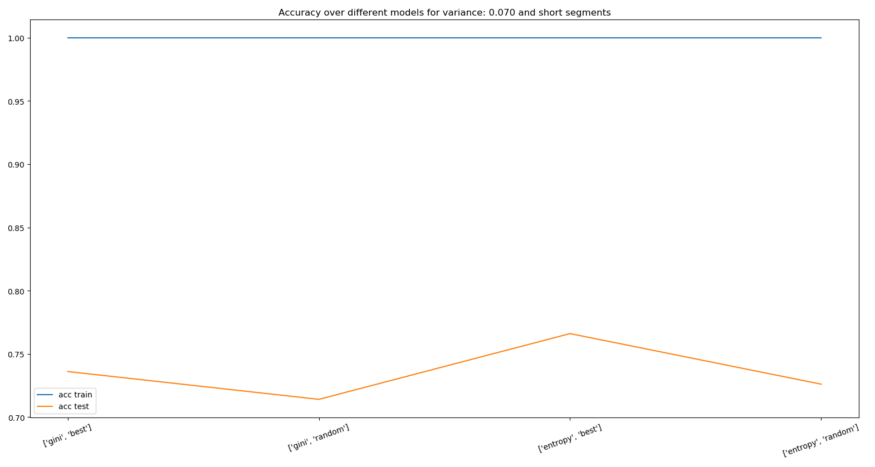
Decision Tree
Best confusion matrix train
 | True | False
Positive | 752 | 0
Negative | 0 | 748
kidney
Assuming that the best feature selection method was variance = 0.07 and short segments.
lung
Best confusion matrix test
 | True | False
Positive | 194 | 54
Negative | 63 | 189
Max accuracy test: 1-0.77 with «entropy» for the information gain and «best» splitter

Slide 16
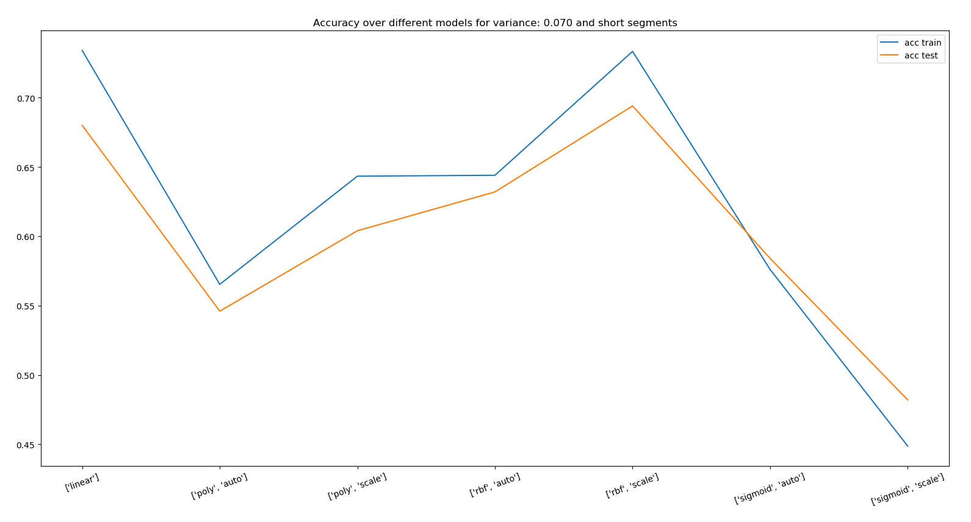
SVM
Best confusion matrix train
 | True | False
Positive | 730 | 22
Negative | 378 | 370
Assuming that the best feature selection method was variance = 0.07 and short segments.
Best confusion matrix test
 | True | False
Positive | 230 | 18
Negative | 135 | 117
Max accuracy: 0.73-0.69 for «rbf» and «scale»

Slide 17
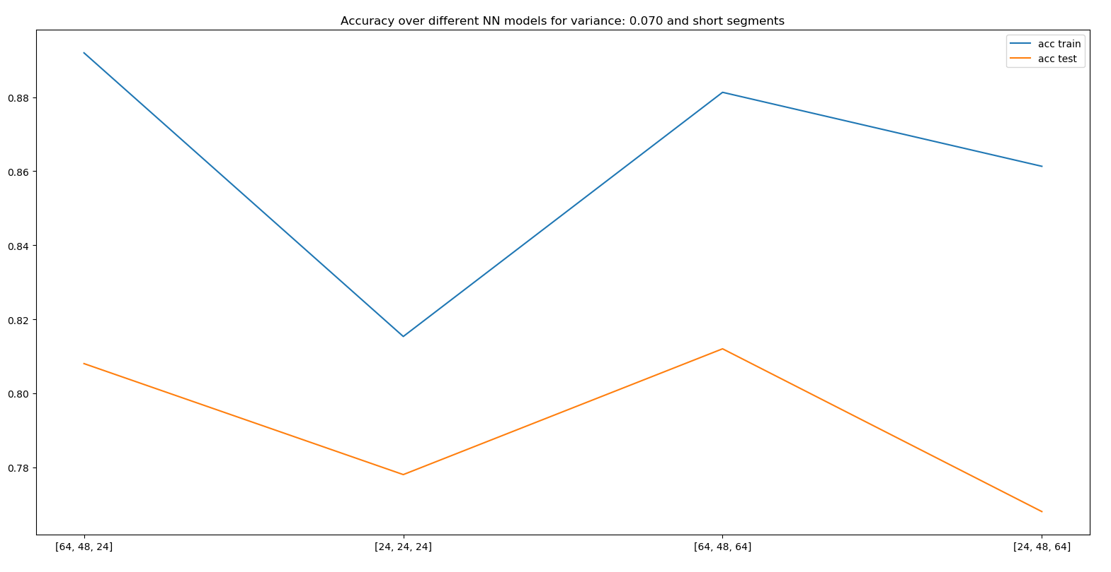
Multilayer perceptron
Best confusion matrix train
 | True | False
Positive | 645 | 107
Negative | 55 | 693
Assuming that the best feature selection method was variance = 0.07 and short segments
Best confusion matrix test
 | True | False
Positive | 195 | 53
Negative | 43 | 209
Max accuracy: 0.89-0.81 for the configuration 64-48-24
Notes:
several 3-layer neural networks models were built, with different combinations of number of nodes, to test which model would solve the classification in the most efficient way. Accuracy was used as performance measure.

Slide 18
Conclusions
Machine learning is an effective tool for this kind of problem but it does not work perfectly
Variance was not the right feature selection measure

Slide 19
THANKS!

Slide 20
Warnings/criticità
Alcuni geni risultano al di fuori della regione individuata:
Caso protein coding:
gene ENSG00000197437 outside of defined region!
gene ENSG00000169214 outside of defined region!
gene ENSG00000239395 outside of defined region!
gene ENSG00000241128 outside of defined region!
gene ENSG00000153230 outside of defined region!
gene ENSG00000221888 outside of defined region!
gene ENSG00000196772 outside of defined region!
gene ENSG00000197591 outside of defined region!
gene ENSG00000162722 outside of defined region!
gene ENSG00000238243 outside of defined region!
gene ENSG00000177462 outside of defined region!
gene ENSG00000177275 outside of defined region!
gene ENSG00000279263 outside of defined region!
gene ENSG00000187080 outside of defined region!
gene ENSG00000197454 outside of defined region!
gene ENSG00000203663 outside of defined region!
gene ENSG00000198128 outside of defined region!
gene ENSG00000196071 outside of defined region!
gene ENSG00000162727 outside of defined region!
gene ENSG00000198601 outside of defined region!
gene ENSG00000228198 outside of defined region!
gene ENSG00000171180 outside of defined region!
gene ENSG00000177212 outside of defined region!
gene ENSG00000177201 outside of defined region!
gene ENSG00000177186 outside of defined region!
gene ENSG00000177174 outside of defined region!
gene ENSG00000196944 outside of defined region!
gene ENSG00000198104 outside of defined region!
gene ENSG00000175143 outside of defined region!
gene ENSG00000196240 outside of defined region!
gene ENSG00000196539 outside of defined region!
gene ENSG00000203661 outside of defined region!
gene ENSG00000188558 outside of defined region!
gene ENSG00000182783 outside of defined region!
gene ENSG00000183310 outside of defined region!
gene ENSG00000184022 outside of defined region!
gene ENSG00000279301 outside of defined region!
gene ENSG00000177151 outside of defined region!
gene ENSG00000187701 outside of defined region!
gene ENSG00000189181 outside of defined region!
gene ENSG00000259823 outside of defined region!
gene ENSG00000175137 outside of defined region!
gene ENSG00000171161 outside of defined region!
gene ENSG00000171163 outside of defined region!
gene ENSG00000185220 outside of defined region!
45 genes out of 2043 were outside of the defined regions of chr 1
gene ENSG00000176720 outside of defined region!
gene ENSG00000176946 outside of defined region!
gene ENSG00000168397 outside of defined region!
gene ENSG00000168393 outside of defined region!
gene ENSG00000168395 outside of defined region!
gene ENSG00000180902 outside of defined region!
gene ENSG00000154252 outside of defined region!
gene ENSG00000204099 outside of defined region!
gene ENSG00000188389 outside of defined region!
gene ENSG00000188011 outside of defined region!
gene ENSG00000216921 outside of defined region!
11 genes out of 1245 were outside of the defined regions of chr 2
gene ENSG00000114473 outside of defined region!
gene ENSG00000182899 outside of defined region!
gene ENSG00000185621 outside of defined region!
3 genes out of 1076 were outside of the defined regions of chr 3
gene ENSG00000179059 outside of defined region!
gene ENSG00000179046 outside of defined region!
gene ENSG00000184108 outside of defined region!
gene ENSG00000109536 outside of defined region!
gene ENSG00000205097 outside of defined region!
gene ENSG00000260596 outside of defined region!
6 genes out of 752 were outside of the defined regions of chr 4
gene ENSG00000168903 outside of defined region!
gene ENSG00000165810 outside of defined region!
gene ENSG00000185372 outside of defined region!
gene ENSG00000182613 outside of defined region!
gene ENSG00000146054 outside of defined region!
gene ENSG00000146063 outside of defined region!
gene ENSG00000204628 outside of defined region!
gene ENSG00000183718 outside of defined region!
gene ENSG00000230178 outside of defined region!
9 genes out of 884 were outside of the defined regions of chr 5
0 genes out of 1044 were outside of the defined regions of chr 6
gene ENSG00000146918 outside of defined region!
gene ENSG00000117868 outside of defined region!
gene ENSG00000126870 outside of defined region!
gene ENSG00000106018 outside of defined region!
4 genes out of 910 were outside of the defined regions of chr 7
gene ENSG00000261236 outside of defined region!
gene ENSG00000260428 outside of defined region!
gene ENSG00000185122 outside of defined region!
gene ENSG00000185000 outside of defined region!
gene ENSG00000261678 outside of defined region!
gene ENSG00000261587 outside of defined region!
gene ENSG00000271698 outside of defined region!
gene ENSG00000185803 outside of defined region!
gene ENSG00000182325 outside of defined region!
gene ENSG00000173137 outside of defined region!
gene ENSG00000071894 outside of defined region!
gene ENSG00000147804 outside of defined region!
gene ENSG00000160948 outside of defined region!
gene ENSG00000160949 outside of defined region!
gene ENSG00000187954 outside of defined region!
gene ENSG00000167702 outside of defined region!
gene ENSG00000160973 outside of defined region!
gene ENSG00000160972 outside of defined region!
gene ENSG00000167701 outside of defined region!
gene ENSG00000167700 outside of defined region!
gene ENSG00000160957 outside of defined region!
gene ENSG00000160959 outside of defined region!
gene ENSG00000254402 outside of defined region!
gene ENSG00000213563 outside of defined region!
gene ENSG00000147799 outside of defined region!
gene ENSG00000198169 outside of defined region!
gene ENSG00000196378 outside of defined region!
gene ENSG00000161016 outside of defined region!
gene ENSG00000197363 outside of defined region!
gene ENSG00000147789 outside of defined region!
gene ENSG00000170619 outside of defined region!
gene ENSG00000196150 outside of defined region!
gene ENSG00000170631 outside of defined region!
gene ENSG00000182307 outside of defined region!
34 genes out of 683 were outside of the defined regions of chr 8
0 genes out of 776 were outside of the defined regions of chr 9
gene ENSG00000203772 outside of defined region!
gene ENSG00000214279 outside of defined region!
gene ENSG00000130649 outside of defined region!
gene ENSG00000171772 outside of defined region!
gene ENSG00000225899 outside of defined region!
5 genes out of 729 were outside of the defined regions of chr 10
gene ENSG00000166105 outside of defined region!
gene ENSG00000149328 outside of defined region!
gene ENSG00000109956 outside of defined region!
3 genes out of 1309 were outside of the defined regions of chr 11
gene ENSG00000187848 outside of defined region!
gene ENSG00000177084 outside of defined region!
gene ENSG00000176894 outside of defined region!
gene ENSG00000247077 outside of defined region!
gene ENSG00000176915 outside of defined region!
gene ENSG00000090615 outside of defined region!
gene ENSG00000072609 outside of defined region!
gene ENSG00000196458 outside of defined region!
gene ENSG00000198393 outside of defined region!
gene ENSG00000198040 outside of defined region!
gene ENSG00000196387 outside of defined region!
gene ENSG00000214029 outside of defined region!
gene ENSG00000256223 outside of defined region!
gene ENSG00000256825 outside of defined region!
gene ENSG00000090612 outside of defined region!
gene ENSG00000227059 outside of defined region!
16 genes out of 1036 were outside of the defined regions of chr 12
gene ENSG00000130177 outside of defined region!
gene ENSG00000169062 outside of defined region!
gene ENSG00000198824 outside of defined region!
3 genes out of 321 were outside of the defined regions of chr 13
0 genes out of 613 were outside of the defined regions of chr 14
gene ENSG00000184277 outside of defined region!
gene ENSG00000185418 outside of defined region!
gene ENSG00000184140 outside of defined region!
gene ENSG00000182854 outside of defined region!
gene ENSG00000177693 outside of defined region!
5 genes out of 600 were outside of the defined regions of chr 15
gene ENSG00000197912 outside of defined region!
gene ENSG00000167526 outside of defined region!
gene ENSG00000178773 outside of defined region!
gene ENSG00000015413 outside of defined region!
gene ENSG00000131165 outside of defined region!
gene ENSG00000167523 outside of defined region!
gene ENSG00000185324 outside of defined region!
gene ENSG00000158792 outside of defined region!
gene ENSG00000075399 outside of defined region!
gene ENSG00000158805 outside of defined region!
gene ENSG00000187741 outside of defined region!
gene ENSG00000204991 outside of defined region!
gene ENSG00000141002 outside of defined region!
gene ENSG00000258839 outside of defined region!
gene ENSG00000198211 outside of defined region!
gene ENSG00000258947 outside of defined region!
gene ENSG00000140995 outside of defined region!
gene ENSG00000177946 outside of defined region!
gene ENSG00000003249 outside of defined region!
gene ENSG00000141013 outside of defined region!
gene ENSG00000126856 outside of defined region!
21 genes out of 855 were outside of the defined regions of chr 16
gene ENSG00000176845 outside of defined region!
1 genes out of 1186 were outside of the defined regions of chr 17
gene ENSG00000131196 outside of defined region!
gene ENSG00000060069 outside of defined region!
gene ENSG00000178342 outside of defined region!
gene ENSG00000122490 outside of defined region!
gene ENSG00000226742 outside of defined region!
gene ENSG00000141759 outside of defined region!
gene ENSG00000267127 outside of defined region!
gene ENSG00000101546 outside of defined region!
gene ENSG00000101544 outside of defined region!
gene ENSG00000178184 outside of defined region!
10 genes out of 269 were outside of the defined regions of chr 18
gene ENSG00000083845 outside of defined region!
gene ENSG00000269855 outside of defined region!
gene ENSG00000171574 outside of defined region!
gene ENSG00000131849 outside of defined region!
gene ENSG00000249471 outside of defined region!
gene ENSG00000083812 outside of defined region!
gene ENSG00000083838 outside of defined region!
gene ENSG00000083807 outside of defined region!
gene ENSG00000119574 outside of defined region!
gene ENSG00000130726 outside of defined region!
gene ENSG00000130724 outside of defined region!
gene ENSG00000130725 outside of defined region!
gene ENSG00000099326 outside of defined region!
13 genes out of 1472 were outside of the defined regions of chr 19
gene ENSG00000197457 outside of defined region!
gene ENSG00000258366 outside of defined region!
gene ENSG00000026036 outside of defined region!
gene ENSG00000243509 outside of defined region!
gene ENSG00000101246 outside of defined region!
gene ENSG00000197114 outside of defined region!
gene ENSG00000273154 outside of defined region!
gene ENSG00000203896 outside of defined region!
gene ENSG00000273047 outside of defined region!
gene ENSG00000125520 outside of defined region!
gene ENSG00000130584 outside of defined region!
gene ENSG00000183260 outside of defined region!
gene ENSG00000101150 outside of defined region!
gene ENSG00000101152 outside of defined region!
gene ENSG00000198276 outside of defined region!
gene ENSG00000196700 outside of defined region!
gene ENSG00000130590 outside of defined region!
gene ENSG00000101161 outside of defined region!
gene ENSG00000196421 outside of defined region!
gene ENSG00000203883 outside of defined region!
gene ENSG00000171703 outside of defined region!
gene ENSG00000171700 outside of defined region!
gene ENSG00000125510 outside of defined region!
gene ENSG00000171695 outside of defined region!
gene ENSG00000196132 outside of defined region!
gene ENSG00000125522 outside of defined region!
gene ENSG00000203880 outside of defined region!
27 genes out of 543 were outside of the defined regions of chr 20
gene ENSG00000182362 outside of defined region!
gene ENSG00000160298 outside of defined region!
gene ENSG00000160299 outside of defined region!
gene ENSG00000160305 outside of defined region!
gene ENSG00000160307 outside of defined region!
gene ENSG00000160310 outside of defined region!
6 genes out of 231 were outside of the defined regions of chr 21
gene ENSG00000100425 outside of defined region!
gene ENSG00000100426 outside of defined region!
gene ENSG00000182858 outside of defined region!
gene ENSG00000184164 outside of defined region!
gene ENSG00000198355 outside of defined region!
gene ENSG00000188263 outside of defined region!
gene ENSG00000138892 outside of defined region!
gene ENSG00000100427 outside of defined region!
gene ENSG00000073146 outside of defined region!
gene ENSG00000073150 outside of defined region!
gene ENSG00000170638 outside of defined region!
gene ENSG00000073169 outside of defined region!
gene ENSG00000128159 outside of defined region!
gene ENSG00000100429 outside of defined region!
gene ENSG00000188130 outside of defined region!
gene ENSG00000185386 outside of defined region!
gene ENSG00000196576 outside of defined region!
gene ENSG00000205593 outside of defined region!
gene ENSG00000100239 outside of defined region!
gene ENSG00000100241 outside of defined region!
gene ENSG00000128165 outside of defined region!
gene ENSG00000100253 outside of defined region!
gene ENSG00000100258 outside of defined region!
gene ENSG00000025770 outside of defined region!
gene ENSG00000284194 outside of defined region!
gene ENSG00000130489 outside of defined region!
gene ENSG00000025708 outside of defined region!
gene ENSG00000177989 outside of defined region!
gene ENSG00000130487 outside of defined region!
gene ENSG00000217442 outside of defined region!
gene ENSG00000205560 outside of defined region!
gene ENSG00000254413 outside of defined region!
gene ENSG00000100288 outside of defined region!
gene ENSG00000008735 outside of defined region!
gene ENSG00000100299 outside of defined region!
gene ENSG00000251322 outside of defined region!
gene ENSG00000100312 outside of defined region!
gene ENSG00000079974 outside of defined region!
38 genes out of 442 were outside of the defined regions of chr 22
gene ENSG00000168939 outside of defined region!
gene ENSG00000124333 outside of defined region!
gene ENSG00000124334 outside of defined region!
3 genes out of 845 were outside of the defined regions of chr X
Sembra esserci un errrore nel calcolo delle percentuali occupate perché il cromosoma 21 segna 160% e effettvamente non sembrano correlate alle immagini.
Caso tumor suppressor:
gene OR2T6 outside of defined region!
gene TRIM58 outside of defined region!
gene TRIM58 outside of defined region!
3 genes out of 1499 were outside of the defined regions of chr 1
gene ATG4B outside of defined region!
gene BOK outside of defined region!
gene D2HGDH outside of defined region!
gene DTYMK outside of defined region!
gene ING5 outside of defined region!
gene ING5 outside of defined region!
gene ING5 outside of defined region!
7 genes out of 806 were outside of the defined regions of chr 2
0 genes out of 937 were outside of the defined regions of chr 3
0 genes out of 649 were outside of the defined regions of chr 4
gene RACK1 outside of defined region!
gene RACK1 outside of defined region!
gene RACK1 outside of defined region!
gene RACK1 outside of defined region!
gene RACK1 outside of defined region!
gene RACK1 outside of defined region!
gene RACK1 outside of defined region!
gene RACK1 outside of defined region!
gene TRIM52 outside of defined region!
9 genes out of 640 were outside of the defined regions of chr 5
0 genes out of 937 were outside of the defined regions of chr 6
gene VIPR2 outside of defined region!
1 genes out of 969 were outside of the defined regions of chr 7
gene BOP1 outside of defined region!
gene HSF1 outside of defined region!
gene HSF1 outside of defined region!
gene HSF1 outside of defined region!
gene HSF1 outside of defined region!
gene HSF1 outside of defined region!
gene HSF1 outside of defined region!
gene HSF1 outside of defined region!
gene HSF1 outside of defined region!
gene HSF1 outside of defined region!
gene HSF1 outside of defined region!
gene RECQL4 outside of defined region!
gene RECQL4 outside of defined region!
gene RECQL4 outside of defined region!
14 genes out of 886 were outside of the defined regions of chr 8
0 genes out of 839 were outside of the defined regions of chr 9
0 genes out of 732 were outside of the defined regions of chr 10
0 genes out of 1035 were outside of the defined regions of chr 11
gene CHFR outside of defined region!
gene CHFR outside of defined region!
gene CHFR outside of defined region!
3 genes out of 917 were outside of the defined regions of chr 12
0 genes out of 375 were outside of the defined regions of chr 13
0 genes out of 538 were outside of the defined regions of chr 14
0 genes out of 272 were outside of the defined regions of chr 15
gene CDK10 outside of defined region!
gene CDK10 outside of defined region!
gene CHMP1A outside of defined region!
gene CHMP1A outside of defined region!
gene DPEP1 outside of defined region!
gene DPEP1 outside of defined region!
gene FANCA outside of defined region!
gene RPL13 outside of defined region!
gene ZNF276 outside of defined region!
9 genes out of 500 were outside of the defined regions of chr 16
0 genes out of 1245 were outside of the defined regions of chr 17
gene NFATC1 outside of defined region!
gene NFATC1 outside of defined region!
gene NFATC1 outside of defined region!
gene NFATC1 outside of defined region!
gene NFATC1 outside of defined region!
gene NFATC1 outside of defined region!
6 genes out of 316 were outside of the defined regions of chr 18
gene MZF1 outside of defined region!
gene MZF1 outside of defined region!
gene MZF1 outside of defined region!
gene MZF1 outside of defined region!
gene MZF1 outside of defined region!
gene TRIM28 outside of defined region!
gene TRIM28 outside of defined region!
gene TRIM28 outside of defined region!
gene TRIM28 outside of defined region!
gene TRIM28 outside of defined region!
gene TRIM28 outside of defined region!
gene TRIM28 outside of defined region!
gene ZNF132 outside of defined region!
13 genes out of 741 were outside of the defined regions of chr 19
gene PRPF6 outside of defined region!
gene RTEL1 outside of defined region!
gene RTEL1 outside of defined region!
gene SOX18 outside of defined region!
gene SOX18 outside of defined region!
gene TNFRSF6B outside of defined region!
gene TNFRSF6B outside of defined region!
7 genes out of 513 were outside of the defined regions of chr 20
gene S100B outside of defined region!
gene S100B outside of defined region!
gene S100B outside of defined region!
gene S100B outside of defined region!
gene S100B outside of defined region!
gene S100B outside of defined region!
6 genes out of 147 were outside of the defined regions of chr 21
gene MAPK11 outside of defined region!
gene PANX2 outside of defined region!
gene PIM3 outside of defined region!
gene PIM3 outside of defined region!
gene PIM3 outside of defined region!
gene TYMP outside of defined region!
6 genes out of 325 were outside of the defined regions of chr 22
0 genes out of 455 were outside of the defined regions of chr X

