Slide 1
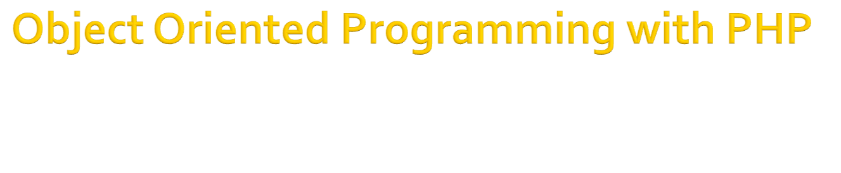

Slide 2

Classes, which are the "blueprints" for an object and are the actual code that defines the properties and methods.
Objects, which are running instances of a class and contain all the internal data and state information needed for your application to function.
Encapsulation, which is the capability of an object to protect access to its internal data
Inheritance, which is the ability to define a class of one kind as being a sub-type of a different kind of class (much the same way a square is a kind of rectangle).

Slide 3

Let's start with a simple example. Save the following in a file called class.lat.php:
<?php
class Demo
{
}
?>

Slide 4

The Demo class isn't particularly useful if it isn't able to do anything, so let's look at how you can create a method.
<?php
class Demo
{
function SayHello($name)
{
echo “Hello $name !”;
}
}
?>

Slide 5

Adding a property to your class is as easy as adding a method.
<?php
class Demo
{
public $name;
function SayHello()
{
echo “Hello $this->$name !”;
}
}
?>

Slide 6

You can instantiate an object of type Demo like this:
<?php
require_once('class.lat.php');
$objDemo = new Demo();
$objDemo->name = “Bayu”;
$objDemo->SayHallo();
?>

Slide 7

There are three different levels of visibility that a member variable or method can have :
  Public
    members are accessible to any and all code
  Private
    members are only accessible to the class itself
  Protected
    members are available to the class itself, and to classes that inherit from it
Public is the default visibility level for any member variables or functions that do not explicitly set one, but it is good practice to always explicitly state the visibility of all the members of the class.

Slide 8

Try to change access level of property named “name” to private of previous code.
What the possible solution of this problem?
Make the getter and setter function...
Always use get and set functions for your properties. Changes to business logic and data validation requirements in the future will be much easier to implement.

Slide 9

It is possible to define constant values on a per-class basis remaining the same and unchangeable.
Constants differ from normal variables in that you don't use the $ symbol to declare or use them
The value must be a constant expression, not (for example) a variable, a property, a result of a mathematical operation, or a function call

Slide 10

<?php
  class MyClass
  {
  const constant = 'constant value';
  function showConstant() {
  echo self::constant . "\n";
  }
  }
  echo MyClass::constant . "\n";
?>

Slide 11

Declaring class properties or methods as static makes them accessible without needing an instantiation of the class.
A property declared as static can not be accessed with an instantiated class object

Slide 12
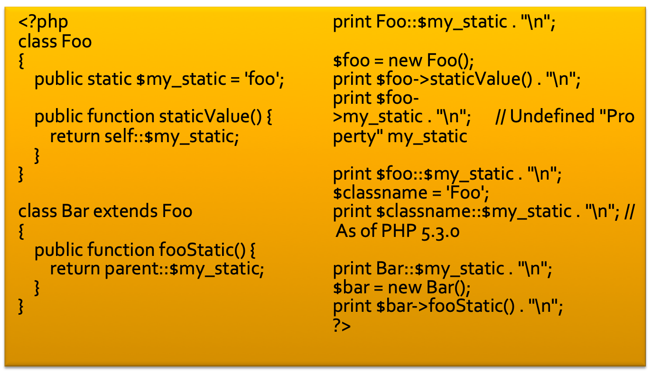

Slide 13

Constructor is the method that will be implemented when object has been initiated
Commonly, constructor is used to initialize the object
Use function __construct to create constructor in PHP
<?php
class Demo
{
function __construct
{
}
}
?>

Slide 14

Destructor, is method that will be run when object is ended
<?php
class Demo
{
function __destruct
{
}
}
?>

Slide 15

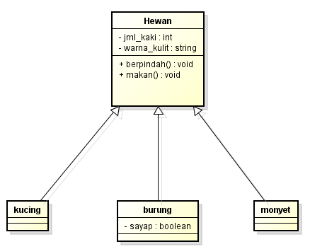
There are many benefits of inheritance with PHP, the most common is simplifying and reducing instances of redundant code.

Slide 16

class hewan
{
protected $jml_kaki;
protected $warna_kulit;
function __construct()
{
}
function berpindah()
{
echo "Saya berpindah";
}
function makan()
{
echo "Saya makan";
}
}

Slide 17

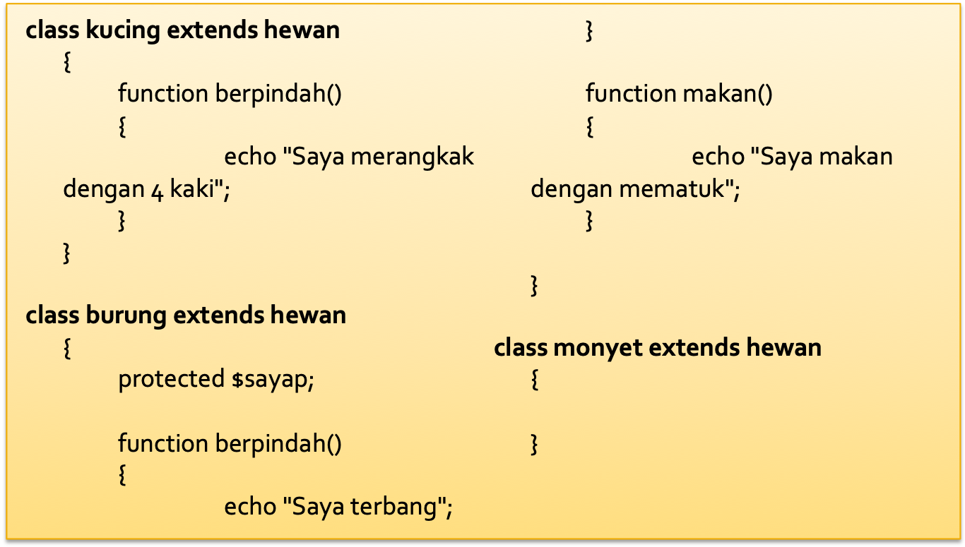

Slide 18

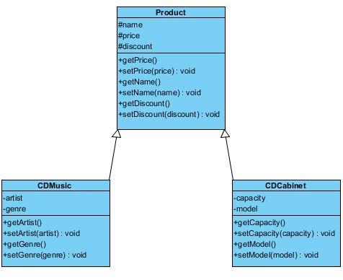

Slide 19

Class product :
  name
  price
  discount
Class CDMusic :
  artist
  Genre
Class CDRack
  capacity
  model

Slide 20
CDMusic
  Menuruni name, price dan discount dari Product
  Price = price + 10%
  Ada penambahan 5% pada discount
CDRack
  Menuruni name, price dan discount dari Product
  Price = price + 15%
  Tidak ada penambahan discount
Buatlah code dalam PHP, serta simulasi untuk kasus tersebut!

