Slide 1
JQuery
Javascript Library

Slide 2
JQuery
Powerful JavaScript library
  Simplify common JavaScript tasks
  Access parts of a page
    using CSS or XPath-like expressions
  Modify the appearance of a page
  Alter the content of a page
  Change the user’s interaction with a page
  Add animation to a page
  Provide AJAX support
  Abstract away browser quirks

Slide 3
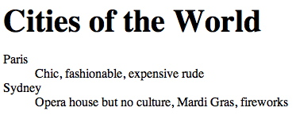
Introductory Sample
<html>
<body>
<h1>Cities of the World</h1>
<dl>
<dt>Paris</dt><dd>Chic, fashionable, expensive rude</dd>
<dt>Sydney</dt><dd>Opera house but no culture, Mardi Gras, fireworks</dd>
</dl>
</body>
</html>
h1 {font-size: 2.5em; margin-bottom: 0;}
.emphasize {font-style: italic; color:red;}

Slide 4
Basic JQuery
Selecting part of document is fundamental operation
A JQuery object is a wrapper for a selected group of DOM nodes
$() function is a factory method that creates JQuery objects
$(“dt”) is a JQuery object containing all the “dt” elements in the document

Slide 5
Basic JQuery
.addClass() method changes the DOM nodes by adding a ‘class’ attribute
  The ‘class’ attribute is a special CSS construct that provides a visual architecture independent of the element structures
$(“dt”).addClass(“emphasize”) will change all occurrences of <dt> to <dt class=“emphasize”>
See also .removeClass()

Slide 6
Basic JQuery
To make this change, put it in a function and call it when the document has been loaded and the DOM is created
function doEmph(){$(“dt”).addClass(“emphasize”)}
<body onLoad=“doEmph()”>
We had to alter the HTML (bad)
Structure and appearance should be separated!
Also, onLoad waits until all images etc are loaded. Tedious.

Slide 7
Basic JQuery
JQuery provides an independent scheduling point after DOM is created and before images are loaded
  $(document).ready(doEmph);
No HTML mods required. All done in script.
Better solution:
  $(document).ready(function(){
$(“dt”).addClass(“emphasize”)
});
<html><head>
<script src="jquery.js" type="text/javascript"></script>
<script src="test.js" type="text/javascript"></script>
…

Slide 8
JQuery Selectors
CSS
p element name
#id identifier
.class classname
p.class element with class
p a anchor as any descendant of p
p > a anchor direct child of p

Slide 9
JQuery Selectors
XPath
-- paths
/html/body//div
-- anchor with an href attr
a[@href]
-- div with an ol inside
div[ol]
-- any anchor with a specific value for the ref attribute
//a[@ref='nofollow’]

Slide 10
JQuery Filters
p:first first paragraph
li:last last list item
a:nth(3) fourth link
a:eq(3) fourth link
p:even or p:odd every other paragraph
a:gt(3) or a:lt(4) every link after the 4th or
up to the fourth
a:contains(‘click’) links that contain the
word click

Slide 11
Example
JQuery uses chaining as follows
$(‘a:contains("ECS")’)
.parent()
.addClass("emphasize")

Slide 12
JQuery Events
bind(eventname, function) method
  ‘click’
  ‘change’
  ‘resize’
$(“a[@href]”).bind(‘click’, function() {
$(this).addClass(‘red’);
});

Slide 13
Other JQuery Effects
.css(‘property’, ‘value’)
.css({‘prop1’:‘value1’, ‘prop2’:’value2’…})
E.g. .css(‘color’, ‘red’)
.hide(speed) or .show(speed)
  Where speed is ‘slow’, ‘normal’ or ‘fast’

Slide 14
More JQuery Changes DOM
.attr({‘name’, ‘value’})
  sets a new attribute (or many)
$(‘<i>hello</i>’)
  Creates a new element
$(‘<i>hello</i>’).insertAfter(‘div.chapter p’);
  Creates element and inserts it into the document
.html() or .text() or .empty() will replace matched elements with newly created elements

Slide 15
Object Oriented Programming with PHP

Slide 16
Object Oriented Concept
Classes, which are the "blueprints" for an object and are the actual code that defines the properties and methods.
Objects, which are running instances of a class and contain all the internal data and state information needed for your application to function.
Encapsulation, which is the capability of an object to protect access to its internal data
Inheritance, which is the ability to define a class of one kind as being a sub-type of a different kind of class (much the same way a square is a kind of rectangle).

Slide 17
Creating Class
Let's start with a simple example. Save the following in a file called Person.php:
<?php
class Demo
{
}
?>

Slide 18
Adding Method
The Demo class isn't particularly useful if it isn't able to do anything, so let's look at how you can create a method.
<?php
class Demo
{
function SayHello($name)
{
echo “Hello $name !”;
}
}
?>

Slide 19
Adding Properties
Adding a property to your class is as easy as adding a method.
<?php
class Demo
{
public $name;
function SayHello()
{
echo “Hello $this->$name !”;
}
}
?>

Slide 20
Object Instantiation
You can instantiate an object of type Demo like this:
<?php
require_once(‘person.php');
$objDemo = new Demo();
$objDemo->name = “Juan”;
$objDemo->SayHallo();
?>

Slide 21
Protecting Access to Member Variables (1)
There are three different levels of visibility that a member variable or method can have :
  Public
    members are accessible to any and all code
  Private
    members are only accessible to the class itself
  Protected
    members are available to the class itself, and to classes that inherit from it
Public is the default visibility level for any member variables or functions that do not explicitly set one, but it is good practice to always explicitly state the visibility of all the members of the class.

Slide 22
Protecting Access to Member Variables (2)
Try to change access level of property named “name” to private of previous code.
What the possible solution of this problem?
Make the getter and setter function...
Always use get and set functions for your properties. Changes to business logic and data validation requirements in the future will be much easier to implement.

Slide 23
Class Constants
It is possible to define constant values on a per-class basis remaining the same and unchangeable.
Constants differ from normal variables in that you don't use the $ symbol to declare or use them
The value must be a constant expression, not (for example) a variable, a property, a result of a mathematical operation, or a function call

Slide 24
Class Constants (cont.)
<?php
  class MyClass
  {
  const constant = 'constant value';
  function showConstant() {
  echo self::constant . "\n";
  }
  }
  echo MyClass::constant . "\n";
?>

Slide 25
Static Keyword
Declaring class properties or methods as static makes them accessible without needing an instantiation of the class.
A property declared as static can not be accessed with an instantiated class object

Slide 26
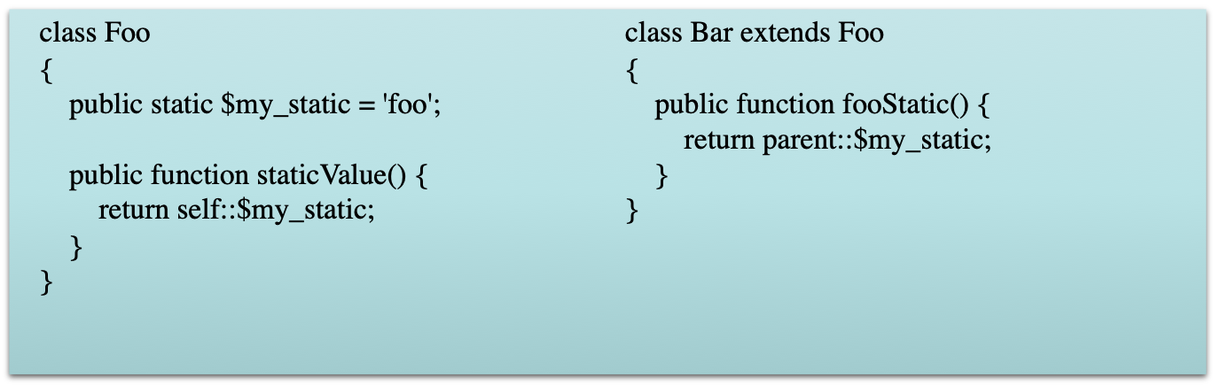
print Foo::$my_static . "\n";
$foo = new Foo();
print $foo->staticValue() . "\n";
print $foo->my_static . "\n"; // Undefined "Property" my_static
print $foo::$my_static . "\n";
$classname = 'Foo';
print $classname::$my_static . "\n"; // As of PHP 5.3.0
print Bar::$my_static . "\n";
$bar = new Bar();
print $bar->fooStatic() . "\n";

Slide 27
Contructor
Constructor is the method that will be implemented when object has been initiated
Commonly, constructor is used to initialize the object
Use function __construct to create constructor in PHP
<?php
class Demo
{
function __construct
{
}
}
?>

Slide 28
Destructor
Destructor, is method that will be run when object is ended
<?php
class Demo
{
function __destruct
{
}
}
?>

Slide 29
Inheritance
There are many benefits of inheritance with PHP, the most common is simplifying and reducing instances of redundant code.

Slide 30
Database Access with
PHP and MySQL

Slide 31
PHP for Database Access
Connect to the MySQL server
  $connection = mysql_connect("localhost", $username, $password);
Access the database
  mysql_select_db("winestore", $connection);
Perform SQL operations
Disconnect from the server
  mysql_close($connection);

Slide 32
Error Handling
All mysql_ functions return NULL (or false) if they fail.
Several functions are helpful in graceful failure
  die(string) - halts and displays the string
  mysql_errno() - returns number of error
  mysql_error() - returns text of error

Slide 33
Error Handling examples
if (!($connection = mysql_connect("localhost",$name,$passwd)))
die("Could not connect");
function showerror()
{
die("Error " . mysql_errno() . " : " . mysql_error());
}
if (!(mysql_select_db("winestor", $connection)))
showerror();

Slide 34
Building a Query
Directly
  $query = 'select * from wines';
Using input information
  $winery = $_POST['winery'];
  $query = “select * from wines where winery=$winery”;

Slide 35
Running a Query
mysql_query returns a result handle
  $result = mysql_query($query, $connection)
mysql_num_rows indicates the number of rows returned
  $num_rows = mysql_num_rows($result)
mysql_fetch_array creates array/hash of result
  For ($n=0; $n<$num_rows;$n++)
  $row = mysql_fetch_array($result)

Slide 36
Result of fetch_array
Contains both numeric and index tags
Values are duplicated
Example:
  Query: select surname, city from customers;
  Row: ( 0=>'Walker', ‘surname’=>'Walker', 1=>'Kent', 'city'=>'Kent' );

Slide 37
Printing the Complete Row
By number
  for ($i=0; $i<mysql_num_fields($result); $i++)
  echo $row[$i] . " ";
By field
  echo $row['surname'] . ' ' . $row['city'];

Slide 38
Avoiding Special Characters
When building HTML, characters such as '&' in the data can cause problems
Function htmlspecialchars() replaces all such characters with HTML escapes such as &amp;
  print( htmlspecialchars($row['surname'] . ' ' . $row['city']);

Slide 39
Special Characters in Input
The same problem exists with special characters in input (e.g. ' )
PHP switch magic_quotes_gpc (default on) inserts backslashes before single & double quotes, backslashes and NULL characters in input data (from GET, PUT and cookie data)
Use stripslashes() to remove the slashes
Use addslashes() to add the slashes if magic_quotes_gpc is off

Slide 40
Avoid Dangerous User Input
Passing user input to other programs opens the door to exploits
  Eg. exec("/usr/bin/cal $input")
  Generates a calendar (/usr/bin/cal 2004)
  But a malevolent user might send '2004 ; cat /etc/passwd' or '2004 ; rm *'
Overlong inputs can also cause problems
Always clean input
  $input = escapeshellcmd($input);
  $input = substr($input,$maxlength);

Slide 41
PHP / Form in one Document
Combine the original form with the PHP document that processes data
  if empty($regionName)) { //parameter provided?
  //produce the <form>
  }
  else {
  //run the query using data from $_GET or $_POST
  }

Slide 42
Inserting Into a Database
Collect data from a form
Validate data (JavaScript, PHP or both)
Create a query
  $query = "insert into customer set cust_id = NULL, " . "surname =\"" . $surname ."\"" …
Run the query
  mysql_query($query, $db);

Slide 43
Updating a Database
Query to find item to update
Present old information
Collect new information
Validate
Construct and run the update query

