Slide 1
POLYU SCHOOL OF DESIGN · SD2112 · WEEK 01 · LECTURE
Artificial intelligence in design.
Week 1 — the journey, and two ways to teach a machine.
a·t4x
Notes:
Welcome. Say the course code. ClassPoint join code is on the screen from 30 minutes before class; Nicolò and Amber are at the front helping people join. Everyone joins with the last four digits and the letter of their student ID.

Slide 2

SD2112 · WEEK 01
Today
01
Why are we here?
05
AI in design, now
02
Who are we?
06
The designer's turn
03
The journey
07
Activity: teach the machine
04
What is AI?
08
How this course works
SD2112 · AI IN DESIGN · WEEK 01
02
Notes:
Eight stops. Point out the interactive moments: five ClassPoint questions in the first half, the activity capture, and two at the end that tell us what you expect. About ninety minutes with a short break after stop four.

Slide 3

01 · QUESTION · WORD CLOUD
AI in design. One word.
The first word that comes to mind. No right answer — we read the biggest words aloud.
SD2112 · AI IN DESIGN · WEEK 01
03
Notes:
ClassPoint word cloud, one word each. Leave it on screen for a minute. Read the three biggest words aloud and keep them — we come back to them at the end when we ask "what is your X". Expect: tool, cheating, fast, fake, future, Midjourney, ChatGPT.

Slide 4
01
Why are we here?
AI IS IN THE TOOLS, IN THE PRODUCTS, AND IN THE JOB
SD2112 · AI IN DESIGN · WEEK 01
04
Notes:
Chapter one. Three reasons this course exists, all three are about you, not about the technology.

Slide 5
01 · WHY ARE WE HERE
Three things changed
THE TOOLS
THE PRODUCTS
THE JOB
Your tools have models inside them.
Your products have models inside them.
Your job is moving.
Generative fill in Photoshop. Layouts in Figma. A brief written with a chatbot at 2 a.m. You already work with AI, whether you chose to or not.
Feeds, filters, recommendations, assistants. The thing you design increasingly decides, on its own, what each person sees. Someone has to design that.
From making every artefact by hand to choosing, briefing, curating and setting the rules. What a designer is for is being renegotiated this decade. Better to be in the room.
SD2112 · AI IN DESIGN · WEEK 01
05
Notes:
Tools, products, job. The first is about process — weeks 1 to 6. The second is about the product — weeks 8 to 12. The third is the question that runs underneath the whole course.

Slide 6
02
Who are we?
YOUR TEAM · AND YOU
SD2112 · AI IN DESIGN · WEEK 01
06
Notes:
Chapter two. The team first, then three quick questions about you.

Slide 7




02 · WHO IS TEACHING YOU
I study how machines form concepts.
Giovanni Lion. PhD in computational creativity: how a machine ends up with an idea of "chair", and what that does to makers.
Two years operating Sophia at Hanson Robotics. It rebooted minutes before a show. It came back.
Musical Fruitstand: fruit you can play. A-Eye: the audience repainted live at M+. Featherman: a game with WWF Mai Po.
One photo of me, three models, three styles.
Top: one photo of me through three image models. Bottom right: "Ada Lovelace at her machine", a diffusion model, 2025.
SD2112 · AI IN DESIGN · WEEK 01
07
Notes:
Economics, then robotics, then a PhD on concept formation in computational creativity. The point of the avatars: the same photo through three models gives three different styles — the model, not the photo, decides the look. Ada at the bottom right is also generated; she is on the next slide as a real quote.

Slide 8
02 · YOUR TEAM THIS SEMESTER
Four people. Use them.
GL
N
A
ZZ
Giovanni Lion
Nicolò
Amber
ZHOU Zhibin
LECTURER
TEACHING ASSISTANT
TEACHING ASSISTANT
CLASS COORDINATOR
Lectures, briefs, grading. Questions in class first, then email.
giovannilion.link
In the room 30 minutes before and 30 minutes after every class.
Tools, accounts, code, the weekly challenges. Also built the course video playlist.
In the room 30 minutes before and 30 minutes after every class.
Assignments, group project, feedback on your work in progress.
Attendance and absences, admin, anything about the class as a whole.
Cannot come? Tell Zhibin before class. That is what keeps your participation mark.
SD2112 · AI IN DESIGN · WEEK 01
08
Notes:
Nicolò and Amber are here half an hour before and half an hour after every class — that hour is where laptops get fixed and assignments get unstuck. Zhibin coordinates: if you cannot come, tell Zhibin before class, not after. Participation is attendance plus ClassPoint activity.

Slide 9
02 · WHO ARE YOU · MULTIPLE CHOICE
Which studio are you closest to?
A
Communication or advertising design
B
Product or industrial design
C
Interaction, digital or media design
D
Environment, interior, social — or something else
SD2112 · AI IN DESIGN · WEEK 01
09
Notes:
ClassPoint multiple choice. Show the split. We use it to pick examples: if the room is mostly communication design we lean on type, layout and campaigns; if product, on chairs and parametric form; if interaction, on feeds and chatbots.

Slide 10
02 · WHO ARE YOU · MULTIPLE CHOICE
How much have you used AI in your design work?
A
Never, or once to try it
B
Sometimes — for ideas, images, or text
C
Every week; it is part of my workflow
D
I have built something with a model or an API
SD2112 · AI IN DESIGN · WEEK 01
10
Notes:
ClassPoint. This is the level check. If most of the room is A or B, weeks 4 and 5 go slower on the tools. If many are D, we pair them with beginners in the challenges. No judgement either way; say so.

Slide 11
02 · WHO ARE YOU · MULTIPLE CHOICE
Have you written code?
A
No
B
A little — p5.js, Python, HTML or CSS
C
Comfortably
SD2112 · AI IN DESIGN · WEEK 01
11
Notes:
ClassPoint. Week 2 has a small p5.js workshop: rules that make pictures. Nobody needs to know how to code, but we need to know how many do. If more than a third say C, the week-2 exercise gets a harder second half.

Slide 12
03
The journey
13 WEEKS · FOUR MODULES · ONE QUESTION
SD2112 · AI IN DESIGN · WEEK 01
12
Notes:
Chapter three: the whole semester on one slide, then the one question that runs through it.

Slide 13
03 · THE SEMESTER
Where we are going
1 · What is AI?
WEEK 1
WEEK 2
WEEK 3
Two ways to teach a machine
Rules that make things: code, chance, generative art
Learning from examples: concepts, neurons, Move 37
2 · AI for the creative process
WEEK 4
WEEK 5
WEEK 6
Language machines: LLMs, prompts, agents
Image machines: diffusion, CLIP, mediation
Sound machines: music, voice, spectrograms
Mid-term
WEEK 7
Mid-term quiz · project pitches · teams · reflection due
3 · AI inside products
WEEK 8
WEEK 9
WEEK 10
AI as design material: use vs incorporate
Data, bias and privacy
Recommendation systems and the feed
4 · The designer's turn
WEEK 11
WEEK 12
Curating outputs and datasets · authorship
Language as an interface: chatbots and agents
Showcase
WEEK 13
WEEK 14
Poster fair — group projects
Final quiz
SD2112 · AI IN DESIGN · WEEK 01
13
Notes:
Four modules. Weeks 1 to 3: what AI is, in two flavours — rules and examples. Weeks 4 to 6: the tools you will use in your own process; each week ends with a small making challenge. Week 7: quiz, pitches, teams. Weeks 8 to 10: AI as a material inside the product you design. Weeks 11 and 12: what is left for the designer. Week 13 poster fair. You are here.

Slide 14
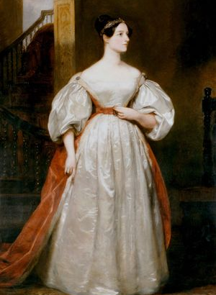
"The Analytical Engine has no pretensions whatever to originate anything. It can do whatever we know how to order it to perform."
Ada Lovelace, Note G, 1843 — the first published program, for a machine that was never built
SD2112 · AI IN DESIGN · WEEK 01
14
Notes:
1843. Lovelace writes the first program for Babbage's engine, and in the same notes the first objection to machine creativity: it only does what we order. Turing answered her in 1950; we spend thirteen weeks on the answer. The course question: can a machine originate a design? By week 13 you should have an answer you can defend, either way.

Slide 15
03 · THE QUESTION
Can a machine originate a design? By week 13 you will have an answer you can defend.
SD2112 · AI IN DESIGN · WEEK 01
15
Notes:
Say it plainly. Either answer is acceptable in this course, as long as it is argued with what we learn. The reflection assignment is exactly this question, in your own practice.

Slide 16
04
What is AI?
A DEFINITION · TWO MACHINES · ONE CHAIR
SD2112 · AI IN DESIGN · WEEK 01
16
Notes:
Chapter four. First their definitions, then ours, then the two machines.

Slide 17

04 · QUESTION · SHORT ANSWER
What is AI? One sentence, your own words.
Do not look it up. Write what you actually think it is.
SD2112 · AI IN DESIGN · WEEK 01
17
Notes:
ClassPoint short answer. Give it 90 seconds. Read four or five aloud, pick ones that disagree: "a program that thinks", "a tool that copies", "statistics". All of them are half right. Then our working definition.

Slide 18
04 · A WORKING DEFINITION · GIO, 2025
Intelligent-like output or behaviour, achieved through computation.
SD2112 · AI IN DESIGN · WEEK 01
18
Notes:
Our working definition. Three words matter: "intelligent-like" — we judge the output, not the inside; "behaviour" — it can be an action, not only a picture; "computation" — it runs on a Turing machine, so it can be copied, scaled and sold.

Slide 19
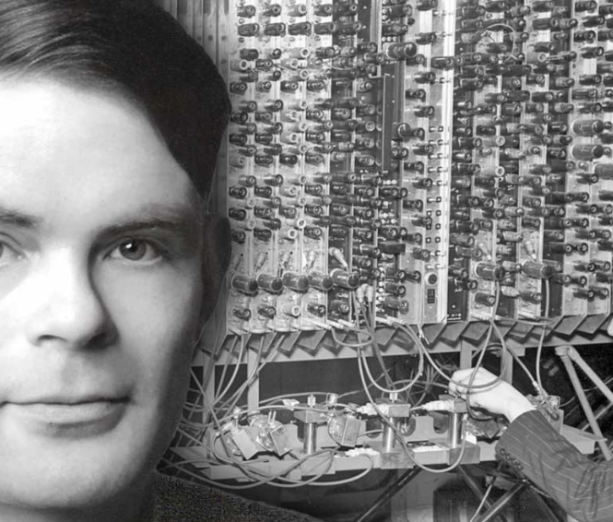
04 · INTELLIGENT, OR CREATIVE?
Intelligent is not the same as creative.
Wiggins, 2006: computational creativity is "the performance of tasks which, if performed by a human, would be deemed creative."
The trick: it judges the output, not the process.
Intelligent: solves the problem you set.
Creative: makes something you did not order, and you still want it.
Lovelace said the second is impossible. Hold that until Move 37.
Alan Turing. 1936: every computer is a Turing machine. 1950: "Can machines think?" becomes the imitation game.
SD2112 · AI IN DESIGN · WEEK 01
19
Notes:
Wiggins' definition is agent-agnostic: creativity is in the eye of the audience. That is why this is a design question and not only an engineering one. Turing 1936 gives us the machine; 1950 replaces "can machines think" with the imitation game — judge the behaviour.

Slide 20
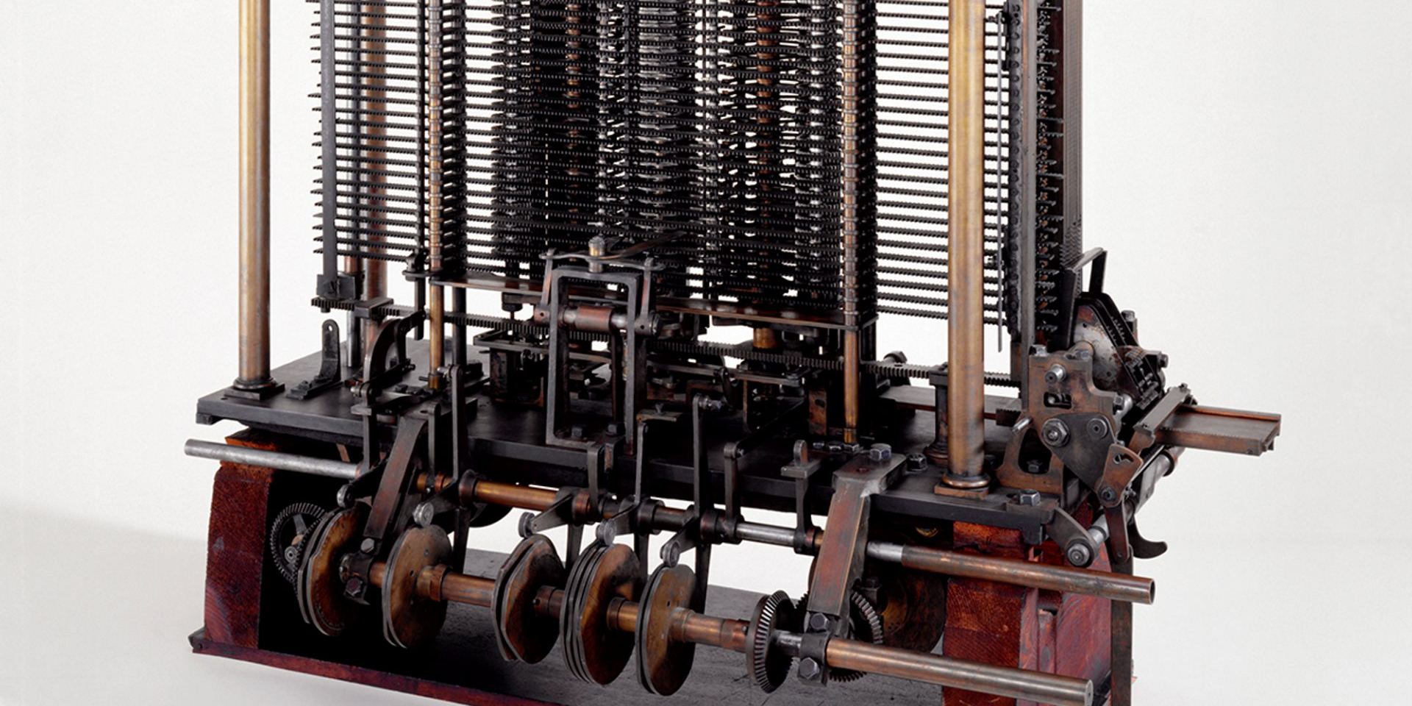
1837 · CHARLES BABBAGE · THE ANALYTICAL ENGINE
A computer is a physical thing: brass and steel, cut by hand. This one was designed and never finished. Lovelace programmed it anyway.
Notes:
Babbage's Analytical Engine, trial model, Science Museum London. Physical, mechanical, made by craftsmen. A computer is a machine that follows rules — which is exactly what Lovelace meant.

Slide 21
04 · TWO MACHINES
Two ways to teach a machine what a chair is.
SD2112 · AI IN DESIGN · WEEK 01
21
Notes:
The heart of the course, in one object. Chairs, because every design school has a chair canon and because everybody thinks they know what one is.

Slide 22
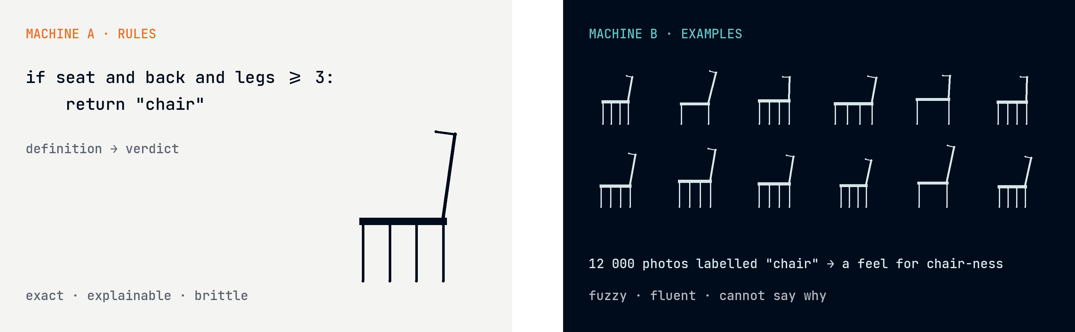
04 · TWO MACHINES
Write the rule, or show the examples.
Machine A: symbolic AI, 1956 onwards — definitions, logic, expert systems. Machine B: machine learning, 1958 / 1986 / 2012 — statistics over examples.
SD2112 · AI IN DESIGN · WEEK 01
22
Notes:
Left: give the machine a definition and it applies it. Exact, explainable, brittle — it will never accept a beanbag. Right: give it twelve thousand labelled photos and it develops a feel for chair-ness. Fluent, fuzzy, and it cannot tell you why. Every AI you will meet this semester is one of these, or a mix.

Slide 23
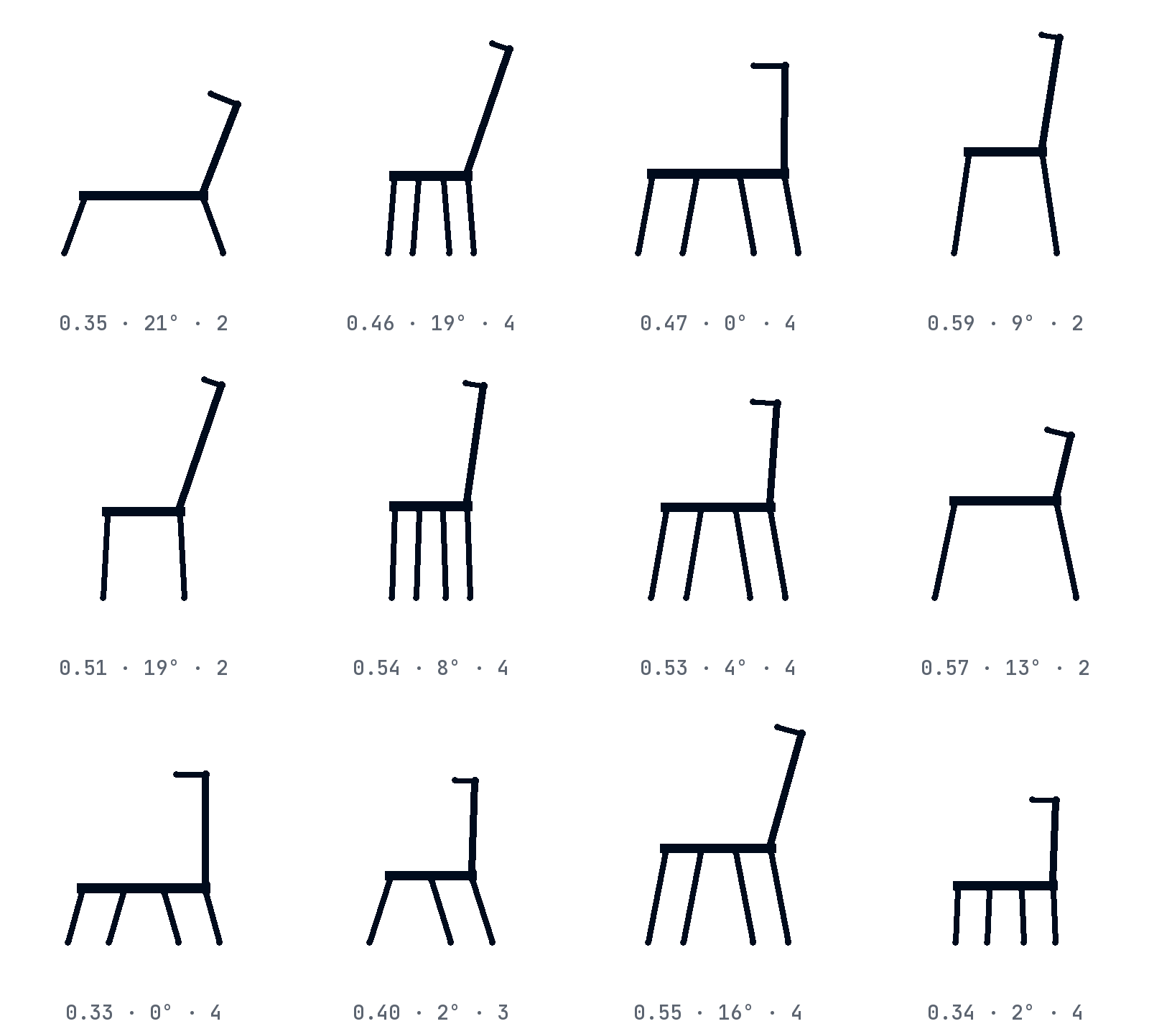
04 · MACHINE A · RULES
One rule. Twelve chairs.
Every chair here comes from the same six numbers: seat height, seat width, back height, back angle, number of legs, splay.
Change a number, get a chair. It can make a million and every one is a chair by definition.
It can never make a beanbag. The definition does not know beanbags exist.
This is parametric design — Grasshopper, variable fonts, CSS grid. Week 2 is this: rules that make things.
chair(seat=0.45, width=0.62, back=0.6, angle=8, legs=4, splay=0.05) — the same function, twelve times
SD2112 · AI IN DESIGN · WEEK 01
23
Notes:
Rules generate. Product designers know this as parametric design; type designers as variable fonts; web designers as a grid system. The strength and the limit are the same thing: nothing outside the rule can ever appear.

Slide 24
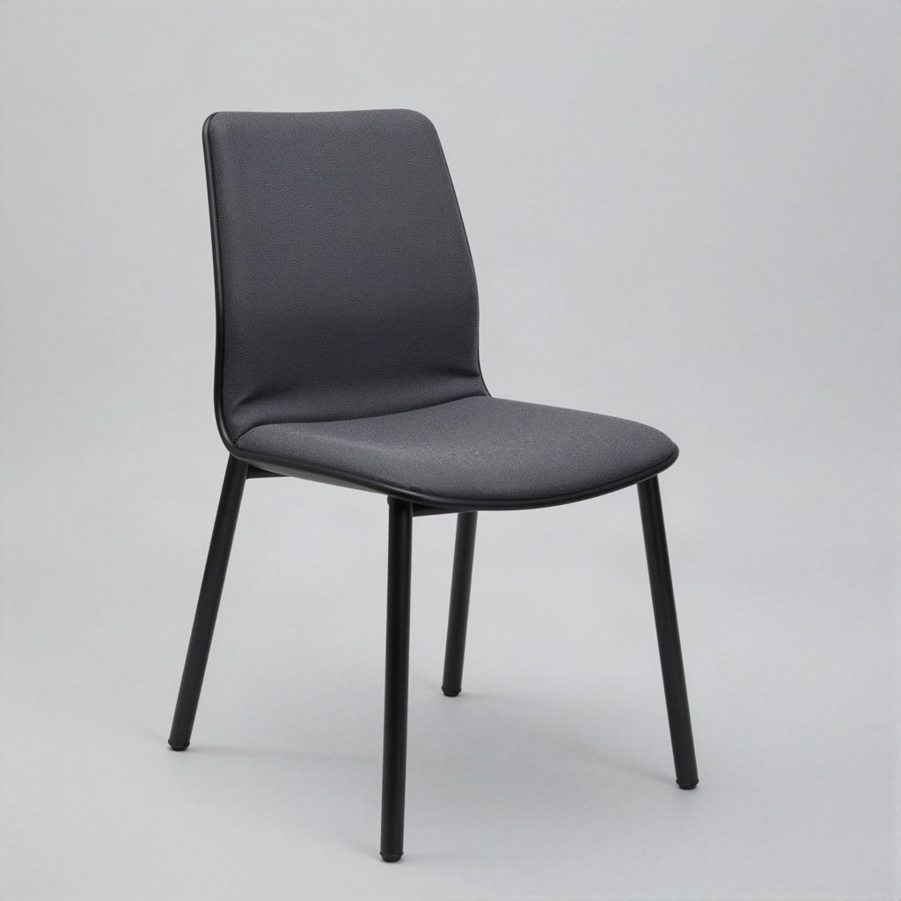
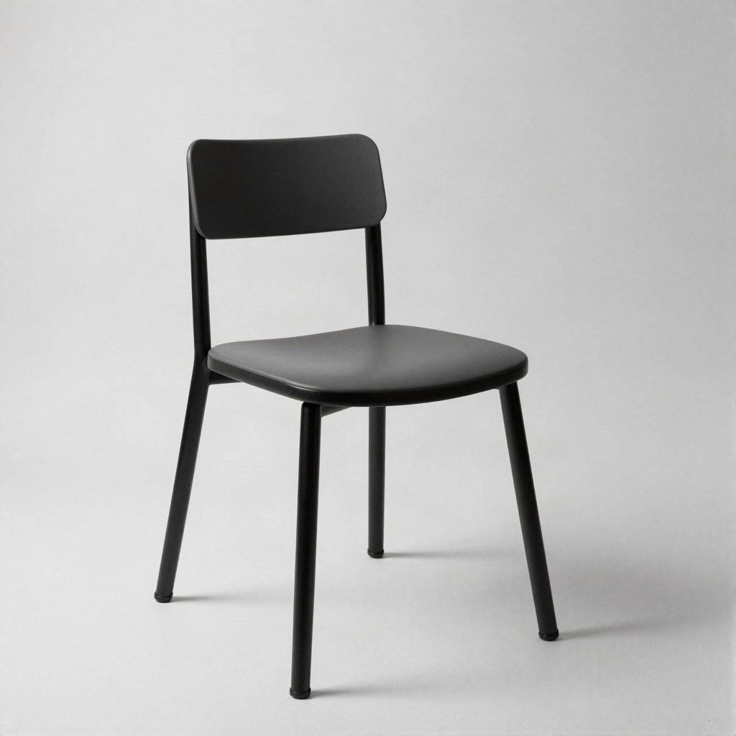
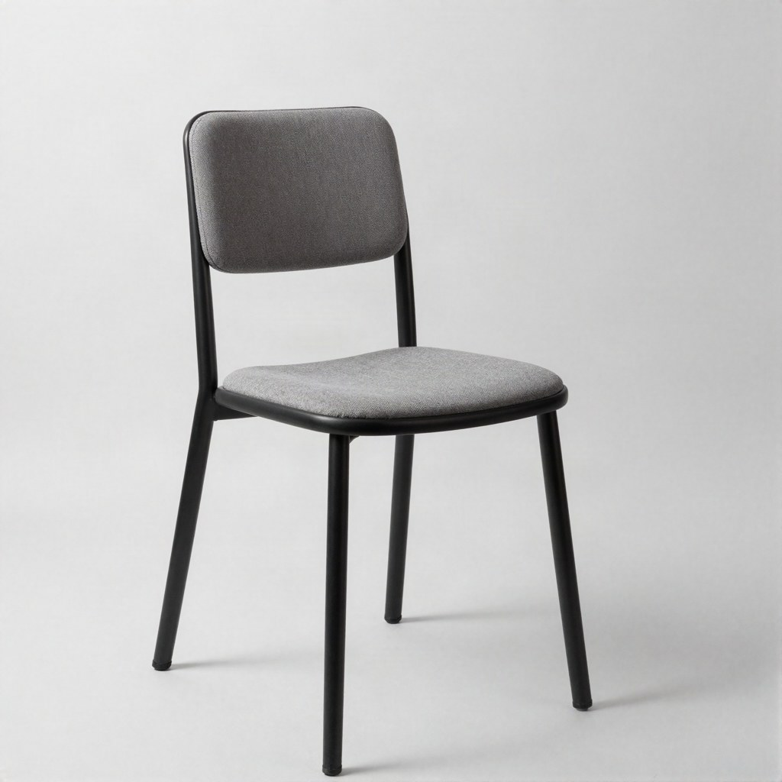
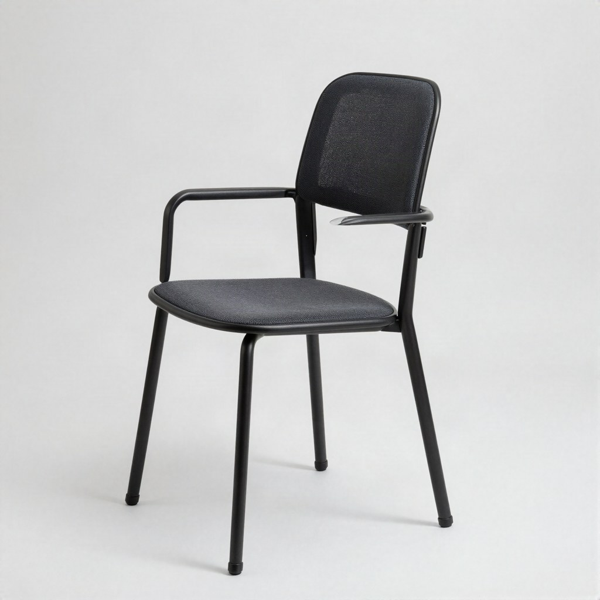
04 · MACHINE B · EXAMPLES
Ask a model for "a chair". Four times.
No rule anywhere. A diffusion model saw millions of pictures with the word "chair" nearby and learned a feel for it.
Four requests, four chairs, and they are all the same chair: four legs, a back, wood, a bit of mid-century.
It cannot tell you why. It can tell you what is typical.
Weeks 3 and 5 are this: learning from examples, and what the examples do to the result.
Prompt: "a chair, studio product photograph, plain white background" — one fast text-to-image model, four seeds, September 2026.
SD2112 · AI IN DESIGN · WEEK 01
24
Notes:
Generated today with a small, fast model and the same prompt four times. Notice how similar they are. Nobody told the model what a chair is; it learned what is typical. That word — typical — is the bridge to the next slide.

Slide 25
15 sec
04 · ONE MINUTE · DRAW
Draw a chair. Fifteen seconds. Hold it up.
Pen, paper, no thinking. When the time is up, hold the drawing above your head and look around the room.
SD2112 · AI IN DESIGN · WEEK 01
25
Notes:
Fifteen seconds. Then everyone holds it up. Almost every drawing is the same chair: four legs, a back, seen from the side or the front. That is the prototype — you did what the model did. Eleanor Rosch showed this in 1975: concepts are organised around typical members, not definitions.

Slide 26
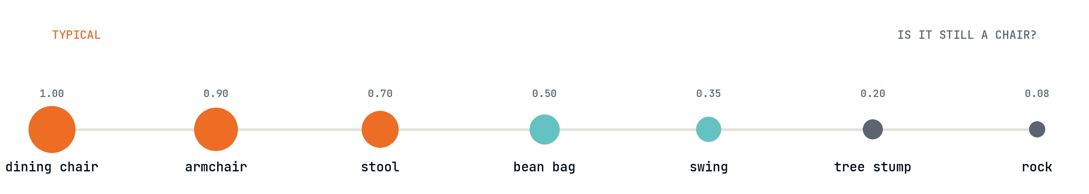
04 · ROSCH, 1975 · TYPICALITY
Concepts have a middle and an edge.
Typical members are named first, learned first, recognised faster. The edge is where the definition breaks: is a bean bag a chair? a swing? the rock you sat on at lunch?
Rosch & Mervis 1975 — family resemblance, not necessary and sufficient conditions. Machine A lives on the definition. Machine B lives in the middle. Designers work at the edge.
SD2112 · AI IN DESIGN · WEEK 01
26
Notes:
The rule-machine cannot hold the edge: any definition of chair either lets in the rock or throws out the beanbag. The example-machine lives in the middle: it reproduces the typical. Design is the art of leaving the prototype without leaving the concept — a chair that is still a chair, but nobody has seen. Neither machine does that on its own. Week 3 goes deeper: classical theory versus prototype theory, GOFAI versus connectionism.

Slide 27
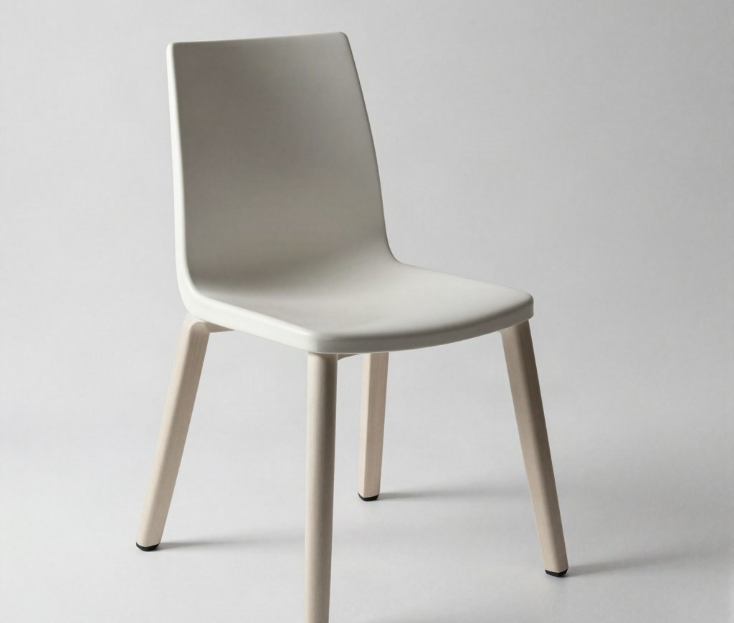
04 · MACHINE B · AT THE EDGE
Ask for the edge. Get the middle.
I asked the same model for "an object that is barely still a chair, an unusual seat that stretches the definition".
It gave me this. A chair. Slightly more designed. Four legs and a back.
A model trained on examples pulls towards the typical. The edge is where its examples run out.
The designer's job starts exactly where the model's confidence ends.
Prompt: "an object that is barely still a chair, an unusual seat that stretches the definition of chair, studio product photograph". Same model, one seed.
SD2112 · AI IN DESIGN · WEEK 01
27
Notes:
The most honest slide in the deck: I asked for the edge and got the prototype. Bigger models do better, but the pull is the same. Prompting is negotiating with the middle; design is deciding where the edge is. Week 5 shows how to push a model off the prototype: references, ControlNet, fine-tuning on your own work.

Slide 28
04 · QUICK CHECK · MULTIPLE CHOICE
Which of these is a chair?
A
A bean bag
B
A tree stump you sit on
C
Both
D
Neither
SD2112 · AI IN DESIGN · WEEK 01
28
Notes:
ClassPoint. There is no correct answer and the split proves the point: the concept is fuzzy, and the room disagrees at the edge. Whoever wrote the rule on the previous slide has to live with the beanbag.

Slide 29
04 · SAME APP, TWO MACHINES
You already use both, every day.
PHOTOSHOP · 1990S
PHOTOSHOP · 2010
PHOTOSHOP · 2023
Auto Levels
Content-Aware Fill
Generative Fill
A rule: stretch the histogram until the darkest pixel is black and the lightest is white. Same input, same output, forever. Machine A.
An algorithm (PatchMatch) that searches the image for patches that fit the hole. Clever rules, no training. Still machine A.
A diffusion model trained on Adobe Stock invents what belongs in the hole. Fluent, surprising, sometimes wrong. Machine B.
SD2112 · AI IN DESIGN · WEEK 01
29
Notes:
Three features, one menu, thirty years. Two are rule-based, one is learned. Ask: which one would you trust for a client's product shot, and why? The answer is a design decision, not a technical one. Week 3 makes this distinction precise: rule-based versus adaptive systems.

Slide 30
04 · HOW WE GOT HERE
Two lines, one hundred and eighty years.
1843
1950
1965
1986
2012
2016
2022
2026
Lovelace, Note G
Turing asks
Nake & Nees
Backprop
AlexNet
Move 37
ChatGPT · Stable Diffusion
You
The first program — and the first objection: it cannot originate.
"Can machines think?" becomes: can you tell the difference?
A plotter draws from a program, in a gallery. Rules make art.
Rumelhart, Hinton, Williams: networks learn from examples.
Deep learning wins at seeing. GPUs and the web made it possible.
AlphaGo plays a move no human would. Creative, or alien?
Machine B reaches everyone, through a text box.
Both machines in every tool. The designer decides which, and when.
SD2112 · AI IN DESIGN · WEEK 01
30
Notes:
Two lines braided together: rules (Lovelace, Turing, Nake) and examples (backprop, AlexNet, diffusion). The second line took sixty years to work; it needed the web for data and gaming for GPUs. Week 2 is the rules line; week 3 the examples line.

Slide 31
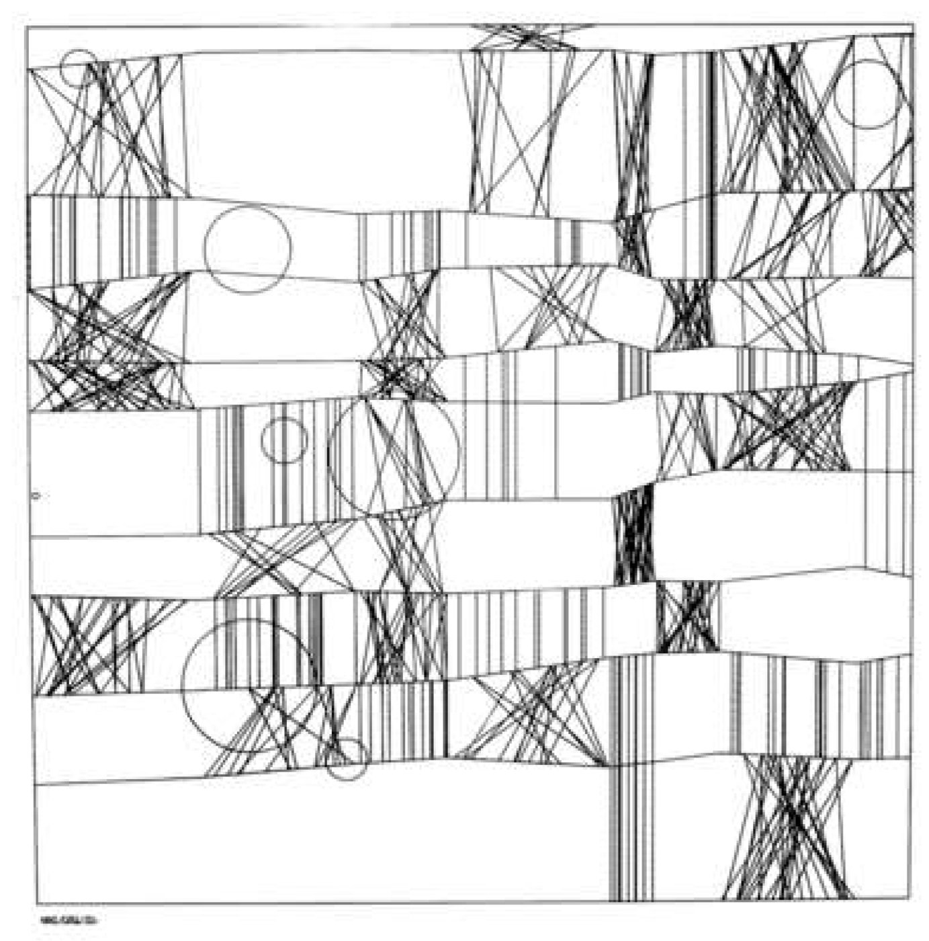
1965 · FRIEDER NAKE · HOMAGE TO PAUL KLEE
A program drew this. Screenprint after a plotter drawing, 49 x 49 cm. It hangs in the V&A. Bense called it information aesthetics: beauty from rules, on purpose.
Notes:
1965, Stuttgart. Nake and Nees show plotter drawings in a gallery — the first computer art exhibition. Max Bense's idea: aesthetics as mathematics, art from a formal procedure. Notice the design move: the program, not the pencil, becomes the material. Week 2 you write one of these.

Slide 32
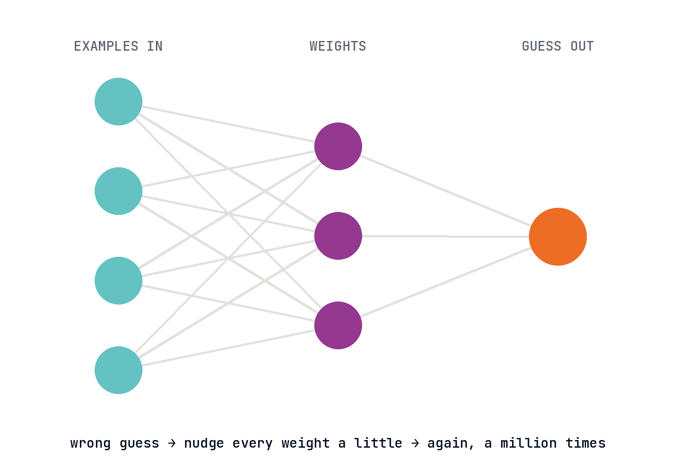
04 · MACHINE B · HOW IT LEARNS
A guess, a correction, a million times.
Rosenblatt's perceptron, 1958: connections that adjust when the guess is wrong. Ignored for thirty years.
1986: backpropagation makes deep networks trainable (Rumelhart, Hinton, Williams). Hinton: Nobel Prize in Physics, 2024.
2012: AlexNet, trained on a million labelled photos, wins at seeing. The web gave the examples, gaming gave the chips.
2017: transformers, the architecture inside every chatbot. Week 4.
SD2112 · AI IN DESIGN · WEEK 01
32
Notes:
Keep this light: a network is a pile of adjustable connections; training is showing an example, measuring how wrong the guess was, and nudging every connection a little. Repeat a million times. The design point: the examples are the material. Who chose them? Week 9.

Slide 33
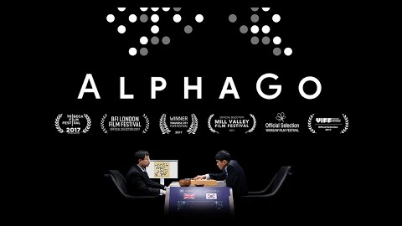
2016 · ALPHAGO · WATCH BEFORE WEEK 3
Move 37.
Game two against Lee Sedol. AlphaGo plays a move the commentators call a mistake. It was not.
Trained on human games, then on millions of games against itself. Nobody ordered move 37.
Lovelace's objection meets a counter-example. Or an alien way of thinking that only looks creative.
Watch the documentary before week 3. It is on the course playlist.
https://www.youtube.com/watch?v=WXuK6gekU1Y
SD2112 · AI IN DESIGN · WEEK 01
33
Notes:
Play the move-37 chapter if there is time. Ask: is this creative? Wiggins says judge the output — the experts were astonished. The counter: it is intelligent, and alien, and has no idea what it did. This debate is week 3, and it is the debate under the whole course.

Slide 34
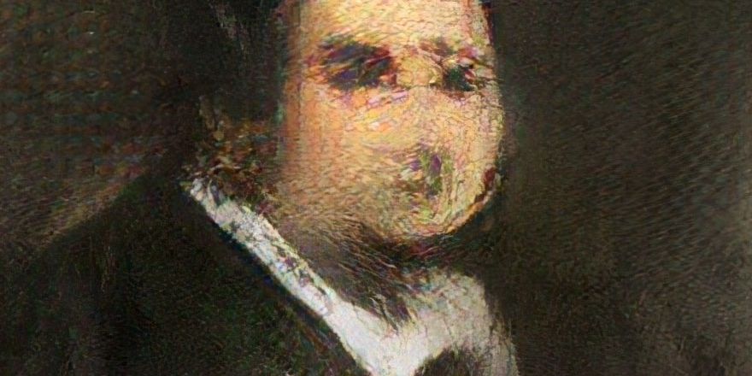
2018 · OBVIOUS · EDMOND DE BELAMY
Sold at Christie's for US$432,500. Signed, bottom right, with the loss function of the network that made it. Who is the author? Week 11.
Notes:
Belamy, 2018: a GAN trained on 15,000 portraits; the signature is the training formula. Christie's sold it for 432,500 dollars. The authorship question — the collective, the coder who wrote the model, the painters in the dataset — is week 11.

Slide 35
05
AI in design, now
USING IT · INCORPORATING IT · THREE CASES
SD2112 · AI IN DESIGN · WEEK 01
35
Notes:
Chapter five: the distinction that organises the semester, and three cases from the last two years.

Slide 36
05 · THE DISTINCTION THAT ORGANISES THE COURSE
Using AI, or incorporating AI.
WEEKS 1 – 6 · THE PROCESS
WEEKS 8 – 12 · THE PRODUCT
Using AI
Incorporating AI
AI as a tool in how you design: a brief drafted with a chatbot, a moodboard from a diffusion model, generative fill, layouts from Figma Make.
You stay the author. You become the curator, the briefer, the editor.
AI as a material in what you design: a feed, a recommendation, an assistant, a filter — the product decides something for each person, on its own.
You design a behaviour, not a picture. Data, bias, trust and accountability become design problems.
SD2112 · AI IN DESIGN · WEEK 01
36
Notes:
Using versus incorporating. Using is about practice — how you make. Incorporating is about the outcome — what you make. The first half of the course is the first, the second half the second. The designer's role is different in each: curator versus system architect.

Slide 37
05 · THREE CASES
What it looks like when it ships.
USING · 2024
INCORPORATING · SINCE 2017
AI AS THE PRODUCT · 2024–25
Coca-Cola remakes its holiday ad with generative video
Netflix chooses a different poster for each viewer
The Humane AI Pin
The trucks, the snow, the faces: made with generative video tools and finished by hand. Viewers noticed — the reception split. What did the audience see that the model did not? Craft is now a question of what you let through.
The same film, several pieces of artwork; a model picks the one you are most likely to click. The poster designer no longer makes one image — they design a space of images and the rules for choosing.
A wearable whose entire interface was an assistant. Beautiful hardware, launched at US$699, discontinued within a year. A model is not a product. The interaction, the trust and the failure states still have to be designed.
SD2112 · AI IN DESIGN · WEEK 01
37
Notes:
Three cases, three roles. Coca-Cola: using — and the audience judged the craft. Netflix: incorporating — the designer designs a space of options and a rule for choosing. Humane: AI as the whole product — a warning that a model is not an experience. Ask the room for one more case from the last month; there is always one.

Slide 38
05 · QUESTION · SHORT ANSWER
Where did AI touch your design work this week?
One example: a tool you used, a feed that chose for you, a product that answered back. A link if you have one.
SD2112 · AI IN DESIGN · WEEK 01
38
Notes:
ClassPoint short answer, two minutes. This replaces the old scavenger hunt: everyone has an example on their phone. Sort a few live into "using" and "incorporating". Keep the list — it seeds the week-3 categorising exercise.

Slide 39
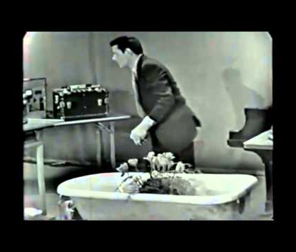
05 · THE COURSE PLAYLIST · BY NICOLÒ
Fifteen videos, in the order we need them.
youtube.com/playlist?list=PLU58DFEI5YDQ
Before week 3: AlphaGo. Illiac Suite (1957), Cage's Water Walk (1960), Tinguely's Homage to New York (1960), Kaprow's Fluids (1967).
Week 4: large language models, explained briefly (3Blue1Brown).
Week 5: diffusion, how AI images work, CLIP, autoencoders, UNet, text-to-video, ComfyUI.
Week 6: AI sound and music. Week 12: generative vs rules-based chatbots.
John Cage, Water Walk, 1960: a score of timed instructions, performed on live television. Rules, chance and a bathtub.
SD2112 · AI IN DESIGN · WEEK 01
39
Notes:
Nicolò compiled the playlist from every video in the slides. Each week names the ones to watch before class; quizzes draw on them. This week: AlphaGo, and the four art pieces — they are short, and they are week 2's argument that art has been made from rules and chance since before computers.

Slide 40
06
The designer's turn
TECHNOLOGY IS NEVER NEUTRAL · NEITHER IS DESIGN
SD2112 · AI IN DESIGN · WEEK 01
40
Notes:
Chapter six, short: the philosophical spine of the course, in three slides. Verbeek is the reading for week 5.

Slide 41
"Designing things is designing human existence."
Peter-Paul Verbeek, Beyond Interaction: A Short Introduction to Mediation Theory, Interactions, 2015 — the reading for week 5
SD2112 · AI IN DESIGN · WEEK 01
41
Notes:
Verbeek, 2015, written for interaction designers. Technologies do not sit between a ready-made human and a ready-made world; they shape both. The double-sided printer default decides how much paper a company uses. A feed decides what a city talks about. Designers materialise morality.

Slide 42
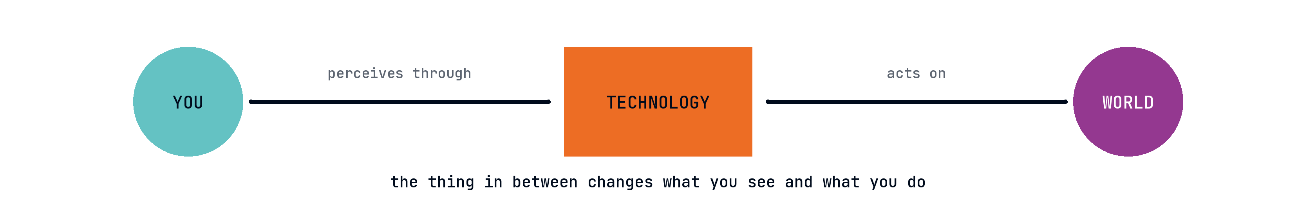
06 · IHDE · VERBEEK · TECHNOLOGICAL MEDIATION
The thing in between is never neutral.
You do not see the world and then use a tool. You see the world through the tool: glasses, a camera, a feed, a fill. Week 5 gives you Ihde's four relations and a vocabulary for designing them.
Ihde 1990, Verbeek 2015. Embodiment (through), hermeneutic (reading), alterity (facing), background — and the AI versions of each.
SD2112 · AI IN DESIGN · WEEK 01
42
Notes:
Don Ihde's human – technology – world. Every AI feature sits in the middle and changes both ends: what you perceive and what you do. When the filter picks the poster, the viewer's world has been designed. Week 5 works through the four relations with AI examples; the group project asks you to name which one you are building.

Slide 43
06 · WHAT IS LEFT FOR YOU
Designers as…
OUTPUTS
DATASETS
RULES
STORY
Curators of what ships
Curators of what it learns
Setters of guardrails
Tellers of the process
A model makes a hundred. You choose one, and you answer for it. Not everything generated should be released.
Choose the examples and you choose the prototype. Fine-tune on your own work and the model learns your edge, not the internet's middle. Week 11.
Decide what the machine may not do, when a human must be in the loop, how it fails in front of a person. Machine A protecting people from machine B.
Clients, users and juries will ask how it was made. Documenting the human decisions is now part of the design. Your reflection starts this.
SD2112 · AI IN DESIGN · WEEK 01
43
Notes:
Four roles, all four graded in this course: the reflection is the story, the group project is outputs plus rules, week 11 is datasets. The old fear — "will AI replace designers" — is the wrong question. The right one: which of these four do you want to be good at?

Slide 44
07
Teach the machine what a chair is
8 MINUTES · PEN AND PAPER · NO SOFTWARE
SD2112 · AI IN DESIGN · WEEK 01
44
Notes:
The activity. Think-pair-square: one minute alone, two in pairs, four in fours, then one line per four into ClassPoint. TAs walk the room and keep time.

Slide 45
1 min
ACTIVITY · 1 — ALONE
Write the rule.
Define "chair" so that a machine could apply it, with no judgement of its own. One sentence: X is a chair if ___.
Be strict. A rule that admits everything is useless. Pen and paper, silent.
SD2112 · AI IN DESIGN · WEEK 01
45
Notes:
One minute, silent, paper. Necessary and sufficient conditions — the classical theory of concepts, though they do not need the name yet.

Slide 46
2 min
ACTIVITY · 2 — IN PAIRS
Break the rule.
Swap sentences with your neighbour. Find one thing that passes their rule and is not a chair, and one chair that fails it.
Write both down under the rule. Whoever's rule survives longest wins nothing; the point is that neither survives.
SD2112 · AI IN DESIGN · WEEK 01
46
Notes:
Two minutes. Typical breakers: the rock, the beanbag, the swing, the wheelchair, the throne, a sofa cut in half. The point lands when they see that every rule leaks at the edge.

Slide 47
4 min
ACTIVITY · 4 — TWO PAIRS
Now teach it with examples instead.
Join the pair behind you. Four people, one machine. Pick the five photographs you would show it to teach "chair". Then one hard no: something that looks like a chair and is not.
Decide together: what does the machine learn if all five are office chairs? Whose chairs are missing? One person writes.
SD2112 · AI IN DESIGN · WEEK 01
47
Notes:
Four minutes in fours. This is dataset curation. Push them: five examples is a design decision — which cultures, which centuries, which bodies. The hard negative is the guardrail. One scribe per four.

Slide 48
07 · CAPTURE · 2 MIN · SHORT ANSWER
Scribes only. One line per four.
RULE broke on: ___ · FIVE EXAMPLES: ___ · HARD NO: ___
e.g. "broke on: a swing · examples: Thonet 14, monobloc, a throne, a wheelchair, a kindergarten chair · hard no: a stepladder"
SD2112 · AI IN DESIGN · WEEK 01
48
Notes:
ClassPoint short answer, scribes only: about 28 lines, not 114. Read three aloud. Keep them: week 3 uses the rules as classical-theory examples, week 9 uses the example lists as a bias exercise.

Slide 49
07 · WHAT JUST HAPPENED
You built both machines.
Eight minutes, no software. The rule-writers hit every problem of the classical theory of concepts — Plato's problem, fuzziness, the counter-example. Week 3.
The example-pickers hit dataset bias and curation: five chairs decide what "chair" means. Weeks 9 and 11.
A machine can apply the rule. A machine can learn from the examples.
It cannot decide which examples. That was you.
SD2112 · AI IN DESIGN · WEEK 01
49
Notes:
Mirror of the whole course. The rule and the examples are both machines; the choice of examples and the choice of rule are design. Say the last line slowly.

Slide 50
08
How this course works
ASSESSMENT · ASSIGNMENTS · WEEKLY CHALLENGES · RULES
SD2112 · AI IN DESIGN · WEEK 01
50
Notes:
Chapter eight: the admin. Five components, two assignments, the weekly challenges, the rules on attendance and on AI use.

Slide 51
08 · ASSESSMENT
Five components.
10%
20%
10%
40%
20%
Participation
Individual reflection
Mid-term quiz
Group project
Final quiz
Come to class, or tell Zhibin before you cannot. Answer in ClassPoint. Stars count.
Weeks 1–6: experiment with AI in your own process. ~1000 words, due week 7.
Multiple choice, week 7. Concepts from weeks 1–6 and the playlist.
Design a product that incorporates AI. Poster A0 + 3–5 min video + one-page mediation brief. Poster fair, week 13.
Multiple choice, week 14. The whole course.
SD2112 · AI IN DESIGN · WEEK 01
51
Notes:
Five parts. The group project is the big one; it starts in week 7 when teams form. Quizzes are multiple choice and draw on the lectures and the playlist. Participation: attendance plus ClassPoint stars — being here and answering.

Slide 52
08 · INDIVIDUAL REFLECTION · 20% · DUE WEEK 7
Use AI in your own process for six weeks. Then argue.
Topic: the role of AI in your creative process — with particular attention to the difference between rule-based and adaptive systems.
About 1000 words, submitted on Blackboard.
Evidence: at least three of your own experiments from the weekly challenges, with images.
A short process note at the end: how you used AI to make the reflection itself. Allowed, expected, disclosed.
Graded on understanding (30), argument (30), evidence (20), clarity (10), originality (10). Rubric on Blackboard.
SD2112 · AI IN DESIGN · WEEK 01
52
Notes:
The reflection is the course question in your own practice. The two machines are the lens: which of your tools are rules, which are learned, and what did each do to your process. Three experiments minimum — the weekly challenges give you five. AI use in writing it is fine and must be disclosed.

Slide 53
08 · GROUP PROJECT · 40% · DUE WEEK 13
Design a product that incorporates AI.
Teams of four to five, formed in week 7. A product or service in which a model decides something for each person — and your account of what that does to them.
Poster, A0: the research and the design concept, shown at the poster fair.
Video, 3–5 min: how the product works, for someone who has never seen it.
Mediation brief, one page: which human–technology relation you are building, what data it needs, where it is biased, and the guardrails.
Rubric: research and context (30), ethical and social impact (30), poster (20), video (10), teamwork and process (10).
SD2112 · AI IN DESIGN · WEEK 01
53
Notes:
Forty percent. Not a prototype competition: the rubric rewards research depth and the ethical account more than polish. The mediation brief is new this year: one page that names the relation (Ihde), the data, the bias and the guardrails — the vocabulary of weeks 5, 9 and 11.

Slide 54
08 · WEEKLY CHALLENGES · WEEKS 2 – 6
Make one thing a week.
WEEK 2
WEEK 3
WEEK 4
WEEK 5
WEEK 6
A picture from rules
A dataset of ten
A brief, automated
An image you could not draw
Thirty seconds of sound
A p5.js sketch. One rule, one random number, your own picture.
Ten images that teach a machine one concept from your studio. Say what it would learn wrong.
A design brief drafted by a language model from your prompt, then edited by you. Show both.
Generated, iterated, and critiqued: what did the model decide that you did not?
A sound or music snippet for a product. Where did control stay with you?
SD2112 · AI IN DESIGN · WEEK 01
54
Notes:
Small, weekly, low stakes. Bring it to the next class; the room votes; the winners get shown and a participation star. All five become evidence for the reflection. Nicolò and Amber help before and after class.

Slide 55
08 · THE RULES
Three rules.
ATTENDANCE
AI USE
ROOM
Come, or say so before.
Allowed. Disclosed. Yours.
30 minutes before, 30 after.
Participation is attendance plus ClassPoint. If you cannot come, tell ZHOU Zhibin before the class starts. Silent absence costs the mark; a message does not.
Use any model, in any assignment. Say which, and how, in a process note. You are the author: you answer for accuracy, for sources, and for taste. Invented citations fail the assignment.
Nicolò and Amber are in the room before and after every class. Laptops, accounts, tools, drafts. That hour is the tutorial.
SD2112 · AI IN DESIGN · WEEK 01
55
Notes:
Three rules, no small print. The AI rule is the important one: allowed and disclosed, and you remain responsible. The TA hour before and after class is where the practical help lives.

Slide 56
08 · BEFORE NEXT WEEK
Four things to set up, one thing to watch.
ClassPoint: you are in. Same name every week — the last four digits and the letter of your student ID, e.g. 8695D.
Blackboard: the course page, submissions, the rubric, these slides.
p5.js web editor: a free account at editor.p5js.org. Week 2 is rules that draw.
One image tool you can log into: Firefly, Bing Image Creator, or another. Week 5 needs it; week 3 helps to have it.
Watch: AlphaGo (90 min) and the four short art films on the playlist. Bring a laptop next week.
SD2112 · AI IN DESIGN · WEEK 01
56
Notes:
Concrete homework. The slides live on the course site and on Blackboard. The AlphaGo film is the one long thing; the four art films are short.

Slide 57
08 · QUESTION · WORD CLOUD
What's your X? One word.
What do you want to make with AI this semester? A poster, a chair, a game, a brand, a film, a service — one word.
SD2112 · AI IN DESIGN · WEEK 01
57
Notes:
ClassPoint word cloud to close, like the opening one. Compare the two clouds: the first was what AI is; this is what you want from it. Screenshot both — they go into the week 2 recap.

Slide 58
08 · QUESTION · SHORT ANSWER · ANONYMOUS
One hope and one worry.
About AI in your own design work. Names are hidden. Two short lines.
SD2112 · AI IN DESIGN · WEEK 01
58
Notes:
Anonymous. This is the expectation check: read the worries, not the hopes. Common ones — cheating, losing skills, copyright, jobs — each maps to a week. Tell them which.

Slide 59
See you next week. Rules that make things.
Bring a laptop. Watch AlphaGo. Draw another chair.
a·t4x
VENETANJI.GITHUB.IO/SD2112-TEACHING · WWW.YOUTUBE.COM/PLAYLIST?LIST=PLU58DFEI5YDQ
Notes:
Next week: rules that make things — Nake, Nees, LeWitt, Cage, and your first p5.js sketch. Nicolò and Amber stay for 30 minutes.

