Slide 1
Learn it step by step, and get unstuck
tap “I don’t get this”
Learned: a visual, slide-based learning app for Nigerian university and polytechnic students
Notes:
Opening. Type a topic, get slides, and tap "I don't get this" wherever you are lost to get a cited explanation on that slide. Everything shown is a working prototype with sample content.

Slide 2
Students have material, but not a way to use it
THE PROBLEM · 1 OF 2
Three problems the brief names, as they show up for a student in a technical course:
1
2
3
Finding resources
Staying engaged
Getting guidance
Notes, handouts, videos and chat groups. No easy way to tell which explanation is right, or where it came from.
Long PDFs and hour-long videos are hard to finish on a small phone and a small data budget. People drop off at the first confusing step.
A student stuck at 10 pm has nobody to ask. The NUC says universities admit about 700,000 of roughly 2 million applicants a year.
Notes:
The three problems come from the invention-sprint brief. The 700,000 of 2 million figure is from the NUC via Nairametrics, September 2024. The rest is our framing and still needs checking with students.

Slide 3
The audience is online, on phones, and watching data
THE PROBLEM · 2 OF 2
109M
165M
₦600
Nigerians online at the end of 2025, 45.5% of the population
mobile connections, so the phone is the main device
about the price of 1 GB of mobile data, and students pay it per megabyte
DataReportal, Digital 2026
DataReportal, Digital 2026
Team estimate, 2026
So the design rule is text and diagrams, not video, with a shell that works offline.
Notes:
DataReportal Digital 2026 Nigeria (late 2025). The 600 naira per GB figure is the team's own estimate and needs a citation before submission.

Slide 4
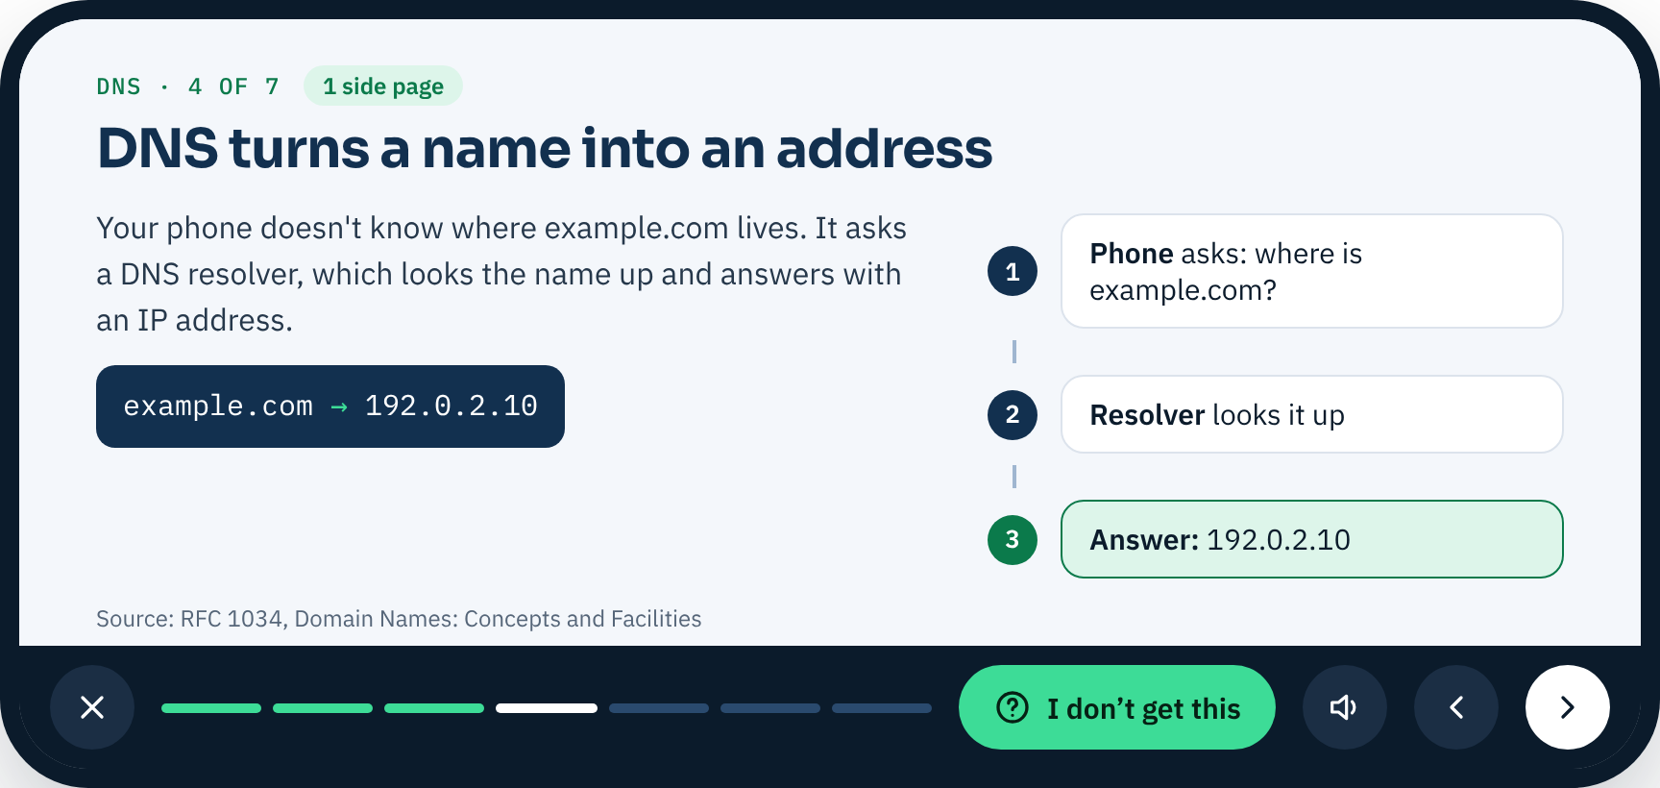
Topic in, slides out, tap where you are lost
THE APP · 1 OF 9
1 Create
Type a topic, or use your own notes.
2 Learn
Slides like a lecture deck: one idea each, with a diagram.
3 Get unstuck
Tap “I don’t get this” for a cited side page.
A slide, opened full screen in landscape
Notes:
This is the whole product. Create a deck, read it as full-screen landscape slides, and when something does not make sense, ask on that exact slide.

Slide 5
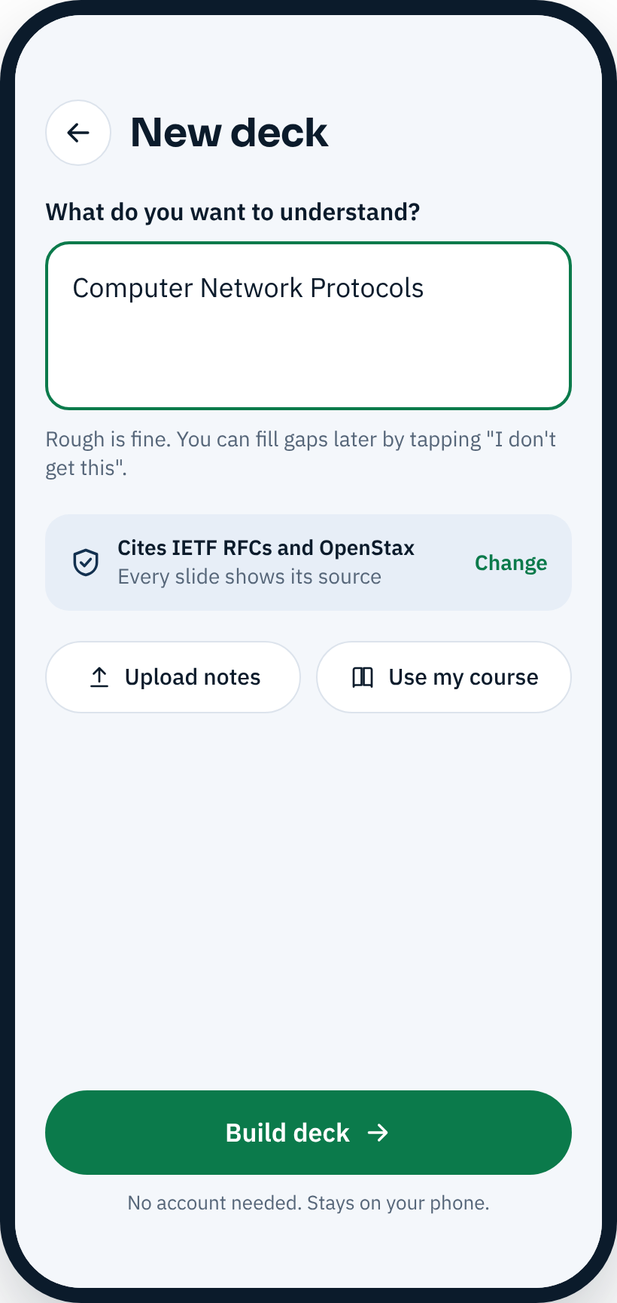
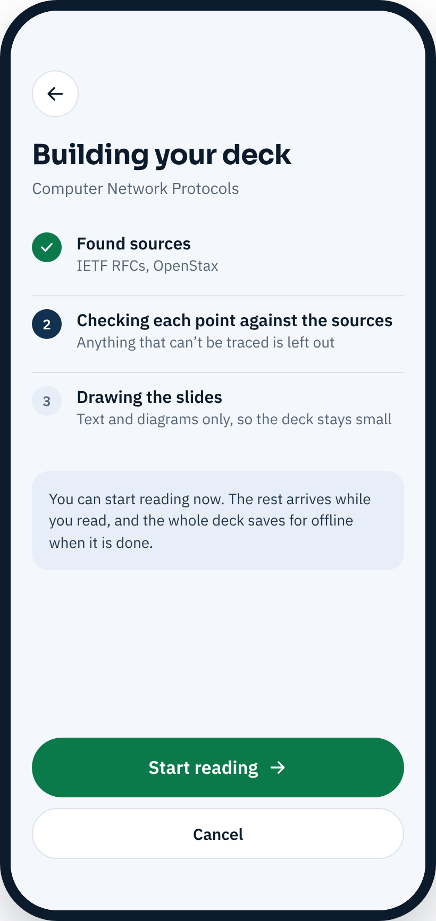
Start from a topic, and start reading in seconds
THE APP · 2 OF 9
One question
What do you want to understand? Rough is fine.
Sources up front
Every slide cites IETF RFCs or OpenStax, and you can change that.
Start reading early
The first slides arrive first. The deck saves offline when done.
New deck
Building your deck
Notes:
New deck takes a topic. Sources are shown before building. Reading can start while the rest of the deck arrives. Upload notes and Use my course are buttons in the prototype; text extraction is not built.

Slide 6
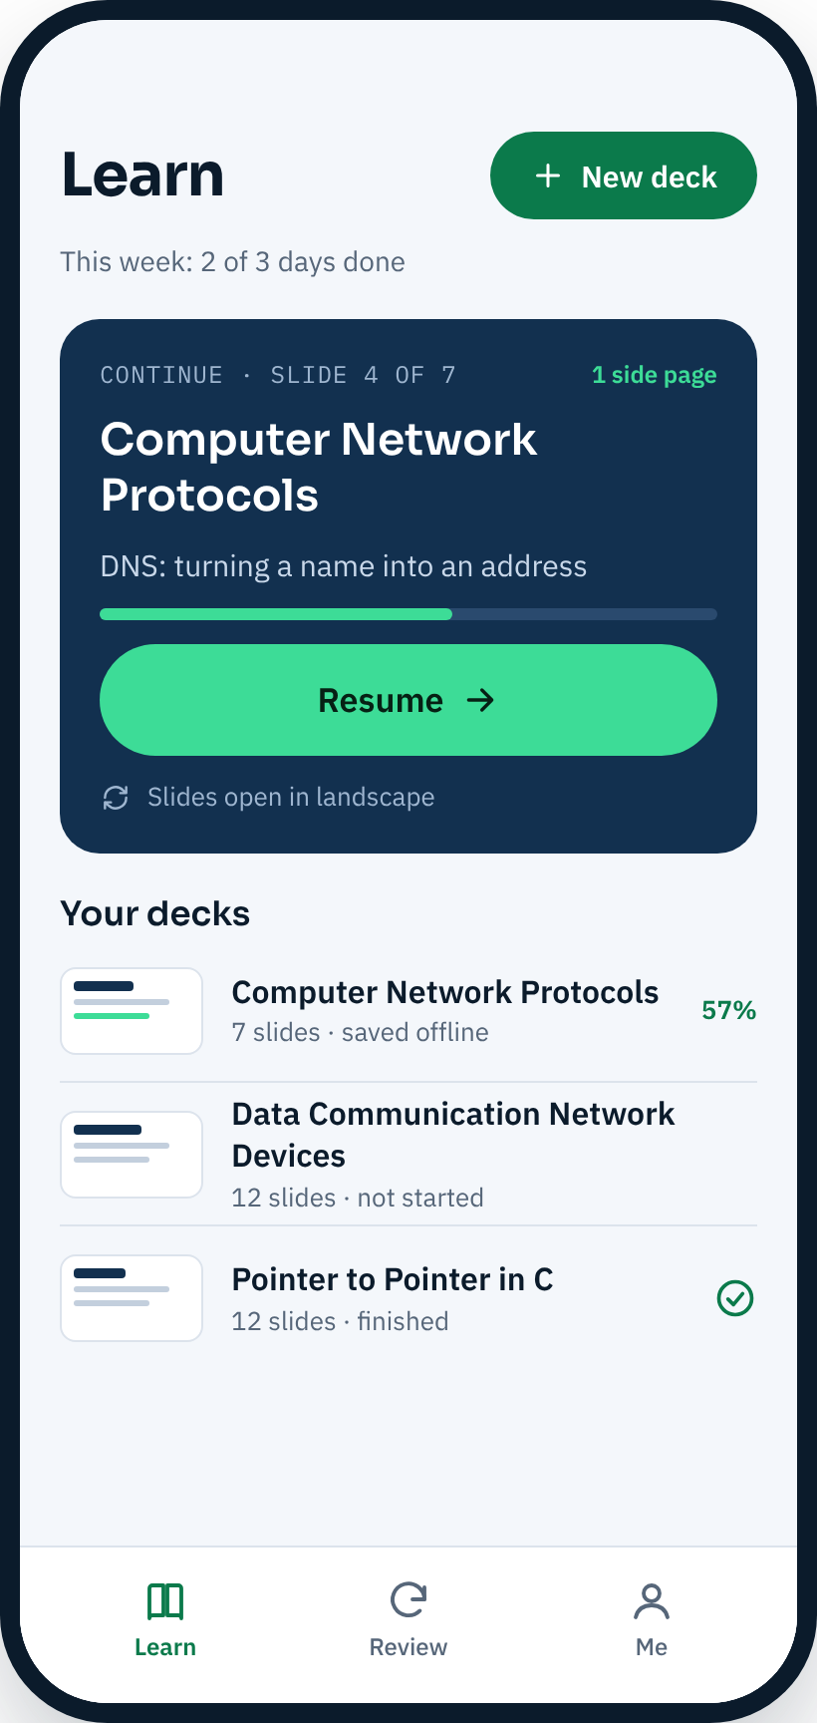
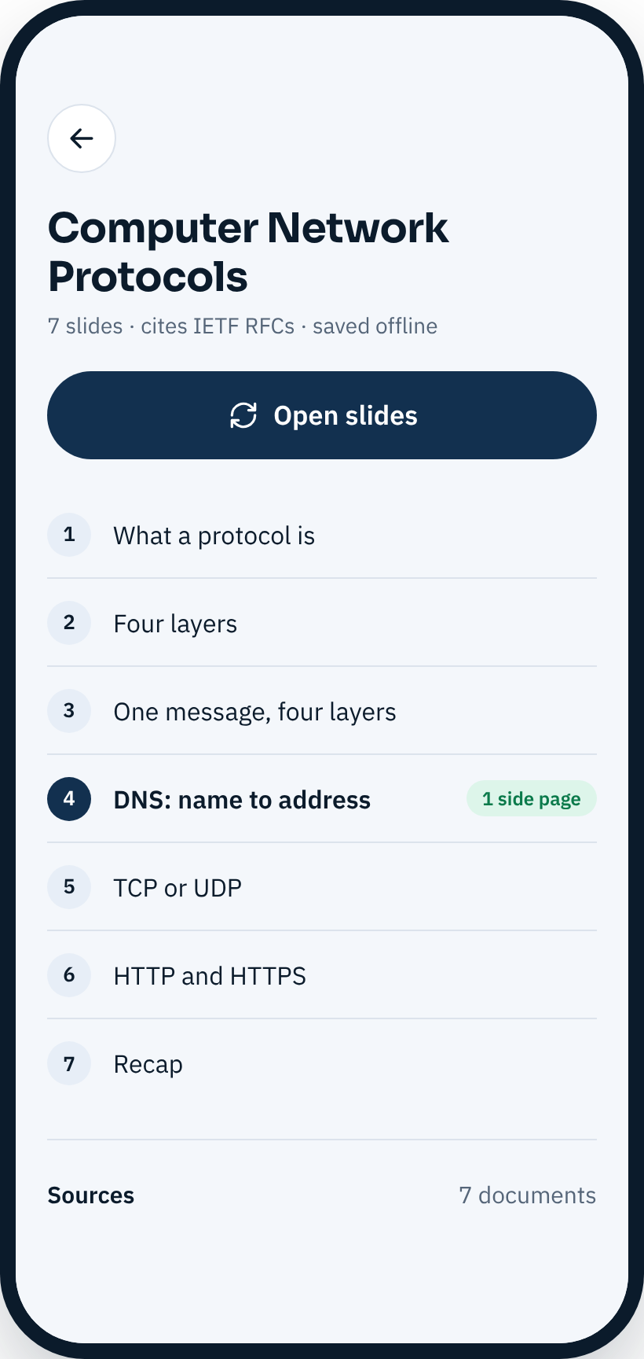
Learn: resume first, then your decks
THE APP · 3 OF 9
Resume
One tap back to the slide where you stopped.
Your decks
Progress on each, and which work offline.
Deck page
Slide list, side-page markers and all sources.
Learn
A deck
Notes:
The Learn tab leads with the deck you were reading and a large Resume button. New deck is one button at the top. Opening a deck shows its slides and sources.

Slide 7
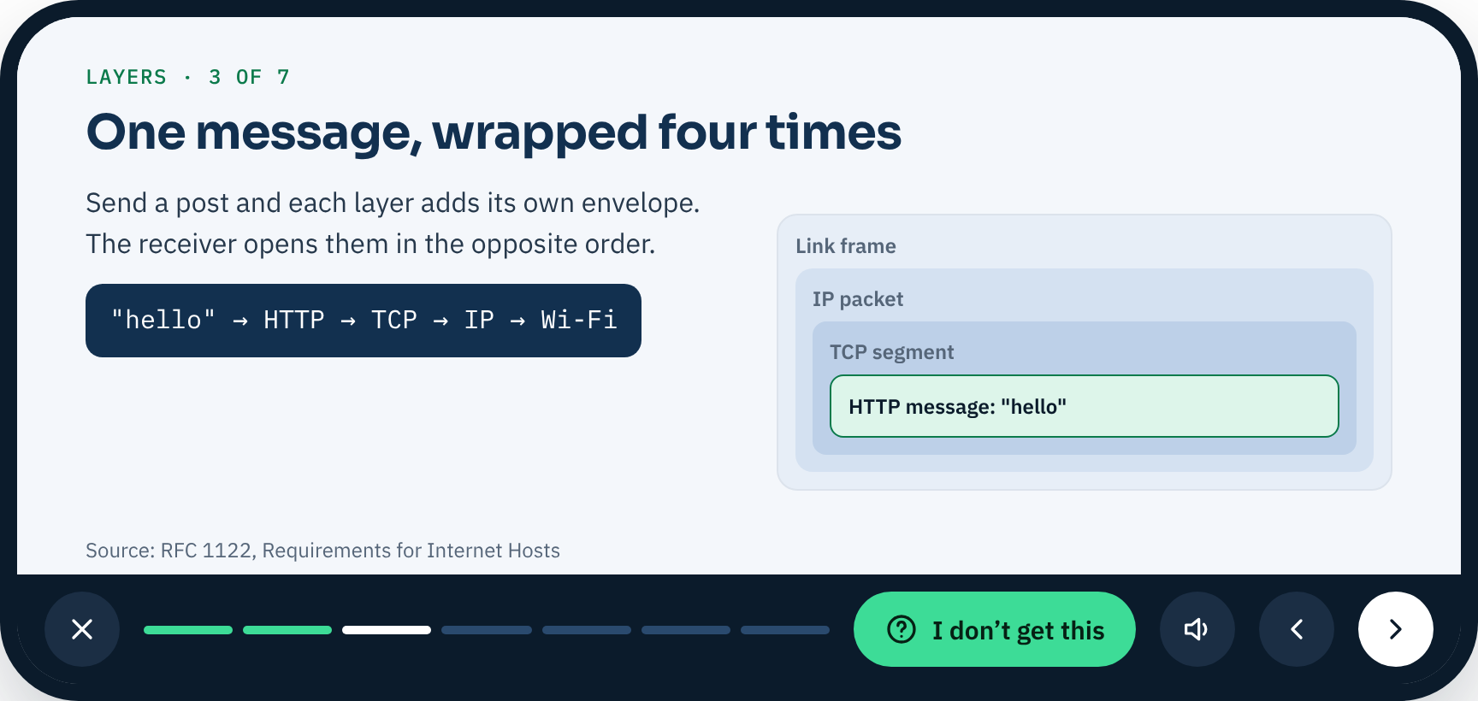
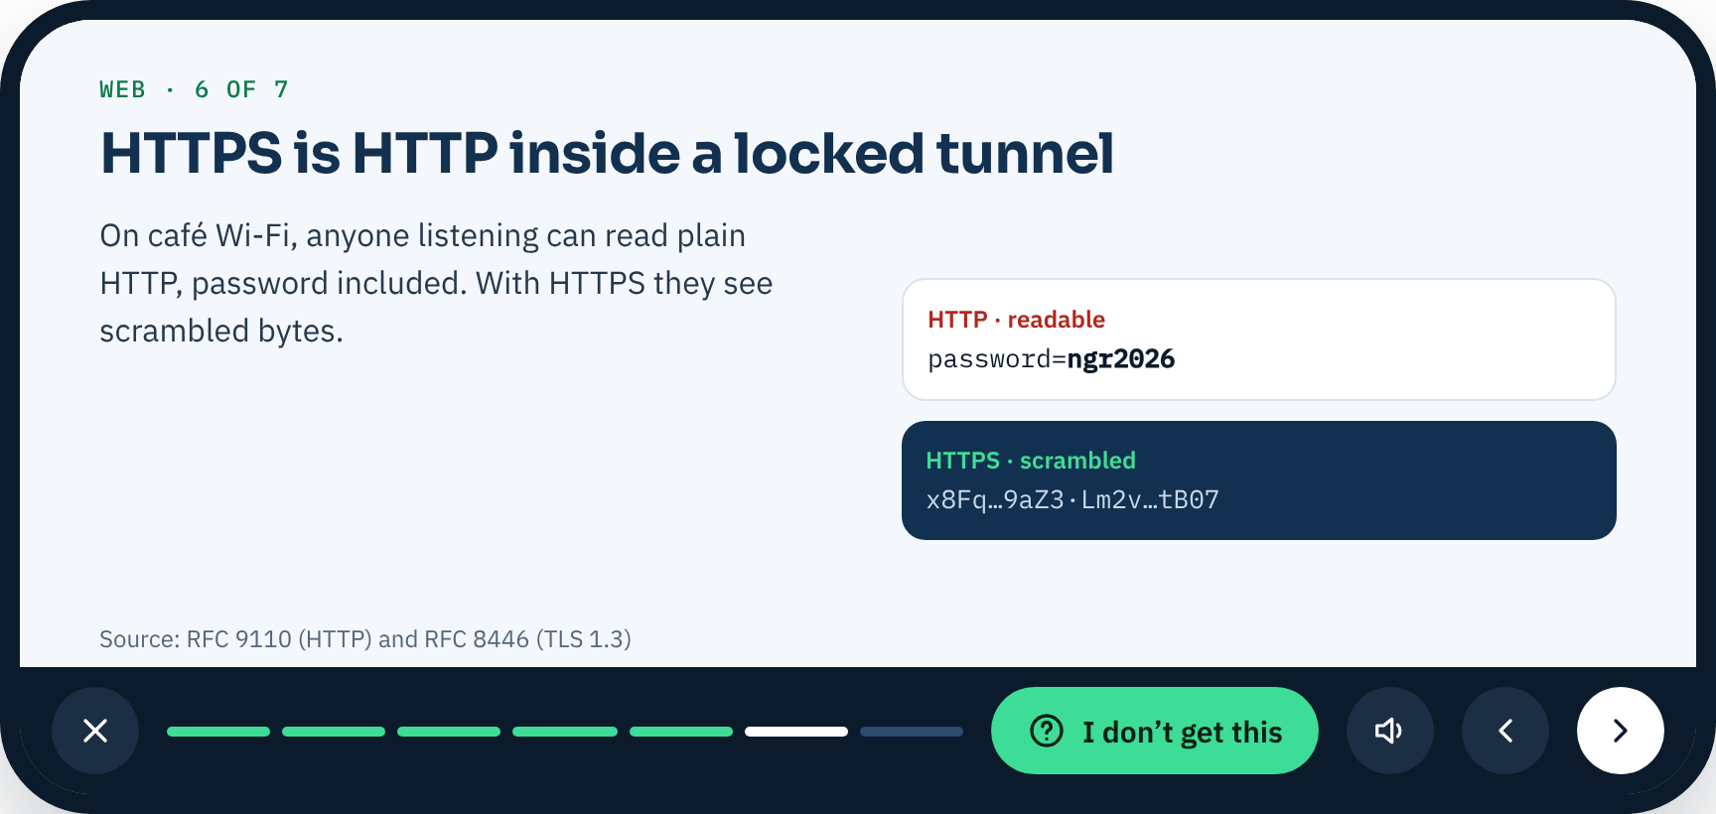
Decks open full screen, as landscape slides
THE APP · 4 OF 9
Full screen, landscape
The deck opens like a presentation, with one idea per slide.
One slim control bar
Close, progress, “I don’t get this”, listen, back and next.
Slide 3: one message, four layers
Works on any phone
Held upright, the slide is turned to fill the screen.
Slide 6: HTTP and HTTPS
Notes:
Opening a deck turns the phone to landscape and fills the screen, so a slide reads like a lecture slide. All controls sit in one slim bar under the slide.

Slide 8
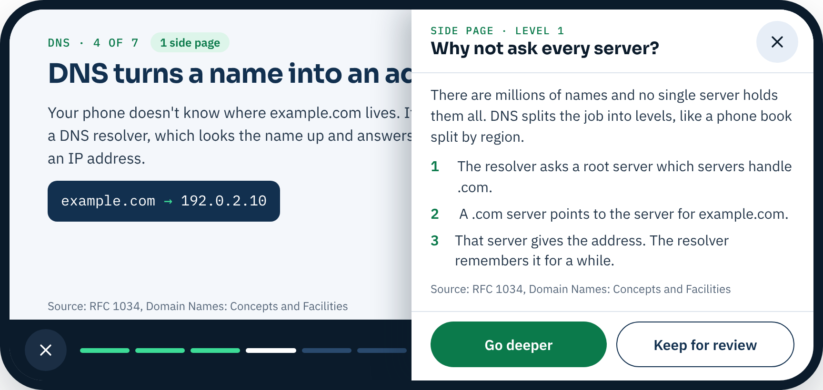
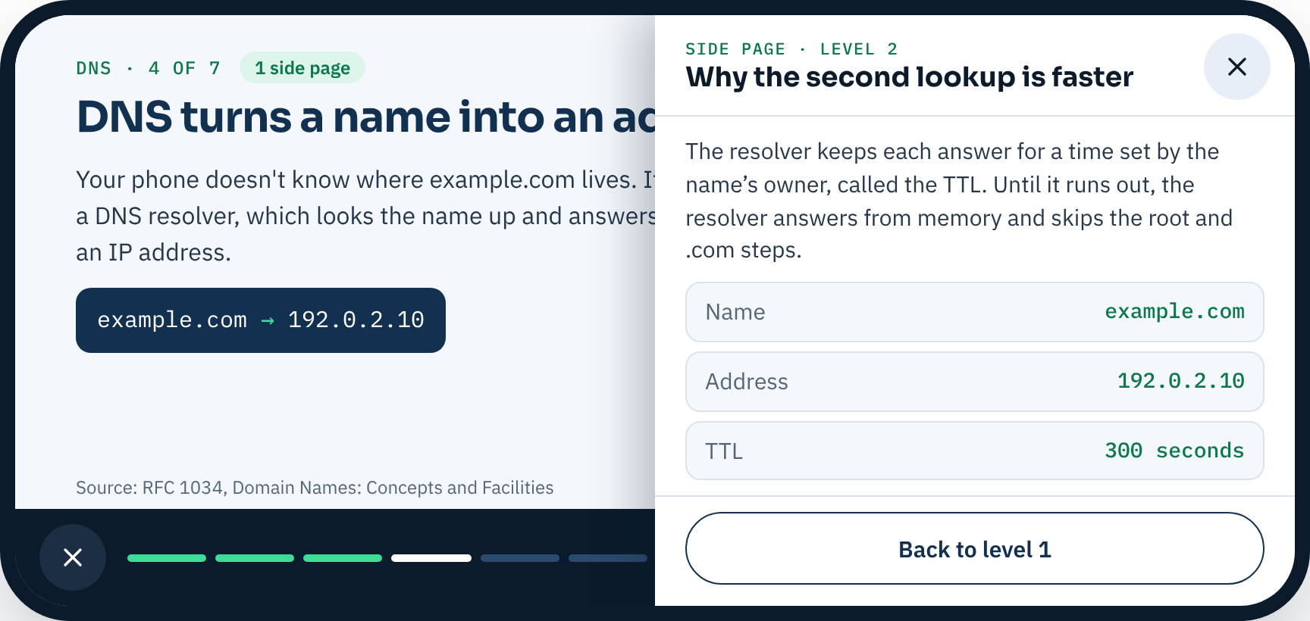
Get unstuck with a side page
THE APP · 5 OF 9
“I don’t get this”
Opens an explanation attached to that exact slide, with its source.
Go deeper
Level 2 gives a second explanation. It is the last level.
Side page, level 1
Keep for review
Saved on your phone; it comes back in Review.
Level 2
Notes:
The side page opens over the right of the slide, so the slide stays visible. Level 2 goes deeper. Kept side pages come back in Review.

Slide 9
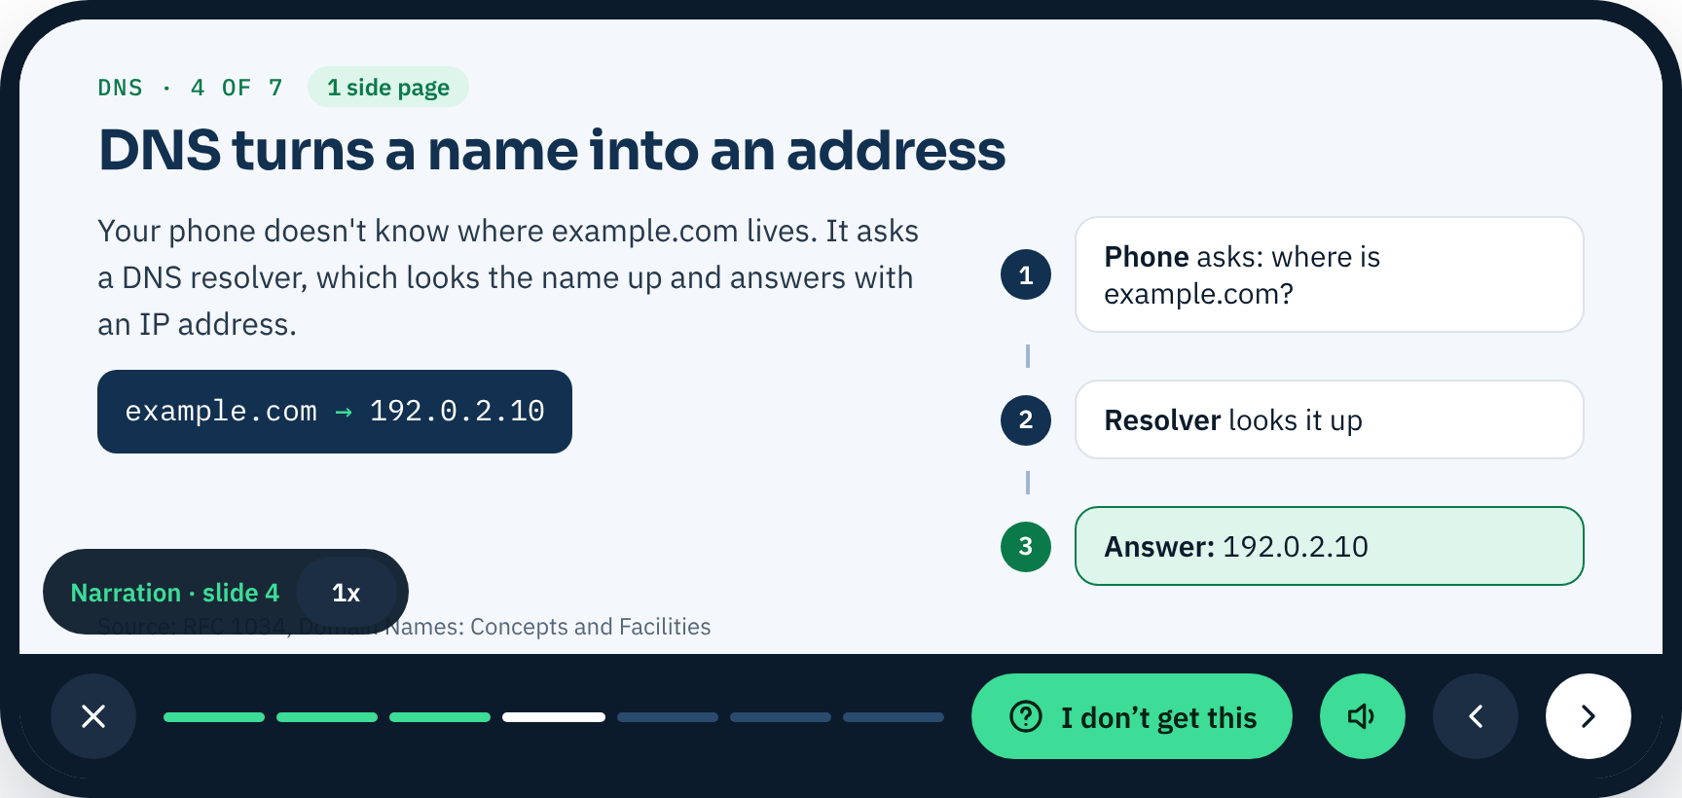
Built to be listened to, not only read
THE APP · 6 OF 9
Narration on every slide
Read aloud by the phone’s own voice. Nothing to download.
You set the pace
Cycle the speed: 1x, 1.25x, 1.5x, 0.75x.
Text stays
Audio supports the slide. It never replaces the text.
Narration on a slide
Notes:
Each slide has a short narration, spoken with the phone's built-in voice, so it adds no audio download. Audio supports readable text; it does not replace it.

Slide 10
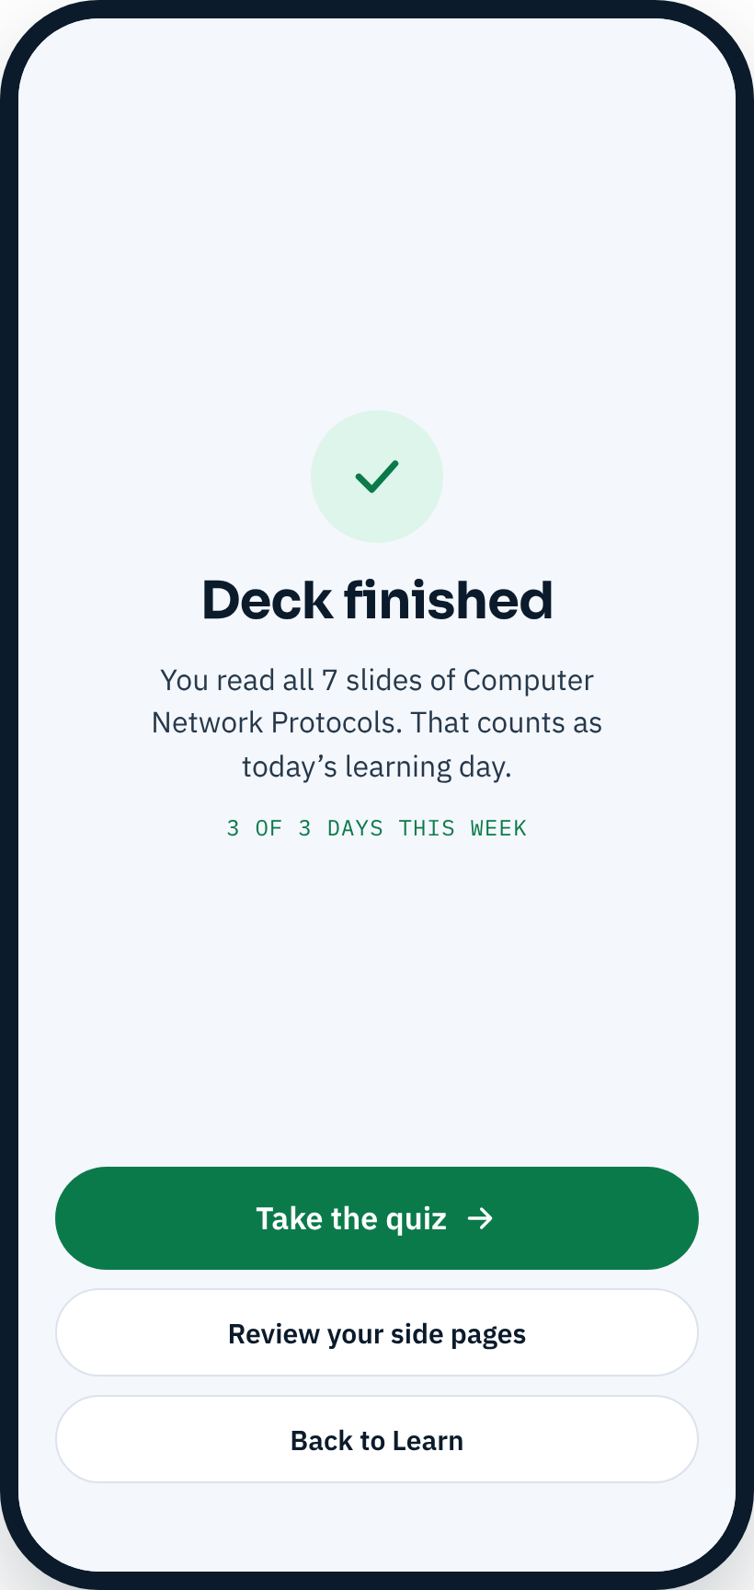
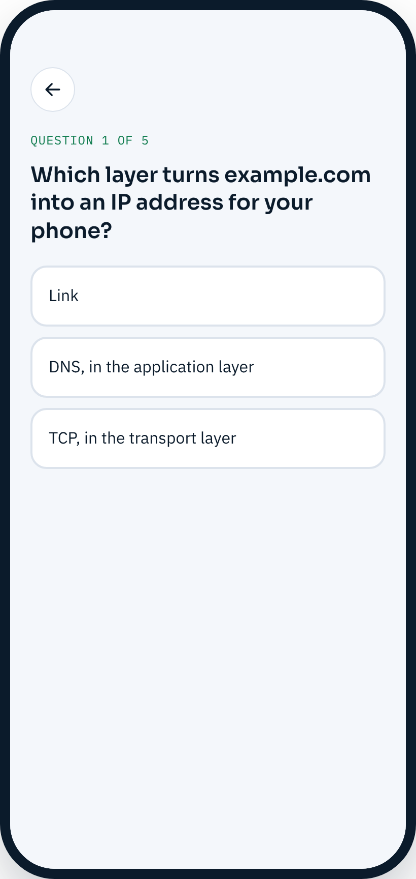
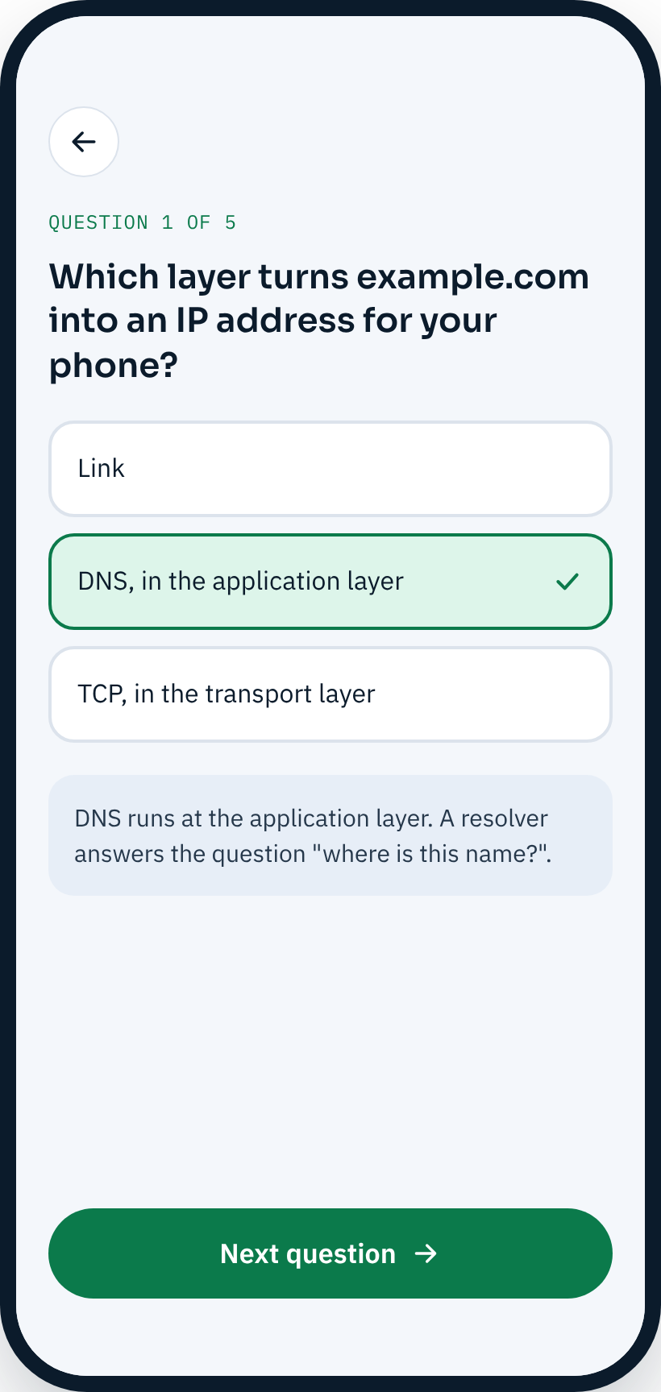
Quizzes that check, never block
THE APP · 7 OF 9
End of a deck
You are offered the quiz, or you can go back to Learn.
Explained answers
Each answer says why, in a line or two.
Always optional
Skipping never blocks the next deck.
End of a deck
A question
After answering
Notes:
The quiz is five questions with an explanation after each. It is offered at the end of a deck and from Review, and is always optional.

Slide 11
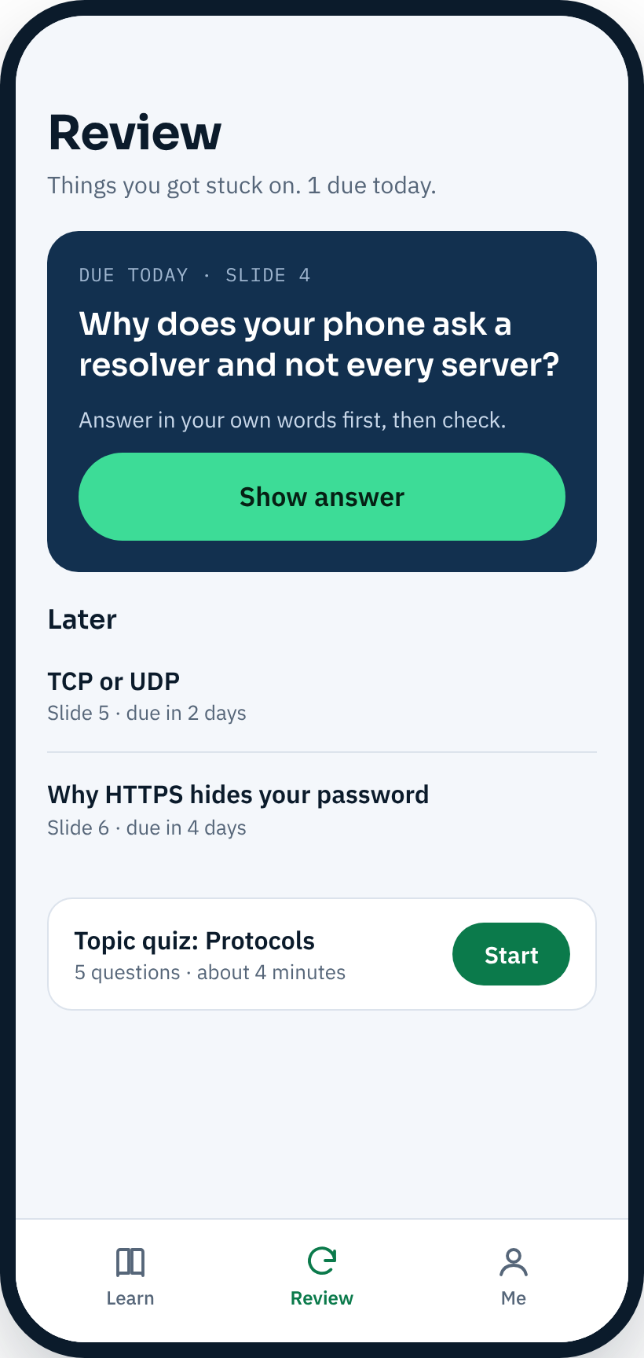
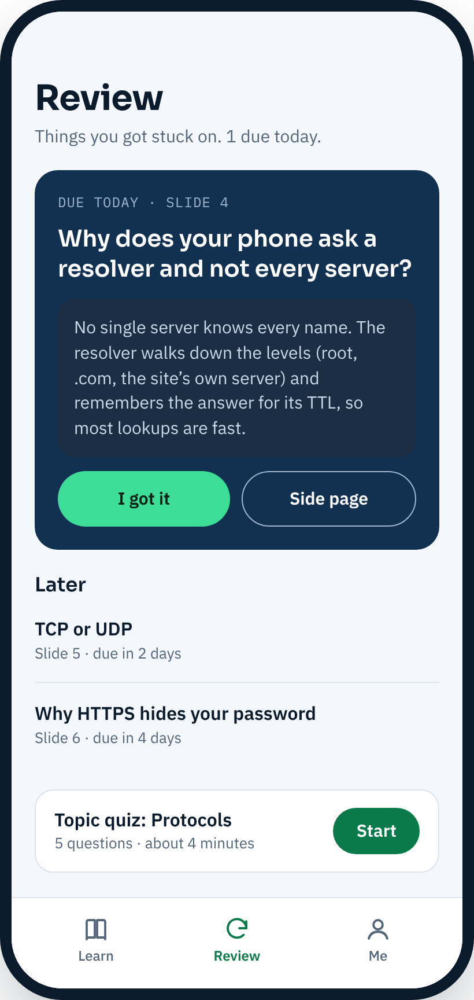
Review brings back what you needed help with
THE APP · 8 OF 9
Due today
One card from your side pages, with a question to answer first.
Recall, then reveal
Try to answer, then show the answer.
Later and quiz
Upcoming cards, and the topic quiz, on one screen.
Try to recall
Answer shown
Notes:
Review turns the side pages the learner opened into recall cards. A finished review or quiz counts as an active day for the weekly goal.

Slide 12
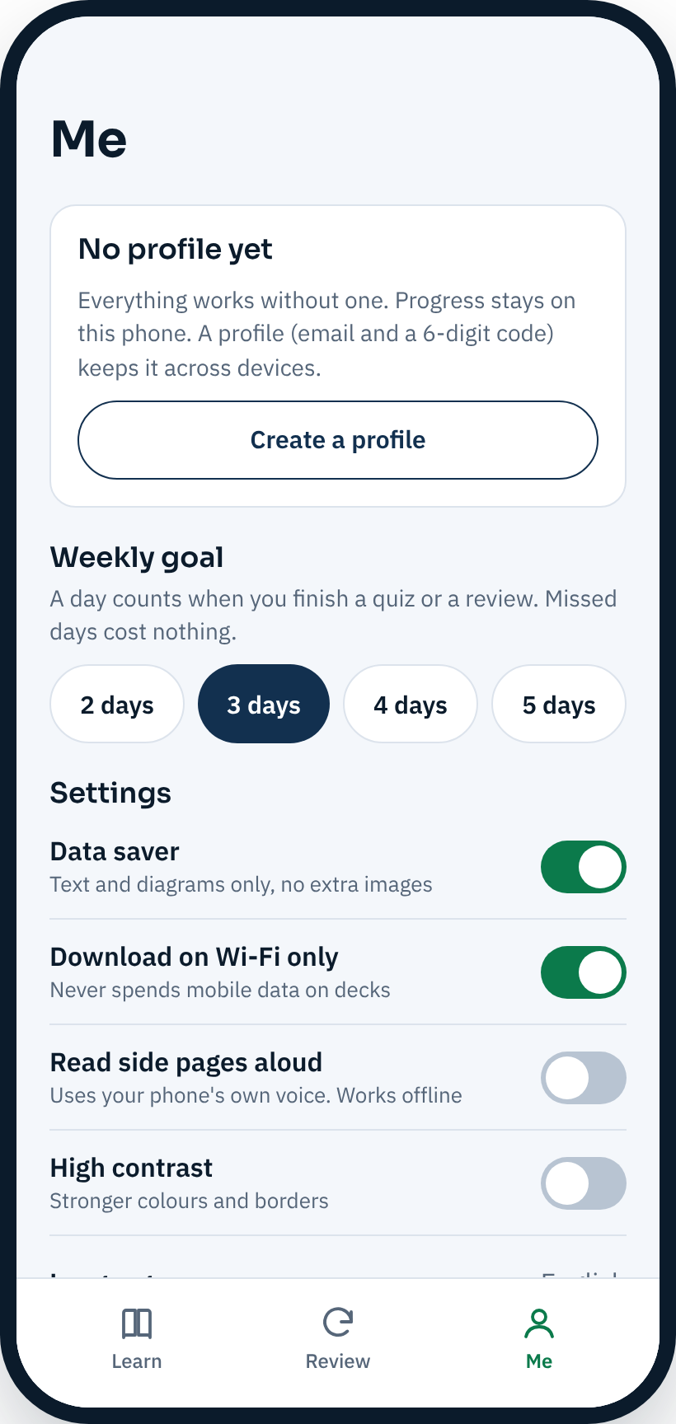
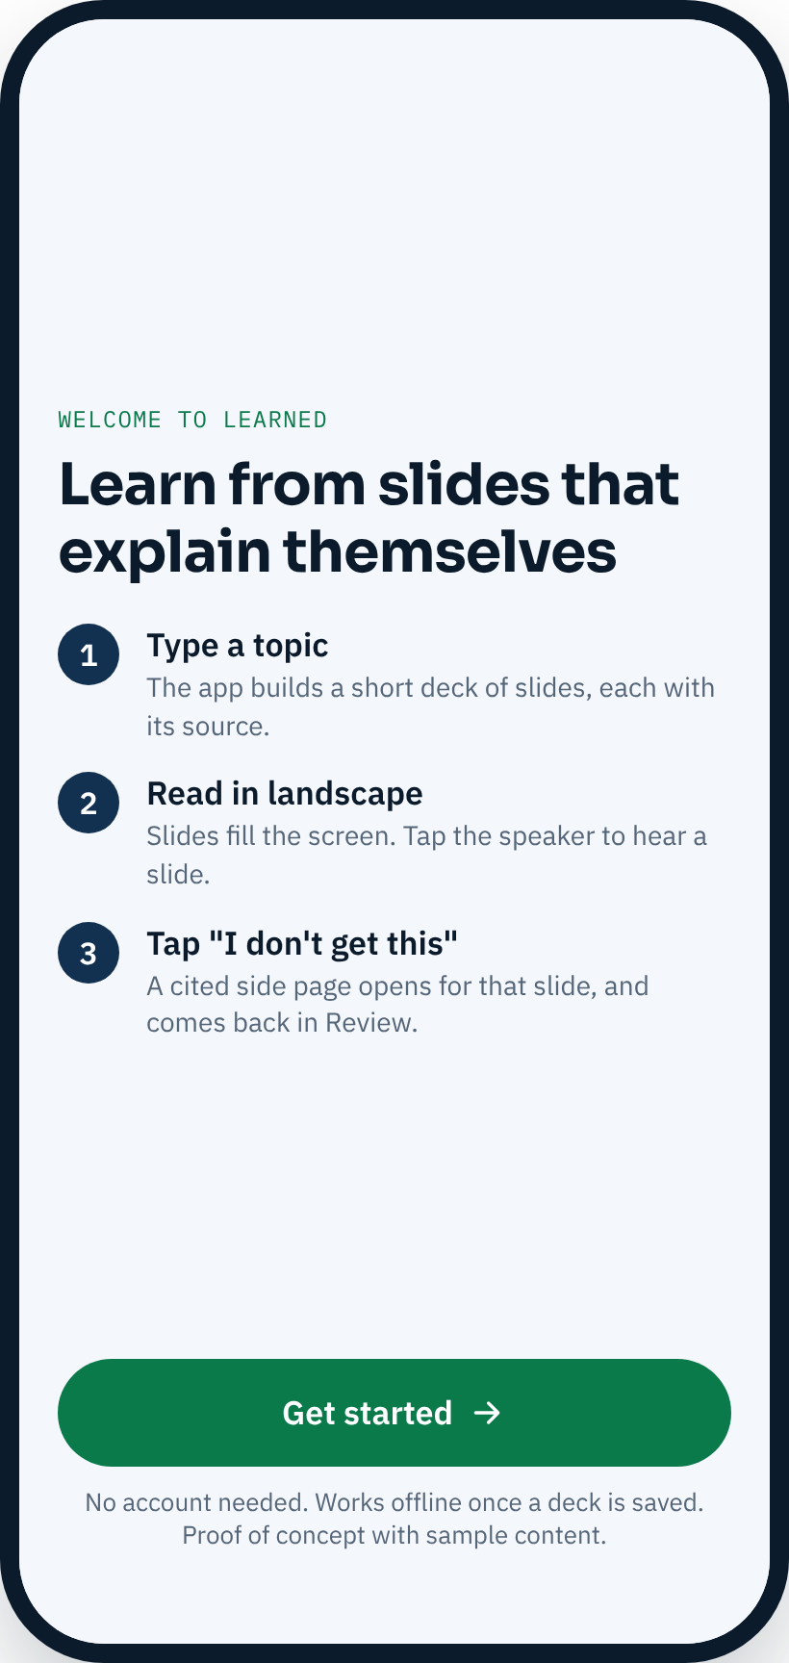
A weekly goal, simple settings, optional profile
THE APP · 9 OF 9
Weekly goal
Two to five days a week. Missed days cost nothing.
Data saver and Wi-Fi only
Text and diagrams only, and no mobile data spent on decks.
Optional profile
Email and a 6-digit code. Learning works without one.
Me
First visit
Notes:
The streak is weekly: three days a week by default. Deliberate, so students who cannot study every day are not pushed out. A profile is optional and uses an email and a six-digit code, with no password.

Slide 13
How the design meets the brief’s constraints
THE BRIEF · CONSTRAINTS
Credible, traceable sources
Curated sources, a citation on every claim. Pipeline not built yet.
Low bandwidth
Text and diagrams, no video. Offline shell. Only extracted text is uploaded.
Accessible
Narration, large targets, labelled controls.
Personalisation without exclusion
Advised start, never forced. Weekly goal.
Privacy
Profile optional; email and code only.
Multilingual
English now. Pidgin and one local language planned, after native-speaker review.
Local relevance
Nigerian technical courses and department course packs.
Notes:
Each of the brief's constraints and what the design does about it. Sources and multilingual are the most unfinished: the sourcing pipeline is not built and translation needs native-speaker review.

Slide 14
Impact: hypotheses a pilot would test
IMPACT
Students finish more
Measure: Share of decks finished; return rate the following week
Confusion gets resolved
Measure: Share of “I don’t get this” taps followed by a correct quiz answer
Works on a small data budget
Measure: Megabytes per finished deck; share of sessions that work offline
Lecturers see where a class struggles
Measure: Course packs published; slides flagged by many students
No usage data exists yet. Quiz outcomes, not streaks, should be the headline measure.
Notes:
Be clear that these are things to test, not results. The main danger is a confident wrong explanation, so source checking matters more than any feature.

Slide 15
Free for students, paid for by a sponsor
MARKETABILITY
Edukoya shut down in early 2025
It raised $3.5M, but free users did not convert to paying customers.
Institution or department licence
The school pays; students use it free. Risk: slow sales cycles.
Career outcomes sell
Platforms tied to a job or skill do better with learners who see a return.
Sponsor or telco zero-rating
A partner pays; no data cost to students. Risk: depends on a partner.
Gap: tertiary technical courses
uLesson charges from ₦50,000 a year and serves school level.
Optional paid extras
Exam packs, offline bundles. Risk: low willingness to pay.
Start with one or two polytechnic departments and one lecturer each, in one subject, for one term.
Notes:
Sources: Techloy on Edukoya (27 Feb 2025) and TechCabal on uLesson pricing. The business model is a proposal, not tested.

Slide 16
What exists today, and what does not
STATUS
Built
Not built yet
Installable phone web app (PWA) with sample content
Three tabs: Learn, Review and Me
Landscape slide player with side pages and narration
Quiz, Review, weekly goal and settings
Deck generation from curated sources, with citations
Source checking and expert review of explanations
Upload notes (button only for now)
Accounts, saved progress, lecturer view
Pidgin and local-language versions
Notes:
Honest status. The hard, valuable work is the generation and source-checking pipeline; the prototype proves the experience, not the content quality.

Slide 17
Test it in a real class
next one cited deck
Build one fully cited deck (TCP, networking) and try it with a class before building more.
Notes:
The ask: agree a first pilot subject and a lecturer, and fund the source-checking effort for one deck.

