Slide 1
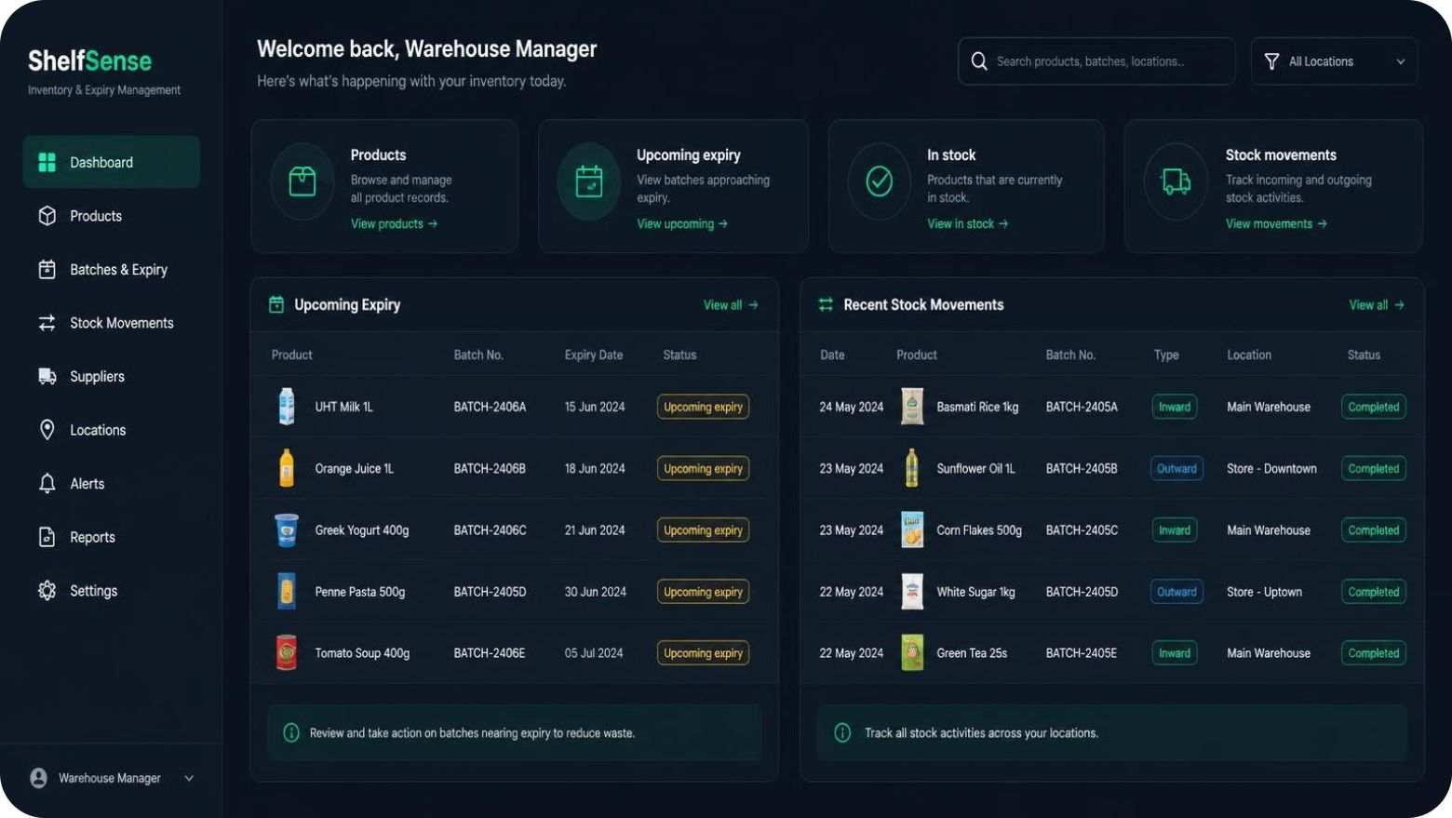
PRODUCT DESIGN · SHELFSENSE
ShelfSense: Smart Inventory & Expiry Management Platform
Smarter Inventory. Less Waste. Better Business Decisions.
V Rohith (23501A05I9)
P Somesh (23501A05E1)
O Venkat Sai (23501A05D3)
Illustrative interface concept, not an implementation screenshot.
Notes:
Introduce ShelfSense as the intended platform design. The interface is illustrative; the deck does not claim measured results.

Slide 2



THE PROBLEM
Disconnected stock tracking creates costly blind spots
Manual records
Unexpected shortages
Expired products
Separate records make current stock difficult to establish.
Missing visibility leaves replenishment needs easy to overlook.
Expiry risk can remain hidden until stock can no longer be sold.
Supplier coordination and business insights are difficult without a shared view.

Slide 3
EXPECTED BENEFITS
Visibility makes everyday inventory decisions easier
Disconnected processes make it harder to spot expiry risk, replenish stock and understand business activity.
What needs attention?
What should we buy?
What is happening?
Batch and expiry records help identify stock approaching expiry.
Stock visibility supports more informed replenishment decisions.
Connected sales and purchase records make activity easier to review.
Connect operational records to clearer decisions.

Slide 4




PLATFORM OVERVIEW · INTENDED DESIGN
ShelfSense brings inventory workflows together
ShelfSense Hub
Products, Batches & Expiry
Analytics & Reports
Sales, Purchases & Suppliers

Slide 5






DESIGN OBJECTIVES
Six objectives guide the platform
Centralize operations
Improve stock visibility
Bring core records into one workspace.
Make inventory status easier to understand.
Minimize expiry-related waste
Automate stock updates
Surface batches that need attention.
Connect movements to purchases and sales.
Improve purchasing decisions
Improve business reporting
Use stock context when replenishing.
Review connected operational activity.

Slide 6
TECHNOLOGY · INTENDED STACK
A TypeScript-based MERN stack powers ShelfSense
MERN combines MongoDB, Express.js, React and Node.js.
Frontend
Backend
Database
React, TypeScript, Vite, Tailwind CSS
Node.js, Express.js, TypeScript
MongoDB and Mongoose
API and business logic
Data storage and models
Interface and styling
JWT for authentication · Zod for validation · TanStack Query for server data · Zustand for application state · Recharts for charts

Slide 7
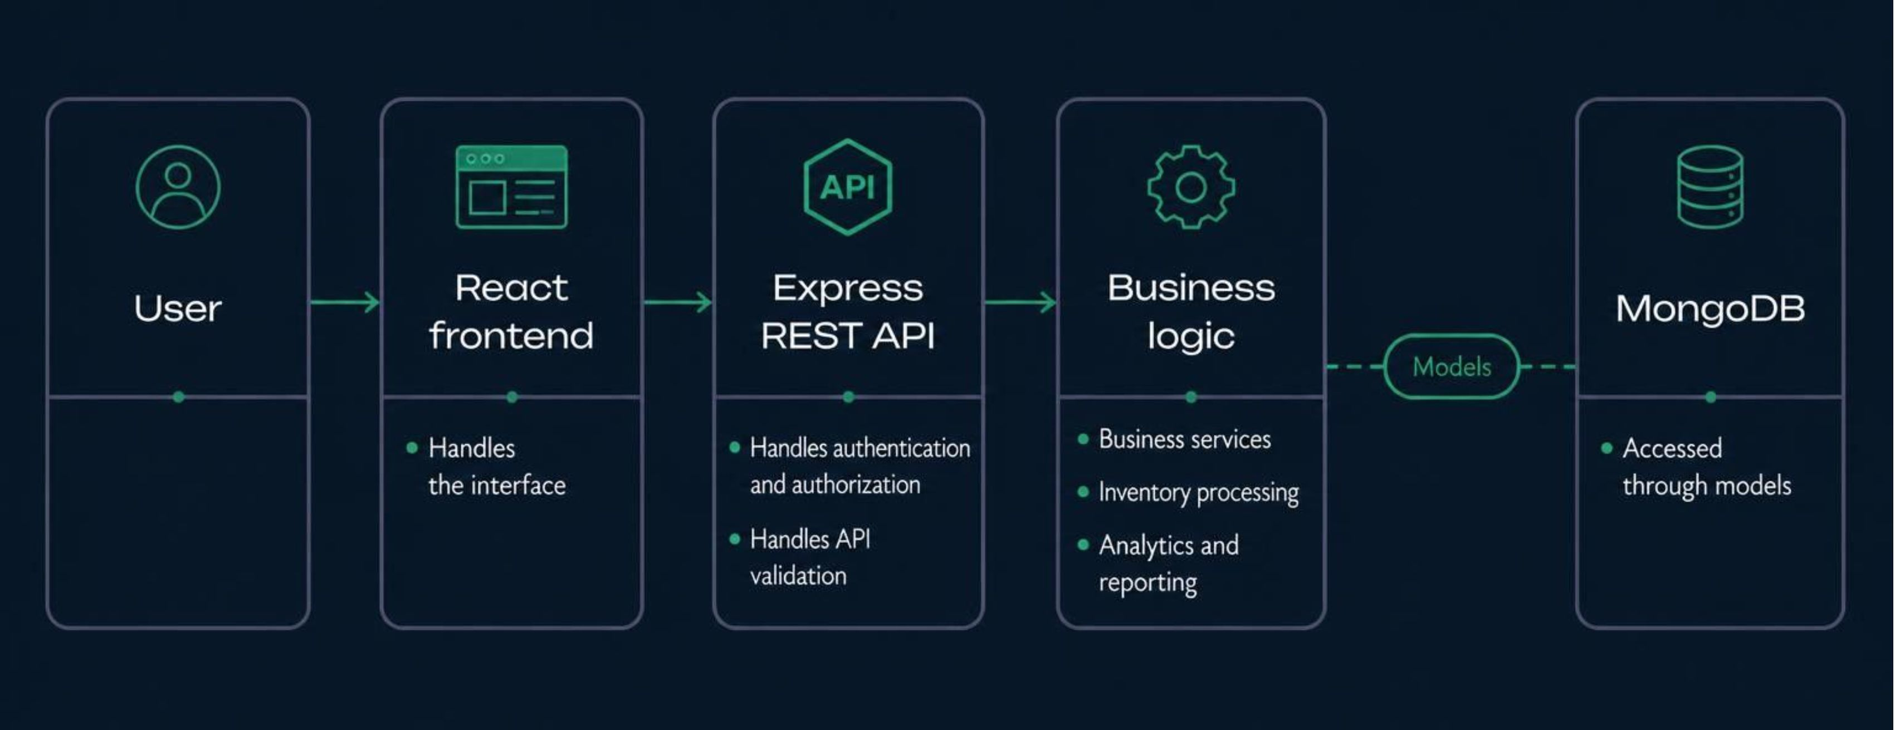
REQUEST ARCHITECTURE · INTENDED DESIGN
Requests flow from the interface to the database
REST API means the HTTP interface between the frontend and backend services.

Slide 8









FUNCTIONAL SCOPE
Nine modules cover the business workflow
Authentication and users
Products and categories
Inventory and movements
Access and user records
Catalog organization
Stock and its changes
Batches and expiry
Suppliers
Purchases
Expiry-aware stock records
Supplier information
Incoming stock workflow
Sales
Notifications
Analytics and reporting
Outgoing stock workflow
Operational alerts
Business activity review

Slide 9
INVENTORY LOGIC
Batch-level tracking supports expiry-aware allocation
Multiple batches per product preserve expiry context alongside stock availability.
01
02
03
Track each batch
Identify expiry status
Allocate with FEFO
Keep product stock linked to its batch and expiry record.
Distinguish upcoming expiry and expired stock.
Prioritize stock by first expiry, first out.
Low-stock alerts complement expiry tracking by highlighting replenishment needs.

Slide 10
TRANSACTION WORKFLOWS · INTENDED DESIGN
Purchases add stock; sales allocate and deduct it
Purchasing
Purchase Order → Supplier → Stock Received → Batch Created → Inventory Updated
Sales
Product Selection → Cart → Checkout → FEFO Allocation → Stock Deduction → Receipt
Purchases create incoming stock records. Sales apply expiry-aware allocation before deducting stock.

