Slide 1
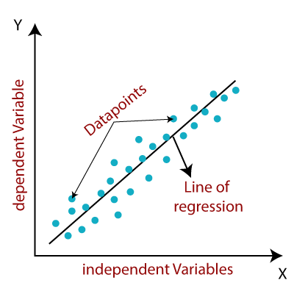
Linear_ Regression
Linear regression is one of the easiest and most popular Machine Learning algorithms. It is a statistical method that is used for predictive analysis. Linear Regression makes predictions for continuous/real or numeric variables such as sales , salary, age, product price, etc.
Linear regression algorithm shows a linear relationship between a dependent (y) and one or more independent (y) variables , hence called as linear regression. Since linear regression shows the linear relationship, which means it finds how the value of the dependent variable is changing according to the value of the independent variable.
The linear regression model provides a sloped straight line representing the relationship between the variables. Consider the below image.

Slide 2
Type of Linear_Regression
Simple Linear regression:
If a single independent variable is used to predict the value of a numerical dependent variable, then such a Linear regression algorithm Is called Simple Linear Regression.
Multiple Linear regression:
If more than one independent variable is used to predict the value of a numerical dependent variable , then such a Linear Regression algorithm is called Multiple Linear Regression.

Slide 3
Classification Algorithm in Machine Learning
What is the Classification Algorithm?
The Classification algorithm is a Supervised Learning technique that is used to identify the category of new observation on the basis of training data. In Classification, a program learns from the given dataset or observation and then Classifies new observation into a number of class or groups . Such as , Yes or no, 0 or 1, Spam or Not Spam , cat or dog, etc. Classes can be called as targets//labels or categories.
Unlike regression , the output variable of Classification is a category, not a value, such as “Green or Blue”, ”fruit or animal ”, etc. Since the Classification algorithms is a supervised learning technique, hence it takes labeled input data, which means it contains input with the corresponding output.
In Classification algorithm, a discrete output function(y) is mapped to input variable(x).
Classification algorithms can be better understood using the below diagram. In the below diagram, there are two classes, class A and Class B. These classes have features that are similar to each other and dissimilar to other classes.

Slide 4
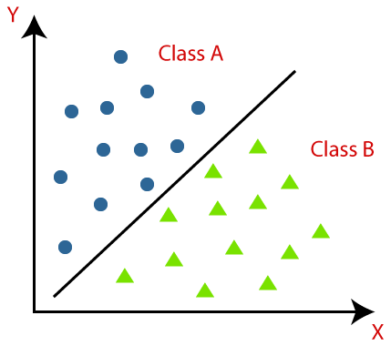
The algorithms which implements the classification on a dataset is known as a classifier . There are two types of Classifications:
Binary Classifier: If the Classification problem has only two possible outcomes , then it is called as Binary Classifier.
Examples:YES or NO, MALE or FEMALE, SPAM or NOT SPAM, CAT or DOG, etc.
Multi_Class Classifier: If a classification problem has more than two outcomes, then it is called as Multi_class Classifier.
Example: Classification of types of crops, typrs of music

Slide 5
Classification Problems
In the Classification problems , there are two types of learners
Lazy Learners: Lazy Learner firstly stores the training dataset and wait until it receives the test dateset. In Lazy learner case, classification is done on the basis of the most related data stored in the training dataset. It takes less time in training but more time for predictions
Example: K-NN algorithm, Case-Based reasoning
Eager Learners: Eager Learners develop a classification model based on a training dataset before receiving a test dataset, Opposite to Lazy learners, Eager Learners, Eager Learner takes more time in learning, and less time in prediction .
Example: Decision Trees, ANN.

Slide 6
Evaluating a Classification model
Once our model is completed, it is necessary to evaluate its performance, either it is a Classification oe Regression model. So for evaluating a Classification model, we have the following ways:
Log Loss or Cross-Entropy Loss:
It is used for evaluating the performance of a classifier, whose output is a probability value between the 0 and 1.
For a good binary Classification model , the value off log less should be near to 0.
The value of log loss increases if the predicted value deviate from the actual value.
The lower log loss represents the higher accuracy of the model.
Confusion Matrix:
The confusion matrix provides us a matrix/table as output and describes the performance of the model.
It is also known as the error matrix.
The matrix consists of predictions and result in a summarized form, which has a total number of correct predictions and incorrect prediction .The matrix looks like as below table

Slide 7

 | Actual Positive | Actual Negative
Predicted Positive | True Positive | False Positive
Predicted Negative | False Negative | True Negative

Slide 8
Logistic Regression in Machine Learning
Logistic regression is one of the most popular Machine Learning algorithms, which comes under the supervised Learning technique. It is used for predicting the categorical dependent variable using a given set of independent variables.
Logistic regression predicts the output of a categorical dependent variable. Therefore the outcome must be a categorical or discrete value. It can be either Yes orNO1, true or False, etc. but instead of giving the exact value as 0 and 1, it gives probabilistic values which lie between 0 and 1.
Logistic Regression ins must similar to the Liner Regression except that how they are used. Linear Regression used for soling Regression problems, whereas Logistic regression is used for solving the classification problems.
In Logistic regression , Instead of fitting a regression line, we fit an “S” shaped logistic function, which predicts two maximum values (0 or 1).
Logistic Regression Is a significant machine learning algorithm because it has the ability to provide probability and classify new data using continuous and discrete datasets.
Logistic Regression can be used to classify the observations using different types of data and can easily determine the most effective variables variables used for the classification.

Slide 9
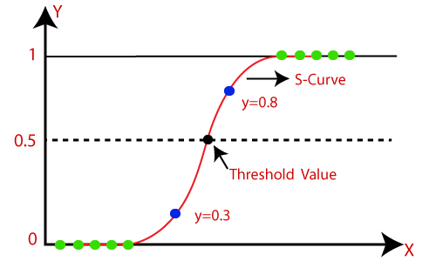
Note: Logistic regression uses the concept of predictive modeling as regression, therefore it is called logistic regression, but is used to classify samples, Therefore it falls under the classification algorithm.

Slide 10
K-Nearest Neighbor (KNN)
K-nearest Neighbor is one of the simplest Machine Learning algorithms based on Supervised Learning technique.
K-NN algorithm assumes the similarity between the new case/data and available cases and put the new case into the category that is most similar to the available categories.
K-NN algorithm stores all the available data and classifies a new data point based on the similarity. This means when new data appears then it can be easily classified into a well suite category by using K-NN algorithm.
K-NN algorithm can be used for Regression as well as for Classification but mostly it is used for the Classification problems.
K-NN is a non-parametric algorithm , which means it does not make any assumption on underlying data.
It is also called a lazy learner algorithm , which means it does not learn from the training set immediately instead it stores the dataset and at the time of classification, it performs an action on the dataset.

Slide 11
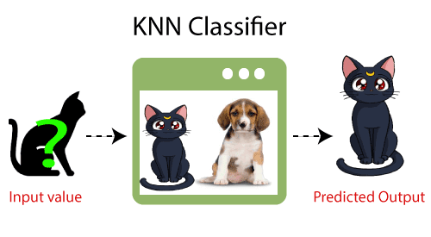
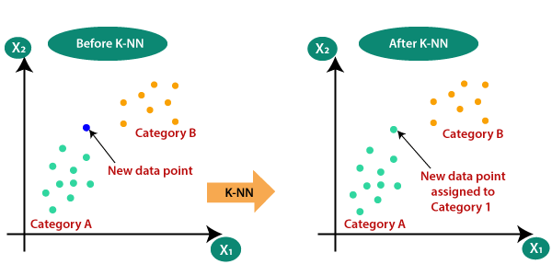
Why do we need a K-NN Algorithm ?
Suppose there are two categories, i.e, Category A and Category B, and we have a new data point x1 so this data point will lie in which of these categories. To solve this type of problem , we need a K-NN algorithm, with the help of K-NN, we can easily identify the category or class of a particular dataset. Consider the below diagram:

Slide 12
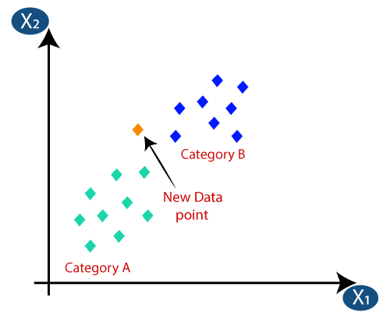
How does K-NN work?
The K-NN working can be explained on the basis of the below algorithm
Step-1: Select the number K of the neighbors
Step-2: Calculate the Euclidean distance of K number of neighbors
Step-3: Take the K nearest neighbors, count the number of the data points in each category.
Step-4: Among these k neighbors, Count the number of the data points in each category.
Step-5: Assign the new data points that category for which the number of the neighbor is maximum.
Step-6: Our model is ready.

Slide 13
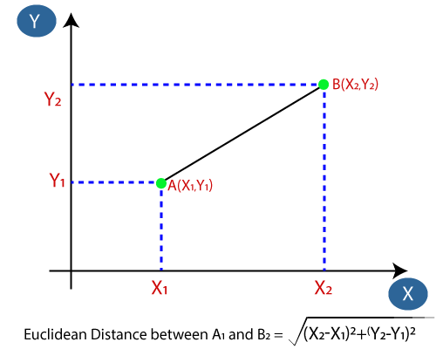
Firstly, we will choose the number of neighbors, so we will choose the k=5.
Next, we will calculate the Euclidean distance between the data points. The Euclidean distance is the distance between two points, which we have already studied in geometry . It can be calculated as:

Slide 14
By calculating the Euclidean distance we got the nearest neighbors, as three nearest neighbors in category A and two nearest neighbors in category B.
As we can see the 3 nearest neighbors are from category A, hence this new data point must belong to category A.

Slide 15
How to select the value of Kin the K-NN Algorithm?
There is no particular way to determine the best value for “K”, so we need to try some values to find the best out of them. The most preferred value for K is 5.
A very low value for k such as K=1 or K=2, can be noisy and lead to the effects of outliers in the model.
Large value for K are good , bur it may find some difficulties.
Advantages of KNN Algorithm:
It is simple to implement.
It is robust to the noisy training data
It can be more effective if the training data is large.
Disadvantages of KNN Algorithm:
Always needs to determine the value of K which may be complex some time.
The computation cost is high because of calculating the distance between the data points for all training samples.

