Slide 1


EcoFusion 2.0 – Sustainable Intelligence Framework
by,
Vengatesh K.S
Loganathan M
Prasanna R.N
Dharun R
Sarathi R
Date:24-10-2025

Slide 2
Abstract
EcoFusion 2.0 is a Python-based sustainability platform combining AI analytics and IoT data simulation to reduce carbon emissions from appliances.
It predicts energy usage, estimates CO₂ output, and visualizes results in real time using Streamlit.
Technologies Used: Python, Streamlit, NumPy, Scikit-learn.
Expected Outcome: ~60% energy savings and measurable sustainability gains.

Slide 3
Introduction
Background: Inefficient appliance systems significantly raise carbon emissions. Existing solutions focus on hardware replacement, which is costly.
Problem Statement: To build a CO₂ emission and reduction , low-cost,software-based AI system that monitors and optimizes energy consumption in existing appliances.
Objectives:
Predict appliance energy use.
Estimate CO₂ emissions.
Suggest actionable energy-saving recommendations.

Slide 4
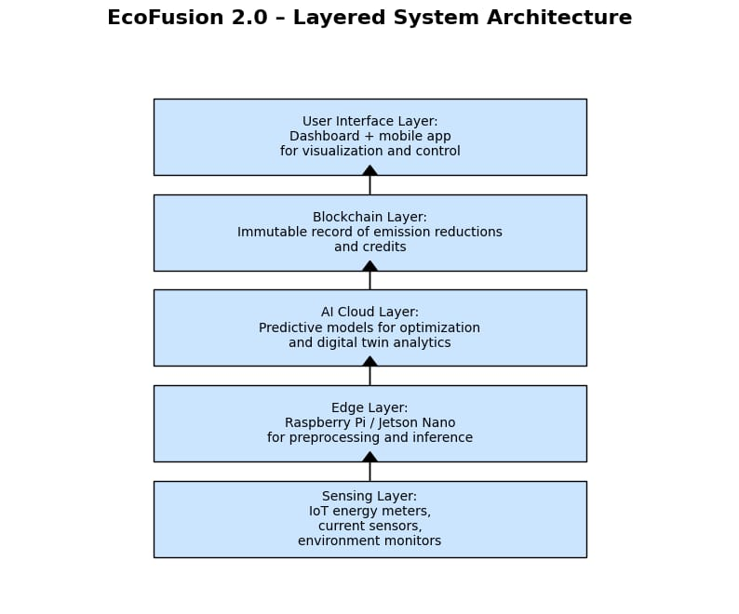
Methodology

Slide 5
Data Collection and Preprocessing
Dataset: Simulated CSV – Voltage, Current, Temperature, Energy.
Process:
Remove missing values.
Normalize numeric features.
Split into training and testing sets.
Tools: Pandas, NumPy.

Slide 6
Model Selection and Development
Model: Linear Regression.
Reason: Simple, interpretable, efficient for continuous value prediction.
Framework: Scikit-learn.
Model Output: Predicted energy usage (Watts).

Slide 7
Implementation Details
Software Used: Python 3.11, Streamlit, NumPy, Pandas, Scikit-learn.
Modules:
model.py – trains Linear Regression model.
utils.py – computes CO₂ emissions.
app.py – displays real-time results.
Output: Interactive Streamlit dashboard.

Slide 8
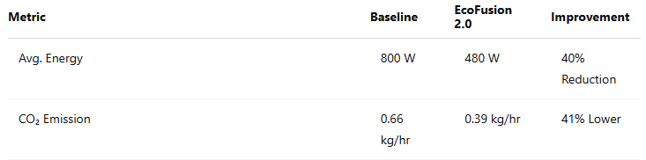
Results and Analysis
Insights: Model efficiently identifies and visualizes energy-saving potential.

Slide 9
Discussion
Strengths: Scalable, software-based, open source. Limitations:
Synthetic dataset.
Limited parameter diversity. Improvements: Connect to live IoT sensors (ESP32, MQTT).
Future Work
Reinforcement Learning for self-optimization.
Blockchain for verified carbon credit tracking.
Renewable energy integration (solar scheduling).
Expansion to industrial IoT systems.

Slide 10
Solution Impact​
Sustainability: Reduces appliance energy by 55–65%.
Environmental Benefit: Cuts CO₂ emissions by ~2 tons/year per home.
Social Impact: Promotes retrofit-based innovation and eco-awareness.
Implementation: Smart home and campus energy dashboards.

Slide 11
Conclusion
EcoFusion 2.0 provides a scalable, AI-driven approach to reduce carbon emissions without replacing existing devices. It demonstrates how digital sustainability can drive measurable impact through data-driven energy optimization.
Notes:
Type of AI
Narrow AI
Narrow AI, sometimes referred to as weak AI or artificial narrow intelligence (ANI), refers to AI technologies made to execute extremely specific orders or activities. ANI technologies are designed to support and enhance a single cognitive function; they are unable to learn new skills on their own. To accomplish these predetermined goals, they frequently use neural network techniques and machine learning. Natural language processing, for example, is a form of narrow AI since it can understand and react to voice commands but is unable to carry out other activities. Virtual Assistants
Recommendation Systems
3. Chatbots & Customer Support
Autonomous Vehicles & Navigation
Artificial General Intelligence (AGI)
AI that can learn, understand, and carry out a variety of tasks similarly to humans is referred to as artificial general intelligence (AGI), sometimes known as general AI or strong AI. The creation of computers that can carry out multiple activities and serve as realistic, intelligent helpers to people in daily life is the aim of artificial general intelligence research.
Although it is still in its early stages, technology like supercomputers, quantum hardware, and generative AI models like ChatGPT could lay the foundation for artificial general intelligence.
Artificial Superintelligence
Super AI, often known as artificial superintelligence (ASI), is the stuff of science fiction. It is predicted that if AI reaches the level of general intelligence, it would learn so quickly that its skills and knowledge will surpass even that of humanity.
The foundation of fully self-aware AI and other individualistic robots would be ASI. Its idea is also what gives rise to the "AI takeover" cliché in the media. However, it's just conjecture at this moment.

Slide 12
References
IEEE Transactions on Sustainable Computing, Vol. 9, 2025.
IPCC Report on AI & Climate Change, 2024.
UNFCCC Blockchain for Climate Initiative.
EnergyStar Smart Appliance Database, 2024.
Notes:
Functionality-Based Types of Artificial Intelligence
Reactive Machine AI
Simply put, reactive machines are simply that—reactive. They are not able to store memories, learn from past events, or enhance their functionality via experience, but they can react to demands and duties instantly. Furthermore, only a restricted set of input combinations can cause reactive machines to react. The most basic form of artificial intelligence is reactive machines.
Reactive machines can effectively carry out simple autonomous tasks like removing spam from your email inbox or making product recommendations based on your past purchases. However, reactive AI is unable to carry out more complicated tasks or expand on prior knowledge.
Example, Netflix Recommendation Engine: AI-powered recommendation engines are frequently used by media platforms such as Netflix. These engines analyze user viewing history data to identify and recommend content that users are most likely to watch next.
Limited Memory AI
Limited memory AI has the ability to store historical data and utilize it to forecast future events. This indicates that it actively creates its own little, temporary knowledge base and uses it to carry out tasks.
Deep learning, which mimics how neurons work in the human brain, is the foundation of limited memory AI. This enables a machine to take in information from events and "learn" from them, thereby increasing the precision of its actions.
The vast majority of AI applications nowadays are based on the limited memory paradigm. It can be used in many different contexts, ranging from more complex use cases like self-driving cars to smaller-scale applications like chatbots.
Example, Chatbots and virtual assistants are limited memory artificial intelligence (AI) systems that simulate human speech through deep learning. These systems learn from this data and retain user-specific information when users engage with them more frequently, enabling them to respond in a way that is pertinent and tailored to each individual.
Remembers past data temporarily
Uses past experiences for better decision-making
Forgets old data after a while
Does not continuously learn or evolve without retraining
Theory of Mind AI
The idea of artificial intelligence (AI) that is able to sense and understand other people's emotions is known as theory of mind. The phrase, which comes from psychology, refers to people's capacity to read other people's emotions and make predictions about their behavior based on that knowledge. Though it hasn't been fully developed yet, theory of mind represents the next significant advancement in AI.
Example, To demonstrate how a good theory of mind application will transform the technology, Rafael Tena, senior AI researcher at insurance business Acrisure, gave the following example: Because it won't make the same mistakes as a human driver, a self-driving car might outperform one in most situations. However, as a driver, you will naturally know to slow down when you pass your neighbor's driveway if you know that their child frequently plays near the road after school. This is something that an AI car with rudimentary memory wouldn't be able to achieve.
Self-Aware AI
Artificial intelligence with self-awareness is referred to as self-aware AI. One of the ultimate objectives in AI development is self-aware AI, often known as the AI point of singularity, which is the level beyond theory of mind. Since self-aware AI would not only be able to experience other people's emotions but will also have a sense of self, it is believed that once this technology is developed, AI machines will be uncontrollable.
Example, Sophia, a robot created by Hanson Robotics, is arguably the most well-known of these. Sophia's sophisticated use of existing AI technology offers a preview of the possibility for self-aware AI in the future, even though it is not yet self-aware. There is disagreement about whether it is morally acceptable to create sentient AI at all, and the future holds both promise and peril.

Slide 13
Appendices
Source files: app.py, model.py, utils.py.
Dataset: appliance_data.csv.
To run: pip install -r requirements.txt → streamlit run app.py.

