Slide 1

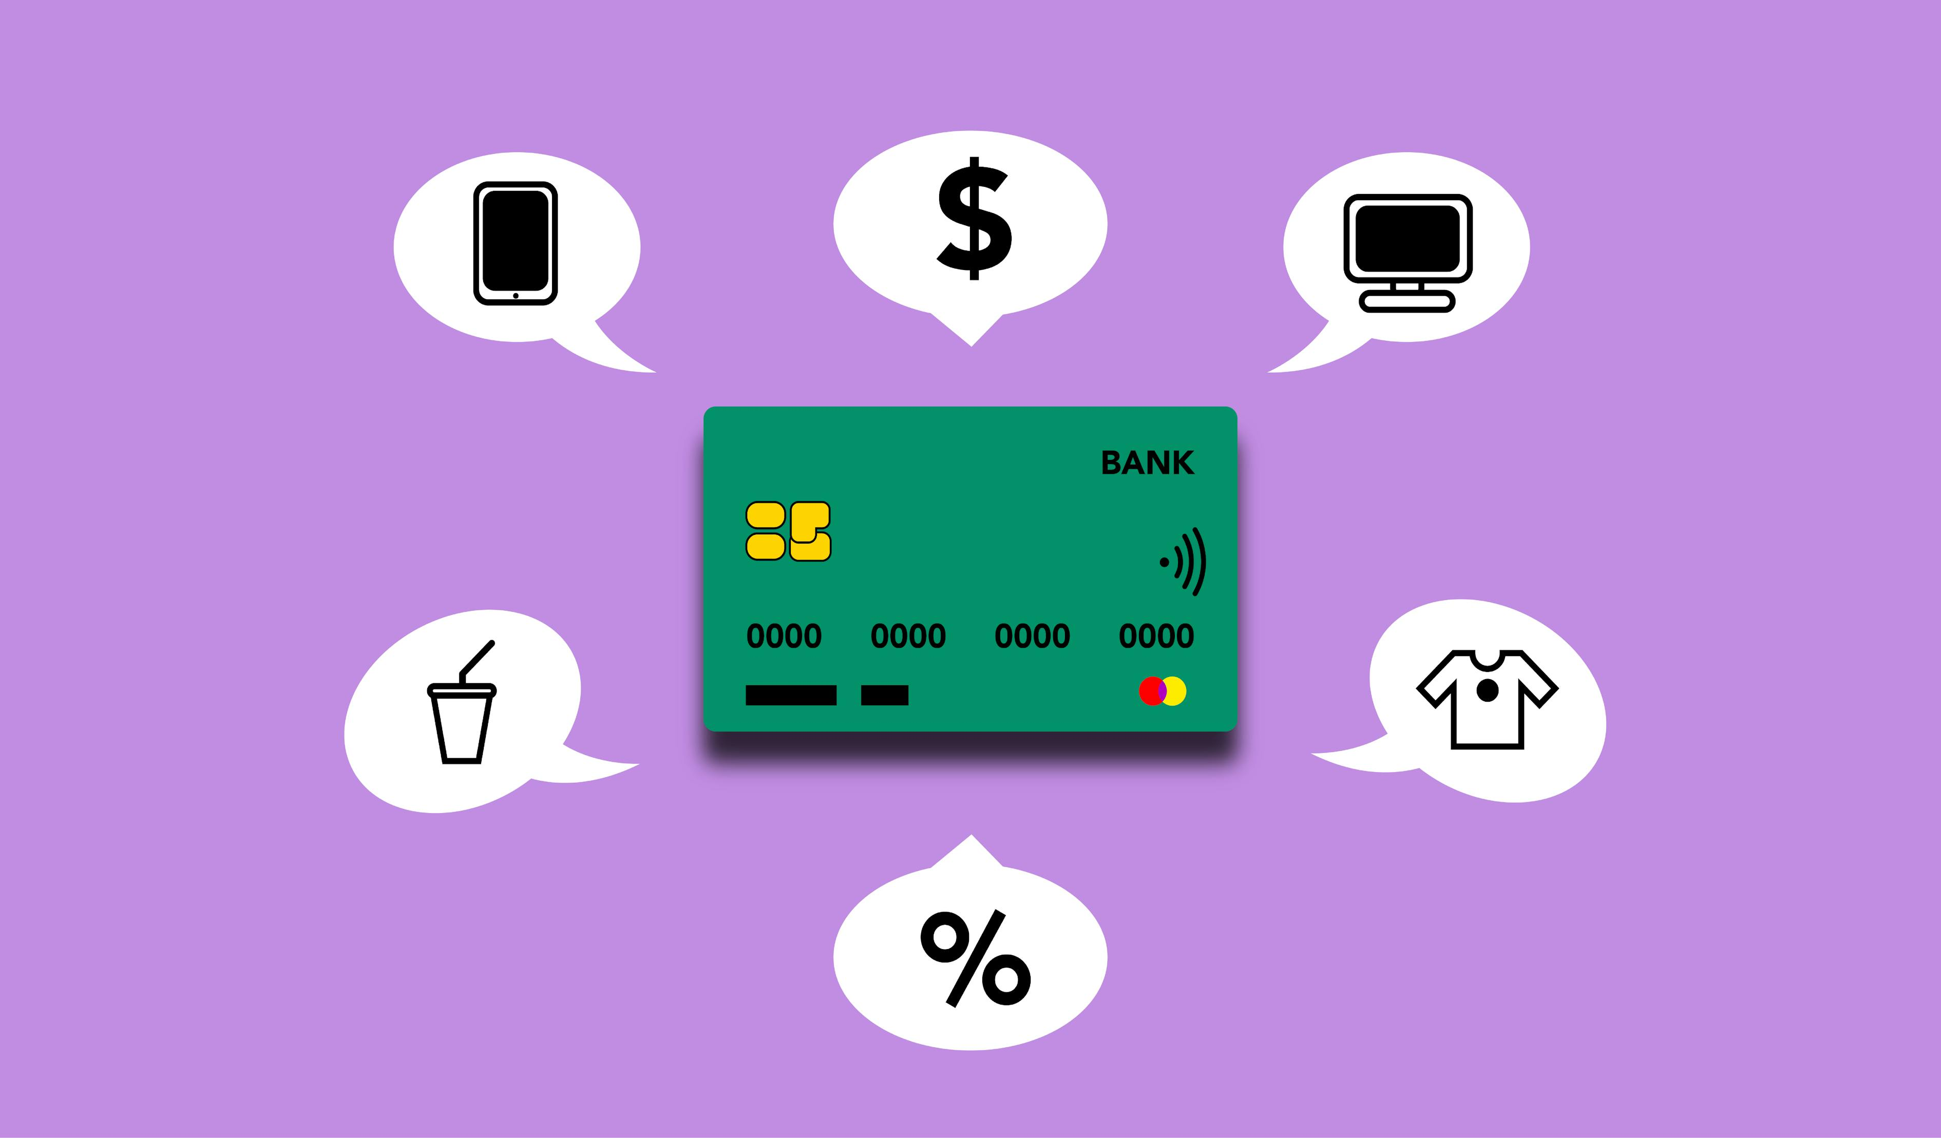
Data Privacy Preserving- Payment Transactions for European Central Bank
Presented by,
Subhasmita Maharana
Keerthi Akhila Pasam
Mukthasree Vengoti

Slide 2

ABSTRACT
Incredible amounts of data is being generated by various organizations like hospitals, banks, e-commerce, retail and supply chain, etc. by virtue of digital technology.
The voluminous data generated from the various sources can be processed and analyzed to support decision making. However, data analytics is prone to privacy violations.
Although data analytics is useful in decision making, it will lead to serious privacy concerns. Hence privacy preserving data analytics became very important.

Slide 3

INTRODUCTION
The banking sector depends heavily on the analysis of payment transaction data for several purposes.
Using some privacy-preserving techniques, institutions look for identifying the confidentiality of specific transaction information.
Given the growing concerns about user security and data privacy laws, using standard data analysis approaches runs a risk of revealing private customer information.

Slide 4
Project description
Primary Goal:
Analysis & Anonymization: Analyze payment data, anonymize it, and assess anonymization effectiveness for privacy protection.
Risk Management: Employ privacy risk techniques to assess transaction and customer risks, aiding in comprehensive risk management for financial institutions and payment service providers.
Challenges Faced:
Extracting valuable insights from payment transaction data while ensuring anonymity and compliance with data privacy regulations to protect individual’s privacy poses a significant challenge.

Slide 5
Background
Software Tools:
Tool: Google Collab notebook, Excel sheet
Libraries: Pandas, Matplotlib, seaborn
Related Programming Skills: Python (with libraries like Pandas, NumPy, SciPy, Scikit-Learn, Matplotlib and, Seaborn), Data analysis, Basic understanding of differential privacy algorithms.

Slide 6
Problem definition
Problem: This project aims to analyze the ECB's Payments transactions dataset while ensuring data privacy preservation. Below are some related research questions based on Data Privacy Preserving in payment transactions for European Central Bank:
What are the factors contributing to privacy risks in various payment transactions, including transaction type, location, and other attributes, and can these risks be quantified based on these attributes?
Challenges:
With the financial industry heavily reliant on such data for risk management, fraud detection, and consumer behavior analysis, there's a critical need to safeguard sensitive consumer information in compliance with evolving data privacy regulations.

Slide 7
Proposed Techniques
To fix the challenges that are identified and worked on while ensuring data privacy preservation, we use some of the below techniques for insightful analysis with the imperative of protecting sensitive financial information.
Data Cleaning & Pre-processing
Statistical & Exploratory Data Analysis
Data Visualizations
Data Aggregation & Generalization
Feature Importance Analysis, Risk Stratification, Risk Aggregation
Modeling Techniques
Linear Regression & Random Forest Regression

Slide 8

Data Pre-processing & Analysis
Displaying column names in dataset- df.columns.
There are 266199 rows and 20 columns in the DataFrame.
Checking for null/ NA values & removing them- isnull().
Displaying the data types in dataset- df.dtypes.
Removing unnecessary columns from dataset- df.drop.
Displaying the summary Statistics of the numerical variables in dataset- df.describe().

Slide 9
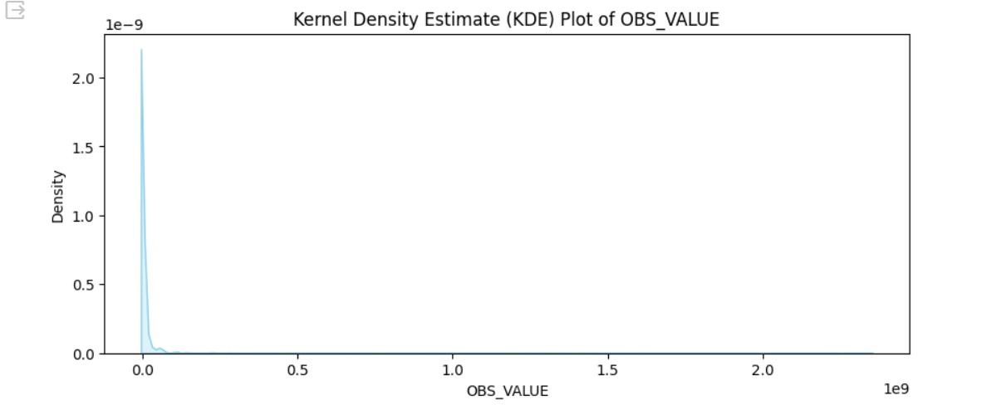
Visual Applications
We have plotted some graphs using matplotlib library in Python to visualize some plots using the payment transactions dataset.
This plot visualizes the distribution of OBS_VALUE according to the frequency of values.

Slide 10
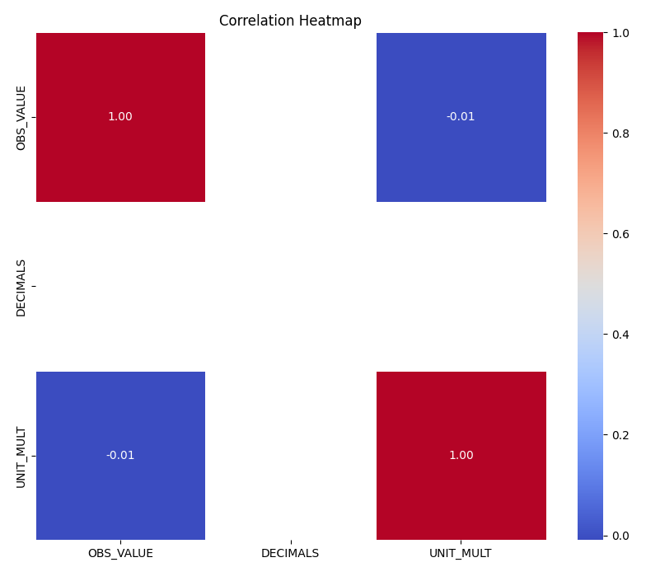
Visual Applications
The correlation heatmap is used to visualize the correlation between different variables.

Slide 11
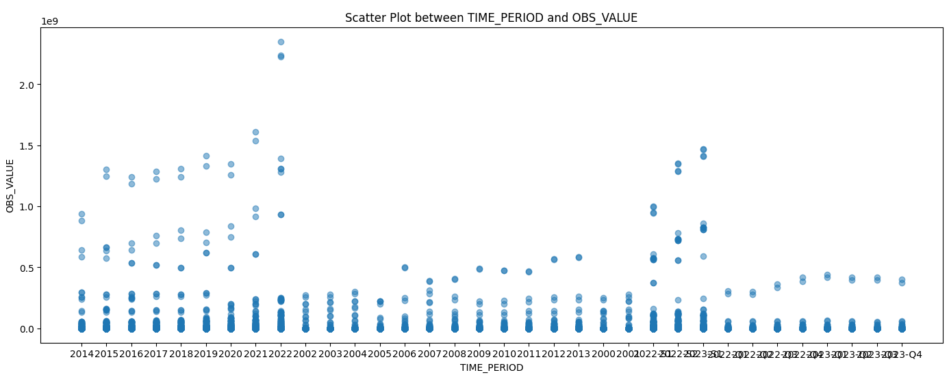
Visual Applications
The above scatterplot visualizes the relationship between the variables TIME_PERIOD and OBS_VALUE. the plot shows the relationship between the time-period (likely referring to the date or time of the transaction) and the transaction value in the payment transaction dataset.

Slide 12


Modeling & Results
Linear Regression Feature selection & Modeling:
Feature variables: except OBS_VALUE, have taken all other variables
Target variables: OBS_VALUE
Random Forest Feature selection & Modeling:

Slide 13
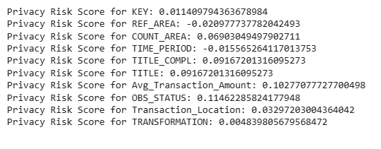
Interpretation of FIA
After conducting feature importance analysis, we have calculated the Privacy Risk Scores for the above features. The results appear to represent scores of privacy risk connected to various transactional variables.
We can interpret that, TITLE and TITLE_COMPL appear to have comparatively higher privacy risk scores than other properties, suggesting that they may contain more sensitive data than others.
However, REF_AREA has a low privacy risk score, indicating that there may not be as much of a risk to privacy in this situation.

Slide 14
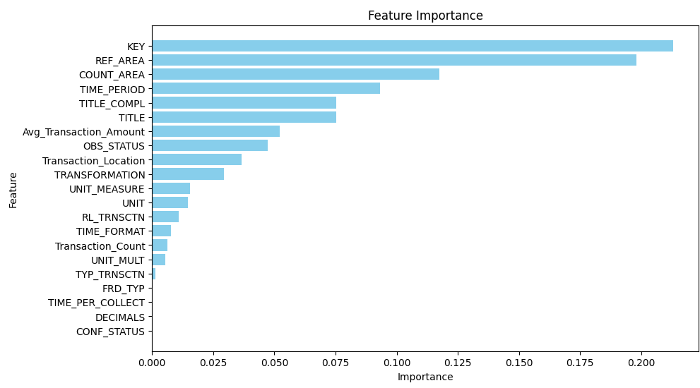
Modeling & Results
Feature Importance Analysis
The bar chart shows how important each feature was in predicting the outcome of a machine learning model trained on the Payment Transaction Dataset.

Slide 15
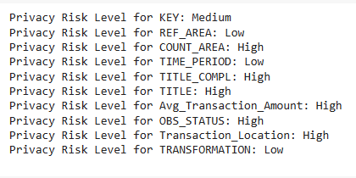
Risk Stratification
Risk stratification is used to assign various degree levels (low, medium, high) based on the Privacy Risk Factor scores.
Certain characteristics, such as COUNT_AREA, TITLE_COMPL, TITLE, OBS_STATUS, Transaction_Location and, Avg_Transaction_Amount have been classified as having a high-level privacy risk. This means that if exposed, the sensitive information included in these properties could possibly jeopardize privacy.
Conversely, qualities with low privacy risk levels—that is, ones that are unlikely to represent a serious threat to privacy if disclosed—are REF_AREA, TRANSFORMATION and TIME_PERIOD.
KEY is classified as medium risk, there is a moderate degree of sensitivity involved in sharing this information.

Slide 16
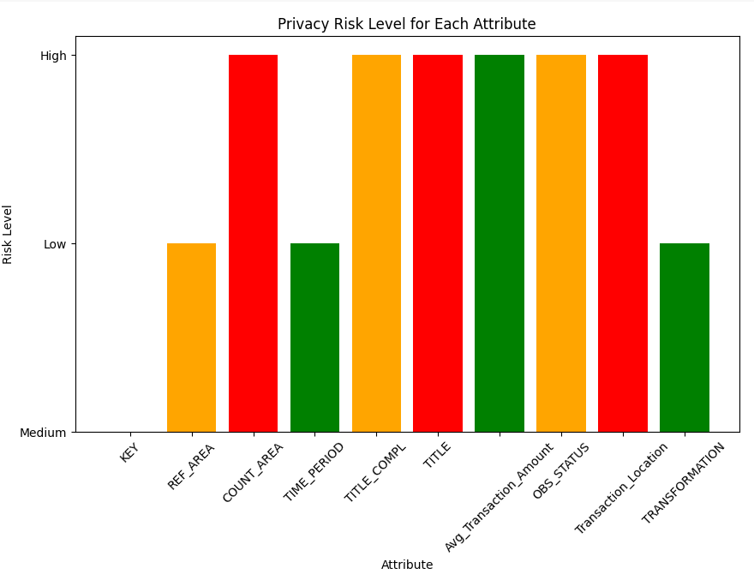
Distribution of Average Privacy Risk Levels
The plot demonstrates the typical level of privacy risk for various variables. The risk to privacy increases with the bar. The characteristics on the graph and their corresponding level of risk are as defined.

Slide 17
Risk Aggregation
Risk Aggregation refers to the merging or aggregating distinct risks connected to various payment transaction characteristics to get a consolidated or comprehensive picture of the risk exposure.
Defining weights for each attributes and aggregating the privacy risk scores for each transaction the overall Privacy Risk Level for the Transaction is Medium.

Slide 18
Experimental Evaluation
Finding Potential Privacy hazards
Evaluation of Transaction Attributes
Quantification of Privacy Risk

Slide 19
Conclusion
By measuring the privacy risk connected to each transaction attribute, we have been able to determine the possible privacy hazards associated with various financial transaction types.
Examined the effects of various transaction parameters on the overall level of privacy risk, including transaction type, location, and others.
We have successfully quantified the privacy risk associated with each transaction based on its attributes, allowing for a deeper understanding of the privacy implications.

Slide 20
Future Scope
Customer Behavior Analysis
Real-Time Monitoring and Alerting
Anomaly Detection
Temporal Analysis

Slide 21
Reference
https://data.ecb.europa.eu/data/datasets

Slide 22

Thank you

