Slide 1
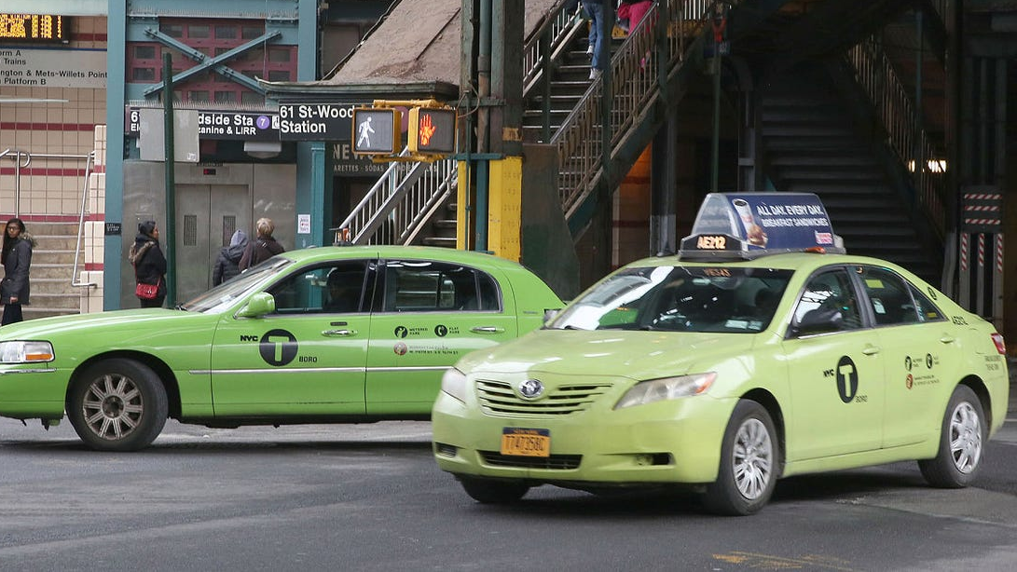
Impact of Traffic Congestion on Taxi Trip Durations and Fares in Different Areas of New York City.
Presented By
1 . Jaladurgam Navya
2. Mukthasree Vengoti
3. Aravind Reddy Thummala

Slide 2
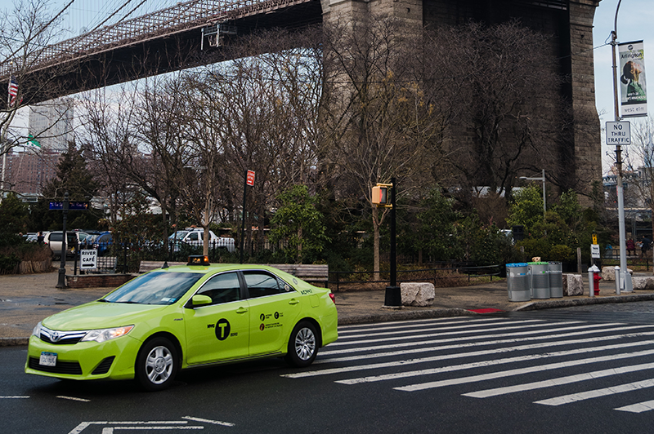
Research question
How does traffic congestion effect taxi trip durations and total fares across various neighborhoods of New York City? What are the spatial and temporal patterns in congestion levels throughout the day and across different locations? Can predictive models be developed to estimate taxi total fares considering factors such as congestion levels, trip distance, pickup time, and neighborhood?

Slide 3
1.Introduction
2.DataSet
3.Data preprocessing
4.Exploratory data analysis
5.Feature Selection
6.Modeling & Metrics
7. Predicted Values

Slide 4
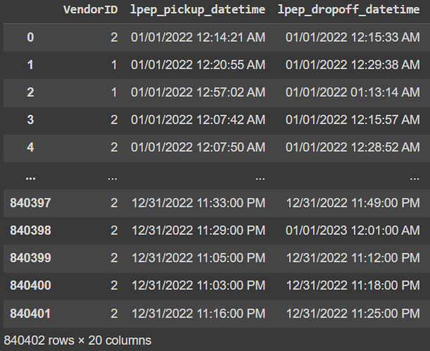
Introduction and dataset
Green Taxi trip dataset
The dataset consists of 840402 observations and 20 columns.
Some of the column names in the data are lpep_pickup_datetime , lpep_dropoff_datetime , store_and_fwd_flag has object datatypes, VendorID,PULocationId, DOlocationID.

Slide 5
Data Preprocessing
Converted datatypes: Converted lpep_pickup_datetime , lpep_dropoff_datetime to datetime datatype.
Checking duplication rows: There are no duplicate rows in the dataset.
Checking for negative values: absolutize

Slide 6
Data Preprocessing
Exclude: RatecodeID- 99. These values are not in the data description.
Checking for missing values in the dataset: There are missing values in the dataset. We used a mode imputation method to handle missing values.
Label_encoding: Performed label_encoding for store_and_fwd_flag

Slide 7
Descriptive statistics
Spatial Analysis:
By the spatial we find the average trip durations and fares across various neighborhoods in the city.
It calculates the average trip duration and total fare for each pickup and drop off neighborhood.
Temporal Analysis: Hourly variations in congestion levels including average trip duration, fare, and congestion surcharge
It extracts the pickup hour and day of the week from the pickup datetime. Average trip duration, total fare, and congestion surcharge are calculated for each hour and day of the week.

Slide 8
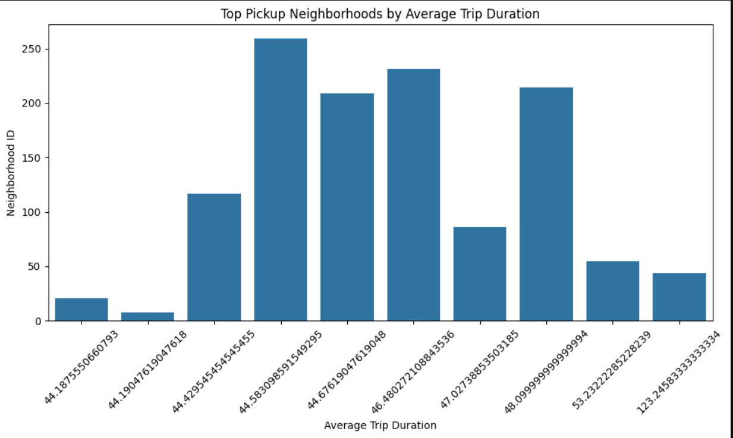
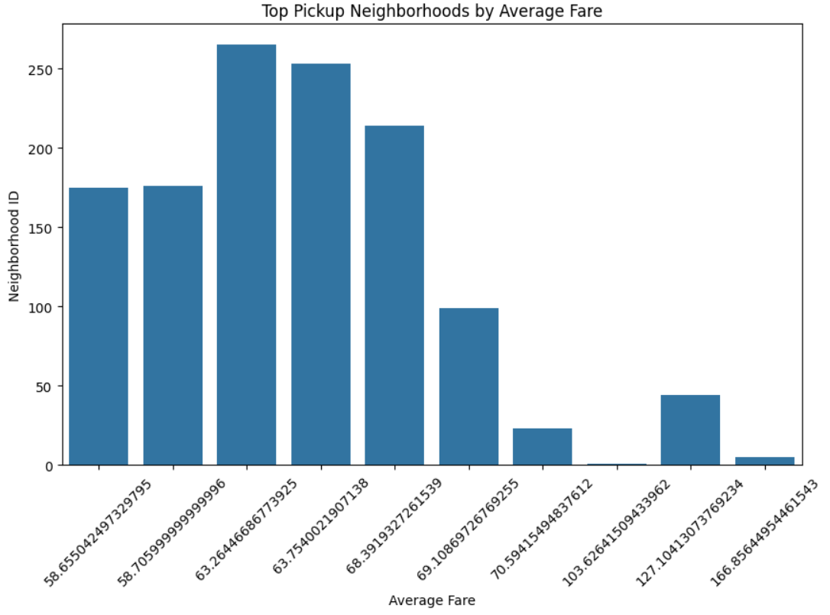
Exploratory Data Analysis Spatial analysis
The neighborhood with the highest average trip duration. This graph highlights the neighborhoods that tend to have longer ride durations on average, which could be influenced by factors such as their distance from popular destinations, traffic patterns.
Average fare for pick ups in different neighborhoods.

Slide 9
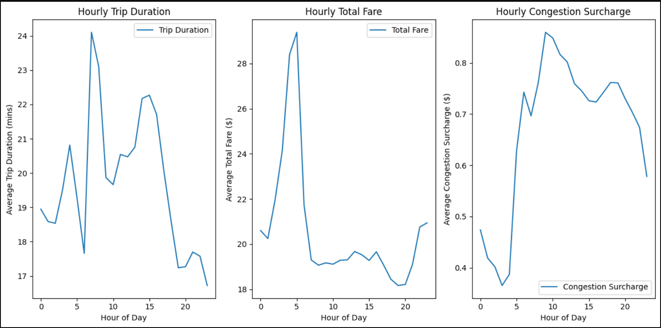
Temporal Analysis
Hourly Trip Duration:
The trip duration peaks around 8-9 AM, indicating that taxi trips during the morning hours tend to take longer
Hourly Total Fare:
The total fare peaks around 7-8 AM, indicating that taxi trips during the early morning hours they are charging more
Hourly Congestion Surcharge:
The congestion surcharge exhibits a distinct peak around 9-10 AM

Slide 10
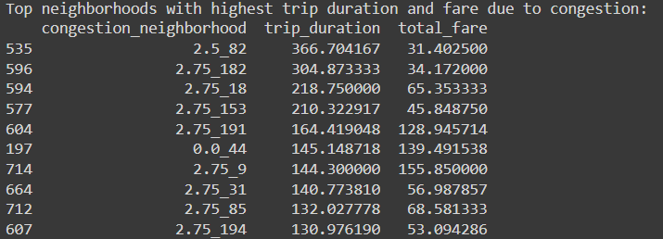
Analyzing how traffic congestion impacts taxi trip durations and fares across different neighborhoods of Newyork city.
Analysis of neighborhoods based on the average trip duration and total fare, a newly created feature that combines congestion surcharge and neighborhood information.
For each unique combination of congestion surcharge and neighborhood, the code calculates the mean of 'trip_duration' and 'total_fare' columns.

Slide 11
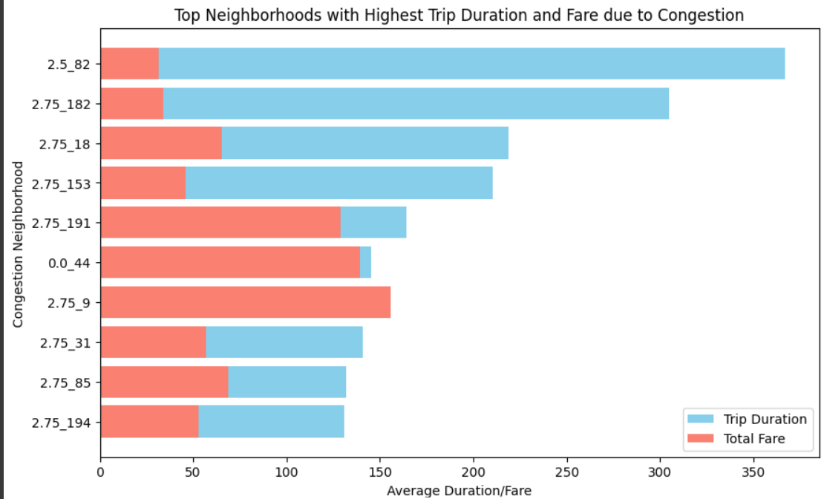
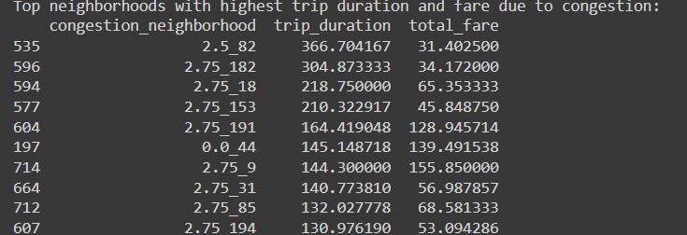
Analyzing how traffic congestion impacts taxi trip durations and fares across different neighborhoods of New York City.
These findings provide insights into which neighborhoods are most affected by traffic congestion in terms of both trip duration and fare.

Slide 12
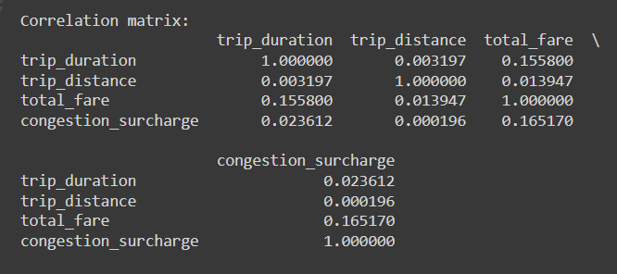
Correlation matrix with congestion surcharge
Trip duration and trip distance have very little to no relationship with congestion surcharge.
Total fare has a moderate positive relationship with congestion surcharge, suggesting that higher fares may be associated with slightly higher congestion surcharges, but the correlation is not very strong.

Slide 13
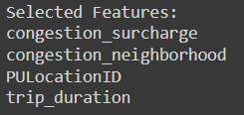
Feature selection
Using Recursive Feature Elimination (RFE) with Ridge regression. RFE recursively removes features, and Ridge regression is used to rank features based on their importance.

Slide 14
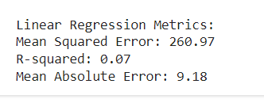
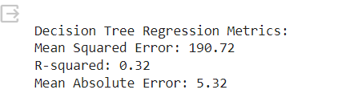
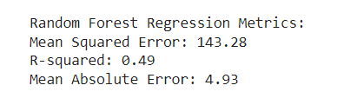
Modeling & Metrics:
LINEAR REGRESSION
MSE : Higher values indicate lower performance.​
R- squared: Indicating a weak level of explanatory power.​
MAE: Higher values indicate lower accuracy.​
Decision Tree Regression
MSE : Lower values indicate better performance​
R-squared An R-squared of 0.32 means that 32% of the variance in the fare amount is explained by the model.​
MAE: Lower values indicate better accuracy.​
Random Forest Regression
MSE: Lower values indicate better performance.​
R-squared: Indicating a moderate level of explanatory power.​
MAE: Lower values indicate better accuracy.​
The Random Forest Regression model is performing​
the best among the three models based on the provided​
metrics. It offers the lowest errors and the highest ​
explanatory power.

Slide 15
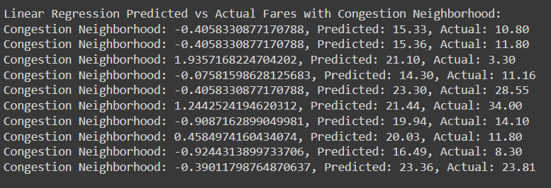
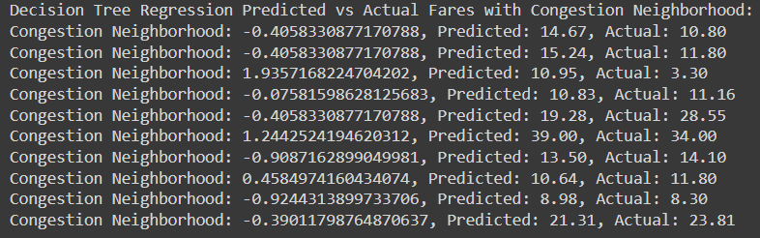
Predicted Values vs Actual values
Linear Regression Predicted vs Actual total Fares with Congestion Neighborhood:
Decision Tree Regression Predicted vs Actual total Fares with Congestion Neighborhood:

Slide 16
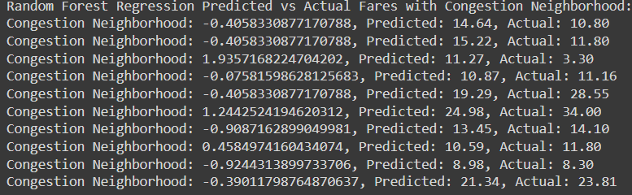
Predicted Values vs Actual Values
Random Forest Regression Predicted vs Actual total Fares with Congestion Neighborhood:

Slide 17
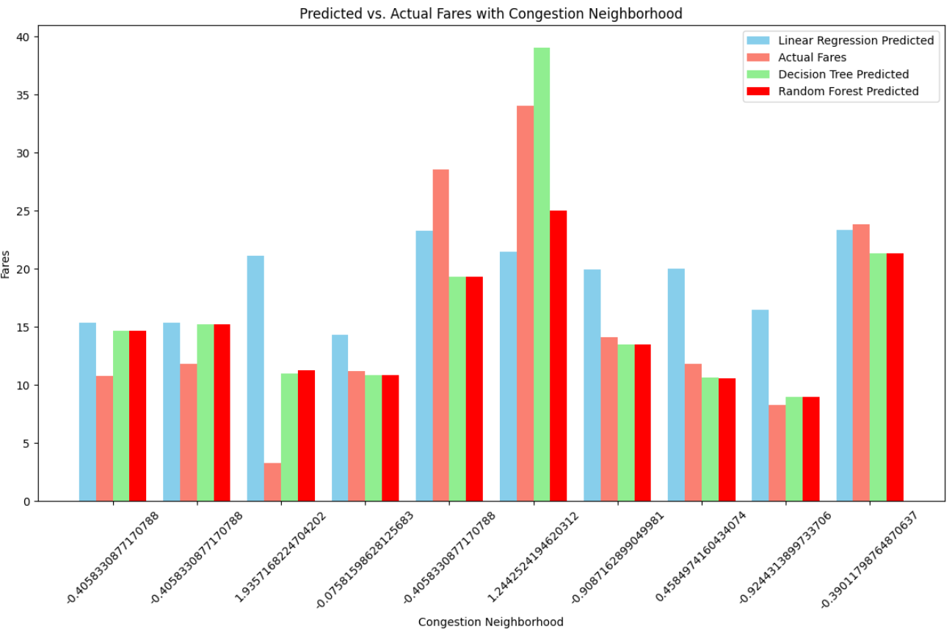
Predicted and Actual fares with congestion neighborhood

Slide 18
Conclusion:
High Congestion Neighborhoods: 82,182,18,153,191,9,31 these neighborhoods experience significantly longer trip durations and higher total fares, indicating the impact of congestion on both travel time and cost . This suggests that congestion patterns vary spatially within the city, influenced by factors such as traffic flow, road infrastructure, and time of day.
The random forest model generally provides more accurate predictions compared to both linear regression and decision tree regression. The predicted total fares are closer to the actual values across most instances, indicating that the random forest model captures the underlying patterns in the data more effectively.

Slide 19
Improvements:
If we had access to detailed information about where congestion occurs in New York City, like which streets or areas are most affected by traffic, it would greatly improve our project. This data could come from sources like traffic management authorities or apps that track traffic conditions.
By using this extra data, we could better understand how congestion impacts taxi rides in different parts of the city. For example, we could figure out which neighborhoods or streets have the longest taxi rides or the highest fares because of traffic jams.

Slide 20
Thank You

