Slide 1
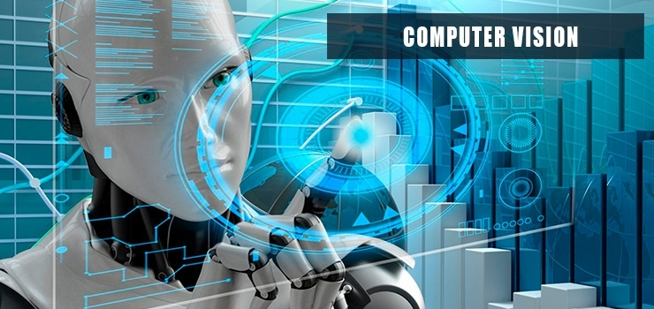
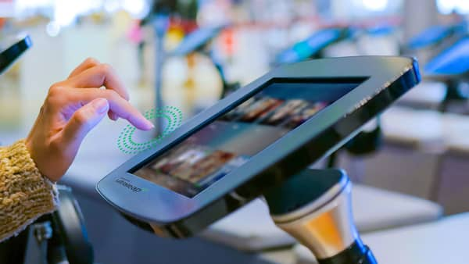
TOUCHLESS TOUCHSCREEN TECHNOLOGY

Slide 2

Agenda
Introduction of Touch Screen & Touch less screen technology
History & Development
Why use Touch screen ?
How does a touch screen work ?
Future Enhancement
Advantages & Disadvantages
Conclusion

Slide 3
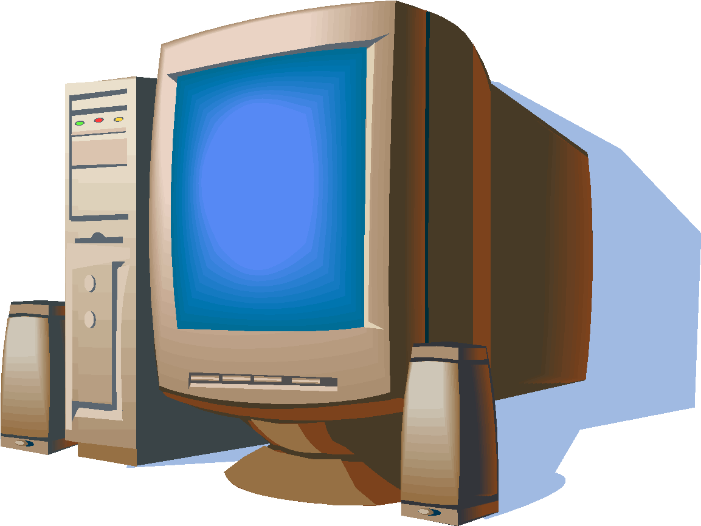
Introduction
What do you mean by Touch screen & Touch less screen
Touch screen is a display device that allows the user to interact with a computer using finger or stylus.
Touch screen are used on a variety of devices, such as cell phones ,Atm’s , ticket vending machines and many more all use touch panels to enable the user to interact with a computer or devices without the use of a keyword or mouse.
It recognizes the position of an object from 5 feet Touch less touch screen technology means without using a finger or without touching a device we can easily operate the system. It is also called as “Don’t touch me” technology.

Slide 4

History & Development
The first touch screen was a capacitive touch screen developed by E.A Johnson at UK.
In 1983, the computer manufacturing company. Hewlett-Packard introduced the HP-150 a home computer with touch screen technology.
The first touch screen phone was launched in 1992 by IBM. The IBM Simon is also referred as the first Smartphone.
The first touch less touch screen technology was invented by Andrew D. Wilson.

Slide 5
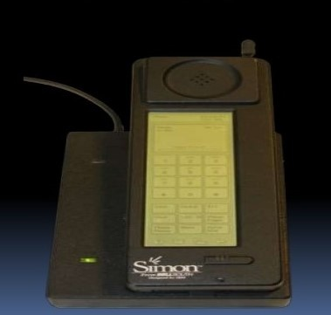
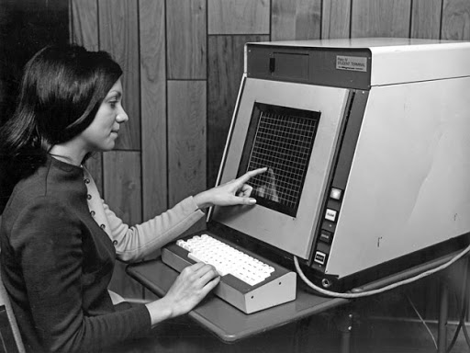
First Touch screen Smart phone
The First Touch Screen

Slide 6
Types Of Touchscreen
Resistive TouchScreen
Capacitive TouchScreen

Slide 7
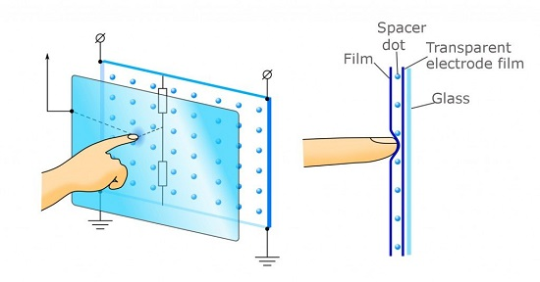
Resistive Touchscreen
Example
ATM Machine
For Bill In Shopping Mall
Made up of several layers of flexible plastic and glass
The front layer is scratch resistant plastic and the second layer is (usually) glass(resistive and conductive)
When someone applies pressure to the panel, the resistance is measured between the two layers highlighting where the point of contact is on the screen.

Slide 8
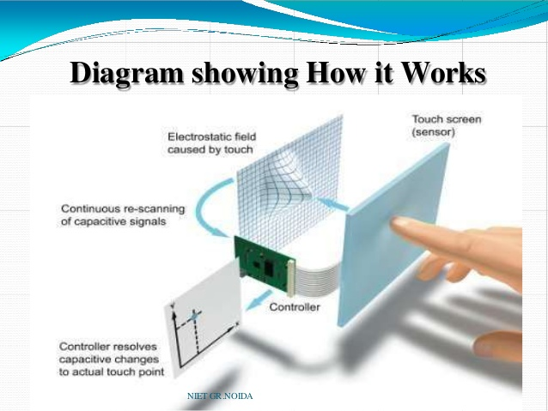
Capacitive TouchScreen
Example
M Mobile
TABLET Tablet
Computer
Capacitive touchscreens use the electrical properties of the human body as input
When touched with a finger, a small electrical charge is drawn to the point of contact, which allows the display to detect where it has received an input

Slide 9
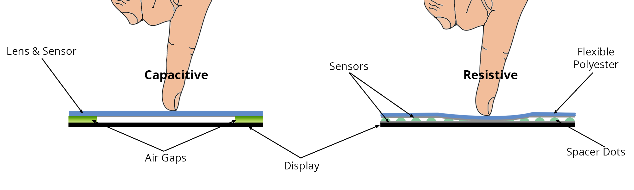
Resistive vs Capacitive

Slide 10
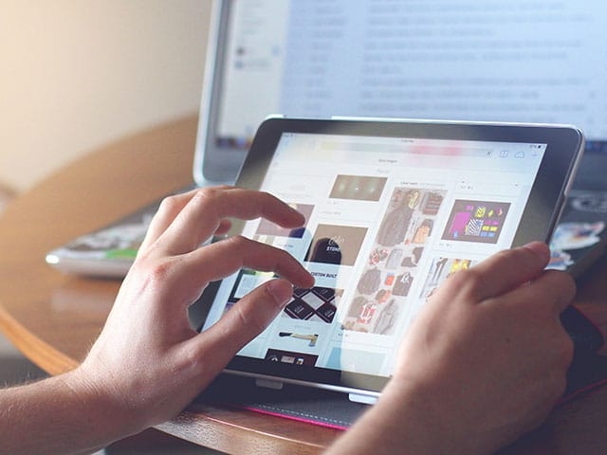
How does a Touch screen work?
Touch sensor
Controller
Software drivers

Slide 11
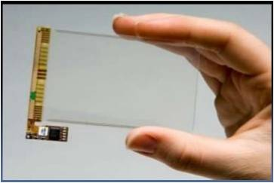
Touch sensor
A Touch screen sensor is a clear glass panel with a touch responsive surface
The sensor generally has an electrical current or signal going through it and touching the screen causes a voltage or signal change.

Slide 12
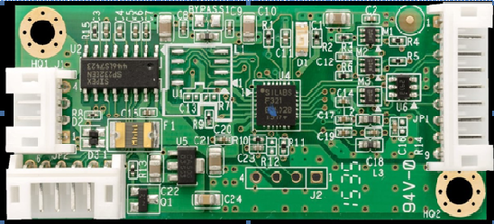
Controller
The controller is a small PC card that connects between the touch sensor and the PC.
The controller determines what type of interface/connection you will need on the PC.

Slide 13
Drivers
The driver is a software that allows the touch screen and computer to work together.
Most touch screen drivers today are a mouse emulation type driver

Slide 14
Why use Touch screens ?
Replacing Mouse And Keyboard
Provide Speed And Accesibility
Easy to clean and maintain
Save time
Touch is for everyone

Slide 15
What is Touchless Touchscreen Technology
Touchless Touchscreen is technology that uses gesturing as form of input.
It has no need of touching screen.
This technology is high-end technology, that uses hand waves and hand flicks.

Slide 16
How does a Touch less Touch screen work ?
The system is capable of detecting movements in 3-dimensions without ever having to put your fingers on the screen.
Sensors are mounted around the screen that is being used. By interacting in the line-of-sight of these sensors the motion is detected and interpreted into on-screen movements.
The device is based on optical pattern recognition using a solid state optical matrix sensor with a lens to detect hand motions.

Slide 17
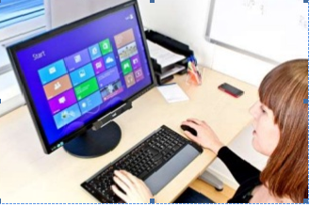
Tobii Rex
Tobii Rex is an eye-tracking devices from Sweden which works with any computer running on windows 8.
The devices has a pair of infrared sensor built in that will track the users eyes.

Slide 18
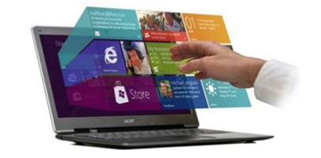
Elliptic lab
Elliptic labs allows you to operate your computer without touching it with the windows gesture suite.

Slide 19
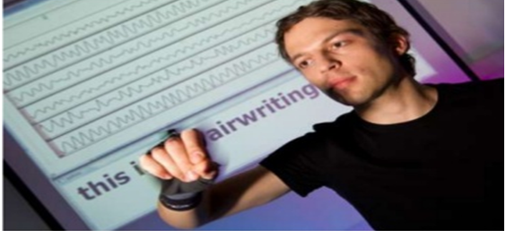
Air writing
Air writing is a technology that allows you to write text message or compose emails by writing in the air

Slide 20
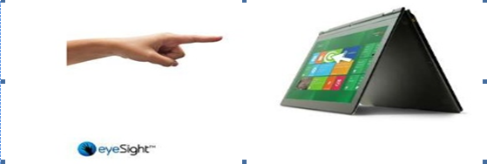
Eye sight
Eye sight is a gesture technology which allow you to navigate through your devices by just pointing at it.

Slide 21
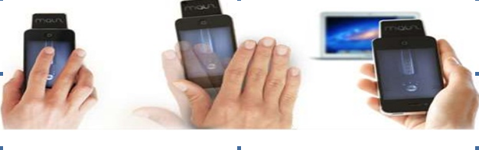
Mauz
Mauz is a third party device that turns your phone into a trackpad or mouse.

Slide 22
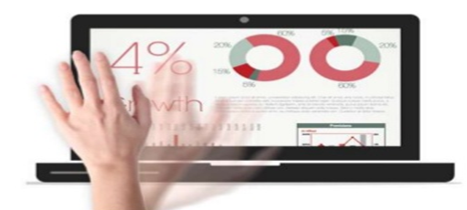
Point Grab
Point Grab is a something similar to eyesight in that it enables users to navigate on their computer just by pointing at it.

Slide 23
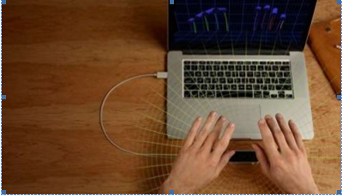
Leap motion
Leap motion is a motion sensor device that recognizes the users fingers with its infrared LEDs and camera.

Slide 24
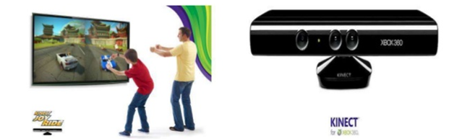
Microsoft Kinect
Microsoft Kinect it detects and recognizes a user’s body movement and reproduces it within the video game that is being played

Slide 25
Future Enhancement
The technology uses sensors to recognize your gestures, facial features or voice to complete a task.
Biometric and aviation are few areas that may see quicker adoption.
Uber is using the technology to check if a driver is wearing a mask.

Slide 26
Future Enhancement
Zomato recently lauched contactless dinning for a post lockdown world.
Infosys launched contact-less baggage management solutions for a North America airline.
Cognizant introduced touch less authorization processing for healthcare service providers.

Slide 27
Future Enhancement
The touch less sensing market is pegged to grow at 17.4%.
However, touch less sensing products are expensive and it may not be possible for firms to implement them in all aspects
The system uses tiny charge- coupled device (ccd) cameras.Integrated into each side of the system to detect user movements to provide security.
There are also concerns like privacy and inaccuracy with this technology.

Slide 28
Advantages
Reduces error while accessing something.
Provides easy and fast access to any file.
Reduces the need of extra input devices like keyboard, mouse, etc.
Provides good security.
No screen desensitization
Simple and easy to use

Slide 29
Since the screen is touch less, a transparent image will always be clear. Because commands are accepted using sensors such as verbal or hand gestures.
You can use your finger or pen (any cable required).

Slide 30
Disadvantages
They are not suitable to store very large amount of data.
Installing a large no. of touch screen devices can be pretty expensive hence not cost effective.
A good environment is required.
The contact of the public must be monitored.

Slide 31
User must sit closer to the screen or stand near.
By using hand, the screen can be more secured.
Any activation of the selected role directly

Slide 32
Conclusion
Today’s thoughts are again around user interface.
The touch less touch screen user interface can be used effectively in computers, cell phones, webcams and laptops
May be few years down the line, our body can be transformed into virtual mouse, virtual keyboard, our body may be turned in to an input devices

Slide 33
Conclusion
Touch less Technology is still developing
With this is few years our body can become a input device.

Slide 34
THANKYOU
THE END

