Slide 1
CITY-WISE AIR QUALITY INDEX (AQI) AND AIR POLLUTION ANALYSIS
Python data analytics project
Student Name:-Bhayani Venish M.(seat no:-3130)
Student Name:-Sodvadiya Nil V.(seat no:-3167)
Course:-BCA
University:-Veer Narmad South Gujrat University
Guide Name:-Krishna Trivedi

Slide 2
Project Profile
Domain: Data Analytics & Environmental Analysis
Programming Language: Python
Libraries: Pandas, NumPy, Matplotlib, Seaborn
IDE: Jupyter Notebook
Dataset Type: CSV Air Quality Dataset

Slide 3
Introduction
Air pollution is a growing global environmental concern affecting millions.
Causes severe respiratory and cardiovascular health issues over time.
Air Quality Index (AQI) acts as a standard measure for tracking pollution.
Continuous monitoring is essential for public health awareness and safety.
Data analysis helps governments implement timely regulatory policies.

Slide 4
Project Overview
Utilizes Python for comprehensive city-wise AQI analysis and tracking.
Processes large datasets to clean and structure raw air quality data efficiently.
Calculates accurate AQI values based on respective pollutant concentrations.
Identifies highly polluted cities and evaluates geographical distribution patterns.
Generates visual reports to make data easily understandable for stakeholders.

Slide 5
Objectives of the System
To analyze historical air quality distributions across multiple Indian cities.
To identify the major underlying pollutants contributing to high AQI levels.
To compare pollution levels between different geographical zones systematically.
To detect seasonal or periodic trends in air quality variations.
To build automated data cleaning and structural transformation pipelines.
To provide statistical evidence for environmental policy making and compliance.
To develop visual dashboards and clean reports for easy interpretation.

Slide 6
Problem Statement
Raw environmental data is often unstructured and contains large missing values.
Difficult for non-technical users to interpret raw pollutant metrics daily.
Lack of integrated systems to compare multiple cities simultaneously.
Manual analysis of thousands of rows of data is error-prone, costly, and slow.
Clear need for an automated, analytics-driven approach to decipher AQI patterns.

Slide 7
Features of Proposed System
• Automated Data Cleaning: Handles missing values and outliers efficiently.
• Exploratory Data Analysis: Deep dive into complex pollutant distributions.
• Correlation Tracking: Finds mathematical relationships between different gases.
• Advanced Visualizations: Renders automatic heatmaps, scatter plots, and bars.
• Scalability: Can easily integrate larger datasets in the future.
• User-Friendly Insights: Transforms numbers into actionable text summaries.

Slide 8
Hardware Requirements
Processor: Intel Core i3 / AMD Ryzen 3 (or higher equivalent)
RAM: 4 GB (8 GB highly recommended for large analytical datasets)
Storage: 256 GB SSD / HDD (Minimum 1 GB free space for packages)
Graphics: Standard Integrated Graphics for chart rendering
Display: 1366x768 resolution or higher for optimal view

Slide 9
Software Requirements
Operating System: Windows 10/11, macOS, or Linux based distributions
Core Programming Language: Python 3.8 or above installed on system
Development Environment: Jupyter Notebook / Visual Studio Code
Data Processing Libraries: Pandas, NumPy
Data Visualization Libraries: Matplotlib, Seaborn

Slide 10
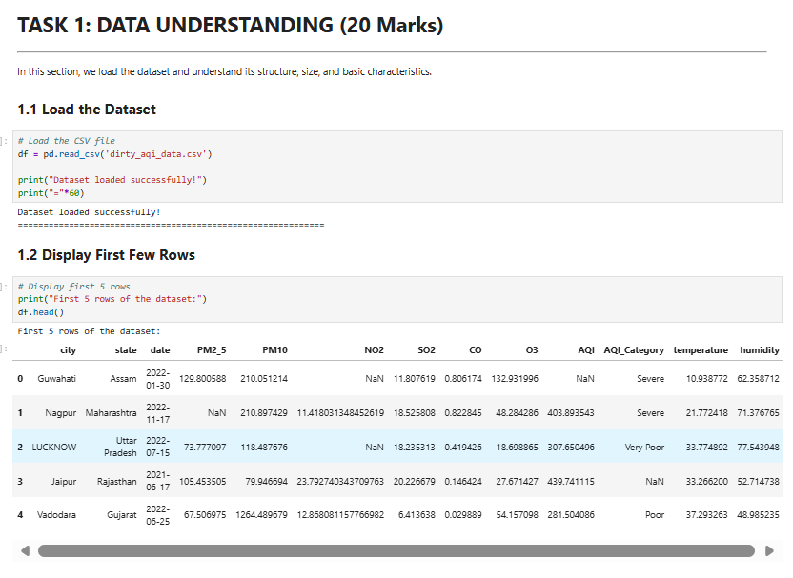
Dataset Overview
The primary dataset contains historical daily records of detailed air quality.
Key Attributes Included:
City, AQI, AQI Category, PM2.5, PM10, NO2, SO2, CO, O3.
Dataset Initial Load & First Few Rows via Pandas

Slide 11
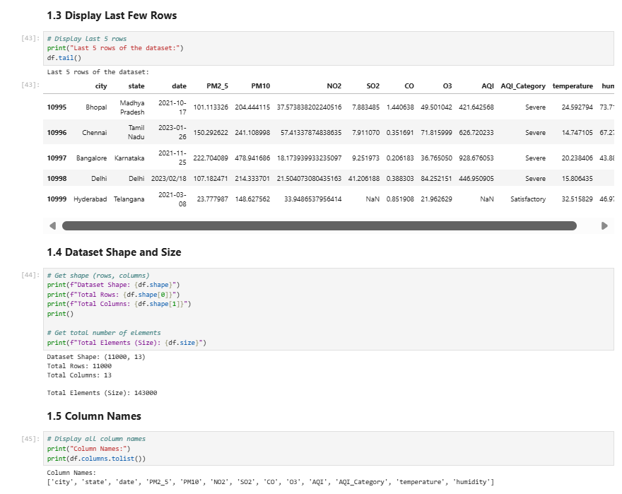
Dataset Overview - Continued
Dataset Structure, Tail Output, Info & Statistical Descriptive Summary via Pandas (Part 1)

Slide 12
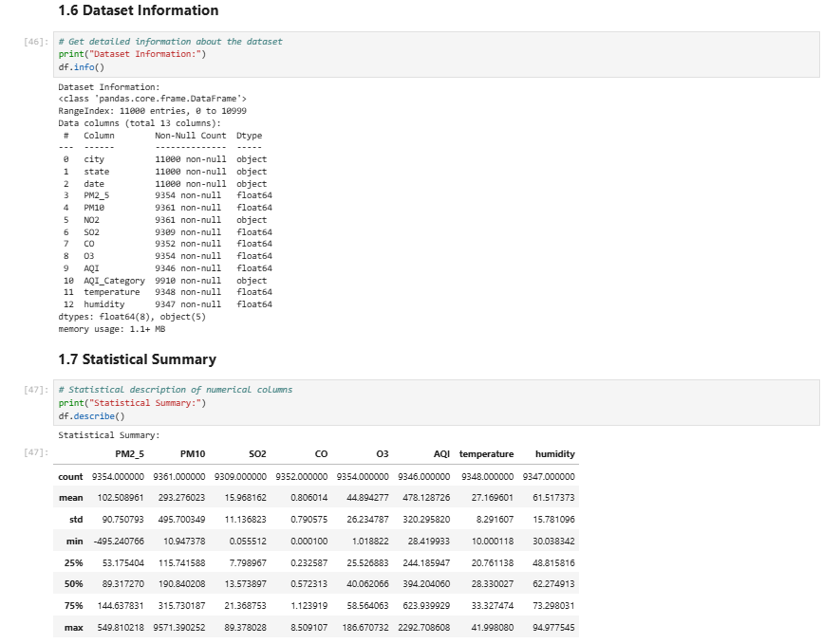
Dataset Overview - Continued
Dataset Structure, Tail Output, Info & Statistical Descriptive Summary via Pandas (Part 2)

Slide 13
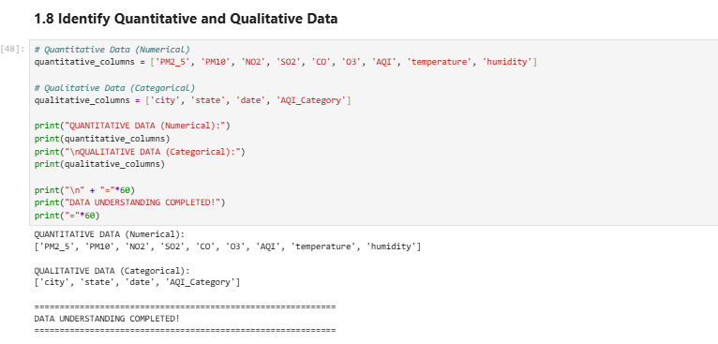
Dataset Characteristics
Structure: Tabular data format stored primarily as Comma Separated Values (CSV).
Numeric Types: Float/Integer values for precise pollutant concentrations.
Categorical Types: Text string data for City names and nominal AQI Categories.
Code Output: Automatic Identification of Qualitative vs Quantitative Data Attributes

Slide 14
Methodology
Step 1 - Data Collection: Importing the raw CSV dataset into a dataframe.
Step 2 - Data Cleaning: Removing nulls and standardizing varied formats.
Step 3 - Exploratory Data Analysis: Initial statistical review of distributions.
Step 4 - Statistical & Regression Analysis: Finding mathematical dependencies.
Step 5 - Data Visualization: Plotting insights graphically using Python tools.
Step 6 - Insights & Reporting: Concluding findings and finalizing reports.

Slide 15
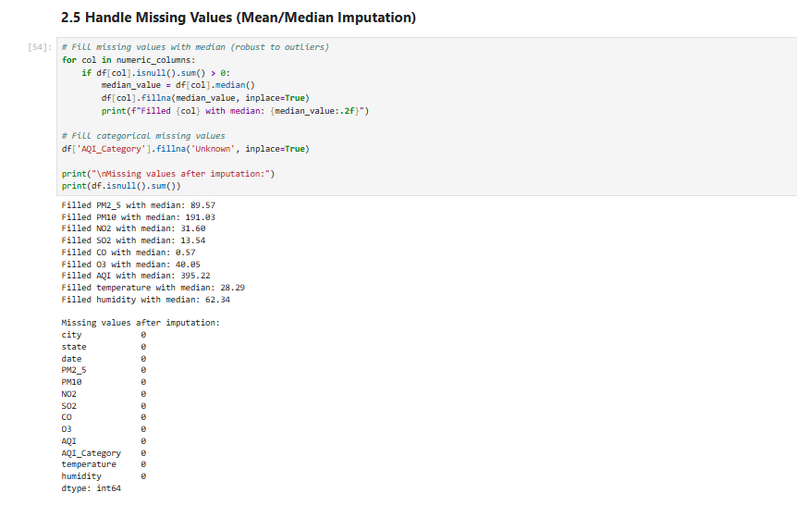
Data Cleaning
Missing Value Treatment: Using median imputation for critical numeric features.
Outlier Detection: Removing external anomalous sensor readings and spikes.
Type Conversion: Ensuring precise dates and numbers are properly formatted.
Handling Missing Values Code (Mean/Median Imputation via Pandas FillNA)

Slide 16
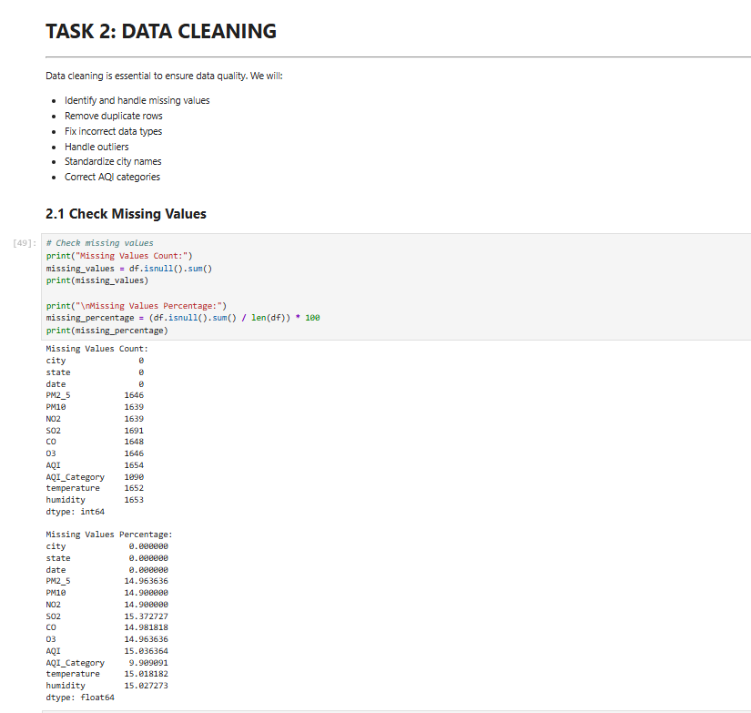
Data Cleaning Pipelines - Continued
Automated verification steps for missing rows and duplication logic via pandas (Part 1)

Slide 17
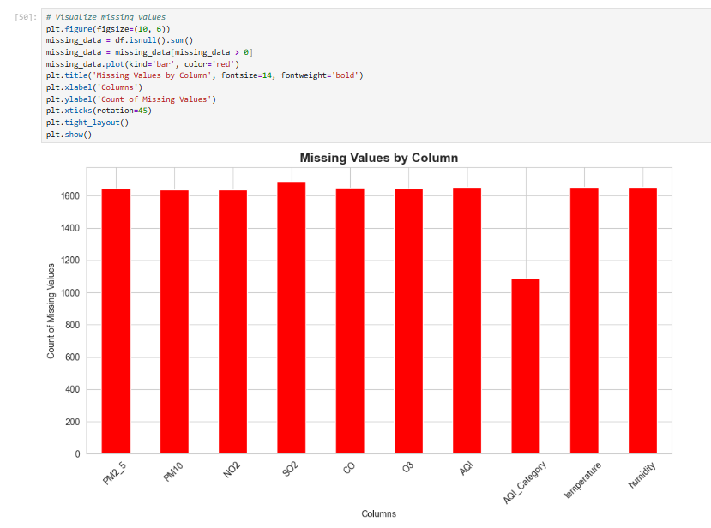
Data Cleaning Pipelines - Continued
Automated verification steps for missing rows and duplication logic via pandas (Part 2)

Slide 18
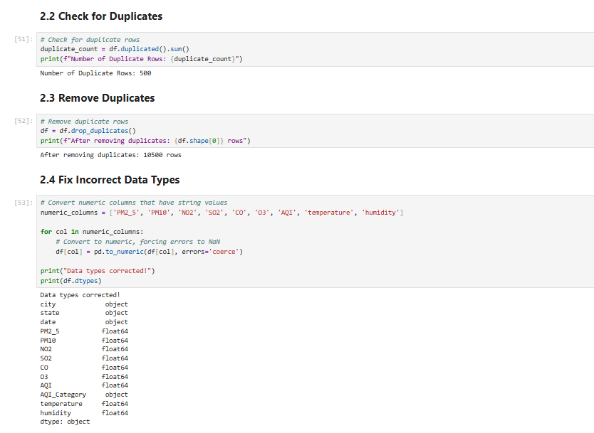
Data Cleaning Pipelines - Continued
Automated verification steps for missing rows and duplication logic via pandas (Part 3)

Slide 19
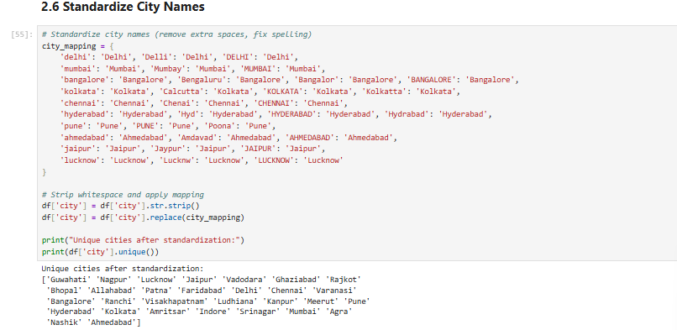
Data Cleaning Formatting - Continued
String normalization, IQR based outlier removal, and final clean data shape outputs (Part 1)

Slide 20
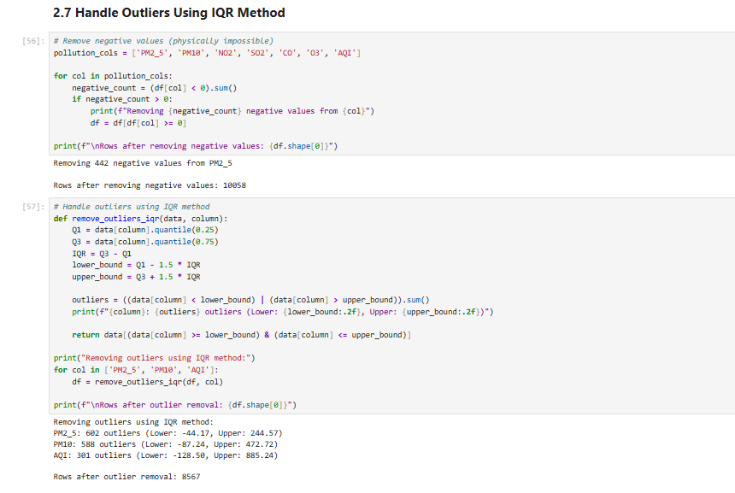
Data Cleaning Formatting - Continued
String normalization, IQR based outlier removal, and final clean data shape outputs (Part 2)

Slide 21
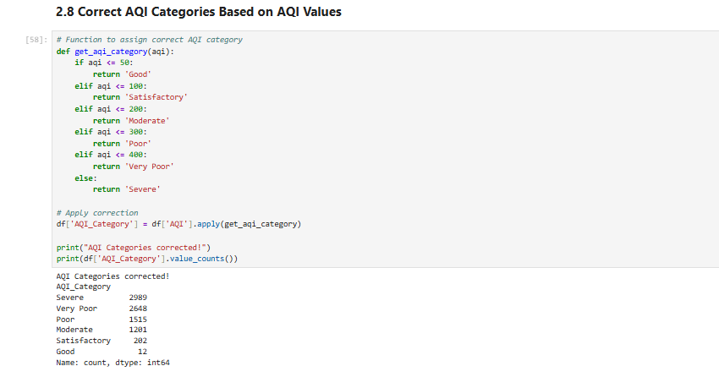
Data Cleaning Formatting - Continued
String normalization, IQR based outlier removal, and final clean data shape outputs (Part 3)

Slide 22
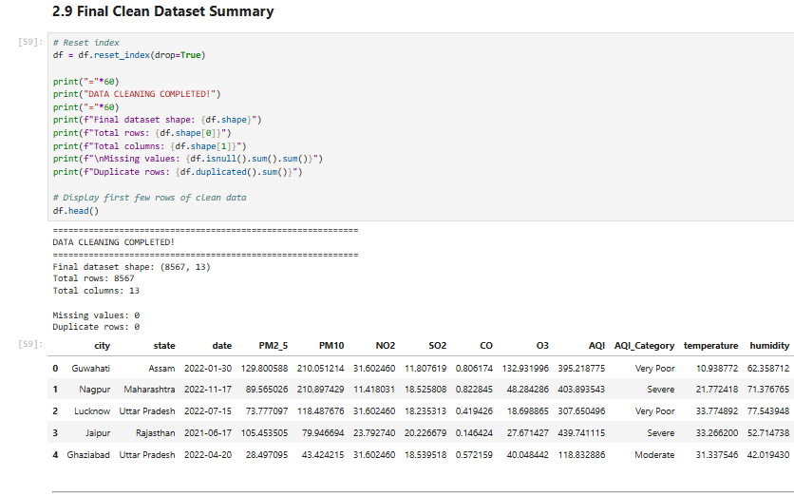
Data Cleaning Formatting - Continued
String normalization, IQR based outlier removal, and final clean data shape outputs (Part 4)

Slide 23
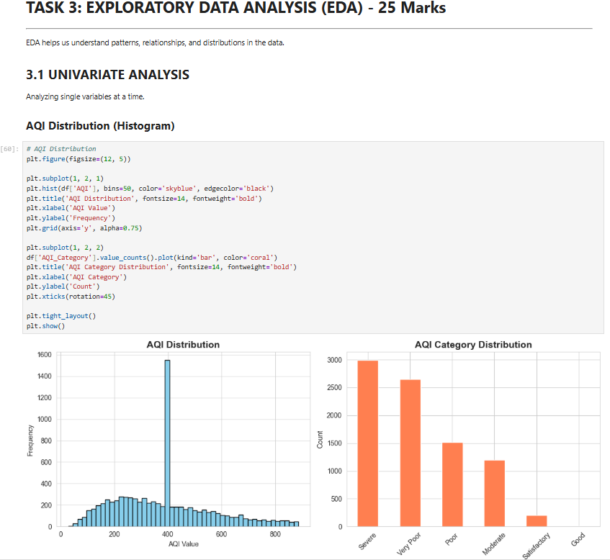
Exploratory Data Analysis (EDA)
Univariate Analysis: Analyzing individual variables independently.
Bivariate Analysis: Comparing combinations of two variables (e.g., AQI vs PM2.5).
Multivariate Analysis: Finding multiple complex interactions.
Univariate Analysis: Distribution of the Calculated Air Quality Index (Histogram)

Slide 24
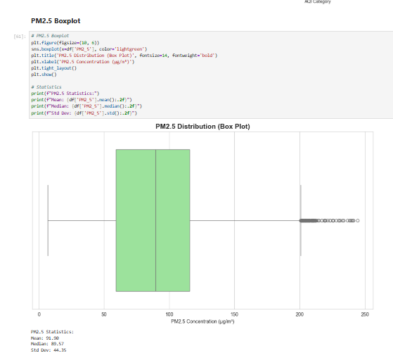
Exploratory Data Analysis - Continued
Various scatter plots profiling relationships between discrete specific pollutants & AQI value (Part 1)

Slide 25
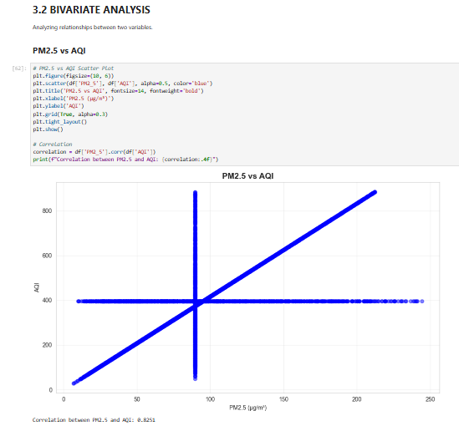
Exploratory Data Analysis - Continued
Various scatter plots profiling relationships between discrete specific pollutants & AQI value (Part 2)

Slide 26
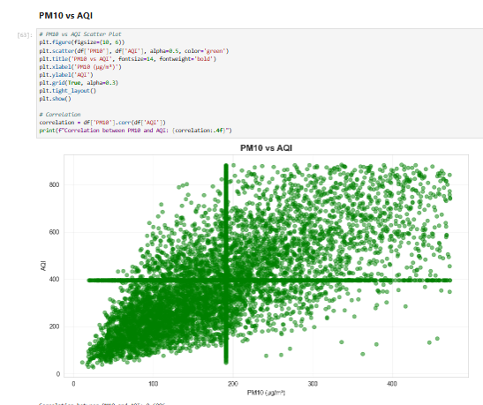
Exploratory Data Analysis - Continued
Various scatter plots profiling relationships between discrete specific pollutants & AQI value (Part 3)

Slide 27
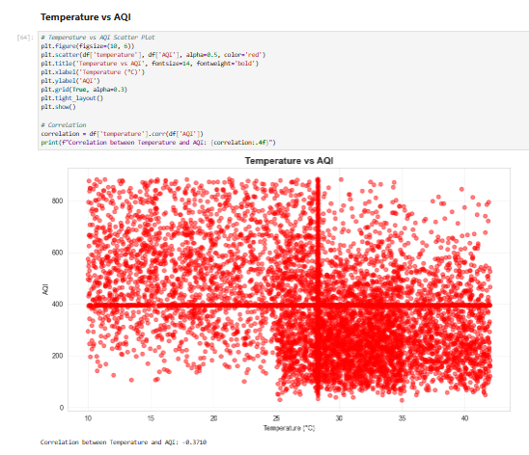
Exploratory Data Analysis - Continued
Various scatter plots profiling relationships between discrete specific pollutants & AQI value (Part 4)

Slide 28
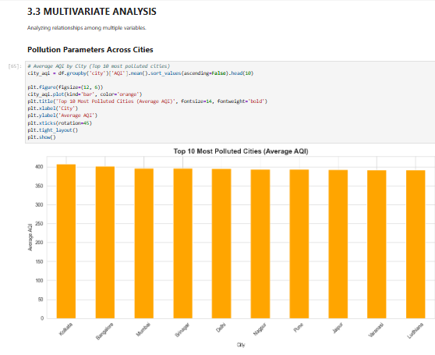
Exploratory Data Analysis - Continued
Various scatter plots profiling relationships between discrete specific pollutants & AQI value (Part 5)

Slide 29
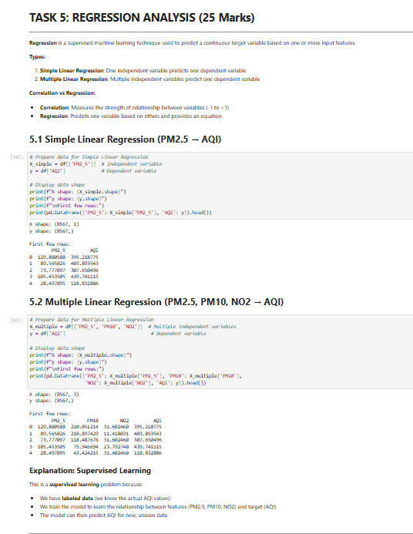
Regression Analysis
Identifies exactly how strongly a specific pollutant drives the total calculated AQI.
Shows direct linear relationships and applies predictive analytical logic.
Code Execution for Multiple Linear Regression (Mapping PM2.5, PM10, NO2 to AQI Target)

Slide 30
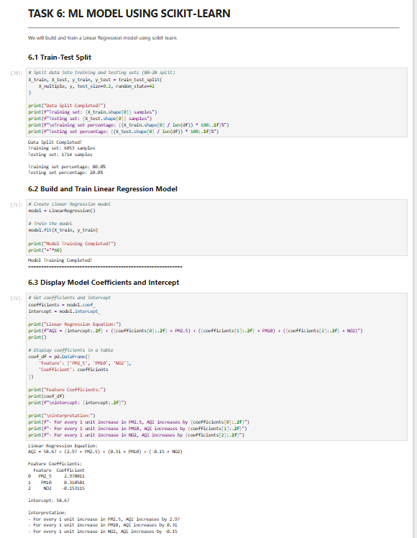
Regression Model Training & Outputs - Continued
Model Coefficient extraction, Prediction logic syntax, and formal Error Metric Calculations (Part 1)

Slide 31
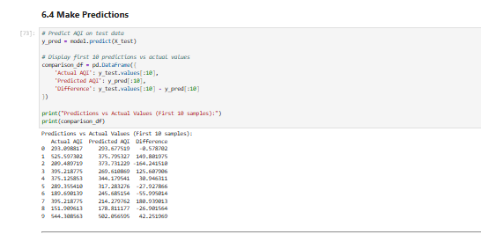
Regression Model Training & Outputs - Continued
Model Coefficient extraction, Prediction logic syntax, and formal Error Metric Calculations (Part 2)

Slide 32
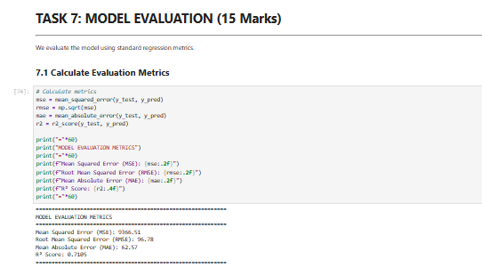
Regression Model Training & Outputs - Continued
Model Coefficient extraction, Prediction logic syntax, and formal Error Metric Calculations (Part 3)

Slide 33
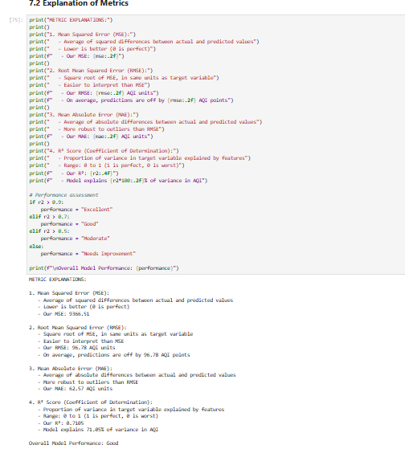
Regression Model Training & Outputs - Continued
Model Coefficient extraction, Prediction logic syntax, and formal Error Metric Calculations (Part 4)

Slide 34
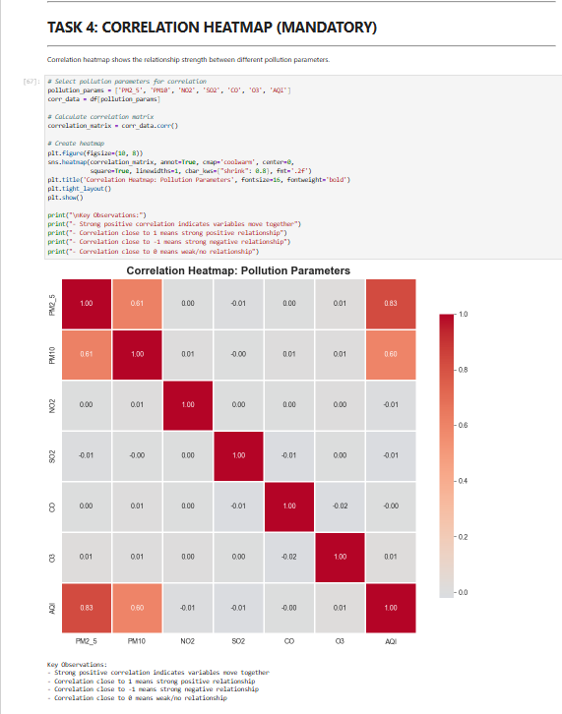
Data Visualization
Showcasing highly dense data dependencies clearly using Python's robust visualization stack.
Data Correlation Matrix Heatmap: Showing internal relationship strengths between variables

Slide 35
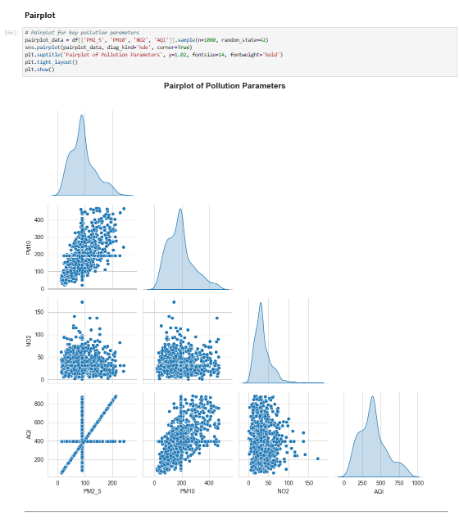
Data Visualization - Continued
Pairplot mappings to view complex internal distribution structures (Part 1)

Slide 36
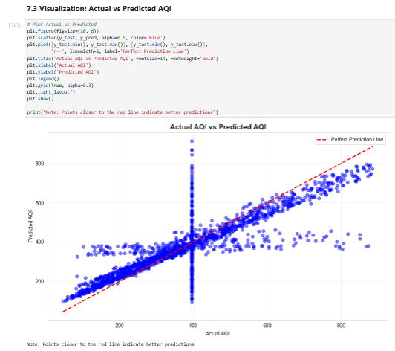
Interpretation of Results
Metro cities consistently exhibit significantly higher AQI metrics than localized zones.
PM2.5 securely correlates with maximum variance observed in general AQI.
Regression Line Interpretation: Predicted values formally mapped over Actual observed true values

Slide 37
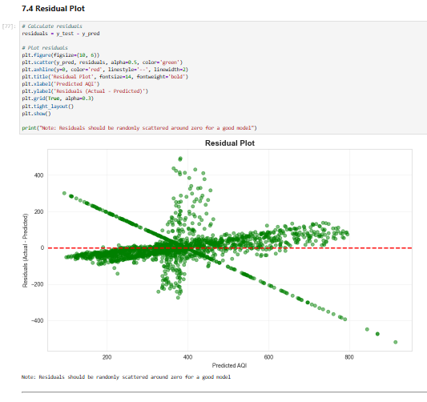
Interpretation of Results - Continued
Analytical Residual error plots defining ML model spread logic (Part 1)

Slide 38
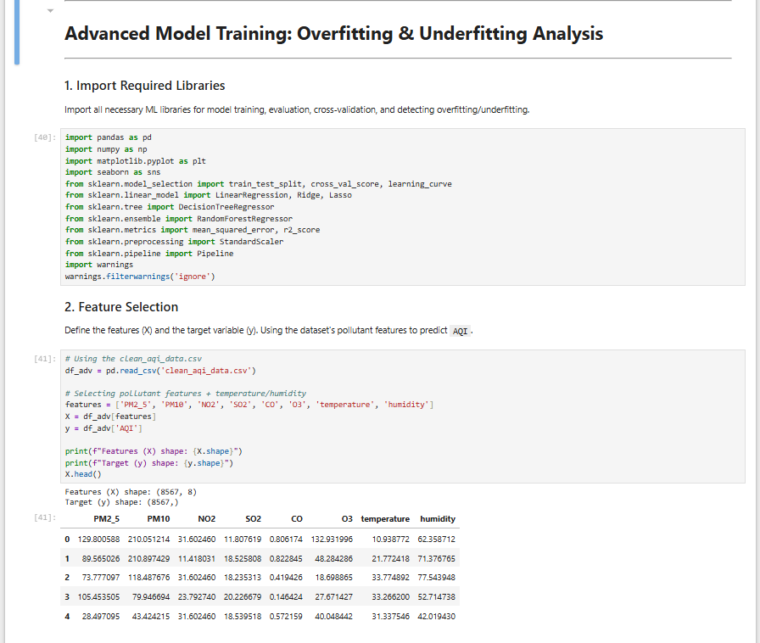
Macine leaning overfitting & underfitting - Continued

Slide 39
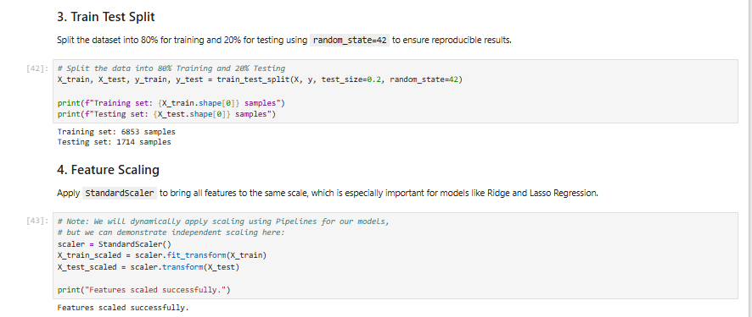
Macine leaning overfitting & underfitting - Continued

Slide 40
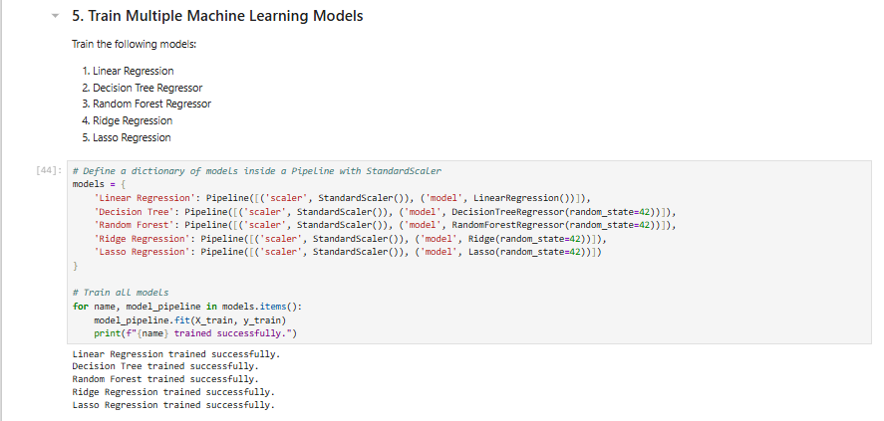
Macine leaning overfitting & underfitting - Continued

Slide 41
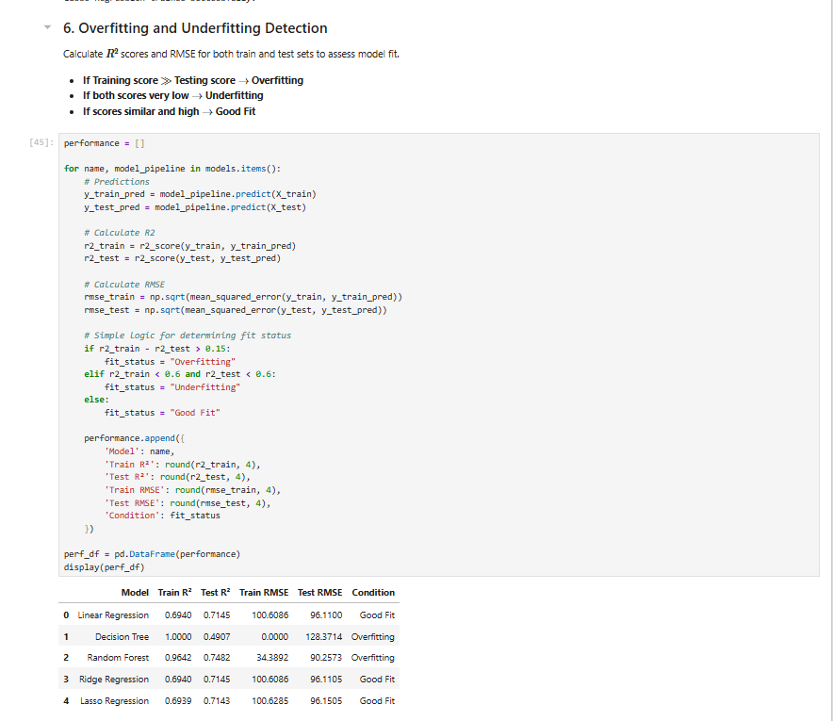
Macine leaning overfitting & underfitting - Continued

Slide 42
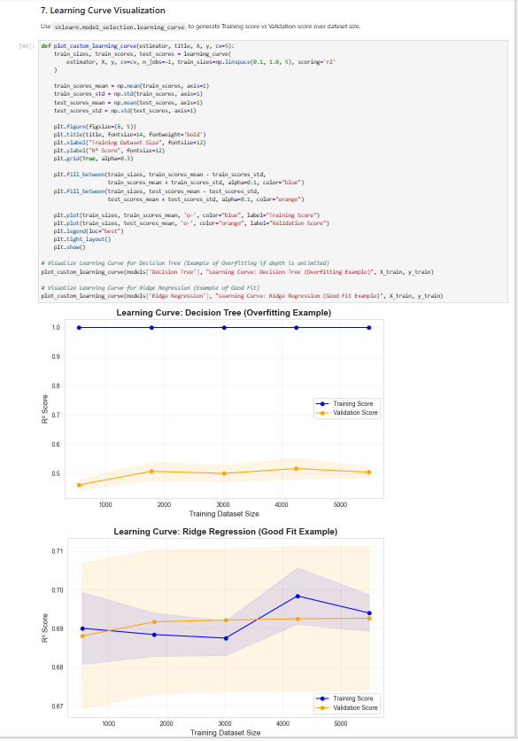
Macine leaning overfitting & underfitting - Continued

Slide 43
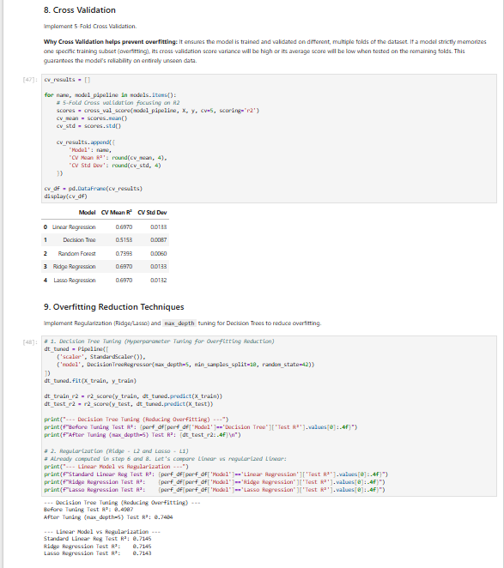
Macine leaning overfitting & underfitting - Continued

Slide 44
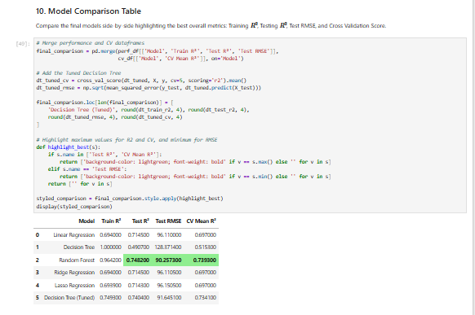
Macine leaning overfitting & underfitting - Continued

Slide 45
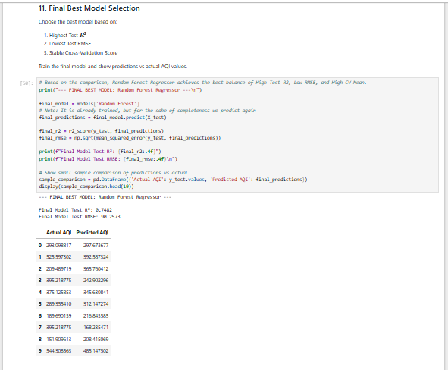
Macine leaning overfitting & underfitting - Continued

Slide 46
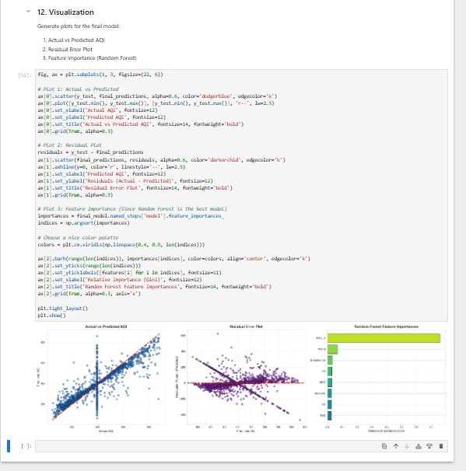
Macine leaning overfitting & underfitting - Continued

Slide 47
Summary
The project systematically implemented a complete environmental data analytics pipeline.
Raw, unstructured CSV data was reliably cleaned, processed, and visualized using Python.
Identified the most polluted cities and their primary causative trace gases.
Demonstrated the powerful capacity of data visualizations in formal environmental science.

Slide 48
Conclusion
Python proves highly effective and versatile for intensive large scale data analytics.
Data-driven models bridge the severe gap between raw data dumps and usable policies.
Continuous automated monitoring ensures scalable, smart-city sustainability planning.

Slide 49
Limitations & Future Enhancements
Current limitation: strictly depends on static historical formatted CSV logs.
Future Enhancement 1: Integrate robust live Real-time REST APIs for instantaneous updates.
Future Enhancement 2: Implement more diverse Machine Learning algorithms like Random Forest.
Future Enhancement 3: Build a custom responsive interactive Web UI App using Dash / Streamlit.

Slide 50
PROJECT SCREENSHOTS
Thank you

