Slide 1

SRINIVAS UNIVERSITY INSTITUTE OF ENGINEERING AND TECHNOLOGY MUKKA MANGALORE-574146 Department of Robotics Artificial Intelligence and IOT Major Project Phase 1 presentation on
“ Brain Tumour detection Using linear regression with SV”
Under The Guidance Of , BY:
Mr Vishwas Shetty
Professor , Dept of mechanical Venkatanatha A V :1SU20RM016

Slide 2
CONTENTS
Abstract
Objectives
Scope
Methodology
Expected outcomes
Innovation
Resource required
Reference
Conclusion

Slide 3
Abstract
A group of algorithms called “deep learning” is used in machine learning. With the aid of magnetic resonance imaging (MRI), deep learning is utilized to create models for the detection and categorization of brain tumors. This allows for the quick and simple identification of brain tumors.
This paper presents a model which is based on machine learning algorithms to detect brain Tumour from magnetic resonance images with high accuracy.

Slide 4
Objectives
The objective of this project is to use linear regression and detect brain tumour with high accuracy and consistency so that we can detect the cancer at early stage, this will be useful in the hands of doctors and assist them in taking accurate result to treat the patient .
This technique was compared with the methods of KNN classifier, Linear Discriminant Analysis (LDA) and Sequential Minimum Optimization (SMO). The accuracy rate was 96.97 in the DNN-based brain tumour classification analysis. But the complexity was very high and the performance was very poor. In a new biomechanical model of tumour growth was presented for step-by-step analysis of patient tumour growth. It will be applied to gliomas and individual fringed solid tumours

Slide 5
Scope
Deep Learning (DL) approaches have recently been popular in developing automated systems capable of accurately diagnosing or segmenting brain tumors in less time. DL enables a pre-trained model for medical images, specifically for classifying brain cancers
A group of algorithms called “deep learning” is used in machine learning. With the aid of magnetic resonance imaging (MRI), deep learning is utilized to create models for the detection and categorization of brain tumors. This allows for the quick and simple identification of brain tumors.

Slide 6
Premalignant Tumours vs Malignant tumours
A Premalignant Tumour (benign tumor) is an abnormal but noncancerous collection of cells. It can form anywhere on or in your body when cells multiply more than they should or don’t die when they should. A benign tumor is not malignant. It grows more slowly, has even borders and doesn’t spread to other parts of your body. Many benign tumors don’t require treatment.
A malignant tumor can also spread to other parts of your body. A benign tumor can become quite large, but it will not invade nearby tissue or spread to other parts of your body.
Some benign tumors can become cancerous over time (for example, in your colon or skin). If you have a benign neoplasm, a healthcare provider should monitor it regularly.
Hemangioma: These types of benign neoplasms grow from blood vessels. Hemangiomas most often occur on the skin in babies. But they can also form on internal organs such as the liver, colon or brain.
Lipoma: A lipoma forms from fat cells. This benign fatty tumor grows just below your skin. It’s the most common type of benign tumor.
Lymphangioma: This type of benign neoplasm develops in your lymphatic system. It can cause fluid-filled cysts on your skin and mucous membranes, which line your mouth, nose and inner eyelids.

Slide 7
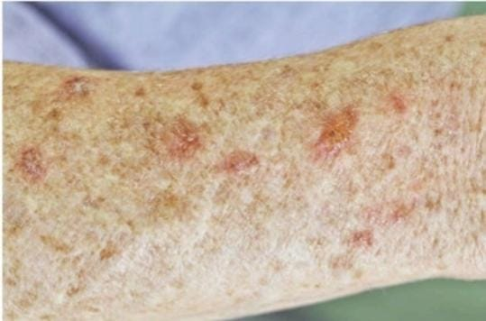
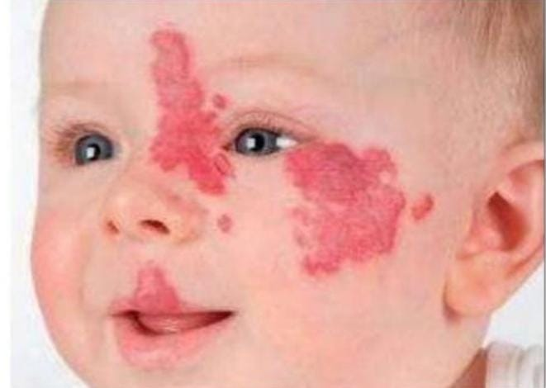
Meningioma: Meningiomas begin in the meninges, a layer of tissue around your brain. They can press on the brain and spinal cord. Most meningiomas are benign, but they can grow large and become life-threatening.
Myoma: These benign tumors grow from smooth muscle. Leiomyomas often grow in the uterus (also known as uterine fibroids) or gastrointestinal tract.
Neuroma: This type of benign neoplasm develops within nerves. They can grow anywhere in your body. Common neuromas include schwannoma, neurofibroma and ganglioneuroma.
Skin tumors: There are many types of benign skin tumors. Some of the most common include cherry angioma, sebaceous hyperplasia, seborrheic keratoses, dermatofibromas and acrochordons

Slide 8
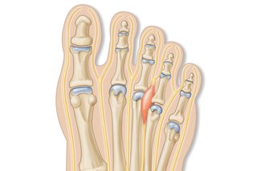
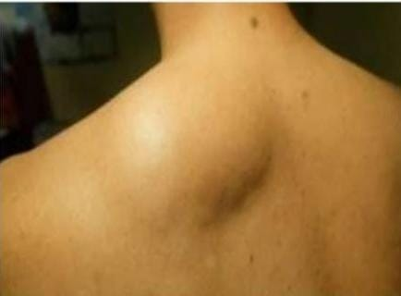
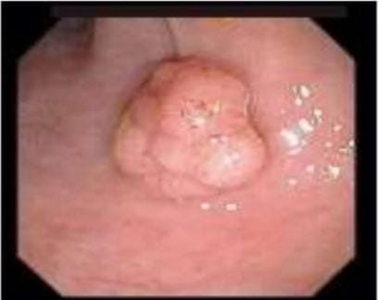

Slide 9
Methodology
In this section, the basic methodologies used to develop the model are discussed.
Data acquisition
The data collected had been separated into two categories as healthy and non-healthy ones. Further, the images are of different dimensions so they are converted into the same dimensions of 224*224.
Import packages and data set
In this stage noise removal will be done from the MRI images to increase the accuracy of the model. MRI images often consist of noise which will increase the redundancy and hence decrease the accuracy of the model. There is a high chance of a tumour not getting detected because of the noise present on the borders of an MRI. Hence affects the accuracy of the model. Pre-processing was done by scaling, reducing and converting them into grayscale. Image Pre-processing is done to enhance the quality, look and characteristics of the image.
Test validation dataset
This is an act of simplifying images while preserving important information. The aim is to reduce unnecessary noise or detail without creating too much distortion to simplify subsequent analyses.

Slide 10
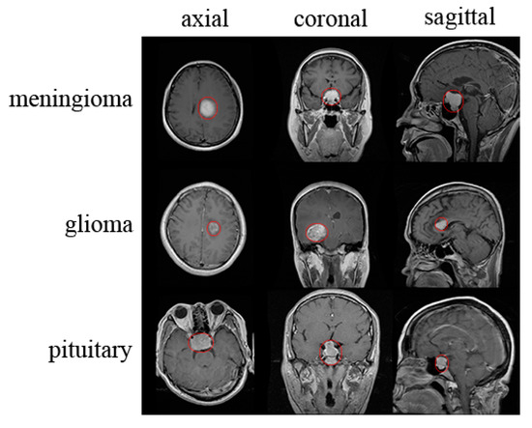

Slide 11
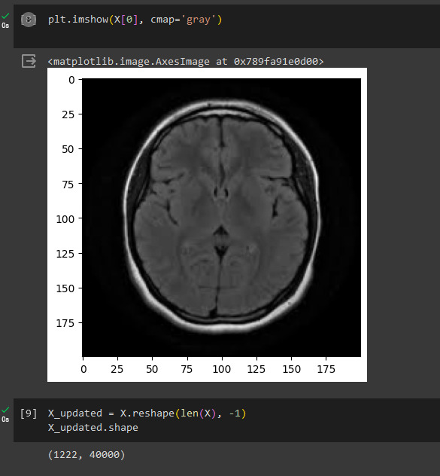
This is the selected Tumour input

Slide 12
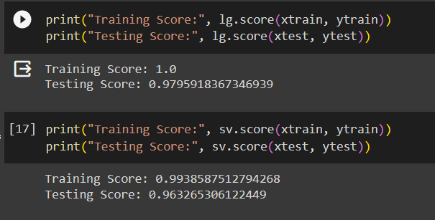
Accuracy of linear regression and support vector

Slide 13
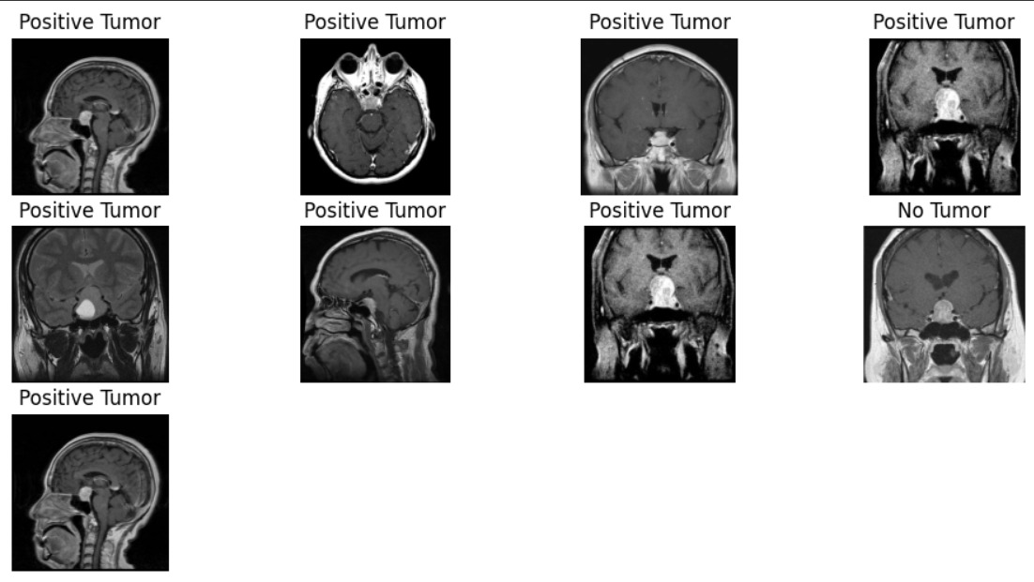
Output of the given tumour

Slide 14
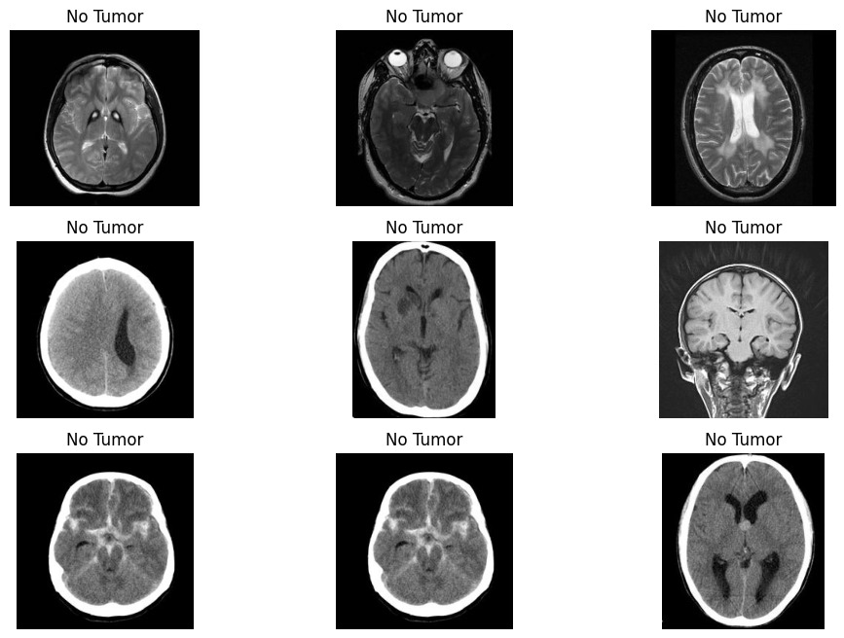
Output 2

Slide 15
Advantages
Early Detection: ML algorithms can identify subtle abnormalities in MRI images that may not be immediately apparent to the human eye. This allows for early detection of brain tumors, which can lead to better treatment outcomes.
Accuracy: ML models can achieve a high level of accuracy in tumor detection. When properly trained on large and diverse datasets, they can consistently and objectively identify tumors, reducing the risk of false negatives and false positives.
Efficiency: ML algorithms can rapidly process and analyze a large number of MRI scans, making the diagnostic process more efficient. This can be especially valuable in busy healthcare settings.
Consistency: ML models provide consistent results and do not suffer from fatigue, distractions, or bias, which can sometimes affect human radiologists' performance.

Slide 16
Research gap
we can try to improve the accuracy of the model as much as we can since this has a medical application we need 99% to 100% accuracy this will the area of our research
Classification
Classification of brain MRI images from tumour to non-tumour is done using the Convolutional neural network. The classifier used for classification is done by CNN itself. It is highly accurate while dealing with image related datasets. It is used for classifying tumour or non-tumour MRIs.
Limitations of the Project
The accuracy depends on the data set which has been taken from different stages, this can improve the accuracy in real world and if there is any noise the model will not work as we expect it to do.

Slide 17
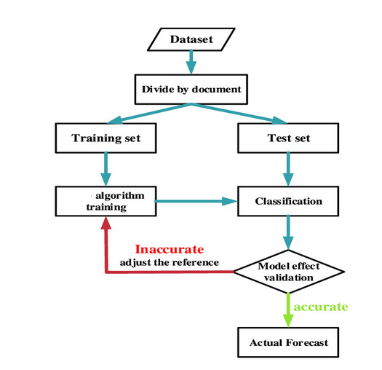
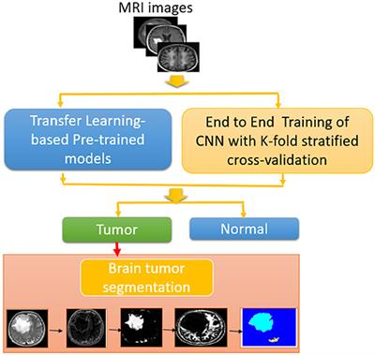

Slide 18
Linear regression using support vector
It is a deep learning algorithm that is used for image processing. This algorithm uses an image as an input and differentiates it on different bases or features.
Advantages
• Brain Tumours are detected from MRI images.
• No human intervention and hence human errors are removed.
• Human life can be saved from earlier detection of the tumour.
• Artificial intelligent systems are more reliable.
Disadvantages
• System requirements for the proper functioning of the model are high.
• Time taken to train the dataset is high.
• Highly accurate but not completely accurate.

Slide 19
.
One of the challenging tasks in the medical area is brain tumor segmentation which consists on the extraction process of tumor regions from images. Generally, this task is done manually by medical experts which is not always obvious due to the similarity between tumor and normal tissues and the high diversity in tumors appearance. Thus, automating medical image segmentation remains a real challenge which has attracted the attention of several researchers in last years. In this paper, we will focus on segmentation of Magnetic Resonance brain Images (MRI). Our idea is to consider this problem as a classification problem where the aim is to distinguish between normal and abnormal pixels on the basis of several features, namely intensities and texture.

Slide 20
.
Need For This Project
Early Detection can save life and this will help doctors to make accurate decision this will be useful in the hands of doctors and assist them in taking accurate result to treat the patient
Increase the chance of survival
Reduce symptoms
Improve the quality of life
Lower the risk of recurrence
Raise awareness and education
Help prevent the tumor from growing
Lead to timely diagnosis and treatment
Have a positive impact on patient quality of life and survival

Slide 21
Conclusion
The aim of this paper is to create a model with high accuracy to determine brain tumours from the MRI images. The dataset used consists of 253 brain MRI images and was sufficient to check the performance of the model. The model is based on the machine learning algorithm linear regression using support vector. It helps to predict just by reducing and resizing the image without losing any important information that will be used for predicting. The created model achieves an accuracy of 97.79% when applied to the training set and an accuracy of 82.86% when applied to the validation set. The loss gradually starts decreasing with the increase in the number of epochs. The model loss is very less when applied to the training set whereas it is high when applied to the validation set. In future, different datasets would be applied to this model, to further increase the overall accuracy.

Slide 22
Reference
[1] H. Mohsen, E.-S. A. El-Dahshan, E.-S. M. El-Horbaty and A.-B. M. Salem, “Classification using deep learning neural networks for brain tumors,” Future Computing and Informatics Journal, pp. 68-71, 2018.
[2] DR YASHWANTH MBBS MD SRINIVAS HOSPITAL MUKKA.
[3] S. Bauer, C. May, D. Dionysiou, G. Stamatakos, P. Buchler and M. Reyes, “Multiscale modeling for Image Analysis of Brain Tumor Studies,” IEEE Transactions on Biomedical Engineering, vol. 59, no. 1, pp. 25-29, 2012.
[4] Islam, S. M. Reza and K. M. Iftekharuddin, “Multifractal texture estimation for detection and segmentation of brain tumors,” IEEE Transactions on Biomedical Engineering, pp. 3204-3215, 2013.
[5] M. Huang, W. Yang, Y. Wu, J. Jiang, W. Chen and Q. Feng, “Brain tumor segmentation based on local independent projection-based classification,” IEEE Transactions on Biomedical Engineering, pp. 2633-2645, 2014. [5] Hamamci, N. Kucuk, K. Karaman, K. Engin and G. Unal, “Tumor-cut: Segmentation of brain tumors on contrast enhanced MR images for radiosurgery applications,” IEEE Transactions on Medical Imaging, pp. 790-804, 2012. [6] H. B. Menze, A. Jakab, S. Bauer, K. Farahani and K. Justin, “The Multimodal Brain Tumor Image Segmentation Benchmark,” IEEE Transactions on Medical Imaging, pp. 1993-2024, 2014.

Slide 23
Thank you

