Slide 1


Bank of Baroda Hackathon - 2022
Technology Partner
Your Team Name : Smart Coderz
Your team bio : Our team involved with two members myself and my friend venkadesh we are currently pursuing bachelor of engineering in Bannari Amman Institute of Technology
Date :18.09.2022

Slide 2
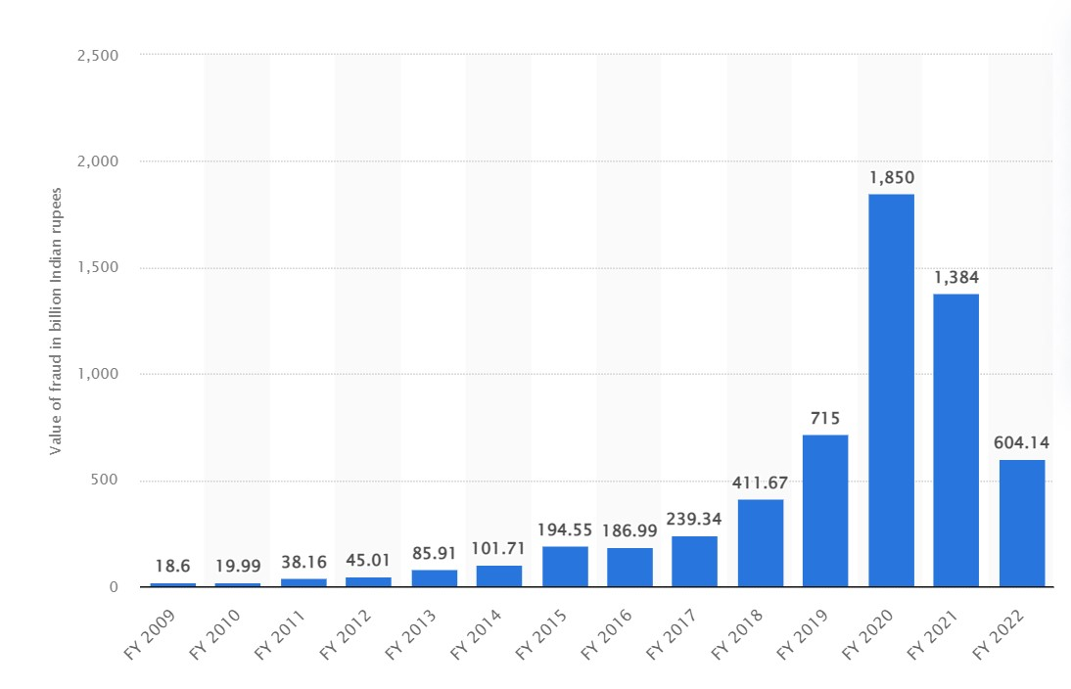
Problem Statement?
Why did you decide to solve this Problem statement?
We have decide choosed the problem statement Video Analytics because almost all over the world bank fraud is happenning like money stealing, card shimming, card trapping, phishing etc… . To avoid these kind of illegal activities in banks definitely we have to take an action otherwise the percentage of bank fraud will increase rapidely every year.
From this graph we can clearly able to understand bank frauds from the year 2009-2022. The bank frauds are rapidly increasing year by year. To reduce these kinds of frauds we have to come up with some new solutions with Machine learning and Deep learning Technologies these technologies are now ruling the world. By these technologies we can definitely able to reduce the bank frauds. So that only we have decided to solve this problem statement.

Slide 3
User Segment & Pain Points
Which user /advertiser segment would be early adopter of your product & why?
HDFC bank limited would be the early adopter of our product because this bank is affected with more bank frauds in india. HDFC bank has the more incidences of over 50,000 frauds that affected indian institutions in the recent 11 fiscal years. So, our product will help in some ways to reduce the frauds occuring in HDFC bank. So In my perspective HDFC bank limited will the early adopter of our product.

Slide 4
Pre-Requisite
What are the alternatives/competitive products for the problem you are solving?
I think our competitive products for the problem we are solving is intoVision products because they make really a good solution they offers a range of video analytics products, from server side intoVision VA and optimized hardware, to camers embedded intoVision edge, as well as OEM options with IntoVision SDK and white labelled solutions. It is too complex to do these kind of things. But we are confident that we can able to any kind of stuffs and we will provide the real time problem solution to the world.

Slide 5
Azure tools or resources
We are planning to use these kind of tools and resources for our project Azure tools: Azure CLI PowerShell JSON templates Azure resources: Virtual machines storage accounts virtual networks

Slide 6
Any Supporting Functional Documents
Present your solution, talk about methodology, architecture & scalability
Our solution is provide the video capturing device that is capable of detecting the human sentimentsand their mimic actions, count of people, body movements, etc… . For this we are using some machine learning classification models like decision tree, logistic regression etc.. . And in the decision tree classification we have to reduce the entropy and we have to increase the percentage of information gain so that model will able to give high accuracy. These models are trained with some people’s input data like age, colour difference. And finally we have to check the model’s accuracy. And finally we have to use deep neural networks(DNN) to train the video analysis systems that will detect the mimic human behaviour it started with the systems based on computer vision(cv) techniques (triggering an alert if the camera image becomes too dark) and moved to system capable of identifying specific object in an image and tracking their path. And we have decided to optical character recognition to extract text from images . And we have used OpenCV to implement video analytics. And result come from the video analytics is served as an input for machine learning models and these models were able to classify the people correctly based on the parameters.

Slide 7
Key Differentiators & Adoption Plan
How is your solution better than alternatives and how do you plan to build adoption?
Our solution is better than alternatives because it is doing mutiple jobs in a fraction of second. I mean it is performing sentimental anlysis on people, identifying expression, identifying count of people, giving person details etc.. . So doing multiple jobs at a same time is the advantage of our project it will be very useful in banking sectors. It will reduce the amount of banking frauds happenning in india.

Slide 8
GitHub Repository Link & supporting diagrams, screenshots, if any
https://github.com/SANJITHCSE20/Bank-of-Baroda-Hackathon

Slide 9
Thank You
Team member names:
SANJITH S
VENKADESH T

