Slide 1
Video Module

Slide 2
Contents
Introduction
Brief on Decode, Encode, Bitrate
Video Codecs
Brief on video codecs
Video streaming requirements
Video clip properties-Media info
Media info Tree View
Different container files

Slide 3
What is video and video codec
Video: The actual content you are watching (like movie/clip)
Video codec: A video code is an electronic circuit or software that compresses or decompresses digital video, thus converting raw (uncompressed) digital video to a compressed format or vice-versa

Slide 4
Decode:
Video decoding is the process of decoding or uncompressing encoded video in
real-time
Encode :
Encoding is the process of compressing and changing the format of raw video
content to a digital file or format
Bitrate:
The amount of information per second in video is known as bitrate. In video
streaming bitrate refers to the number of bits that are processed in a given unit
of time. Bitrate is commonly measured in bits per second (bit/sec).

Slide 5
Video codecs
H263
MPEG2
MPEG4
DIVX
XVID
H264/AVC
H265/HEVC
VP8
VP9
WMV

Slide 6
H.263 Video Codec
H.263 is a video compression standard primarily developed for low-bit-rate video communication.
It was initially created to improve video quality for videoconferencing and videotelephony over networks.

Slide 7
Key Features:
Low Bit-Rate Efficiency: H.263 was designed to provide good video quality at low bit rates, typically under 64 kbps.
Block-Based Compression: It uses a block-based hybrid video coding approach, similar to its predecessors, H.261 and MPEG-1. It divides the video frame into 16×16 macroblocks for processing.
Motion Compensation: H.263 includes motion compensation, which predicts the movement of objects between frames to reduce redundancy and improve compression efficiency.
Transform Coding: The codec employs an 8×8 discrete cosine transform (DCT) to convert spatial information into frequency components, which are then quantized and compressed.

Slide 8
Versions and Enhancements:
H.263v1 (Original Version): The original version of H.263, released in 1995, provided significant improvements over H.261, especially for low-bit-rate applications.
H.263v2 (H.263+): An enhanced version of H.263, introduced in 1998, added several optional features and improvements, including improved error resilience, custom picture formats, and support for higher bit rates.
H.263v3 (H.263++): Further enhancements were made in 2000, adding more advanced features like scalable video coding and improved error recovery.

Slide 9
MPEG-2
Moving Picture Experts Group 2, is a standard for encoding audio and video.
It's widely used in digital television broadcasting, DVDs, and other applications where high-quality video and audio are essential.

Slide 10
Key Features of MPEG-2
Video Compression: It reduces the file size of video data without significantly compromising quality.
Audio Compression: MPEG-2 supports various audio formats, including multichannel surround sound, providing high-quality audio reproduction.
Compatibility: It’s designed to be compatible with a wide range of devices, from televisions to computers, ensuring seamless playback across different platforms.
Scalability: MPEG-2 can be adapted to different bit rates and resolutions, making it versatile for various applications, from standard-definition TV to high-definition broadcasts.

Slide 11
MPEG-4
Moving Picture Experts Group 4, is a standard for encoding both audio and visual digital data.
It's designed to provide high-quality media at lower bit rates compared to its predecessors, making it ideal for streaming and storing multimedia content.

Slide 12
Key Features of MPEG-4
Efficient Compression: MPEG-4 uses advanced compression techniques to reduce file size without significantly losing quality, which is perfect for streaming video over the I
Versatility: It supports a wide range of content, including video, audio, 3D graphics, text, and interactivity, making it suitable for various applications like web videos, DVDs, and video conferencing.
Scalability: MPEG-4 can be scaled to different resolutions and bit rates, ensuring compatibility with various devices from mobile phones to high-definition TVs.
Interactivity: It allows for interactive multimedia, enabling features such as clickable hotspots and enhanced user interactions.

Slide 13
DivX
DivX is a video codec created by DivX, LLC.
It is used for compressing digital video files while maintaining relatively high quality.
DivX is popular for its ability to compress lengthy video segments into small sizes while preserving high visual quality.

Slide 14
Key Features of DivX
Efficient Compression: DivX uses advanced compression algorithms to reduce video file sizes significantly without major quality loss, making it ideal for storage and streaming.
High Quality: Despite its high compression ratio, DivX maintains impressive video quality, which makes it a favorite for movie and video content distribution.
Versatility: It supports various video formats and resolutions, ensuring compatibility with many devices, including computers, TVs, and portable media players.
Playback: DivX files can be played on a wide range of media players and devices, making it highly versatile for different platforms.

Slide 15
Xvid
Xvid is a popular video codec library that follows the MPEG-4 video coding standard.
It's an open-source alternative to other proprietary codecs like DivX.

Slide 16
Key Features of Xvid
Open-Source: Xvid is open-source software, meaning it's freely available and can be modified by anyone.
Efficient Compression: Xvid offers efficient video compression, reducing file sizes while maintaining high visual quality, making it suitable for storage and transmission over the internet.
Cross-Platform Compatibility: It works on multiple platforms, including Windows, macOS, Linux, and various other operating systems, ensuring broad compatibility.
High Quality: Xvid maintains excellent video quality, even at lower bit rates, which makes it ideal for sharing videos online and playing them on different devices.

Slide 17
H264/AVC
H.264, also known as Advanced Video Coding (AVC), is a popular video compression standard used for recording, compressing, and distributing digital video.

Slide 18
Key Features of H.264/AVC
High Compression Efficiency: H.264 offers significantly higher compression efficiency compared to previous standards like MPEG-2. This means it can reduce the file size of video data while maintaining high video quality, which is ideal for streaming and storage.
Broad Application: It’s used in various applications, from streaming video services like YouTube and Netflix to Blu-ray discs, broadcast television, and video conferencing.
Scalability: H.264 supports a wide range of resolutions and bit rates, making it versatile for different devices, from mobile phones to high-definition televisions.
Quality: Despite its high compression efficiency, H.264 maintains excellent video quality, making it a preferred choice for high-definition video content.

Slide 19
H265/HEVC
H.265, also known as High Efficiency Video Coding (HEVC), is the successor to H.264/AVC and offers even better compression efficiency

Slide 20
Key Features of H.265/HEVC
Superior Compression: H.265 achieves roughly double the compression ratio of H.264 at the same quality level, which means significantly smaller file sizes for the same video quality. This is crucial for streaming high-definition and 4K content.
Enhanced Video Quality: It supports higher resolutions (up to 8K) and improved video quality, even at lower bit rates, making it perfect for modern high-definition displays and streaming services.
Wider Application: H.265 is used in a variety of applications, including 4K and 8K Ultra High Definition (UHD) broadcasts, streaming services, video conferencing, and more.
Advanced Features: It incorporates advanced features like better motion compensation and more efficient use of bandwidth, which results in smoother playback and better overall video performance.

Slide 21
H.266/VCC
H.266, also known as Versatile Video Coding (VVC), is the successor to H.265/HEVC.
It is a cutting-edge video compression standard designed to handle the growing demand for high-quality video content.

Slide 22
Key Features of H.266/VVC
Superior Compression: H.266 achieves about 50% better compression efficiency compared to H.265, meaning it can deliver the same video quality at half the file size. This is ideal for streaming 4K, 8K, and 360° videos.
Versatility: As the name suggests, it is versatile and supports a wide range of applications, including ultra-high-definition (UHD) video, virtual reality (VR), and high dynamic range (HDR) content.
Advanced Features: H.266 introduces new tools for better motion prediction, improved intra-frame coding, and support for higher resolutions and color depths.
Bandwidth Savings: By reducing the bit rate required for high-quality video, H.266 helps save bandwidth, making it suitable for modern streaming and broadcasting needs.

Slide 23
VP8
VP8 is a video compression format developed by On2 Technologies and later acquired by Google.
It's part of the WebM project, which aims to create an open and royalty-free video format.

Slide 24
Key Features of VP8
Open and Royalty-Free: VP8 is an open-source codec with no associated licensing fees, making it a cost-effective option for developers and content creators.
High Compression Efficiency: It provides efficient video compression, resulting in relatively small file sizes while maintaining good visual quality, which is ideal for streaming and online video content.
Wide Compatibility: VP8 is supported by many modern web browsers and media players, ensuring broad compatibility across different platforms and devices.
WebM Project: VP8 is a core part of the WebM project, which aims to provide a high-quality, open video format for the web. It is often used alongside the Vorbis audio codec within WebM files.

Slide 25
VP9
VP9 is a video compression codec developed by Google as the successor to VP8.
It is part of the WebM project, which aims to provide an open and royalty-free video format for the web

Slide 26
Key Features of VP9
Higher Compression Efficiency: VP9 offers significantly better compression efficiency compared to VP8. It can achieve similar or better video quality at roughly half the bit rate, making it ideal for streaming high-definition content.
Open and Royalty-Free: Like VP8, VP9 is an open-source codec with no associated licensing fees, which makes it a cost-effective choice for developers and content creators.
Wide Compatibility: VP9 is supported by many modern web browsers, media players, and streaming services, ensuring broad compatibility across various platforms and devices.
Support for High Resolutions: VP9 is designed to handle higher resolutions, including 4K and even 8K, making it suitable for modern high-definition displays and streaming applications.

Slide 27
WMV
Windows Media Video (WMV) is a video compression format developed by Microsoft.
It is part of the Windows Media framework and is commonly used for streaming and distributing video content.

Slide 28
Key Features of WMV
Compression: WMV offers efficient compression, which helps reduce the file size of video data while maintaining relatively high video quality. This makes it suitable for streaming and storage.
Compatibility: It is designed to work seamlessly with Windows-based systems and is supported by various media players and devices, ensuring broad compatibility.
Streaming: WMV is often used for online video streaming. It is also utilized in digital rights management (DRM) to protect copyrighted content.
Resolution Support: WMV supports a range of video resolutions, from low-definition to high-definition, making it versatile for different applications, from web videos to DVDs.

Slide 29
Video streaming requirements
For video content that is streamed over HTTP or RTSP, there are additional
requirements:
Container :
A container is the file that contains your video, audio streams, and any closed
caption files as well.
HTTP:
Hypertext transfer protocol is used to transfer data over the web
RTSP:
Real time streaming protocol is an application level network communication
system that transfer real-time data from multimedia to an endpoint device by
communicating directly with the sever streaming the data

Slide 30
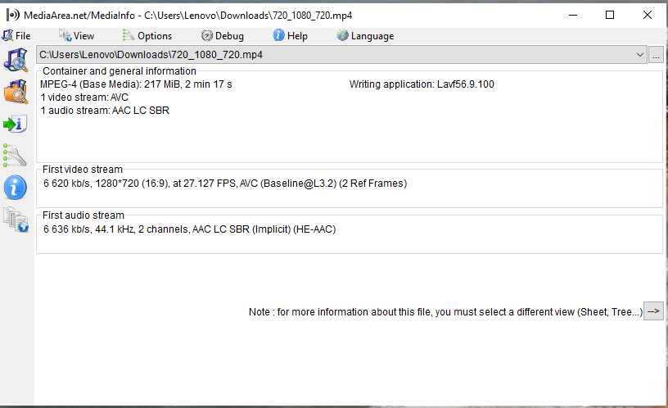
Video clip properties-Media info

Slide 31
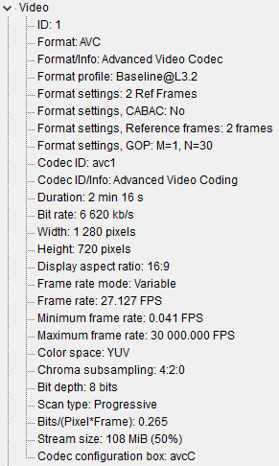
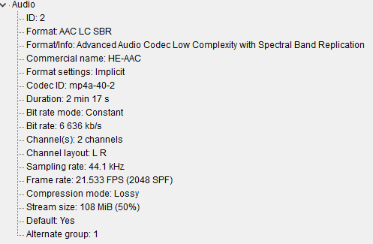
Media info Tree View

Slide 32
Profiles: Profiles represent a sub-set of the encoding technique available. Profiles
address the problem of code complexity and processing power
Ex:H264 supports some encoding profiles ( Baseline, Main, High profiles )
a)The baseline profile supports only a limited subset of techniques so it is simplier to
design, requires less code and less processing power and therefore is aimed at low
power mobile devices and the like .
b)The Main profile supports the majority of encoding techniques so it need more
code, more memory and more processing power on the decoder side. Main profile is
usually supported by set-top-box and the like.
c)The High profile supports virtually all the H264’s encoding techniques. It is designed
for HD and FullHD ( Blueray and HD satellite broadcast) and it’s usually supported
decoders too

Slide 33
Video Testing
Positive Testing
Negative Testing
Functional Testing
Stability Testing

Slide 34
General Issues
Flickering
Corruption
Frame freeze

Slide 35
Thank you

