Slide 1

Lingayas Institute of Management and Technology
(Autonomous)
Approved by AICTE, Affiliated to JNTU Kakinada, Accredited with A Grade by NAAC and
UG-CSE is accredited by NBA
Summer Internship presentation on
E-Platform To Access Library Resources
Roll Number: 22NA1A6103
Name: Thota Venkata Rao
Mentor:
Department of Artificial Intelligence & Machine Learning

Slide 2
Contents
Executive summary
Overview of the organization
Internship part
Activity log for a week
Outcomes description

Slide 3
Executive Summary
I had Performed my short term internship on Full stack Java in Sandspace Technologies Private Limited, it was a two months internship program.
I have completed my internship Activity on “E-Platform to access library resources”.
I have Gained minimum knowledge on Frontend - HTML, CSS, Java Script, Backend - Java, Spring Boot, Database - MySQL.
Understanding of Java(Spring Boot, Maven) development processes and methodologies

Slide 4
Objectives:
To develop practical knowledge of frontend technologies To improve technical skills.
To build a foundational understanding of backend development using Java
To understand real-time development tools and processes
Outcomes:
Gained hands-on experience with HTML, CSS, and JavaScript for responsive UI development, learned basics &flow of Java, Spring Boot, API development.
Gained exposure to industry tools like Maven and development methodologies in a professional environment.

Slide 5
Overview of the organization
About the Company:
Founded: Over 16 years ago, based in Vijayawada
Core Domain: Real-time software solutions with national impact
Annual Turnover: ₹2.1 crore with consistent profitability
Key Highlights:
Develops impactful real-time software projects that support national development
Offers a comprehensive internship program to nurture future software professionals

Slide 6
VISION:
To become a global leader in real-time software solutions, empowering national progress and transforming productivity through innovation.
MISSION:
To design, develop, and deliver advanced software systems that address critical national needs, uphold technical excellence, and elevate client success while contributing to societal growth.
Core Values:
Collaboration: Encouraging teamwork and shared goals
Lifelong Learning: Promoting ongoing skill development and adaptability

Slide 7
Internship part
Full Stack Java is a software development track that combines frontend, backend, and database technologies to build complete web applications.
It involves creating user interfaces, handling server-side logic, and managing data storage efficiently.
During this internship, we focused on learning and implementing the core components of full stack Java development.
This internship helped us understand how frontend, backend, and database layers interact in a real-time software application, and how to build structured, scalable web systems.

Slide 8
Internship part Continuation....
The technologies and skills we worked on are listed below:
Frontend Technologies:
HTML - for page structure and content
CSS - for styling and layout
Java Script - for dynamic interactions and client-side logic
Backend Technologies:
Java - as the main programming language.
Spring Boot - for building RESTful APIs.
Maven - for project build and dependency management.
Database:
MySQL - for storing and managing application data.
Spring Data JPA - for database integration with Java.

Slide 9
Activity Log Book for week-1
Day | Brief description of the daily activity | Learning Outcome
Day-1 | Aim to introduce to about Java & Components of full stack. | Gaining the information about the Java Programming & full stack.
Day-2 | Aim to learn in depth like variables, Data types. | Know in depth of java.
Day-3 | Aim to learn how to install / download intellij idea & java. | Downloaded the tools required.
Day-4 | Aim to learn about the oops concept Abstraction & Encapsulation. | Gaining the data of oops concept of Abstraction & Encapsulation.
Day-5 | Aim to learn about the continuation oops concept Inheritance & polymorphism. | Knowing about the remaining oops concept.
Day-6 | Aim to learn about the Spring boot framework. | Knowing about the Spring boot framework.
Day-7 | Assigned with assignment of 10 java oops programs. | practical knowledge of oops concept.

Slide 10
Outcomes description
Learned the java full stack and developed E-platform to access library resources for Lingayas Library implemented.
Secure OTP-based login via institutional email & reCAPTCHA implemented.
Role-based dashboards (Admin, Faculty, Student).
Books was categorized by the different sections like B.Tech, M.Tech, MBA.
Access to Career development, Research hub, GitHub projects, digital archives, NPTEL/SWAYAM resources.
User-friendly UI reducing manual work.
Practical learning in full-stack development and authentication.

Slide 11
Managerial skills I have acquired
Understood the importance of professionalism, punctuality, and accountability in a corporate setup.
Gained problem-solving ability by identifying issues and proposing logical solutions.
Learned time management by meeting project deadlines and prioritizing tasks effectively.
Improved communication skills through regular updates and collaboration with team members.

Slide 12
Teamwork & Leadership Skills
Improved confidence and clarity while participating in team discussions and meetings.
Actively contributed ideas and feedback during collaborative tasks and code reviews.
Learned to take ownership of assigned tasks and support team goals.
Observed team leaders to understand effective coordination and decision-making.
Gained awareness of how to manage group dynamics.

Slide 13
Communication Skills Improvement
Practiced clear and concise communication during team discussions and task updates.
Improved technical explanation skills while discussing code and project flow.
Learned to listen actively and respond appropriately in group settings.
Gained confidence in expressing ideas through Written and verbal communication.
Understood the importance of tone, clarity, and professionalism in work interactions.

Slide 14
SUMMARY
I gained hands-on experience in the Full Stack Java development track. The internship provided valuable exposure to real-time development processes, industry tools, and collaborative work environments.
This internship helped me strengthen both my technical foundation and soft skills, making me more confident and industry-ready for future roles in software development.
Project Understanding: Learned how different layers (UI, logic, data) interact in full stack apps

Slide 15
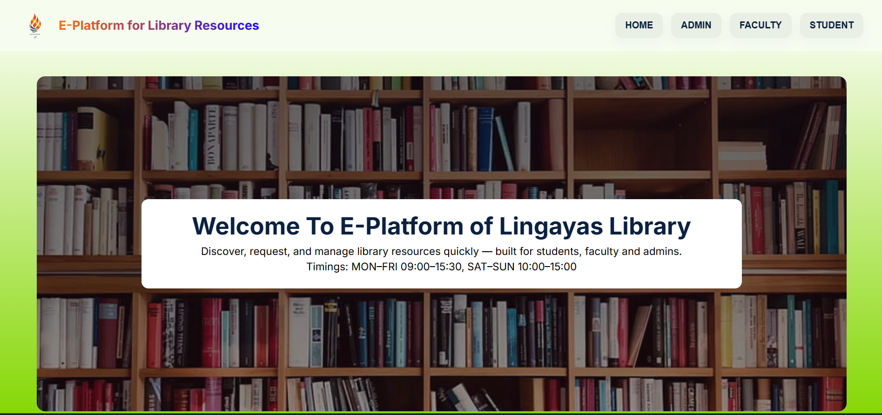
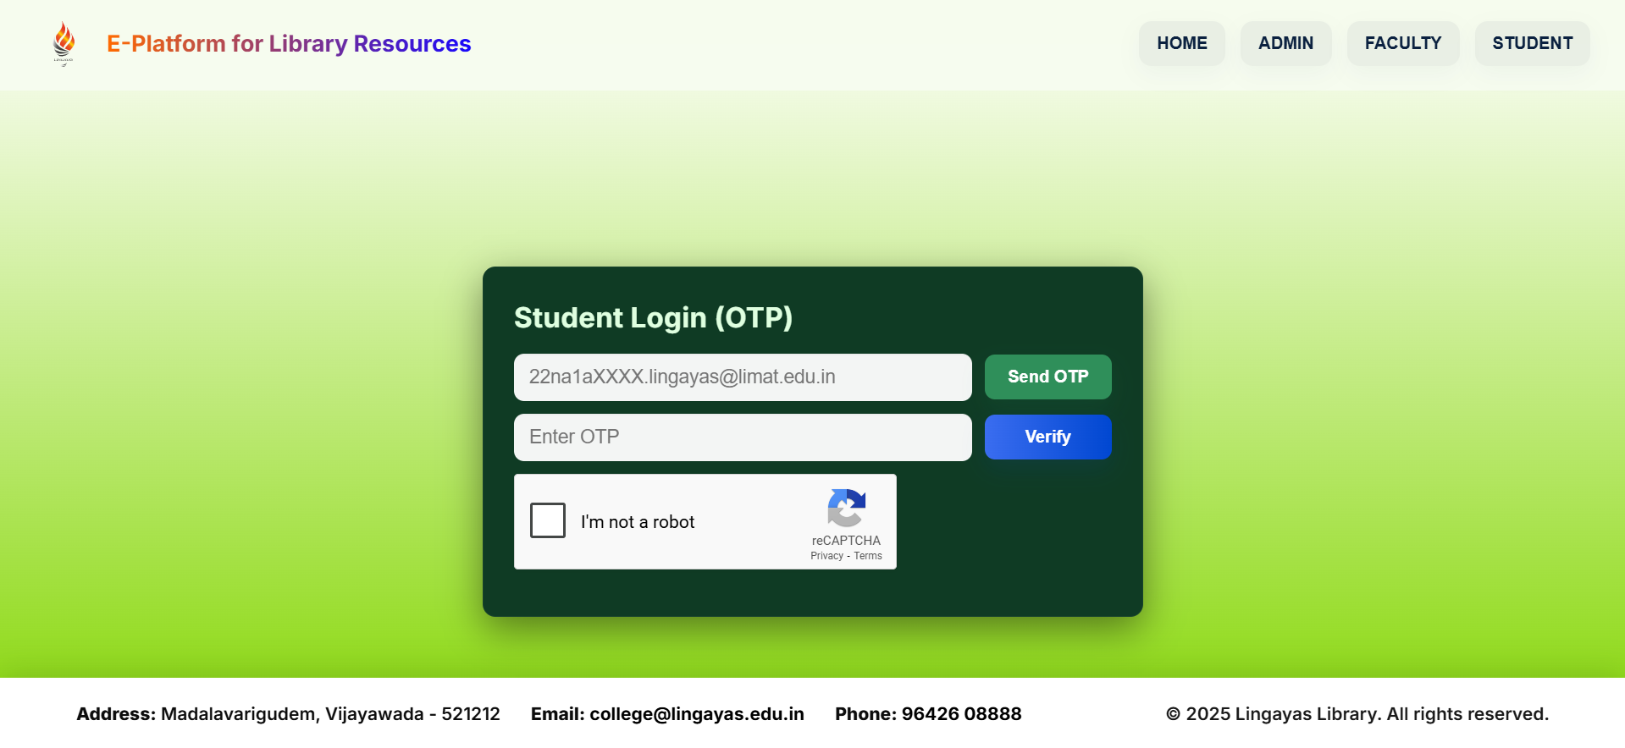
Final output

Slide 16
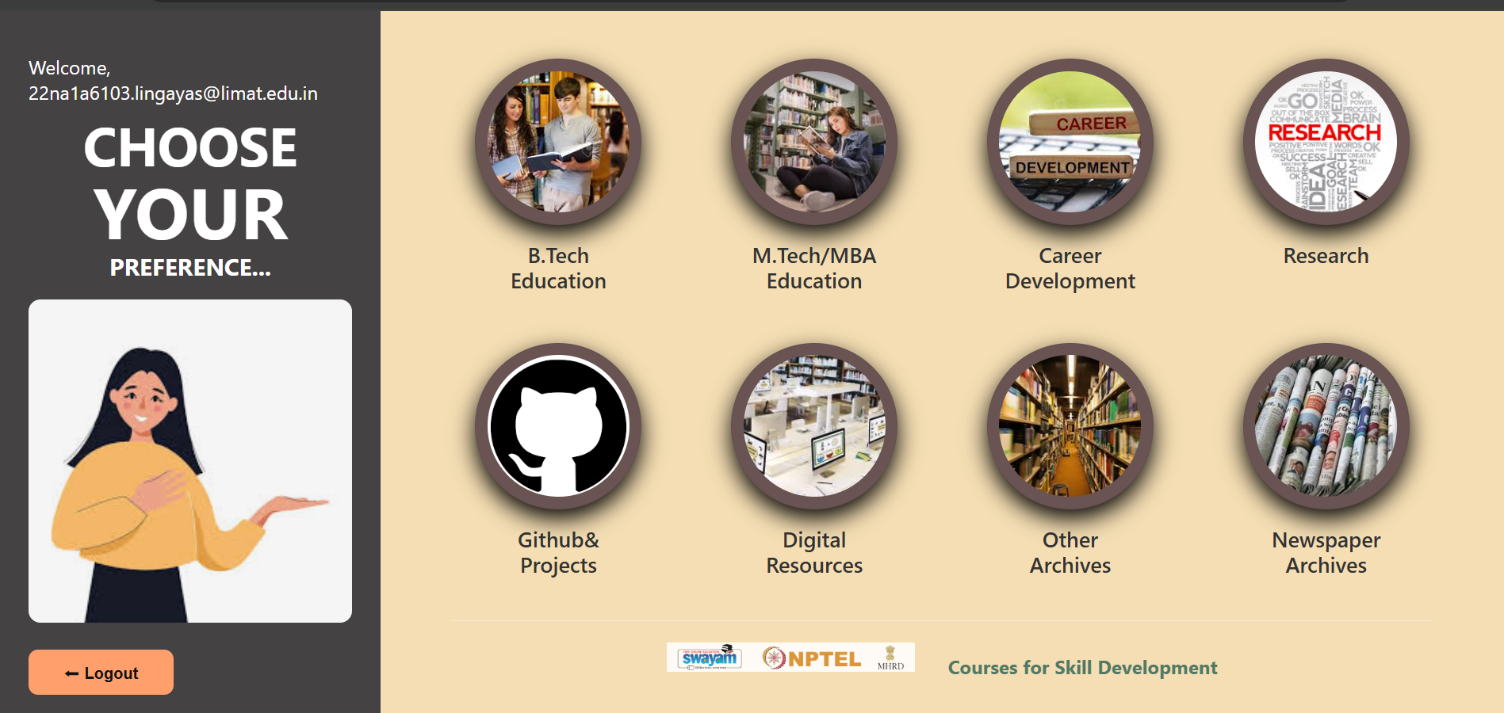
Main page:

Slide 17
References
I extend my heartfelt gratitude to all my mentors and faculty members for their invaluable guidance, continuous support, and encouragement. Their insights and motivation greatly enhanced my skills and overall performance throughout the program.
I extend my heartfelt thanks to Sandspace Technologies Pvt. Ltd.
I would also like to extend a very special thanks to ChatGPT by OpenAI for providing consistent technical guidance, instant support, and clarity throughout my internship journey.

Slide 18
Thank you

