Slide 1

Telecom customer churn prediction
Ankita Deshmukh
Venkatakrishnan subramanian
Date: 4/15/2020

Slide 2
Table of contents
Problem setting
Problem definition
Data sources
Data description
Data exploration
Data mining tasks
Data mining models/methods
Performance evaluation
Project results
Insights for decision making
Impact of the project outcomes

Slide 3
Problem setting
Churn is a measure of the number of individuals or items moving out of a collective group. It is one of two primary factors that determine the steady-state level of customers a business will support
The term is used in many contexts but is most widely applied in business with respect to a contractual customer base

Slide 4
Problem definition
Our analysis focuses on behavior telecom customers who are more likely to leave the platform and we intend to find out the most striking behavior of customers through exploratory data analysis
We will be focusing on predictive analytics by assessing their propensity of risk to churn.

Slide 5
Data sources
We have obtained this dataset from Kaggle.com. The link is given below:
https://www.kaggle.com/blastchar/telco-customer-churn.

Slide 6
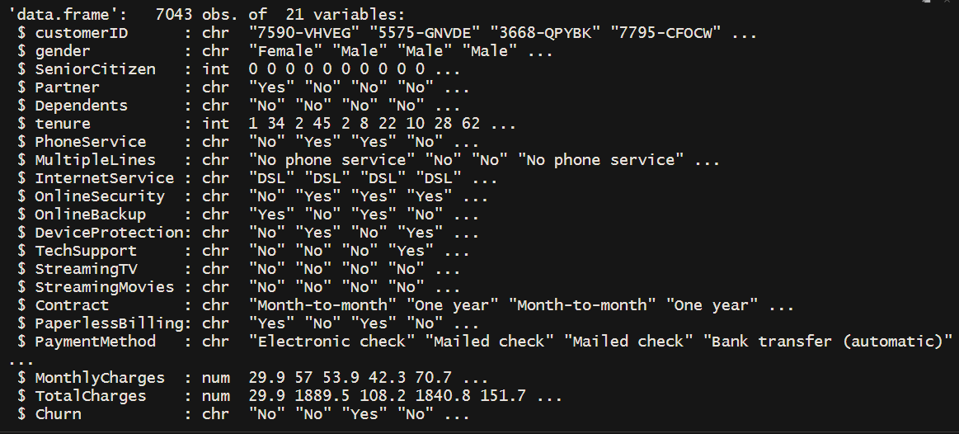
Data description
The dataset ‘Telecom Customer Churn’ there are 21 Columns about 7k rows where each row representing a customer

Slide 7
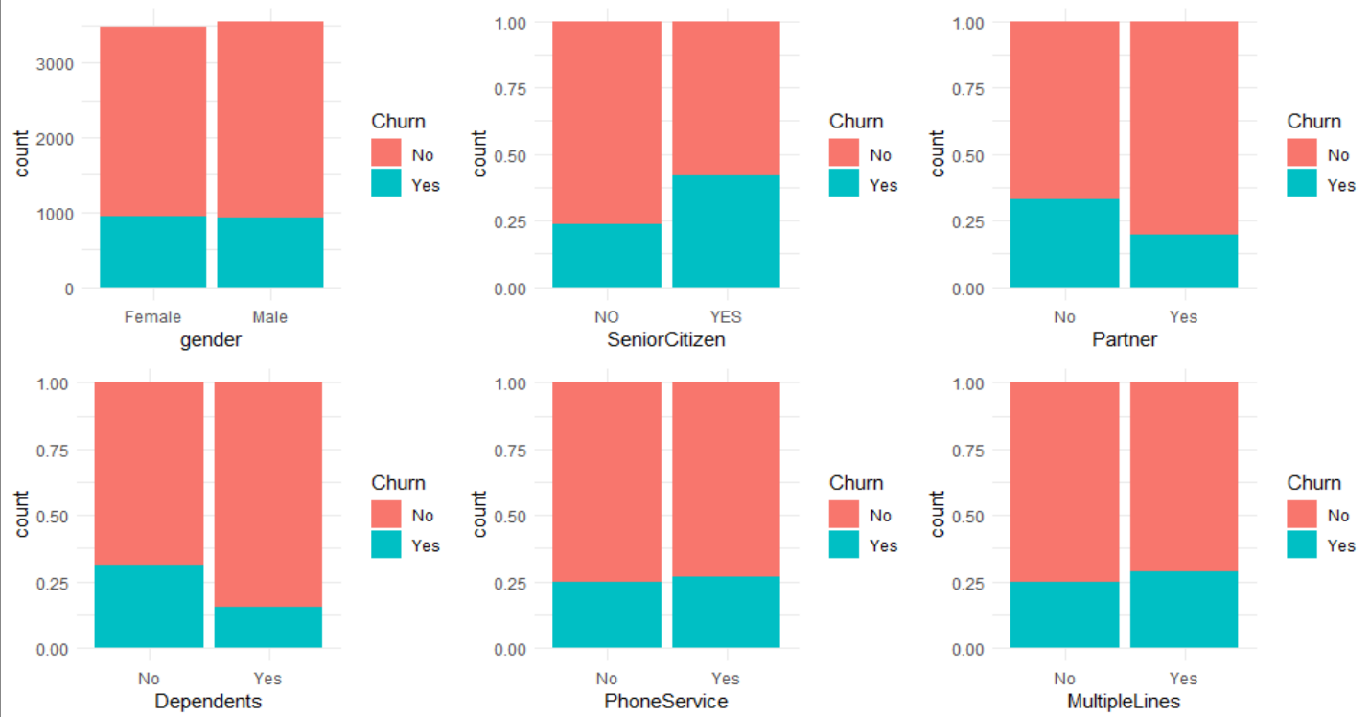
Data exploration

Slide 8
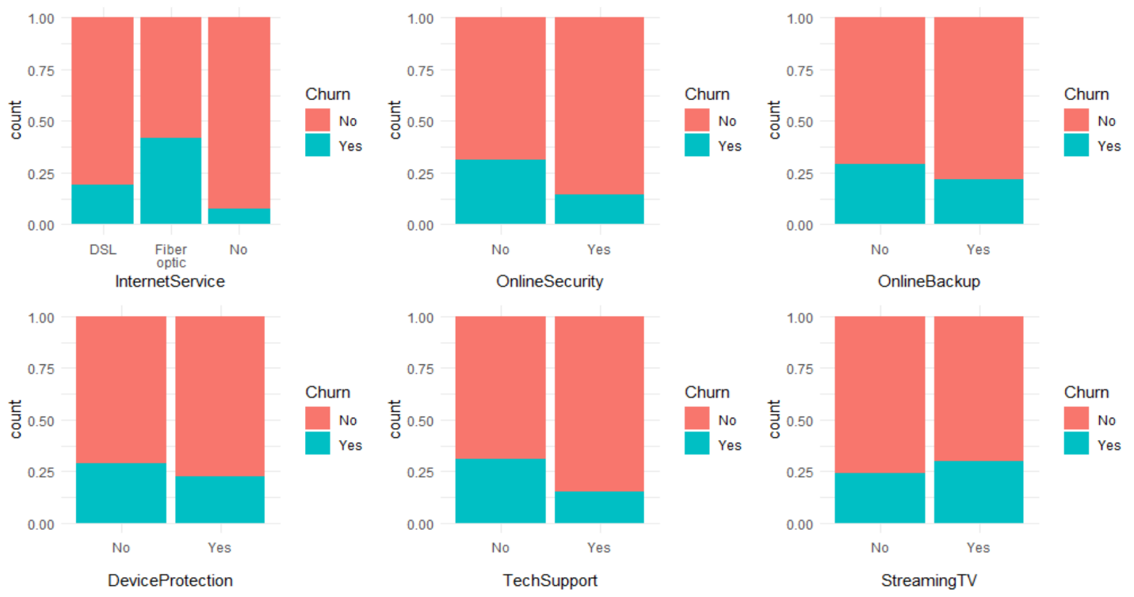

Slide 9
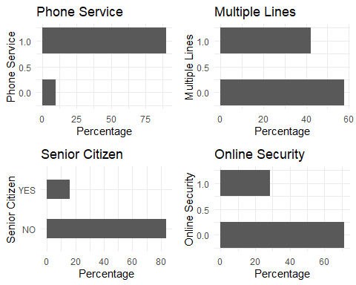
Analyzing the Predictor variables

Slide 10
Data mining tasks
Data Cleaning:
Converting senior citizen to factor form and removing customerID
Cleaning the Categorical features
Some categorical features have 'No' and 'No Internet Service' or 'No Phone Service' as a category, we can make them as 'No' and clean these features. We have changed "No Internet service" to "No" for 6 columns. We also have converted the categorical variables into numerical by making “yes” to 1 and “no” to 0.

Slide 11
Creating derived features:
Since the minimum tenure is 1 month and maximum tenure is 72 months, we have grouped them into five different bins of tenure: “0–12 Month”, “12–24 Month”, “24–48 Months”, “48–60 Month”, “> 60 Month” by creating a function.
Missing data imputation:
For imputing those missing values in our dataset we are using the K-nearest neighbor (KNN) technique.

Slide 12
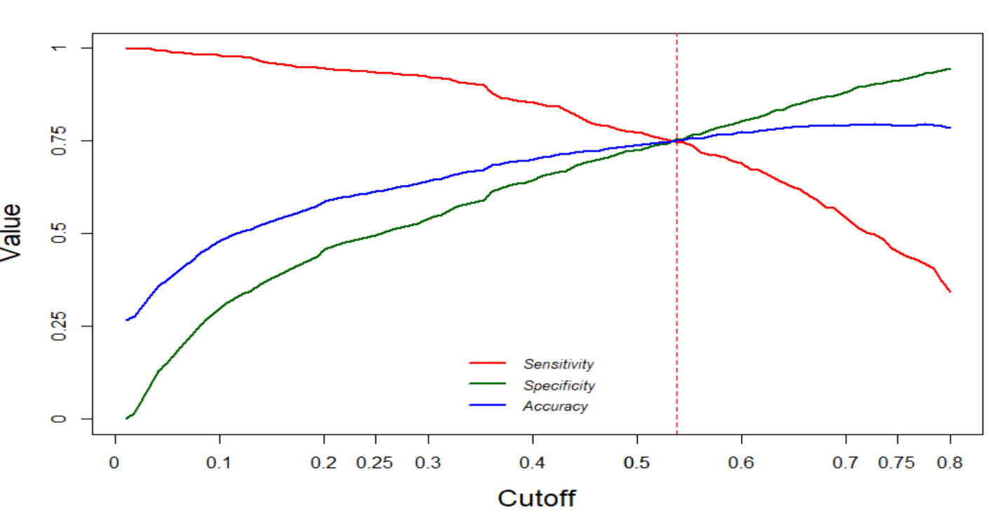
Data Mining Models/Methods
We have employed three models in order to predict the customer churn, namely Logistic Regression, Decision Tree and Random Forest.
1) Logistic Regression:
We plot a sensitivity vs specificity vs accuracy graph to determine the optimal cut-off point for prediction on test data
Looking at the plot below we can determine the cutoff point to be 0.538 at which we get an accuracy of 75.1%.

Slide 13
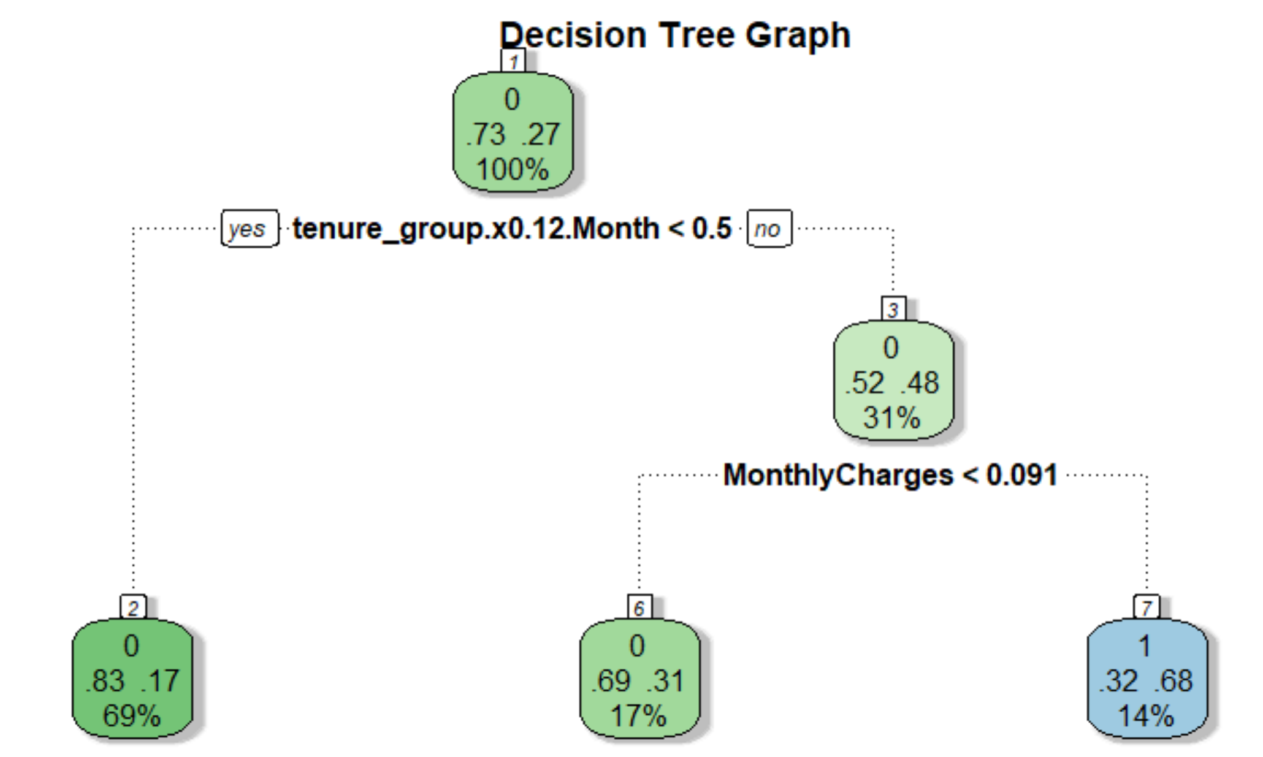
2) Decision Tree:
We run the decision tree model on unseen data and obtain an accuracy of 77.1%.
Looking at the diagram we can see that the most significant predictors given by the model are MonthlyCharges and tenure_group.x.0.12.Month.

Slide 14
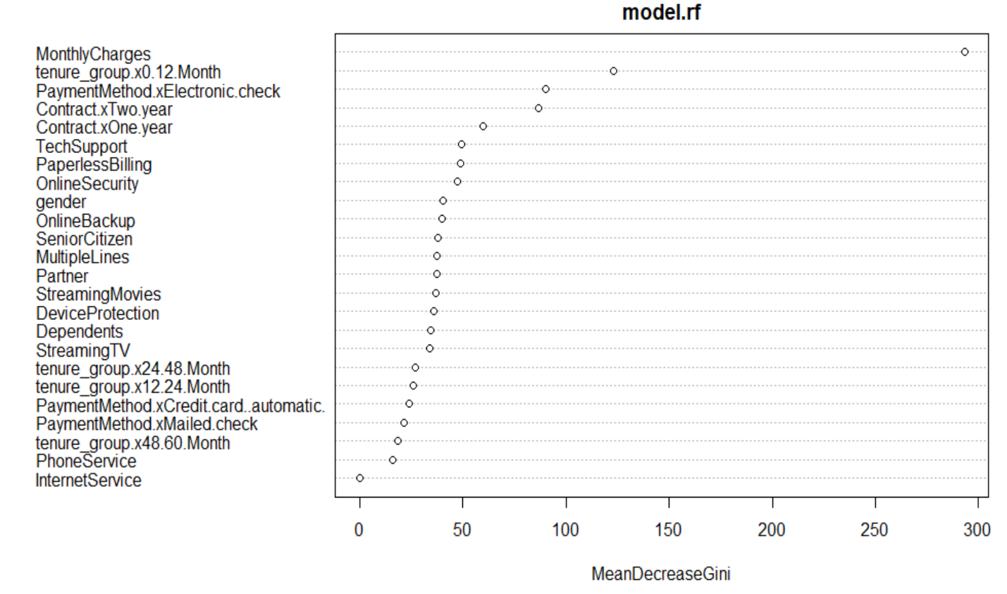
3) Random Forest:
The Random Forest model gives an accuracy of 77.28% (almost close enough to decision tree estimate).
We can see the top-3 most significant variables chosen by the model are MonthlyCharges,tenure_group.x0.12.Month and PaymentMethod.x.Electronic.check.

Slide 15
Performance Evaluation
A brief Summary of all the models:
Logistic Regression:
Accuracy 75.10%,
Sensitivity 74.86%
Specificity 75.19%
Decision Tree:
Accuracy 77.71%,
Sensitivity 79.55%
Specificity 65.85%
RandomForest:
Accuracy 77.28%,
Sensitivity 82.13%
Specificity 59.10%

Slide 16
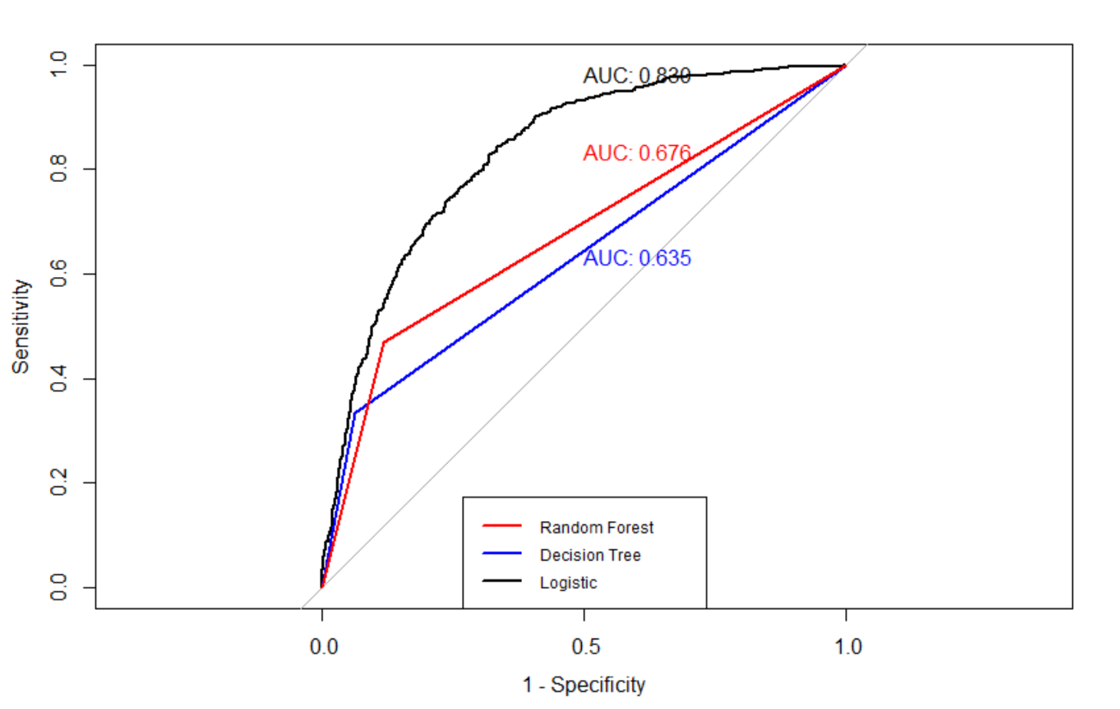
We checked the Area Under Curve (AUC) for all three models:
We can see that the AUC for Logistic Regression Model is the highest at 0.830 followed by Random Forest (0.676) and Decision Tree (0.635).

Slide 17
Project Results
Moving customers to tech support accounts might be a potential way to prevent churn.
Moving some of the people to DSL or eliminating their internet service would be an option to prevent churn. Another option could be some sort of price reduction to their fiber optic plan as some sort of a promotion for being a loyal customer.
A lot of people with phone service churned. Maybe these people don’t use the phone service. Moving them to a plan without phone service to save them some money on their bill might help retain them.
People without online backup, device protection, and online security churn frequently. Maybe their devices have crashed, causing them to lose valuable files. They may have also experienced fraud or identity theft that has left them very unhappy. Moving these people to some of these services may help safeguard their systems, thus preventing a lot of unwanted headaches.

Slide 18
Insights for Decision Making
We can see that Logistic Regression has the highest accuracy of 75% with well balanced Sensitivity and Specificity at 74.8% and 75.1% respectively.
On the other hand Decision Tree gives an accuracy of 77.7% with Sensitivity of 79.5% but Specificity is lower at 65.8%.
Similarly, Random Forests gives an accuracy of 77.2% with a high Sensitivity of 82.1% but low Specificity of 59.1%.
We then compute AUROC curve for all three models to compare which is the best of these three models, we found that the AUROC of logit Model is the best at 0.83.

Slide 19
Impact of the Project Outcome
It’s no secret that customer retention is crucial to the long-term success of your business. The ability to predict that a customer is at a high risk of churning, while there is still time to do something about it, represents a huge additional potential revenue source for every online business. Besides the direct loss of revenue that results from a customer abandoning the business, the costs of initially acquiring that customer may not have already been covered by the customer’s spending to date. Additionally, it is always more difficult and expensive to acquire a new customer than it is to retain a current paying customer. Our project can help the business identify and improve upon areas where service is lacking. Which would help decrease churn and improve the revenue numbers.
In the end, the insights gained from our data mining project can be used by the organization to understand the steps necessary and what factors are affecting the most for churn to ensure lost revenue is minimized.

