Slide 1
Haritha Hospitals Powered by ERPNext + HRMS

Slide 2
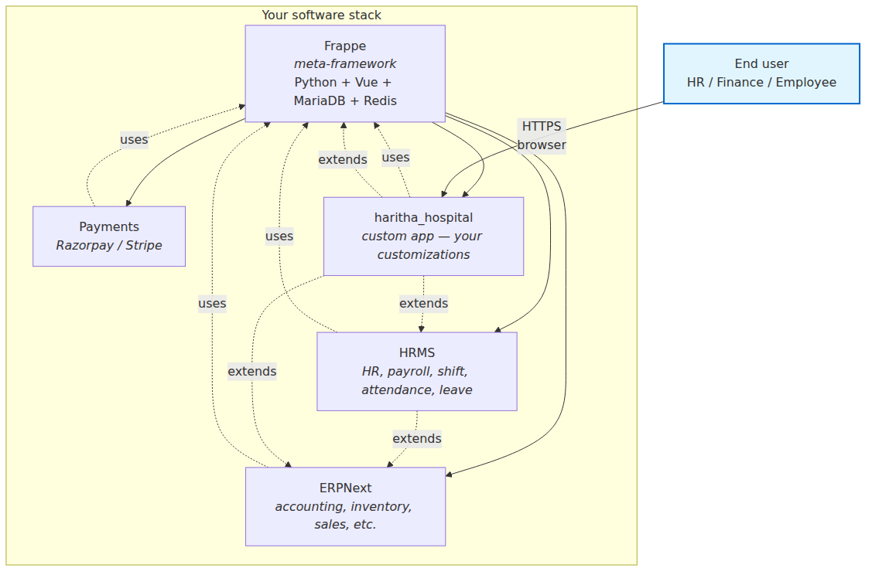
Title
[Visual: 00.1-what-is-erp-frappe-hrms.png]

Slide 3
Agenda
1. The challenge we solve
2. Why ERPNext + HRMS
3. Shift workflow in action
4. Shift types + color coding
5. The Haritha differentiator
6. Live demo
7. Customization showcase
8. Why choose Haritha + ERPNext
9. Q&A
**Speaker note:** Set expectations — "We'll do a live demo in section 6; everything before is context so the demo lands harder."

Slide 4
The Challenge
• 24/7 hospital operations
• 200+ employees across departments
• Shift scheduling errors = patient safety risk
• Manual attendance reconciliation
• Payroll disputes from shift mismatches
• No single source of truth
(Visuals: pain points with icons — nurse, clock, biometric, dispute, Excel icon, question mark.)
**Speaker note:** Pause on "patient safety risk." This is not "an HR headache" — it's the same data that decides who's on shift when an incident happens.

Slide 5
Why ERPNext + HRMS
• Open source (no vendor lock-in)
• Customizable (your workflows, not the other way)
• 274 production-validated customizations
• Healthcare-specific module available
• Active community, 5,000+ contributors
• Mobile-first
• Multi-company, multi-currency
(Visuals: comparison table vs SAP / Oracle / spreadsheets)
**Speaker note:** If a CFO is in the room, the cost line is the headline. If an IT lead is in the room, "no vendor lock-in" wins. If an HR head is in the room, "HRMS-first" is the line.

Slide 6
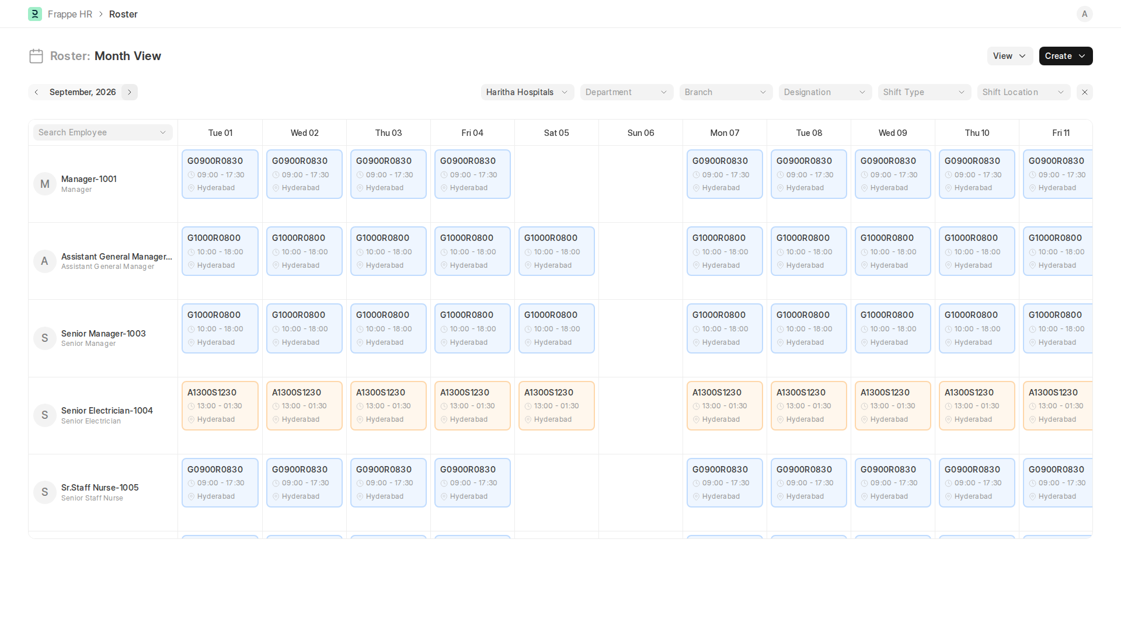
Shift Workflow — Daily Operations
source: screenshot-06-roster.png

Slide 7
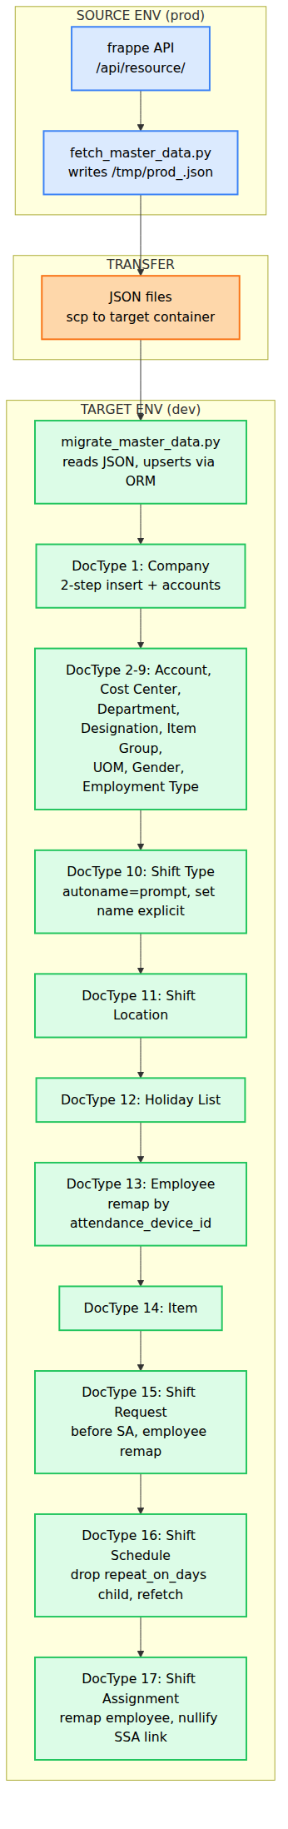
Shift Types & Color Coding
source: 02.2-process-diagram-05.png

Slide 8
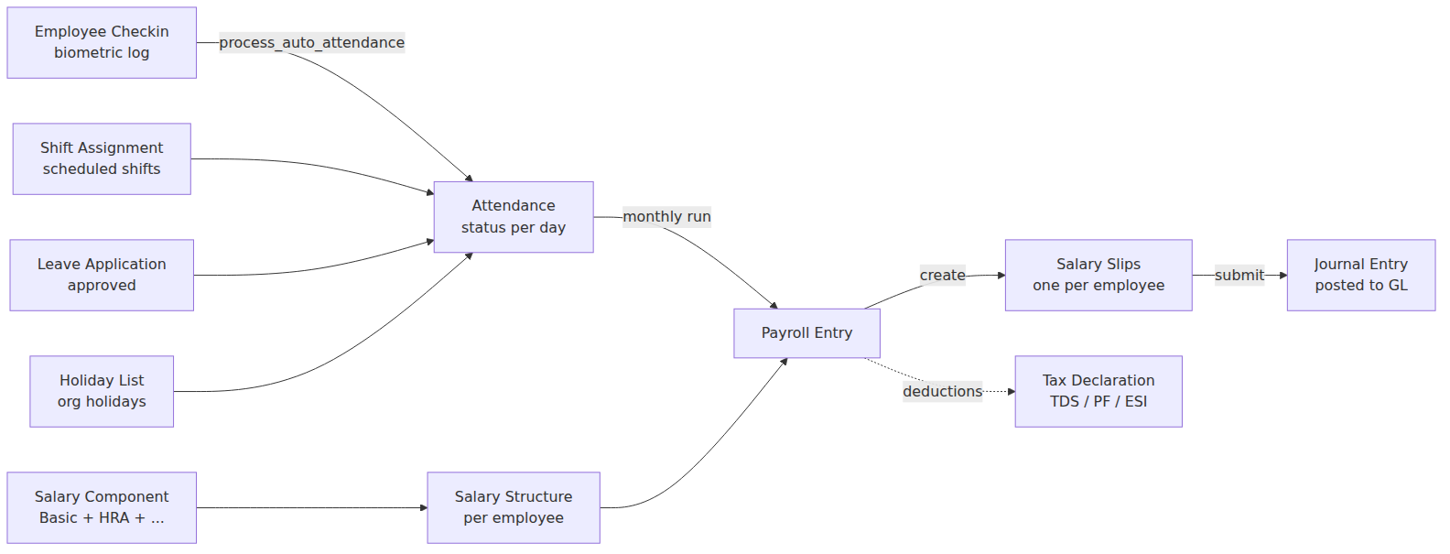
Shift Management — Our Differentiator ⭐
[Visual: 02.1-shift-management-workflow.png]

Slide 9
Live Demo
[Visual: screenshot-06-roster.png]

Slide 10
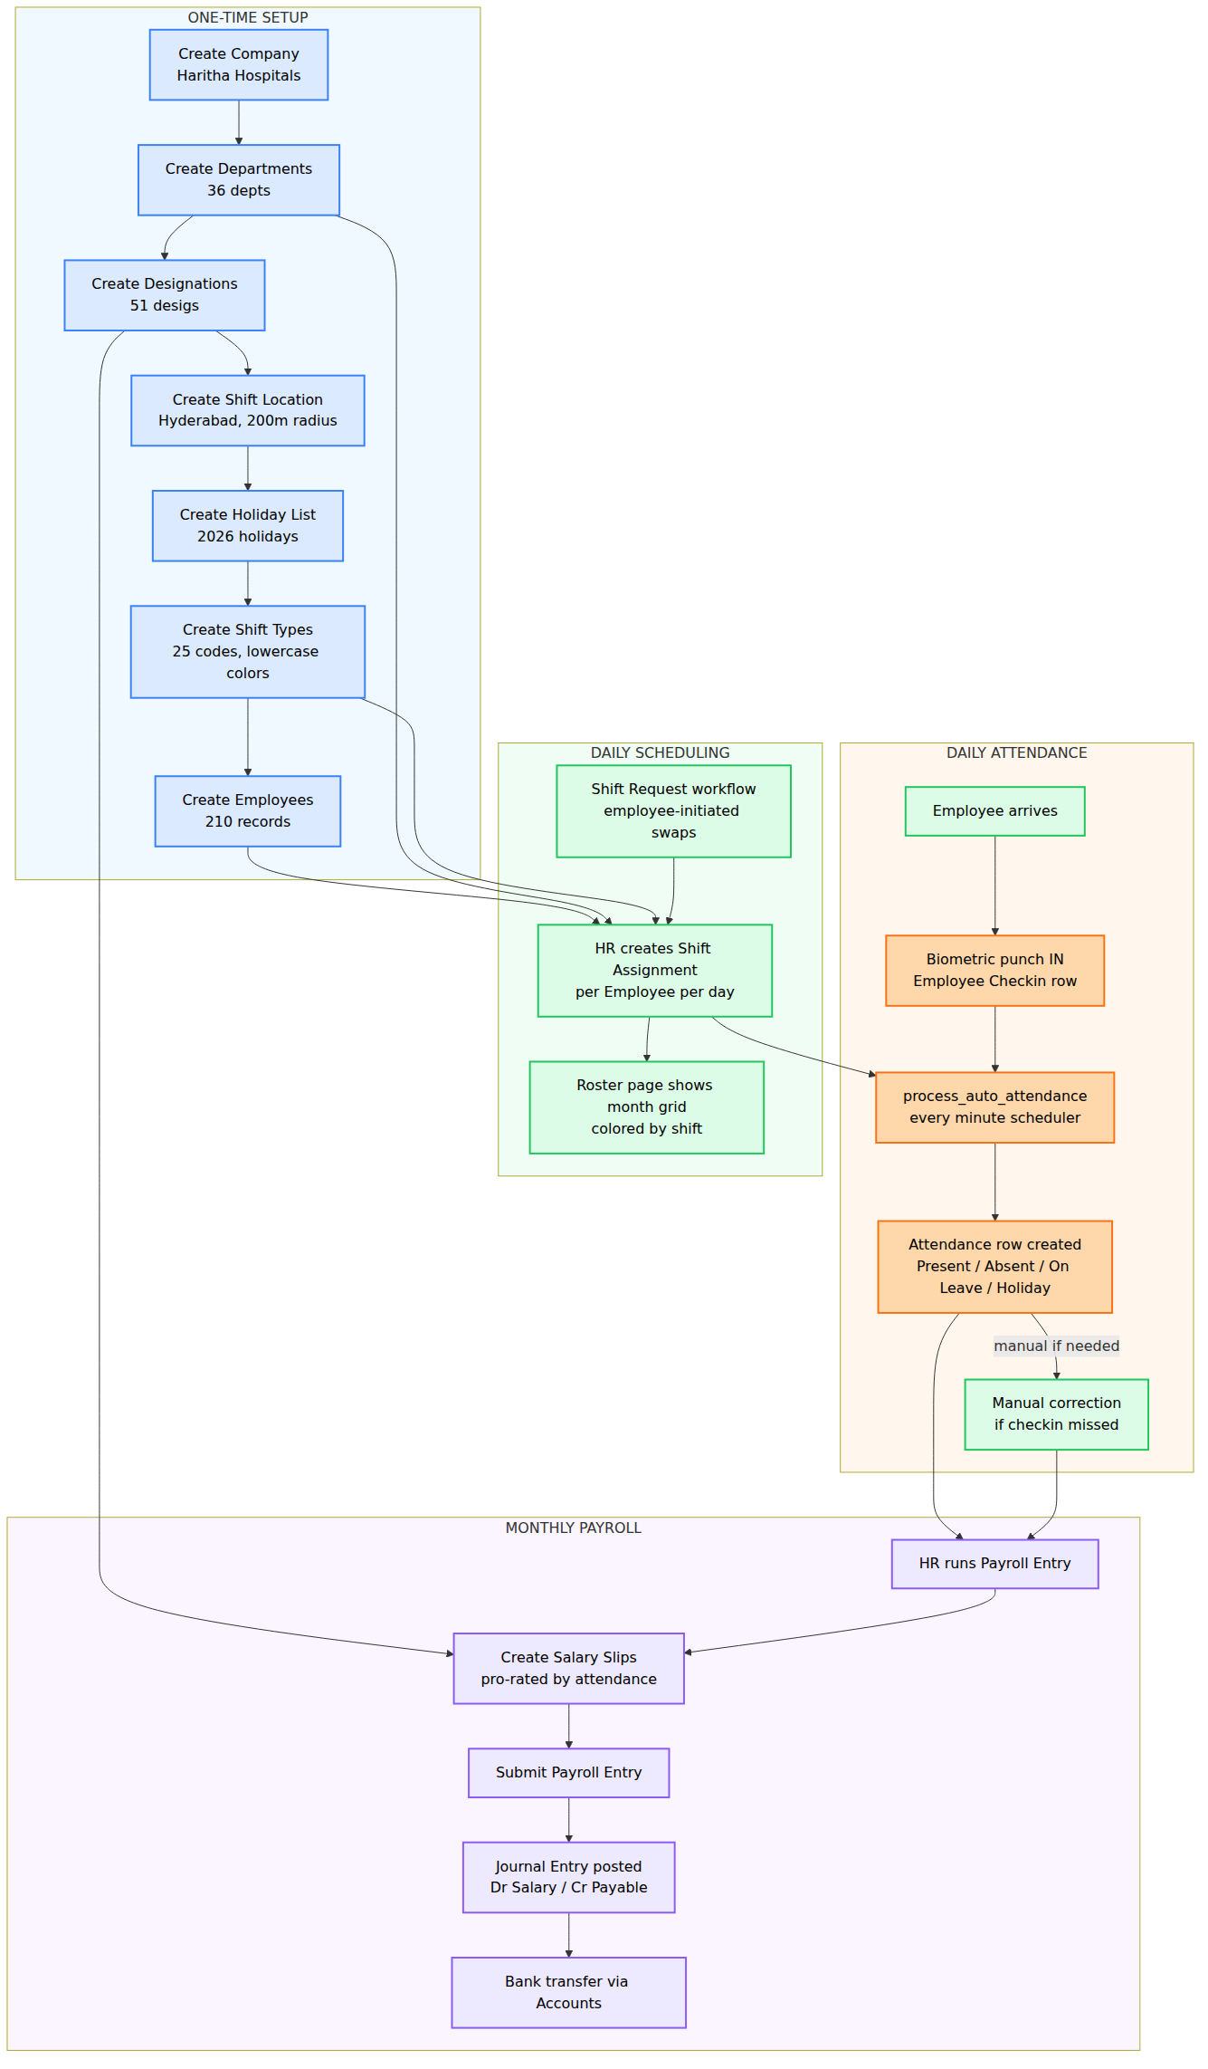
Customization Showcase — `haritha_hospital`
[Visual: 02.2-process-diagram-01.png]

Slide 11
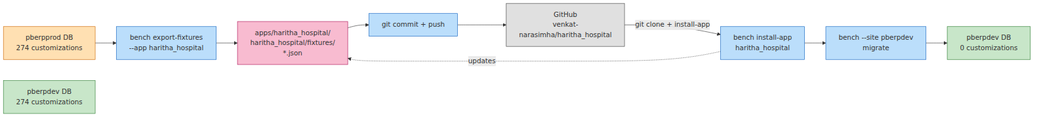
Why Choose Haritha + ERPNext
source: 00.2-architecture-overview-03.png

Slide 12
Q&A
[Empty slide with Q&A topics pre-listed]
**Pre-loaded answers for common questions.** Full FAQ: [03.3 FAQ](03.3-faq.md)
| Question | One-line answer |
|---|---|
| How long until we're live? | 8 weeks fixed-scope; 4-week pilot available |
| Can we self-host? | Yes — Docker Compose, any VPS with 4 GB+ RAM |
| How is data backed up? | 3-2-1 rule, 4×/day cron, SHA256-verified, offsite forever |
| What if our hospital has 500+ employees? | Frappe scales linearly; community-tested to 10,000 employees |
| Can our team modify the code? | Yes — any Frappe developer. 274 fixtures, well-documented |
| Multi-company / multi-currency? | Frappe supports it natively; scope for v2 |
| Biometric integration? | HRMS Employee Checkin accepts any vendor (ZKTeco, eSSL, Mantra, …) |
| Multi-language? | Yes — English shipped, Hindi 1-hour import, custom translations via Translation DocType |
| Mobile app? | Responsive web + HRMS native iOS/Android check-in (geo-fence) |
| What's the cost? | Depends on employee count + modules. No per-user fees. |
**If a question comes up you can't answer live:**
"Great question — let me note that and get back to you within 24 hours with a detailed answer."

