Slide 1
Behind the Code: Uncovering Trends in Open Source Development
Group 3
Shashi Kant Kumawat
Venkata Sairam Yanamandra
Dec 2023
Notes:
s

Slide 2
Table of Contents
Context
Data Collection
Data Cleaning methods
Data Analysis
Hypothesis Testing
Reflections
About the authors
Notes:
s

Slide 3
Context
Open-source is interesting - For individuals and for firms
What’s in it for them? Why contribute to contribute non-proprietary software development?
  Individuals: Ideology, Altruism, Kinship, Fun, Reputation, Reciprocity, Learning, Career¹
  Firms: Attracting talent, Faster & low-cost development, Signaling to the Community²
Trends in Open-source contributions
Hypotheses
Sources:
1 Von Krogh, G., Haefliger, S., Spaeth, S., & Wallin, M. W. (2012). Carrots and rainbows: Motivation and social practice in open source software development. MIS quarterly, 649-676.
2 https://sloanreview.mit.edu/article/companies-are-making-serious-money-with-ai/
Notes:
s

Slide 4
Data & methods
Data Collection
Data cleaning
Data transformation and validation
Data Analysis
GitHub REST API
Postman API
Data Integration
Handling NULL Values
Handling Inconsistent Data Types
Handling Duplicate records
Applied Stratified Sampling technique
Validating of each column in the dataset
Selecting the relevant features
Exploratory Data Analysis
Clustering (k-means)
Hypotheses testing
Trend analysis
Case study
Notes:
v

Slide 5
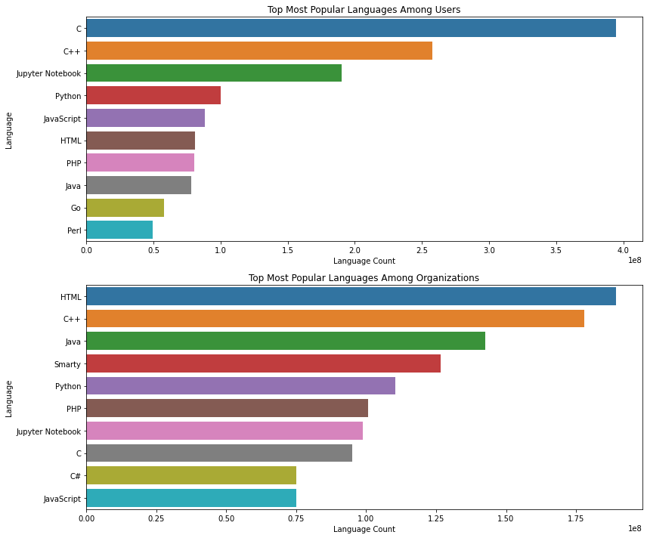
Trends - Language wise Contributions
C is the most popular language used in Open-source project on GitHub among the individual contributors
C++ is the tops one among the contributors belonging to organizations (firms)
*Data date range: 2014-2022
Notes:
s

Slide 6
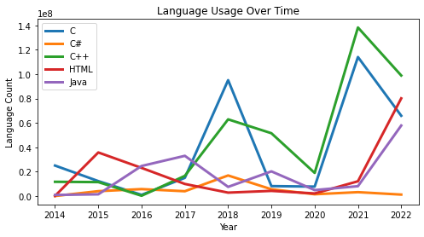
Trends - Language wise Contributions
C++ and C remain the leading languages in the open-source projects
HTML has also picked up adoption, while Javascript use is much lower
Notes:
s

Slide 7
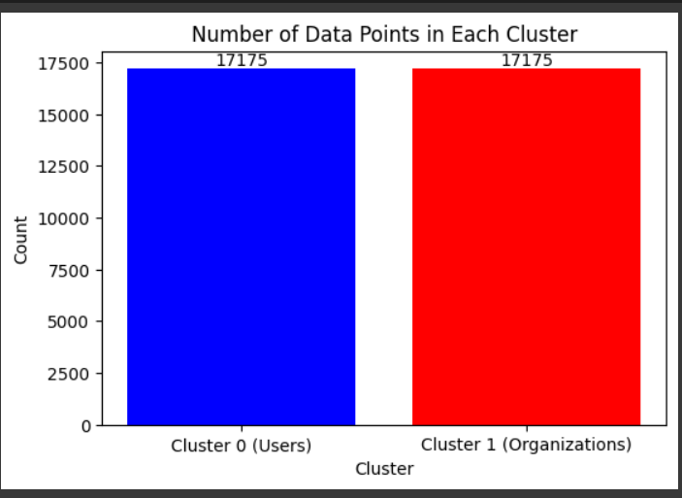
Clustering
Clustered the dataset into two divisions
  Users repository data
  Organizational repository data
Implemented the following clustering algorithms:
  K-Means
  DBSCAN
  Agglomerative Clustering
How good is my Clustered Data ?
Silhouette Score: -1 to 1
  -1: Incorrectly Clustered the data points
  0: Overlapping of the datapoints
  1: Datapoints in the cluster are well separated
Notes:
v

Slide 8
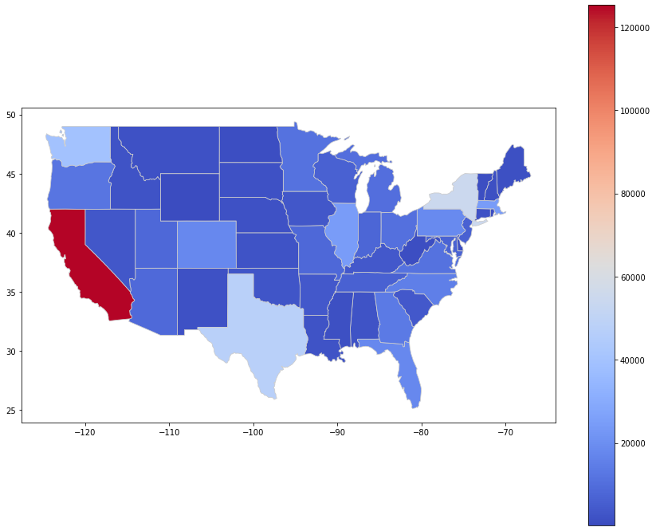
Trends - US State wise Contributions
California, New York, Texas, Washington, Illinois, and Massachusetts lead in OSS contributions
Wyoming, North Dakota, and Delaware have the least contributions to the OSS projects
This a expected as the countries major Computer science innovation and business clusters are located in these states¹
Source: 1 Moretti, E. (2021). The effect of high-tech clusters on the productivity of top inventors. American Economic Review, 111(10), 3328-3375.
Notes:
v

Slide 9
Hypothesis#1: Language Specificity in Contributions
H0 (Null): The average number of contributions per user is the same across different programming languages
H1 (Alternative): Certain programming languages are associated with significantly higher average contributions per user than others
This could indicate that some languages show have more productivity than others.
Conclusion: The low p-values in the ANOVA test indicates that the average number of contributions per user is the not same across different programming languages among both individual and organization developers
ANOVA | F-statistic | p-value
For Users | 1.440 | 3.208 * 10⁻⁷
For organizations | 1.923 | 8.997 * 10⁻¹¹
Notes:
s

Slide 10
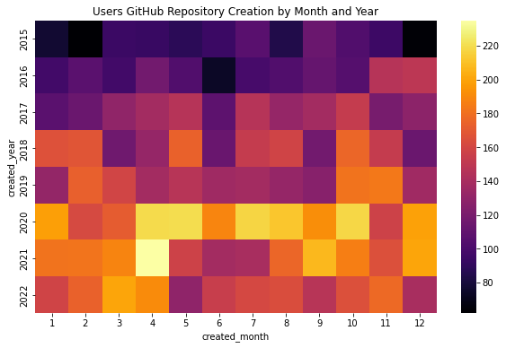
Hypothesis#2: Temporal Activity Patterns in Repository Creation
H0 (Null): there are no significant differences in repository creation across different times of the year.
H1 (Alternative): There is variation in activity level during different months of a year
Conclusion: The ANOVA test and the Heat map shows there is significant variation in the OSS contributions. This is perhaps because of holidays, academic cycles, industry trends, and events like hackathons
ANOVA | F-statistic | p-value
For Users | 2.36 | 0.0065
For organizations | 24.36 | 1.119 * 10⁻⁵⁰
Notes:
S
Investigation Approach: By analyzing the created_at dates of repositories, we can look for patterns or spikes in repository creation over time (monthly or yearly). A significant increase in certain periods compared to others could support this hypothesis.

Slide 11
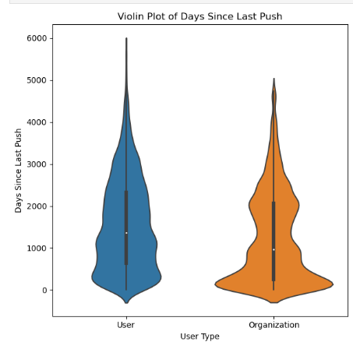
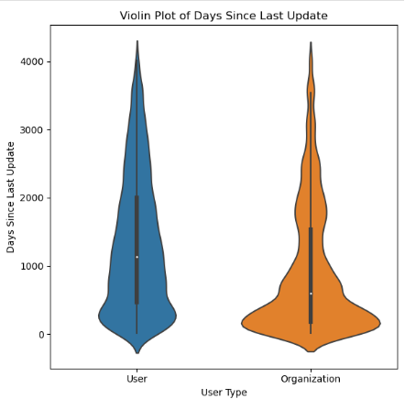
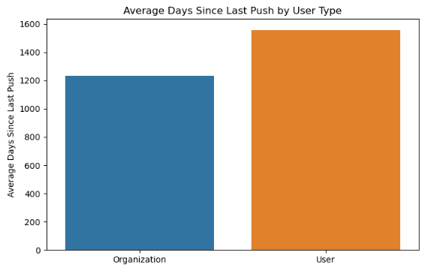
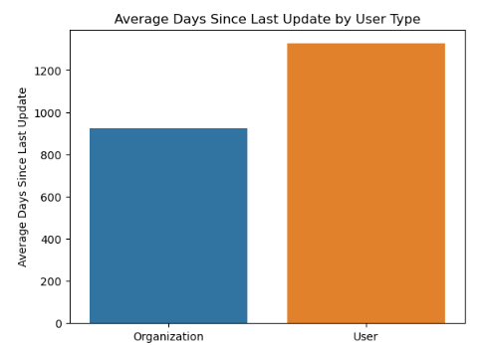
Hypothesis#3: Repository Activity and User Type Dynamics
H0 (Null): There is no significant difference in push or update frequencies between repositories owned by individual users and organizations.
H1 (Alternative): Organization-type users have repositories with more frequent activity (pushes and updates) than individual users, possibly due to more resources or collaborative efforts in organization
Conclusion: we have enough evidence to reject the Null Hypothesis. It's evident from the t-test that the shorter time since the last push and update for organizations suggest that they are more active than users in terms of maintenance and updates.
T-Test | t-statistic | p-value
Push | -27.52 | 0.000
Update | -38.50 | 0.000
the negative sign indicates that organizations have a lower mean days since the last update/push compared to individual users.
Notes:
v

Slide 12
Hypothesis#4: Are certain languages more popular in certain states?
H0 (Null): Certain programming languages are more popular in specific states due to regional factors.
H1 (Alternative): Certain languages are not popular in certain states
Conclusion:
Mean Chi-squared statistic over 100 repetitions: 6265.754
Mean P-value over 100 repetitions: 0.664
It implies that there is no enough evidence to reject the statement certain programming languages are popular in specific states for users and it's a clear rejection for organizations.
Programming Language | Popular States
C | Illinois, Colorado, Oregon, Indiana
C++ | California, New York, Minneapolis
Jupyter Notebook | Illinois, Virginia, Michigan, Idaho
HTML | Illinois, Arizona, California
JAVA | Texas, California, Kansas, Michigan
Chi-Square Test | P- Value
For Users | 0.6640
For Orgs | 3.082 * 10⁻¹³
Notes:
v

Slide 13
Reflecting on the project
It was a great exercise implementing our learning from the course
While researching for project ideas, we developed great appreciation of the applications of Data Science!
Data collection: We started with Web Scraping GitHub data, but realized API route was more efficient.
We learned how to coordinate efficiently to execute various parts of the project
Apart from a tremendous learning of Python, we also learned PowerBI for some interesting visualizations
Notes:
S V

Slide 14
Meet the Team
Shashi Kant Kumawat
First-year PhD Student (Strategy & Entrepreneurship)
Leeds School of Business
University of Colorado at Boulder
Venkata Sairam Yanamandra
First year Masters Student
Depart of Data Science
University of Colorado at Boulder

Slide 15
Thank You

