Slide 1
JOURNEY TO OPENSHIFT BASED DEPLOYMENT
Prashant Kulkarni/ Eric Gieseke
Jan 2017

Slide 2

Agenda
OpenShift Primer
Server Configuration Models
Titanium Deployment to OpenShift
Demo
Next Steps

Slide 3
OpenShift Primer
What is OpenShift?
Application Deployment Platform for Cloud
PaaS offering/solution
Uses Docker containers
Uses Kubernetes orchestration engine
Packages DevOps Tools
Licensed and fully supported by Red Hat
ACI AOD’s preferred cloud deployment model

Slide 4

But … Why OpenShift ?

Slide 5
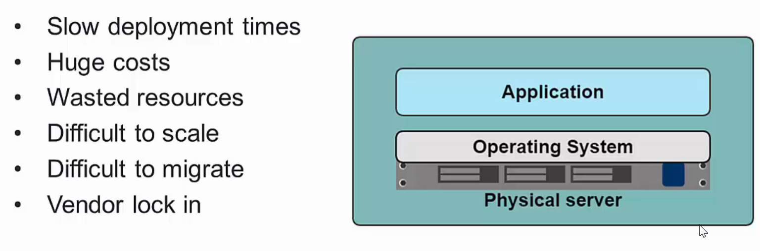
Traditional Machine Setups

Slide 6
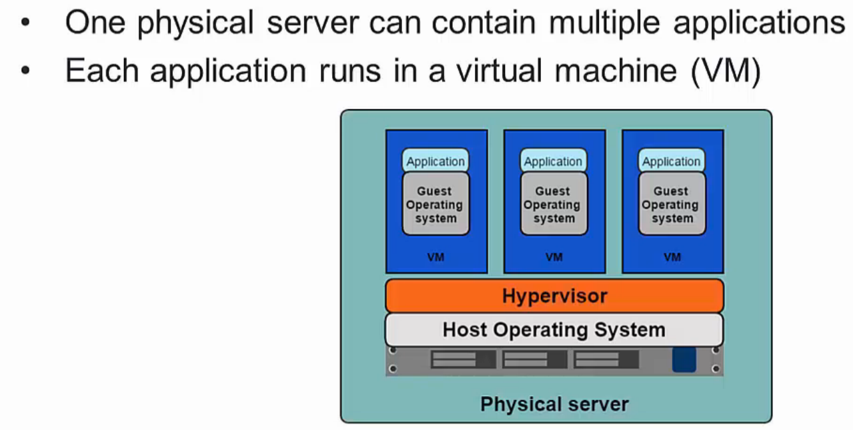
Virtualized Environment

Slide 7
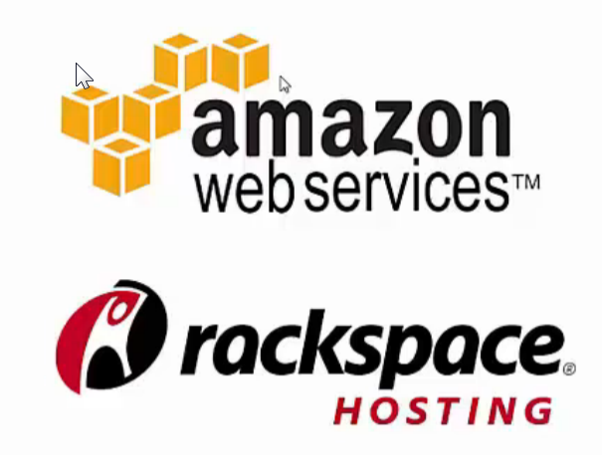
Benefits of VM
Better resource pooling
One physical machine shared among various virtual machines
Easier to Scale
Supports backups/ restore
Support on the cloud/data center
Rapid Elasticity
Pay as you go model

Slide 8
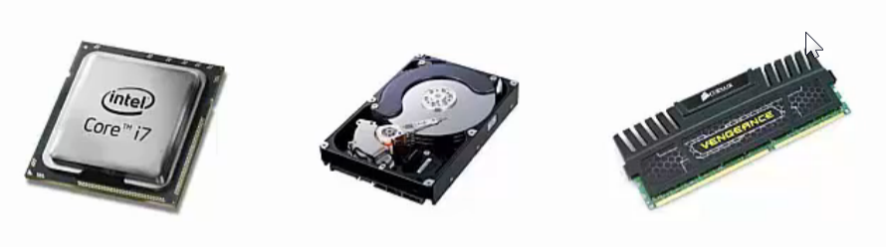
Limitations of VM
Each VM still requires
CPU Allocation
Storage
RAM
Entire guest OS
Wasted resources and Complex Configuration
More VMs you run, more resources you need outside application
Hard to allocate resources to a specific VM on demand
Vendor lock-in
No API standardization

Slide 9
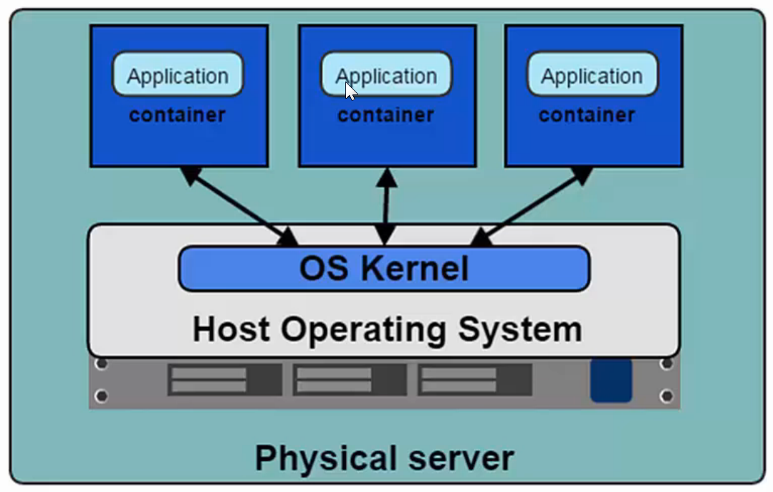
Introducing Container
Containers are the products of operating system virtualization.
Each container has its own
Root file system
Processes
Memory
Devices
Network Ports

Slide 10
Introducing Containers
The key difference between the container setup and VM based setup is that container-based virtualization uses the kernel of the host OS to run multiple isolated guest instances. These guest instances are called Containers.
By making use of the host operating system’s kernel and not relying on a hypervisor to manage resources, the container stack is far more lightweight than other solutions.
It also allows for completely isolated instances. Each container has its own root filesystem, processes, memory, devices, and network interface.

Slide 11
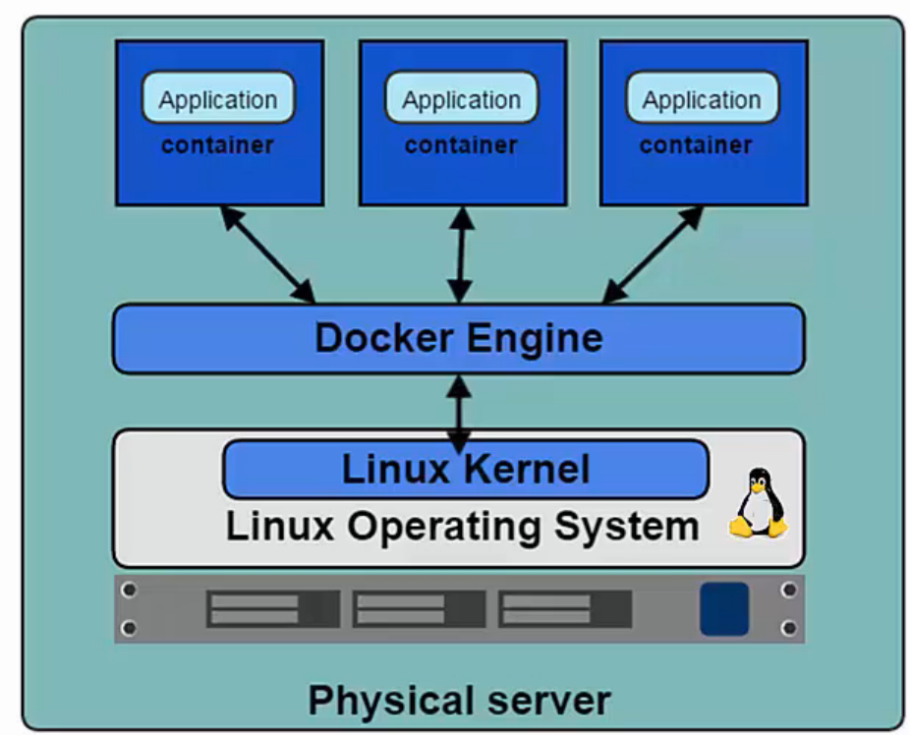
Introducing Docker
Docker is the de facto standard for application containers.
Docker Engine is the program that allows containers to be built, shipped and run
Docker uses Linux Kernel namespaces and control groups and provides isolation

Slide 12
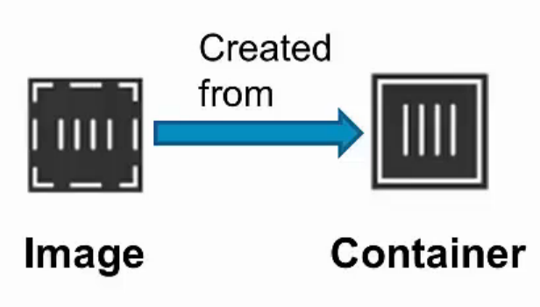
Docker Containers and Images
Images
Read-only templates to create containers
Built by any user
Stored in a common registry for sharing the images
Docker Hub: app store for images
Containers
Isolated, resource controlled and portable operating environment
Contains everything that you need to run app

Slide 13
Advantages of Docker
Application Portability:
Docker allows you to package an application with all of its dependencies into a standardized unit for software development.
Built in one platform and ship to another one
Eliminates ‘snowflake server’ situations
Portability from bare metal to VM to private cloud to public cloud
Environment Consistency
Speed:
Setup | Start Time | Stop Time
Docker Containers | < 50ms | < 50ms
Virtual Machines | 30-45 s | 5-10 s

Slide 14
Advantages of Docker
Additional Level of Abstraction
With Docker one can separate applications from infrastructure and treat infrastructure like a managed application.
Container becomes common abstraction layer (e.g. support multiple app servers)
Improved Resiliency and Robustness:
Swarm/Kubernetes based clustering/orchestration layer can help
Moving the responsibility from application/framework to platform
Enhanced Security/Governance:
Containers are immutable and provide level of abstraction from OS
Image registry helps with traceability/auditing around the image download and usage.

Slide 15
Kubernetes
Automated System for Containers
Deployment
Multi-machine
Deployment Life Cycle
2 Billion Containers Per Week (Google)
Scaling
Discovery and Naming
Failover
Load Balancer
Administration
Monitoring
Logging

Slide 16
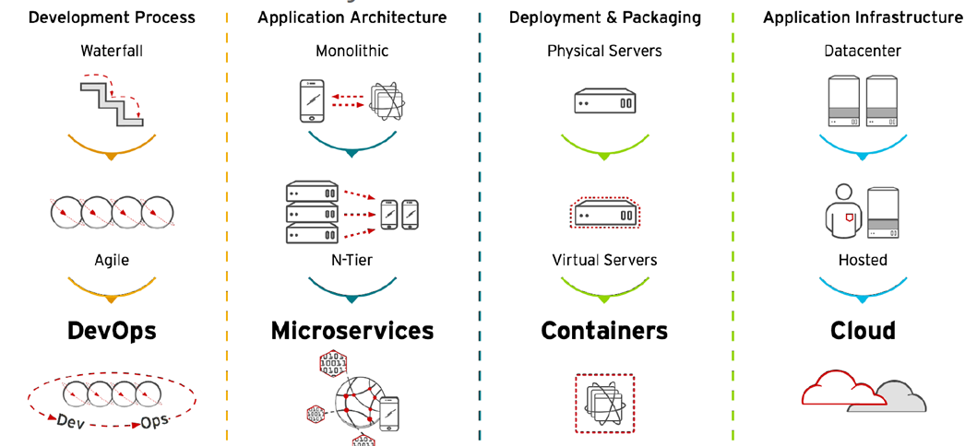
Bringing it all together

Slide 17
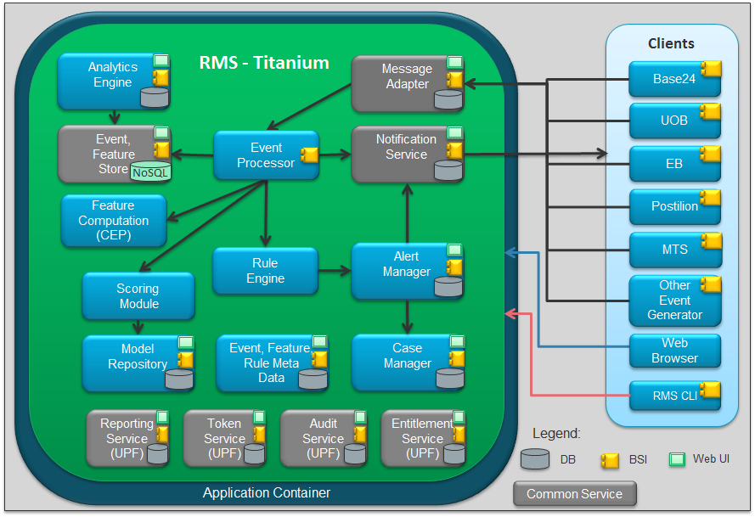
Titanium Microservice Architecture

Slide 18
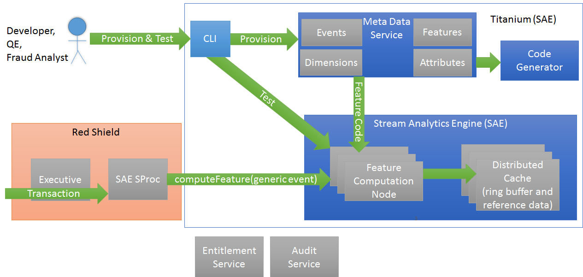
Stream Analytics Engine (SAE)

Slide 19
Distributed Cache
Sharing Transaction State in Memory
Distributed in memory cache
Synchronizes transaction state across CEP nodes
Provides extremely fast (sub millisecond) and efficient access to transaction state and reference data that can be shared by all instances of the SAE.
Using GemFire as primary cache and Cassandra as secondary.
Transaction state is managed using a ring buffer data structure
~ 8 Terabytes of data

Slide 20
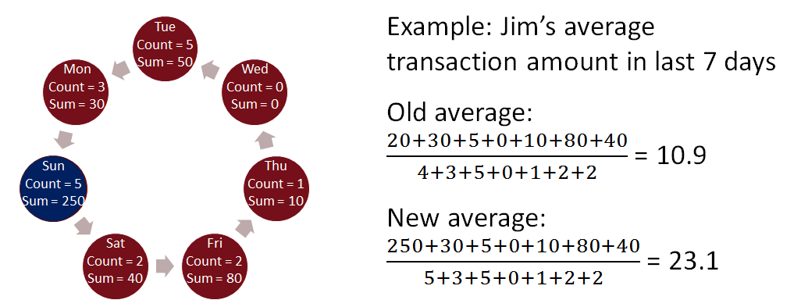
Circular Buffer
Optimized data structure for maintaining transaction state
Flexible and Efficient Structure for maintaining transaction state for computing dimensional features
Innovation from WPI/MQP Storm project (2015)
Example: Average transaction amount per customer

Slide 21
Event based Ring Buffer Management
Low Latency Feature Computation with Asynchronous Ring Buffer Updates
Queue Based Value processing
Dim1 Value Queue
4
1
Esper Node 1
1:t4
6:t3
5:t2
8:t1
transactions
6
Load Balancer
Esper Node 2
Dim1 Circular buffer manager
features
5
Esper Node 3
3
2
Dim1 Circular Buffer
Receive Transaction
Retrieve circular buffer for dimension
Combine value and circular buffer to compute feature
Put value + timestamp on dimension value queue
Return feature value
Batch processing for values to update circular buffer (separate thread). Inserts value into appropriate ring buffer cell based on time stamp.
1
2
3
4
5
6

Slide 22
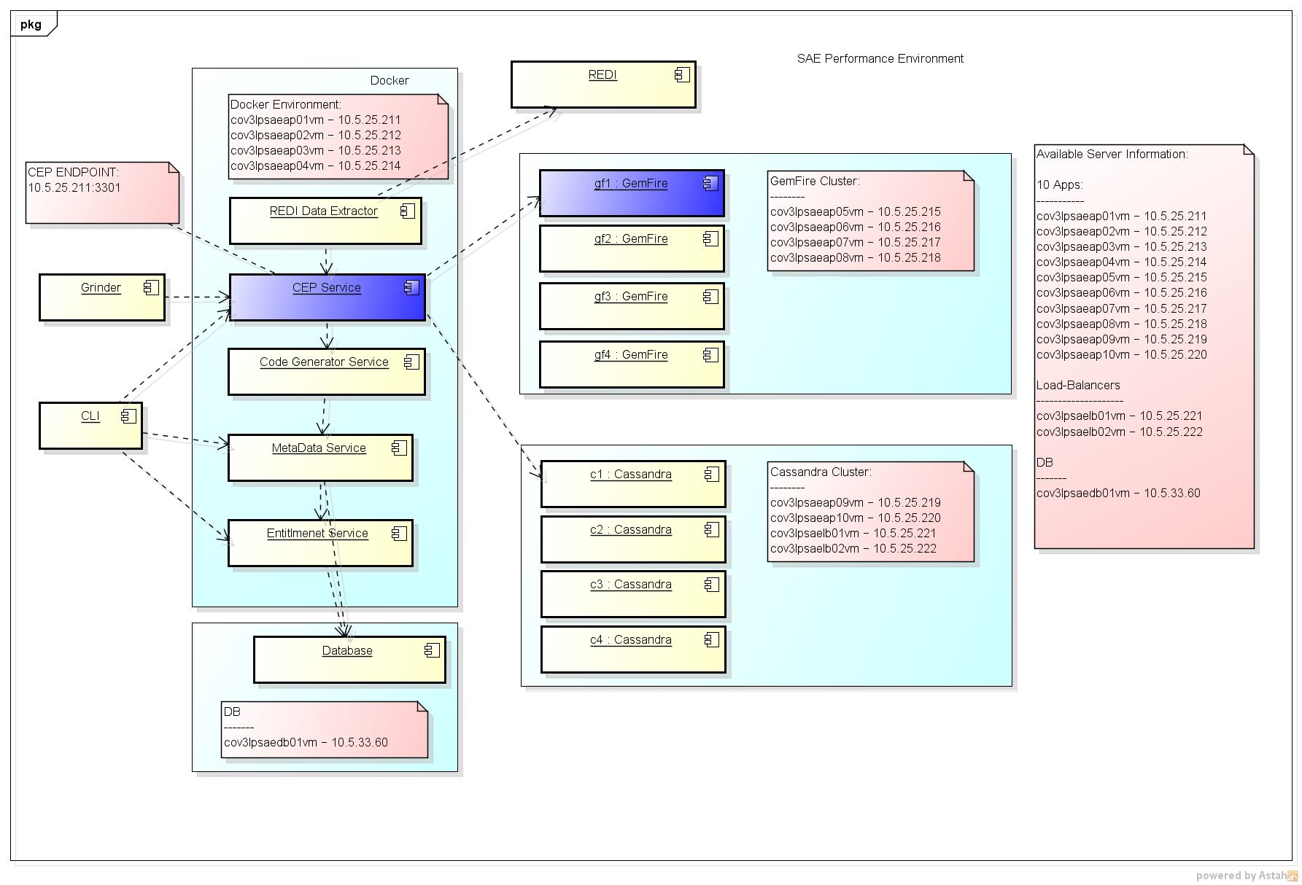
Stream Analytics Engine Deployment Diagram
Performance Environment
Docker and Kubernetes host services
Gemfire and Cassandra clusters are managed independently
Grinder and CLI Clients access services through Kubernetes load balancer

Slide 23
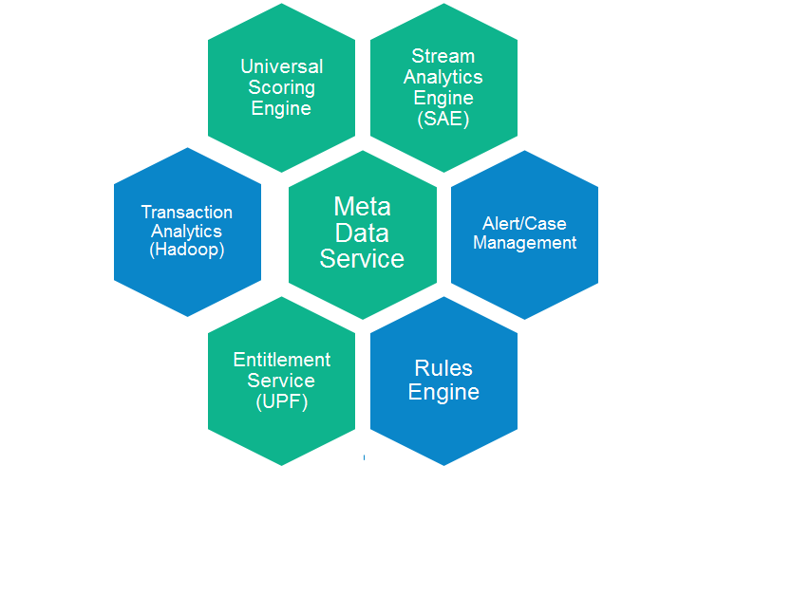
Titanium Microservices
Stream Analytics Engine (SAE)
Compute features, fast, flexible
Universal Scoring Engine (USE)
Machine based transaction scoring
Meta Data Service
Supports dynamic provisioning of Events, Dimensions, Attributes, Features and Rules
Rules Engine
Take actions based on features and scores
Transaction Analytics
Hadoop based transaction storage and analytics
Alert/Case Management
Flexible administration of Alerts and Cases
Entitlement Service (UPF)
ACI Single Sign On (SSO) solution

Slide 24
Command Line Interface
The Command Line Interface (CLI) provides a text based interface to the service interfaces provided by the Meta Data Service and the Stream Analytics Engine (SAE).
The CLI maps text based commands and their parameters to service requests. A user interacts with the CLI either interactively or in script mode. A command shell provides interactive access. In script mode, multiple commands can be saved to a file and invoked as a script.
Results of the service request are then formatted and displayed to the user as output text to standard output.
The CLI provides a convenient mechanism for automating service interaction and can be used by developers, QE, operations team, and customers.
Meta Data Service will be augmented with a Graphical User Interface (GUI), but the CLI will remain as a means of automating provisioning and testing of the Meta Data Service.
CLI
BSI Service Interface
Service Implementation
Notes:
Experience with Cable Modem Provisioning System

Slide 25
Meta Data Service
Externalize configuration
The Meta Data Service is responsible for maintaining metadata about the fraud detection domain objects: Events, Dimensions, Attributes and Features.
The Meta Data Service allows a flexible means of managing information about those objects.
Almost all components of the Titanium system, including the SAE, utilize the Meta Data Service to understand the supported types of events, dimensions, attributes, and features.
In the case of the SAE, the Meta Data Service is used to define the events and their associated attributes, dimensions, and features.
The Meta Data Service supports Code Generators that generate code that the SAE can use to compute the features and process rules.

Slide 26
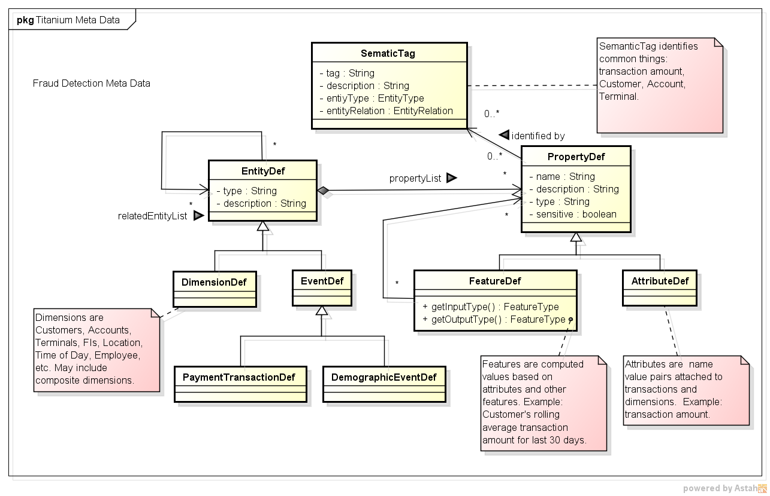
Meta Data Service Domain Model
Notes:
Took about 1.5 years to figure this out, now it seems obvious.

Slide 27
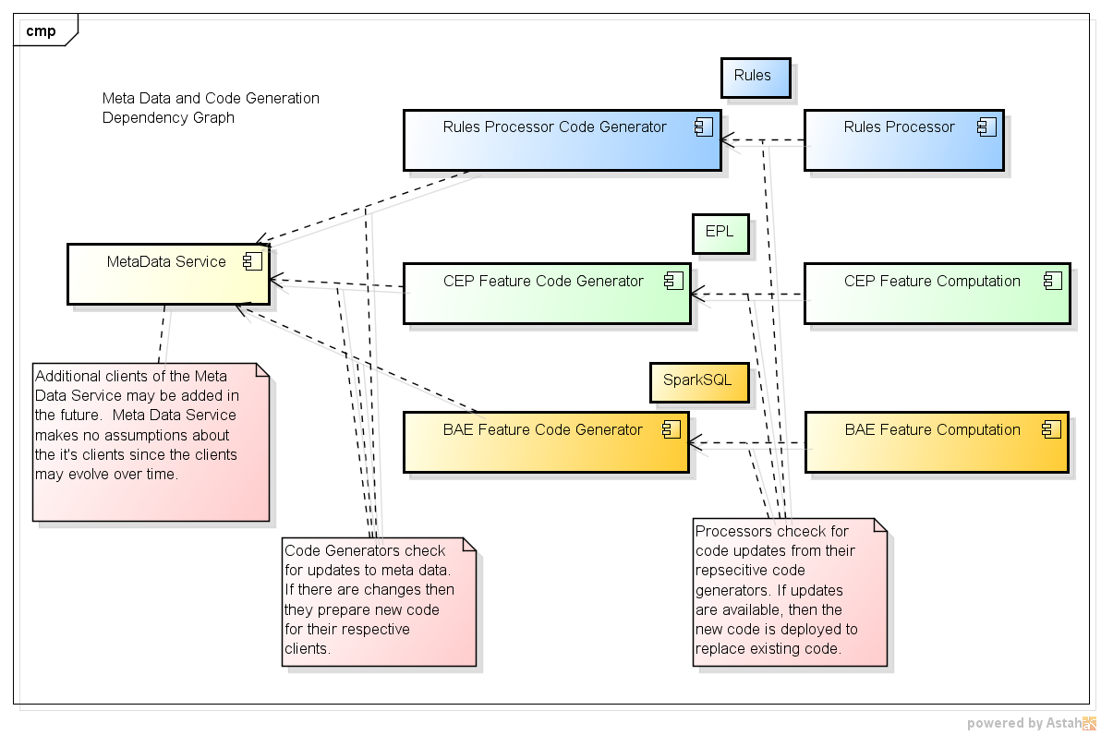
Code Generator
Flexible Feature Computation
The Code Generator uses metadata about the features to generate code that can be executed to compute the features.
The Code Generator is able to generate feature computation code in multiple languages (via Visitor pattern)
For the SAE, the output language will be the Esper Programming Language (EPL)
A Code Generator will also be used to generate code that can be executed in a Hadoop environment for batch computation of features.

Slide 28
Stream Analytics Engine
In Memory Complex Event Processing
The Stream Analytics Engine (SAE) is responsible for handling the feature computation request.
Each request will provide a transaction with a set of attributes. Based on the transaction type, the required set of features will be computed.
The SAE will utilize the feature computation code provided by the Meta Data Service.
The SAE is designed to be stateless so that multiple instances of the SAE service can operate in parallel. This provides high availability and horizontal scalability. Additional SAE nodes can be added to increase throughput.
The SAE is dependent on the Distributed Cache for maintaining shared transaction state and reference data.

Slide 29
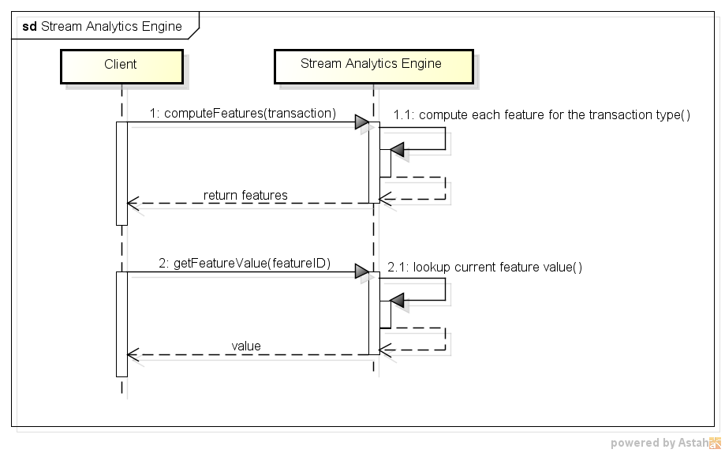
Stream Analytics Engine

Slide 30
Shield Migration to Titanium
Primary focus is a cost efficient, highly effective, flexible, and scalable SAAS solution for fraud detection
Shield is Multitenant and SAAS but having problems scaling and also expensive due to Oracle licensing
Incrementally replace Shield components with Titanium microservices
Incrementally replace Oracle with Big Data frameworks
Provision Metadata Service to support Banking & Retail fraud
Expand Transaction Analytics (REDI)
Replace Sybase IQ with Hadoop
Batch Analytics, Machine Learning

Slide 31
Shield Migration to Titanium
Scoring Engine
Feature Computation (CEP)
Shield
REDI
Shield
Shield
REDI
Shield
Cassandra
BAE
Meta Data Service
Rules Processor (CEP)
Hadoop
Sybase IQ
Hadoop
Entitlement Service
Oracle
Oracle
Oracle

Slide 32
Next Steps
Integrate SAE with Shield
Improve Shield Throughput with faster feature computation and access
Add UDF to DVE for access to precomputed features
Batch Analytics Engine
Hadoop based feature computation
Code Generator produces Feature computation code (Spark/SQL) from Meta Data Service
Rules Processor
Rules Processor for converting features into actions (e.g. block card)
Rules are defined in Meta Data Service
Rules are transformed to language for Rules Processor

Slide 33
SAE Multi Site Data Replication
trx
trx
US Data Center
EU Data Center
REDI
Pan Intelligence
Sybase IQ
3) Use GemFire WAN Asynchronous Event Queue to distribute updates to feature dimension structures between US and EU Data Center
Pros:
Original plan, simple
Cons:
Some increase in traffic between data centers
Does not support Data Sovereignty
Use of WAN has not been validated by ACI
Shield (US)
Shield (EU)
REDI Export
Executive
Oracle
Executive
Oracle
Executive
Oracle
Executive
Oracle
Executive
Oracle
Executive
Oracle
Executive
Oracle
Executive
Oracle
Executive
Oracle
Executive
Oracle
Intra Site Golden Gate Replication
Intra Site Golden Gate Replication
trx
trx
Cross Site Golden Gate Replication
REDI Extractor
Initialization
Catchup
Order Dispositions
Charge Backs
Trx
Stream Analytics Engine
Stream Analytics Engine
CEP
CEP
CEP
CEP
CEP
CEP
CEP
CEP
CEP
CEP
CEP
CEP
Gemfire Cluster
Cassandra Cluster
Gemfire Cluster
Cassandra Cluster
Gemfire WAN Asynch Event Queue

Slide 34


Slide 35
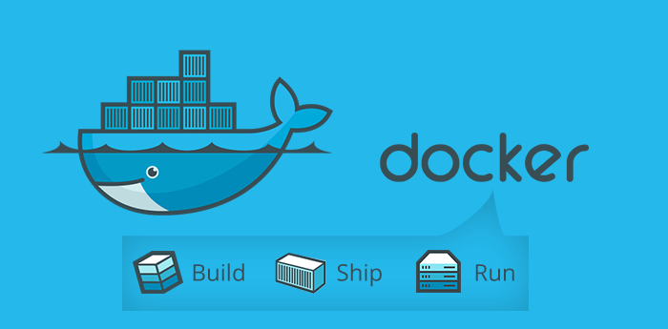
Thank You !

